Slide 1

SuperOffice
Community
A platform that serves, informs, and connects
24 hours a day, in 6 languages

Slide 2
Agenda
01
Engagement Outlook
20,000+ members and actively growing
What we will cover today
02
Self-Service Support
Answers available 24/7, no ticket needed
03
Staying Informed
Follow bugs, releases and user stories
04
The Platform Behind It
8+ integrations, Parliament culture hub and AI Search
05
Business Value
What this means for SuperOffice
06
Parliament & Culture
Employee hub, awards and SuperLand culture

Slide 3
SuperOffice Community
The content hub for customers, users, employees and partners
User & Admin
Technical
Selling Partner
Parliament
Employee-only hub
Best practice and tips, product news (Marketing)
Support and FAQs, register request and manage own requests
Bugs and wishes, release notes, price lists
User and admin forums, pilot programs
Links to docs, events (.com), Youtube
Technical blog archive
Technical forums and announcements
Links to Developer portal and Docs
Links to old documentation
The Algorithm, our growth framework (playbook)
Archives for webinars and upskilling
Launch kits, product roadmap
Lead registration forms
Order-forms, price lists, sales resources
Forums and sales competitions
Blog archive, articles, InfoDoc frameworks
People and awards archive, profile page
Links to SharePoint (SuperHugo), Simployer, Eloomi, ++
Section pages for relevant content
Forums (NPR forum most active)
IT Support, Sales Matross, SCM playbook

Slide 4
Engagement
Outlook
The community is growing and the numbers prove it

Slide 5
The Community by the Numbers
Real members. Real engagement. Real scale.
20,000+
621+
1,315
79+
Registered Members
Forum Subscribers
Bugs and Features Followed
Product Followers
Including customers · partners · employees
334 customers · 194 partners · 93 employees
actively tracked by community members
55 employees · 19 partners · 5 customers
13,084
2,898
1,007
509
Forum Topics
Blog Posts
Articles
FAQs
7,003 help files · 17,498 total pieces of content · 6 languages: EN NO DE NL DA SV

Slide 6
Self-Service
Support
Every answered question is a ticket that was never raised

Slide 7
Answers Without Raising a Ticket
Users find answers themselves, in their language, at any hour
509
FAQs
13,084
Forum Topics
7,003
Help Files
6
Languages
Quick answers to the most common questions, searchable and always available
Peer knowledge built over years. Real questions, real solutions from real users.
Official docs at help.superoffice.com — indexed directly into community search and surfaced in AI results.
EN NO DE NL DA SV. Answers in the users own language, 24 hours a day.
AI-Powered Search
NEW
Searches across all content at once: forums, articles, blogs, videos, help files and FAQs. Returns an AI-generated summary with citations linked to the original sources.

Slide 8
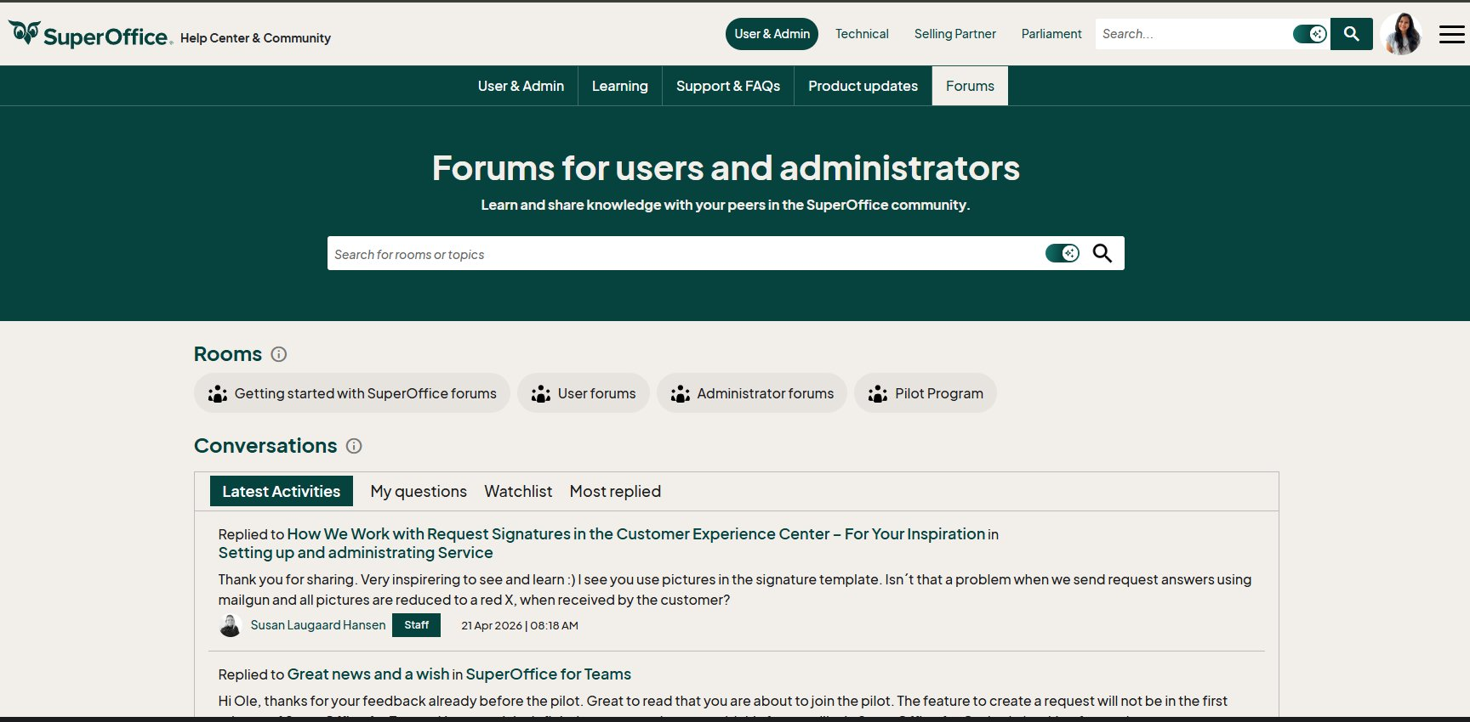
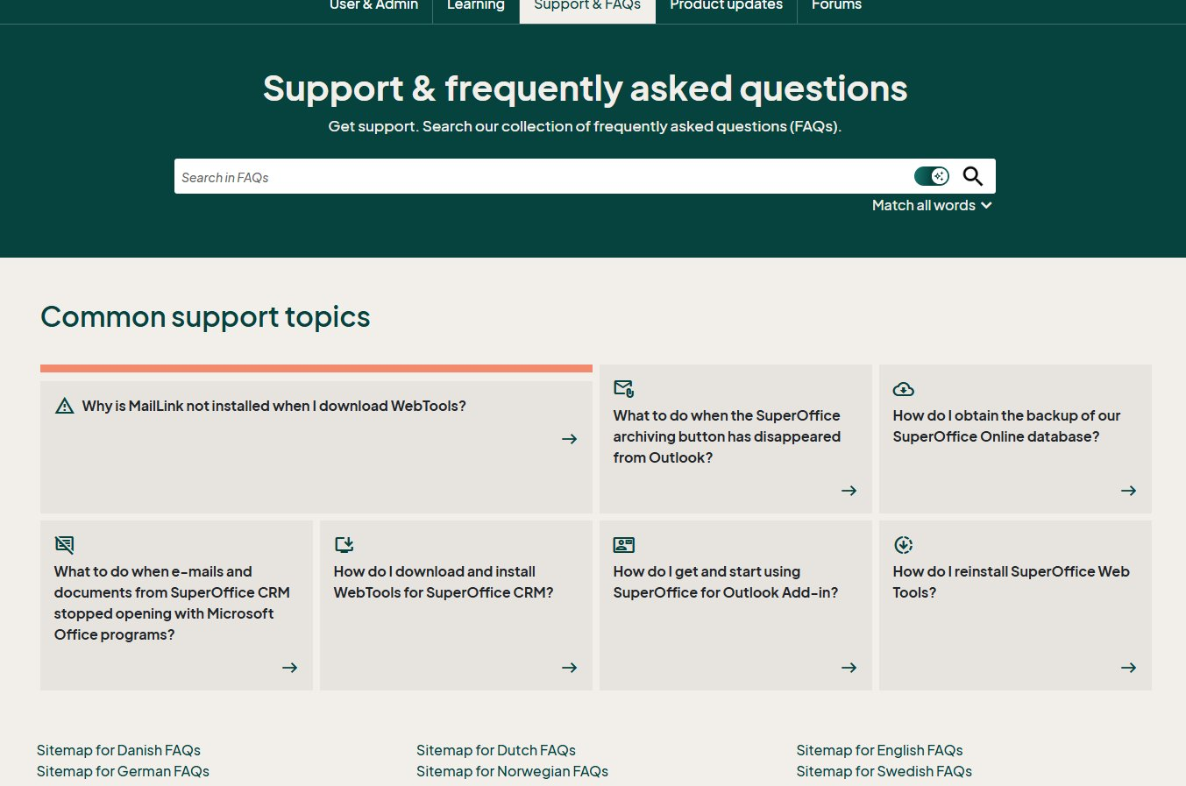
Where Content Comes From
Forums, FAQs, help files and blogs — all indexed into one searchable community platform
Forums for Users, Admins, Technical and Partner sections
Support & FAQs — top 6 shown, full sitemap in 6 languages
13,084 forum topics from users, partners and employees across all sections
509 FAQs plus help.superoffice.com — all indexed into community search and AI results

Slide 9
Staying
Informed
The community comes to you. Not the other way around.

Slide 10
From Support Ticket to Resolved Bug
Users are informed at every step. No follow-up emails needed.
STEP 1
STEP 2
STEP 3
STEP 4
Submit a Support Ticket
Escalated to Azure DevOps
Follow it Publicly
Get Notified
Customer raises a support
ticket
If the issue is a bug or a new wish, the ticket becomes a work item
1,315 bugs are actively
followed in community
Mailgun delivers live status
updates by email when status changes
›
›
›

Slide 11
Stay Connected with Community Alerts
The community keeps members engaged even when they are not logged in
Release Notifications
Subscription Alerts
Subscribe to forums and get notified when new topics or posts are added.
Users are notified when a new release is published. Role-based visibility means customers see what is relevant to them, partners see more, and employees see everything.
Mention Alerts
Mention any community member with @ and they receive an instant notification.
Upcoming releases are also visible so partners and users can plan ahead.
Everyone · Employee and Partner · Employee only
Reply Notifications
Get notified when someone replies to forum post, blog comment or article that users have subscribed

Slide 12
The Platform
Behind It
8+ integrations powering the community. Plus a new AI Search layer built on top.

Slide 13
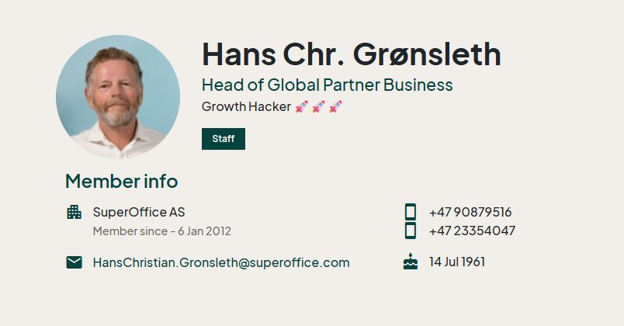
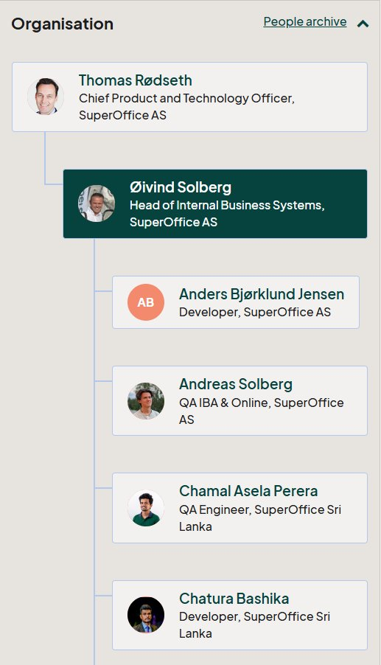
What Gets Synced Into the Community
CRM syncs personal details into every member profile. Azure AD brings the org chart and team structure.
CRM — Member Profile (synced from SuperOffice CRM)
Azure AD — Org Chart
Synced today: Name, email, company, country, language, associate ID, user category
Future potential: Profile picture, team / department, job role, account manager
Identity, org chart and employee lifecycle management

Slide 14
A Connected, Intelligent Platform
Every integration is a deliberate connection, personalised, secure, and always up to date
CRM
Azure AD
Synced today: name, email, company, country, language, associate ID, user category (customer/partner/employee). Potential future sync: profile picture, team/department, job role, account manager.
Identity, org chart and employee lifecycle management
Azure DevOps
Support and FAQ
Releases, bugs, and features with live status in community
Raise tickets directly from community. Check ticket status from the platform.
Help and YouTube
Mailing and Alerts
Official docs and video tutorials surfaced in context
Mentions, reply alerts, subscriptions, release and bug notifications. We have also developed an IT admin tool to identify and remove inactive members, keeping the community clean and relevant.
Notes:
User – profile/ tenant user type into

Slide 15
AI-Powered Search
A new layer of intelligence built on top of the community platform
NEW
Powered by Azure AI
How It Works
Key Facts
Search across everything
8 content types indexed
One search surfaces results from forums, articles, blogs, help files, FAQs and videos at once.
FAQs, articles, blogs, forum topics, how-to guides, members, YouTube videos and help files
AI-generated summary
Autocomplete suggestions
Returns a clear, cited summary above the results so users get the answer immediately.
Smart suggestions appear as users type, reducing time to answer
Citations linked to sources
BM25 relevance scoring
Every claim in the summary links back to the original content. Transparent and trustworthy.
Title weight tuned higher than body text so the most relevant results surface first
Security trimmed
Feedback loop built in
Results respect user roles. Customers, partners and employees each see only what they have access to.
Users can rate AI summaries with thumbs up or down. Every rating improves future results

Slide 16
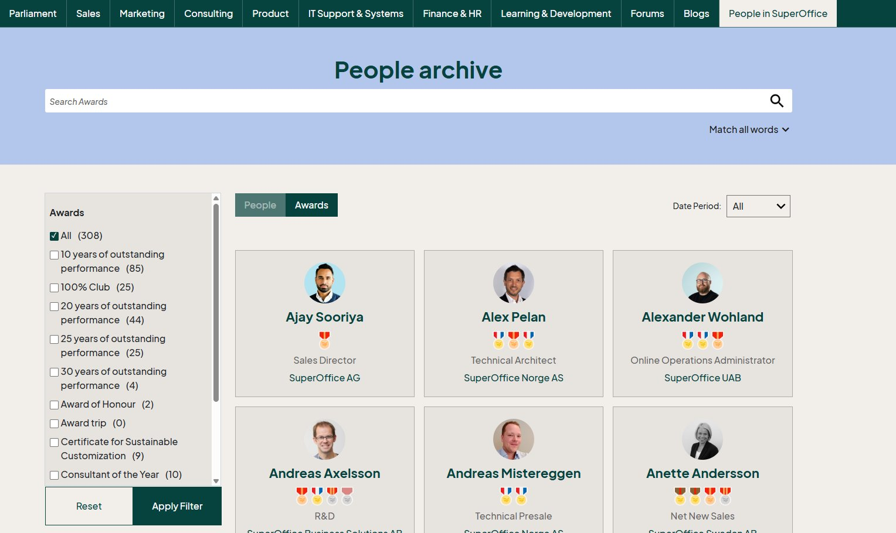
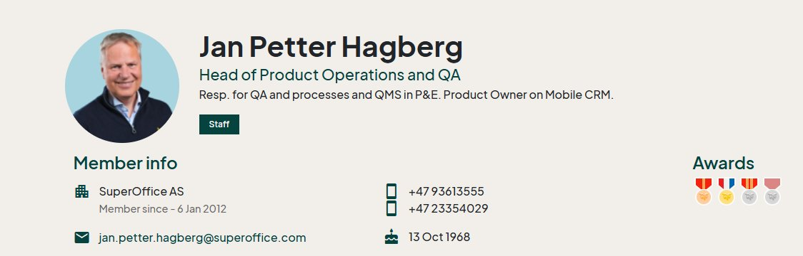
Parliament: The Employee Culture Hub
An employee-only hub that celebrates SuperLand culture, recognises achievements and connects our people
People Archive & Awards — 308 awards given to date
Member Profile — Badges Visible to Everyone
How Parliament supports SuperLand culture
Employees earn badges for milestones: 10, 20, 25, 30 years of outstanding performance, 100% Club, Award of Honour, and more. All badges are visible on their public profile and in the People Archive.
Parliament is also home to blogs, articles, IT support resources, Finance & HR info, and internal forums — all in one employee-only space.
Search employees by name, award, role or company — linked to member profiles with full history

Slide 17
Business
Value
What a thriving community delivers for customers, partners, and SuperOffice

Slide 18
The Community Delivers Real Value
Fewer tickets. Better adoption. Customers and partners who feel heard and informed.
Support Cost Reduction
Faster Adoption
Partner and Customer Value
621+ members self-directing
via forum subscriptions
79+ members actively tracking
releases and roadmap
Partners follow user stories
and releases to plan integrations ahead
509 FAQs deflect the most
common questions before they become tickets
17,498 content pieces
guide users to get more from SuperOffice
Customers track bugs they reported
and get notified when resolved
Solved once,
visible to everyone forever
Embedded YouTube tutorials
learning in context, not in a separate tab
Platform moving toward AI,
getting smarter with every search
Source: Community platform analytics, forum subscription data
Source: Product follower data, release subscriber counts
Source: Azure DevOps bug tracker, Mailgun notification logs

Slide 19
Not just a platform.
The most knowledgeable colleague
your customers will ever have.

