Slide 1
CRM Online

Slide 2
Fordeler med SuperOffice Online
Enkel tilgang via nettleser fra hvor som helst
Mobile CRM inkludert
SuperOffice drifter og oppgraderer kontinuerlig (Databehandleravtale)
SuperOffice er ansvarlig for sikkerhet (GDPR)
Azure AD autentisering
Garantert 99,8% oppetid
Mobilitet
Sikkerhet
Forutsigbare kostnader
Fleksibel justering av brukerplaner og funksjonalitet
Kostnadseffektive utvidelser av funksjonalitet og 3.part.
Appstore - Nye utvidelser og integrasjoner (Kun online)
Sharepoint/Office365/Google integrasjon
Fleksibilitet
Appstore

Slide 3
Fordeler med SuperOffice Online
Tilgjengelig fra hvor som helst via nettleser.
Automatisk/Kontinuerlig oppdatering til nyeste versjon.
Driftskostnader inkludert i avtalen. (sikker backup/serverdrift)
Sikkerhet/Sikring av dine CRM data er i våre hender. (Databehandleravtale)
Forutsigbare kostnader og fleksibel justering av brukerplaner
Utvidelse av funksjonalitet krever ikke store engangskostnader på lisens
Mobil CRM til alle brukerne
Mer funksjonalitet inkludert i brukerplaner.
SuperOffice Appstore - der alle nye utvidelser og integrasjoner lages først.
http://online.superoffice.com/appstore

Slide 4
Utfordringer med lokalt installert løsning
Kostnad
Funksjon
Teknisk
Personavhengig (IT personell)
Skjulte kostnader
Oppgradering
Ineffektivt
Brukeradopsjon
Risiko
Sikkerhet
Ikke tilgang til AppStore
Ikke tilgang til ny teknologi
Mister automatiseringsmuligheter
Alt ansvar på kunden
VPN/Citrix
Nedetid

Slide 5
Fordeler med sky
Kostnad
Funksjon
Teknisk
Forutsigbart
Fleksibelt
Skalerbart
Alt inkludert
AppStore
Nye funksjoner kontinuerlig
O365/sharepoint Integrasjon
Tilgang hvor som helst
SuperOffice garanterer sikkerhet
VPN/Citrix kan unngås
Garantert 99,8% oppetid
Automatisk oppgradering

Slide 6
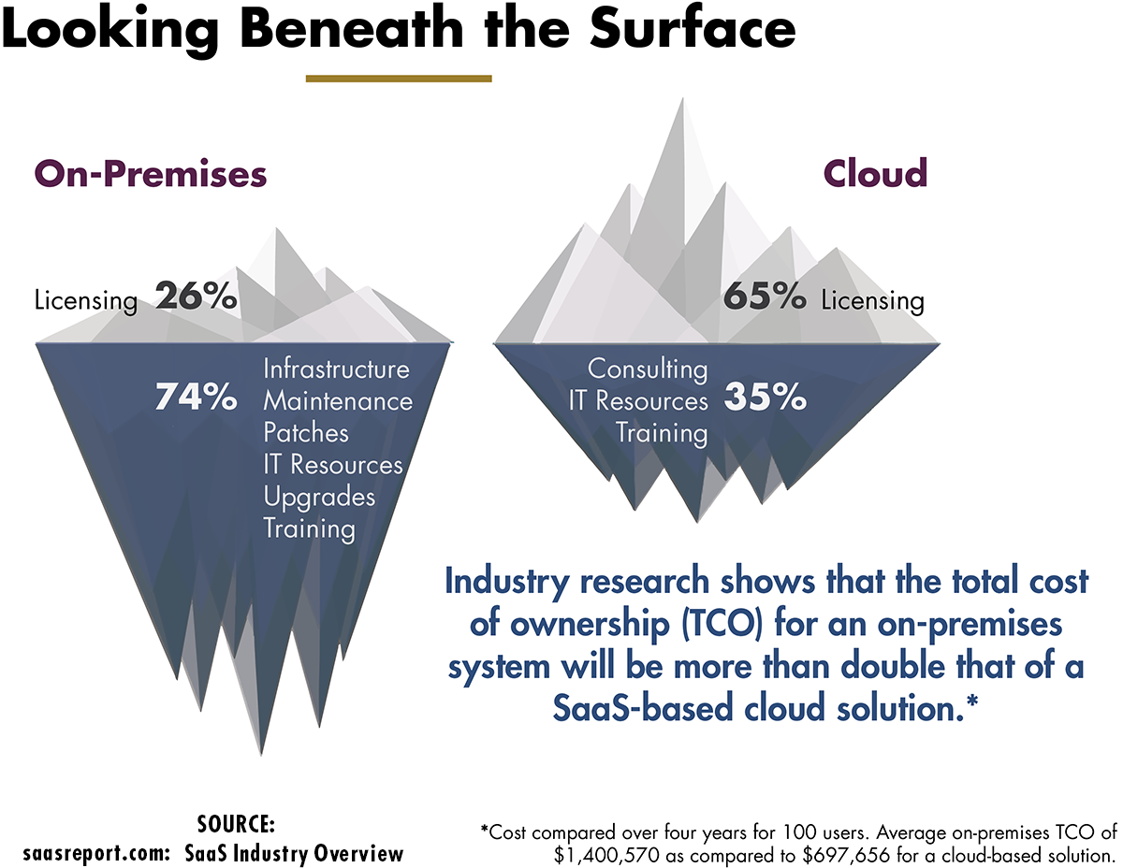

Slide 7
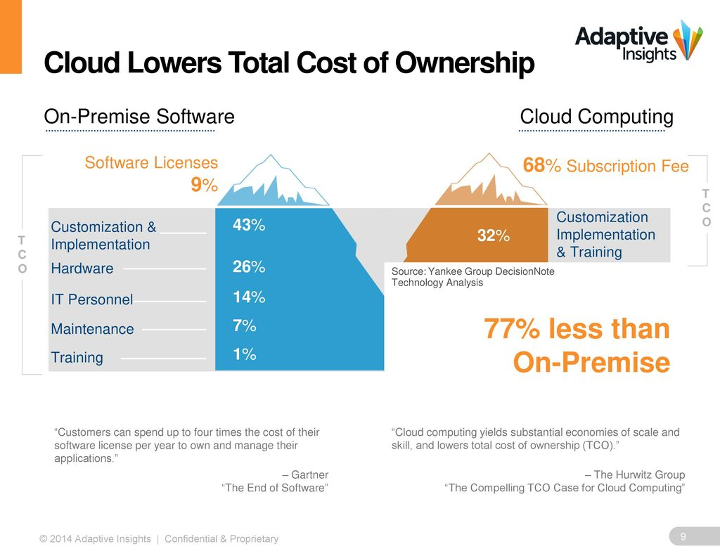

Slide 8
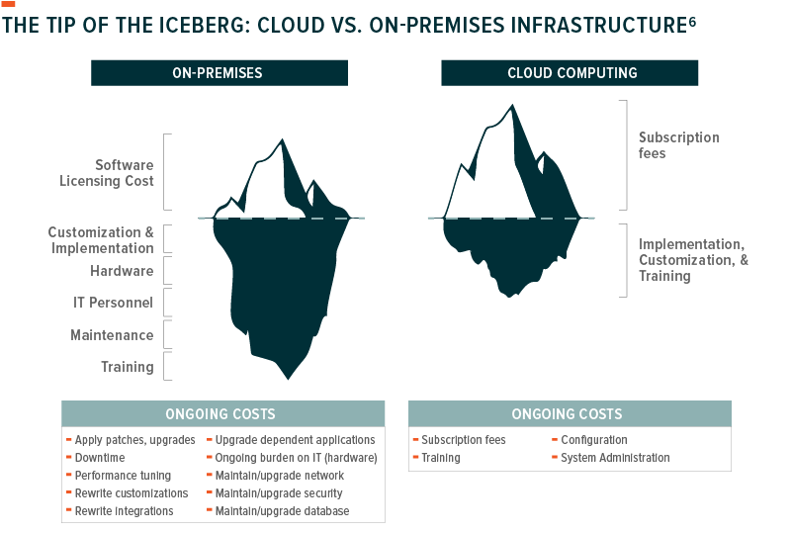

Slide 9
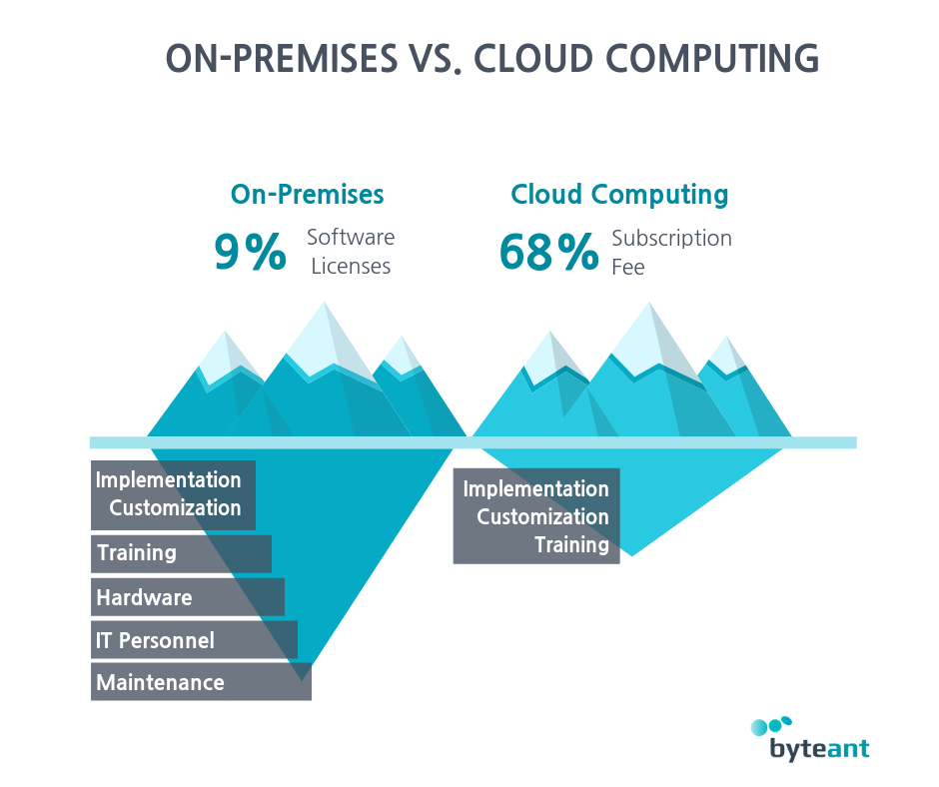

Slide 10
Benefits of cloud CRM summarised
√
Freedom of the cloud
SuperOffice CRM Online – gives you the freedom to access your CRM data at anytime and from anywhere
√
Stay flexible in the changing world
Change user plans, increase storage space, add services or users, tailor the system to match your business
√
Connect, expand and integrate as you want
Connect to and integrate with your existing back-office systems by using one of many standard apps, add-ons and collaboration tools available in our App Store.
√
Get instant access to the latest tools
Be sure that your team automatically get the new and improved functionality as soon as it is released.
Notes:
Freedom of the cloud : Our cloud solution – SuperOffice CRM Online – gives you the freedom to access your CRM data at anytime and from anywhere. Hosted in the cloud and accessible over the Internet, SuperOffice CRM Online always keeps you connected no matter where you work from – be it your office, home or on the go. Automatically upgraded to our latest CRM version, you won’t have to worry about technicalities, such as maintenance of servers, updates or back-ups – all will be taken care of.
Stay flexible in the changing world : The world is changing at a rapid pace, and your needs change with it. You want your CRM system to be flexible and adapt to the new requirements. Change user plans, increase storage space, add services or users, tailor the system to match your business processes, and pay only for what you use today, not what you needed yesterday.
Connect, expand and integrate as you want: Information sharing is only effective when there are no obstacles and limitations. That’s why the customer data in your CRM should not only be accessible to all teams, but also move freely between systems. SuperOffice CRM Online can be connected to and integrated with your existing back-office systems by using one of many standard apps, add-ons and collaboration tools available in our App Store.
Get instant access to the latest tools: Your people deserve the best, including access to the latest CRM features.
Old ways and outdated tools make people look for alternative routes, invent workarounds and cause silos. With SuperOffice CRM Online you can be sure that your team will automatically get the new and improved functionality as soon as it is released. No need to wait for an upgrade or deal with downtime – every new function is delivered and ready to be used instantaneously.

Slide 11
Benefits of cloud CRM continued
√
Get all GDPR functionality and stay compliant
Change user plans, increase storage space, add services or users, tailor the system to match your business
√
Focus more on your business, less on IT
Free your IT personnel from the need to preform system upgrades, server maintenance and run back-ups or security checks.
√
Choose a cost-saving option
With applications, data, hardware, servers, storage and network managed for you, a cloud solution costs considerably less than running the same software on-premises.
√
Trust your data is safe and secure
Be assured that we perform back-ups, ensure the highest data security levels, safeguard privacy, compliance, and transparency in all our cloud products and services.
Notes:
Focus more on your business, less on IT: With SuperOffice CRM Online, you can free your IT personnel from the need to preform system upgrades, server maintenance and run back-ups or security checks. All upgrades, installations, maintenance, and new users are connected to the system without any effort on your side. This means that your IT people can use their time on developing new business solutions and working on other technology-related issues that will advance your company in the market.
Get all GDPR functionality and stay compliant: With SuperOffice CRM Online you can enjoy all GDPR features that will help you process customers’ information in line with the EU law. Register the purposes for storing personal data, manage consents and subscriptions, regulate internal access to customers’ data, and report data breaches – to show your customers that you value and respect their privacy and stay GDPR-compliant.
Choose a cost-saving option: SuperOffice CRM Online is based on a pay-as-you-go model, resulting in a lower total cost of ownership (TCO). While enjoying access to the state-of-the-art technologies, you can forget about spending extra money on hardware or people maintaining the system. With applications, data, hardware, servers, storage and network being managed by the provider, running a cloud solution over time is going to cost you considerably less money than running the same software on-premises.
Trust your data is safe and secure: When you know that your data is protected by the very best systems, technologies and people who treat security as their personal responsibility, you have one less thing to worry about.
In fact, one of the main reasons IT managers recommend moving software applications to the cloud is the increased security it offers*. At SuperOffice, we take data protection extremely seriously: invest in secure servers, perform automatic back-ups and ensure the highest data security levels, safeguarding privacy, compliance, and transparency in all our cloud products and services. SOURCE: https://searchcloudcomputing.techtarget.com/opinion/Clouds-are-more-secure-than-traditional-IT-systems-and-heres-why

Slide 12
Funksjonalitet p.t. som kun er tilgjengelig når SuperOffice CRM er i skyen

Slide 13
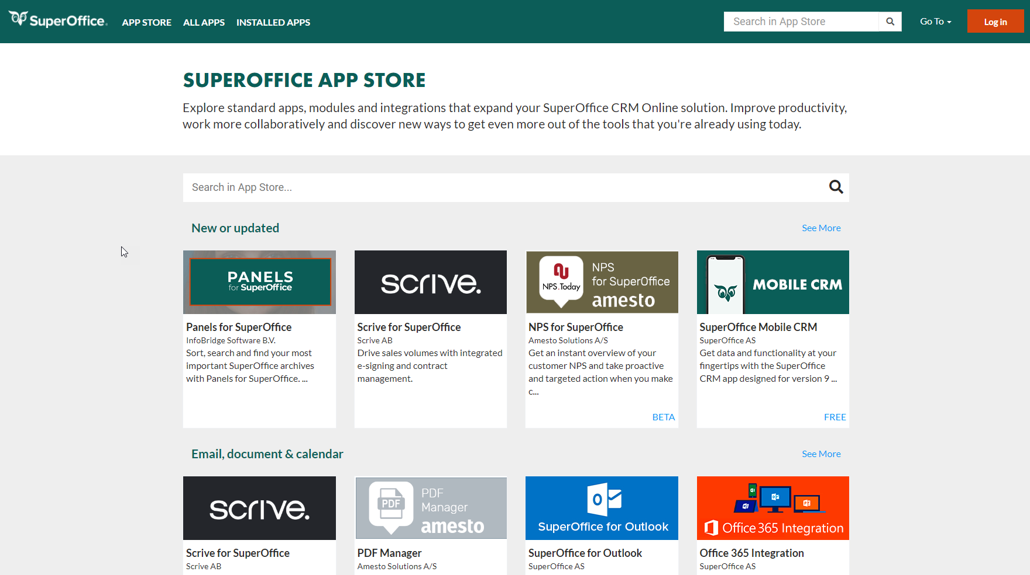
SuperOffice Appstore

Slide 14
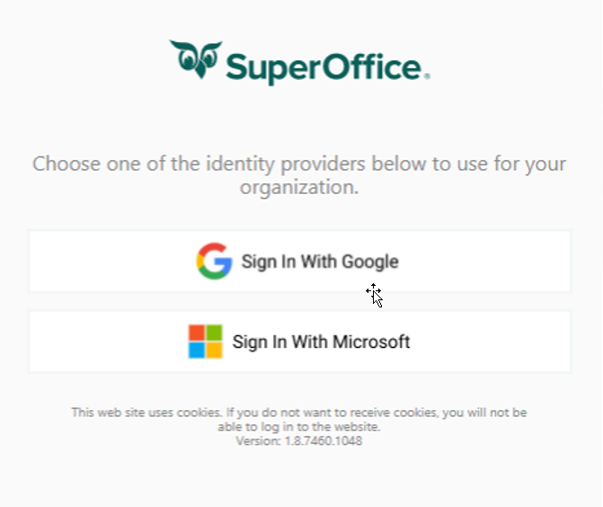
Microsoft Office 365 Integrasjon
Integreres med Office365 SharePoint, slik at du kan opprette, lagre og finne dokumentene dine i SuperOffice, og dra nytte av fordelene med SharePoint sin dokumentfunksjonalitet
Pålogging I SuperOffice styres av Azure AD
Krav
Abonnement på SuperOffice online og admin tilgang
Et Microsoft office365-abonnement *
Azure Active Directory
En Office365-administrator med rettigheter til å konfigurere og godkjenne tilgang
Mappene "SuperOffice Archive" og "SuperOffice template" må være plassert på roten av SharePoint-området, og ikke som et underområde eller “virtuelt” område
*Alle brukere av SuperOffice Online må ha og bruke Microsoft Office365 konto

Slide 15




















Utvidet SharePoint integrasjon (estimert Q2 2021)
SuperOffice
SharePoint
Company*
*3 party Suppliers needs to create integration between Projects, Companies or Contacts in SuperOffice and SharePoint. Enable synchronization of company and persons.
Folder structures, members and other attributes must be inherited from SharePoint.
Calendar
Automation
Project*
Project
Survey
Calendar
Documents
Documents
Committees
Documents created from SuperOffice is stored in SharePoint and available for all users. (Metadata from SO will help create customized views in SP).
Office 365 addin in Word, Excel and Power Point helps users archive documents created in SharePoint into SuperOffice.
Chat/Service
Contacts*
Intranet/extranet
Automation
Sales
Collaboration

Slide 16
Google G Suite
Integrer funksjonene for dokumentbehandling i G Suite slik at du kan opprette, lagre og finne dokumentene dine i SuperOffice, og dra nytte av fordelene med både SuperOffice og G Suite-tjenestene på ett sted.
Pålogging til SuperOffice styres av Google.
Krav
    SuperOffice onlineabonnement
    Et Google G Suite-abonnement
    Administrator tilgang til SuperOffice online.
    Vi anbefaler: tilgang til en dedikert Google G Suite-pålogging (vanlig bruker Google-brukerkonto – brukt til integreringen).
    Alle brukere av SuperOffice online site må ha og bruke en G Suite-brukerkonto (privat Google-eller Gmail-konto er ikke tilstrekkelig

Slide 17
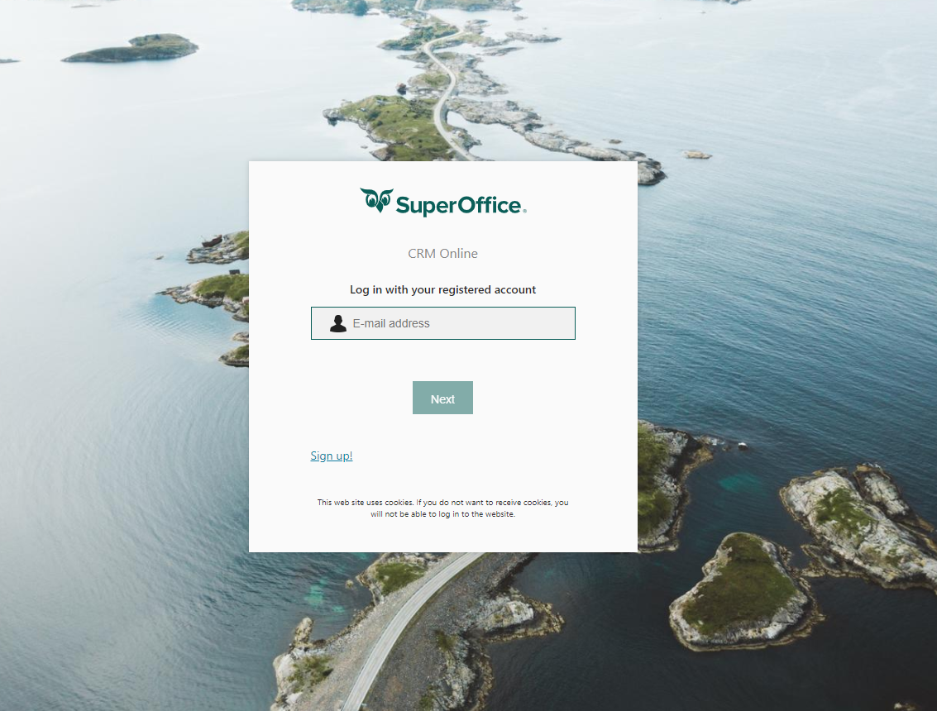
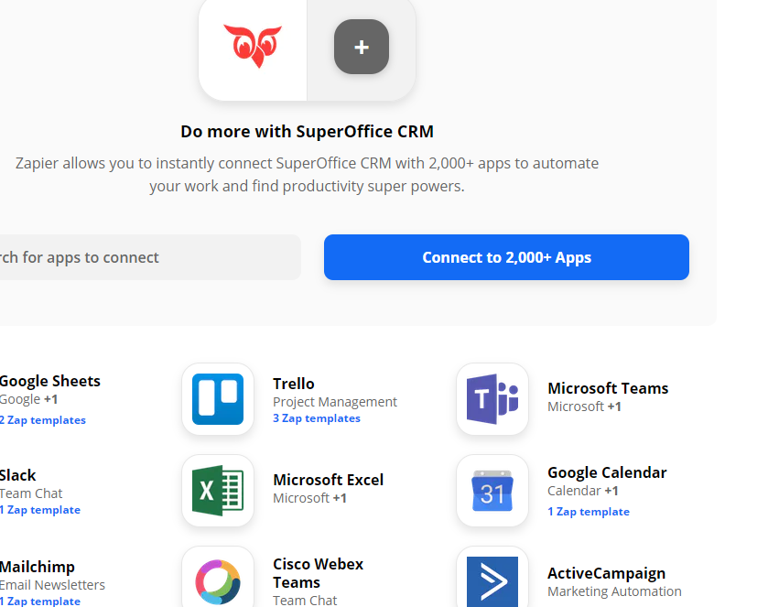
Uante muligheter for automatisering og integrasjon med Zapier!

Slide 18

On-prem. vs online fremover
Teknologiutviklingen og endringstempoet i markedet innen forretningsapplikasjoner gjør at fordelene og mulighetene med skyløsninger vs. on-premise løsninger vil bare øke ytterligere fremover .

