Slide 1


HOW TO CREATE
LONG TERM RELATIONSHIPS
WITH CRM

Slide 2
Agenda
Introduction
Focus areas
The road ahead
Challenges & opportunities

Slide 3

The process ahead
Meeting 1
  Uncover the goals of the implementations
  What do you want to achieve? What effects do you want to realize?
  What are you going to measure? (KPIs)
  What will characterize that the project has been a success?
  What processes do you want to improve?
  Integration points?
  What risks do we see in this project?
  SuperOffice Demo:
  How SuperOffice CRM will cover your desired processes and needs
  Proposal presentation
  Signing the contract
Meeting 2
Meeting 3
Meeting 4

Slide 4






SuperOffice at a glance
The #1 provider of CRM software in the Nordics
Company overview
Presence
Background
Revenue development
Geographies served
Founded in 1990
NOKm
Customer service office
#
Number of employees
Headquartered in Oslo, Norway with offices in 8 European countries
99
256 full time employees
40
18
36
Positioning
6
21
NOK 2.5 billion core target market (Nordics) growing >10% p.a.
25
Market leader for SMEs in the Nordics with ~12.5% market share (~25% in Norway)
Product offering
<
11
5,500+ unique customers
SuperOffice provides mission critical Customer Relationship Management (CRM) software solutions helping businesses improve revenue and profitability, reduce cost and increase customer loyalty
Financials
2020 revenues of NOK 488 million
Apps
Consulting services
FY19A revenue
450 MNOK
APIs
2020 EBITDA of NOK 94 million
Sales
features
Marketing
features
Services
features
Significant cash conversion of >70%
Standard CRM features
~70% of revenue from the Nordics
Recurring revenues

Slide 5
Relationships matter
We help you turn relationships into revenue.
Notes:
We like to start off by highlighting our core belief that “Relationships matter”.
It means that business growth requires strong and long-lasting relationships between people – and that is true no matter what industry you are in.
So, we are a high-tech company passionate about enabling and empowering people, both your employees and your customers.
In fact, from the very beginning, SuperOffice CRM was designed with the individual user in mind - as opposed to so many systems that are designed for management (only). Our design philosophy is to make everyday tasks easier and help users to be more productive. Our 30+ years of experience tells us that the improvement of personal productivity is still a core benefit and key strength of our product. And is something our customers value greatly.
It taps into the simple truth that when you empower your users, so that they want to use your CRM solution, data is added, quality is high, and management gets their up-to-date dashboards and reports they need to steer the company in the direction of revenue increase.
We are a Norwegian company, a European IT adventure we like to say. Our HQ and the development department are located in Oslo, and we have offices in 8 countries across Europe. Our turnover is just under half a billion (NOK?) and 99% of our customers choose the cloud solution.

Slide 6

CRM
is about maximizing the company's value by systematically developing the customer portfolio
Source: MarkUp Consulting
Notes:
Before we talk about how to succeed with CRM, we need to talk about what CRM is... (CLICK)
CRM is about developing your customer portfolio to the highest possible value – which helps you turn your business relationships into revenue.
You can do this by adding new customers, selling more to those you already have and being so good at customer care that you reduce customer churn. Loyal customers also make it easier to get new customers (via the word-of-mouth).
Before you start implementing CRM, you should have decided - from a business standpoint – what it is you want to achieve.
Whether it is securing new customers, or increase the value of existing business, it all boils down to cultivating relationships based on trust.

Slide 7
How do you plan to grow your value?
Customer
value
Upsell to
existing customer
Customer portfolio
Win new
customers
Reduce
churn
Customer
lifetime
Disengage with
non-profitable customers
Source: MarkUp Consulting
Notes:
… In terms of customers, their value is measured by (1) how much they buy from you and (2) for how long they have been doing that.
No matter what your strategy is, customers must be recruited, developed and retained.
You must eventually prioritize. Meaning, you must choose to invest in the customers who have the greatest potential and disengage with those not profitable for you

Slide 8

CRM IS A STRATEGY
Who do you want to be?
For whom?
And how?
Every CRM success starts with a clear ambition!
Notes:
More than anything, CRM is a strategy.
It is about deciding who you want to be – what are your strengths in the market?
For whom – who are your customers (ICP), what segments are you going after?
And how will you succeed? Where are your competitive strengths?
We dare say, that in our 30+ years of experience, we’ve found out that all CRM successes start with a clear ambition.
Ask yourselves: What do you want to get better at? Where are you going to beat the competition?
One area that research and experience tells us offer a significant source of competitive advantage, is to provide world-class customer experiences.

Slide 9

EMPLOYEES
CRM
CUSTOMERS
Notes:
Also, if you’re going to deliver customer experiences that are better than your competitors', it is important to understand the “two faces” of CRM :
On the one hand, it is how you enable your employees to deliver great customer experiences with the help of insights, high-quality customer data, key figures and process support.
Example – In SuperOffice, all salespeople start every morning with a dashboard showing which customers have become “orphans” over night, “orphans” are what we call the customers that have not been followed up according to our customer-retention program.
So you want to enable your employees to do the right thing towards your customers.
On the other hand, it's how you enable customers to help themselves 24/7 by making information available and securing communication both ways.

Slide 10
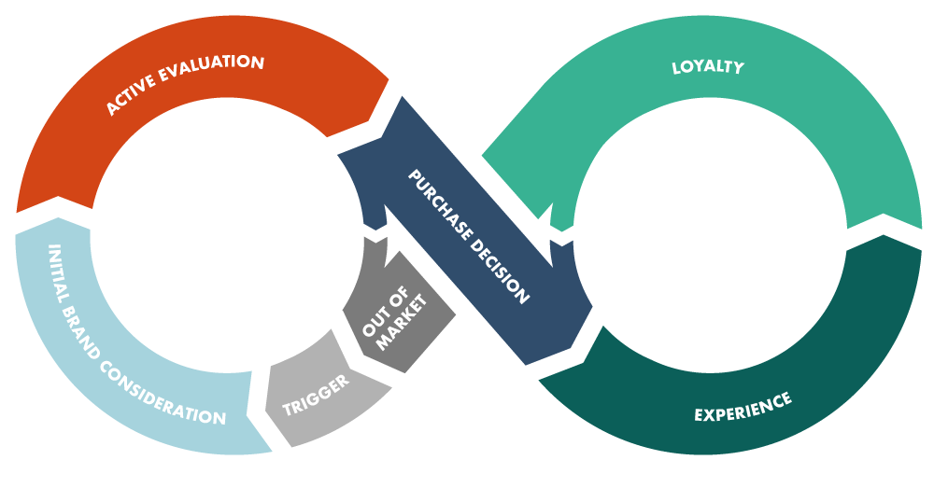

HAVE YOU DESIGNED YOUR
CUSTOMER JOURNEY?
Notes:
One way to see both of these views/faces is by designing the customer journey. This means that by applying the customer's point of view, you need to think through (from start to finish) what it is like to
be a prospect,
buy from your company, and
be an existing customer of your company.
How smooth and uninterrupted this experience/journey is what determines whether you are better than your competition.
A customer journey contains all the meeting points (touchpoints) the customer has (and should have) with you.
Many companies have not designed a full customer journey, but rather have routines for what to do when you get a lead, how to land a sale and how to handle a complaint. Yet, the real power lies in everything you do between these touchpoints as well.

Slide 11

A smooth
CUSTOMER JOURNEY provides a competitive advantage
Is there something in the SuperOffice CRM toolbox, or does every company need to re-invent the wheel?
Notes:
So, our claim is that a smooth customer journey provides a competitive advantage.

Slide 12









A PLATFORM FOR GROWTH
Customer Engagement Platform
MARKETING
AI as a Service
Useability
SALES
SERVICE
Integrations
(App Store & APIs)
Marketing Automation
Mobile
New functions
Productivity Platform
(Office365/Google)
Notes:
SuperOffice CRM is a platform that helps you convert your prospect and customer data into tangible actions and achieve your goals.
By connecting different customer data into one single view and optimizing workflows, SuperOffice CRM gives your sales, marketing and service professionals immediate access to all customer-related insights, helping them to foster stronger relationships and take informed actions to grow revenue.
The platform offer your teams a set of the core functionality that’s the basis of our system which ensures a shared view and the ability to work productively as individuals and collaborate as teams.
In addition, we offer deep functionality to support and improve your processes within sales, marketing and service – individually and collectively. Whatever your business needs at this moment in time to grow.
Furthermore, SuperOffice contain a range of value-added capabilities that allow you design a CRM solution that fit your business now and in the future.
For example, you can benefit from capabilities such as:
AI, integrations, customer engagement, and mobility of course. (More details on these below as required).
All these are a part of the solution and ensures that your CRM solution support all aspects of your business you need and to help you turn your relationships into revenue.
And some customers who have been growing using SuperOffice CRM include: CLICK
AI: There is a lot of “hype” around Artificial Intelligence these days. The most important changes AI will bring to CRM involve automation (elimination of time-consuming manual tasks), as well as improvement of existing conversation tools / Chatbots.
By using data, the chatbot will be able to predict the next question and provide additional information the customer may need. In the long run, these will be sophisticated enough so that we can not separate humans from machines.
Integrations: Standard integrations are available in the form of apps (in our own App Store), as well as a number of well-documented and intuitive tools (APIs) for creating your own customizations.
All this allows companies to get an overall customer view and allows for more relevant, high quality customer service.
CEP: SuperOffice’s platform for customer-facing applications. It includes a customer center, case management, Knowledge base, chat and web forms. Here we offer tools that can support and assist you in interacting with customers on the surfaces they operate.
Mobility: about 48% of the world's population owns or has access to a smartphone (almost 100% of the western world). Increased use of mobile phones, increased use of home offices and working across more geographical distance have redefined the way many companies think and run their business today.
Our mobile app for phones and tablets lets you easily access all your important customer information at anytime and from anywhere. Get full access to your CRM data and perform urgent cases and tasks you have forgotten even if you’ve left the office and you’re away from your PC or Mac. Mobile CRM runs on Android and iOS.

Slide 13












Notes:
Adapt this slide for each vertical/customer
Have a look at the customers we have in your line of business / vertical / etc.
We understand you!

Slide 14
Key findings from the Survey

Slide 15

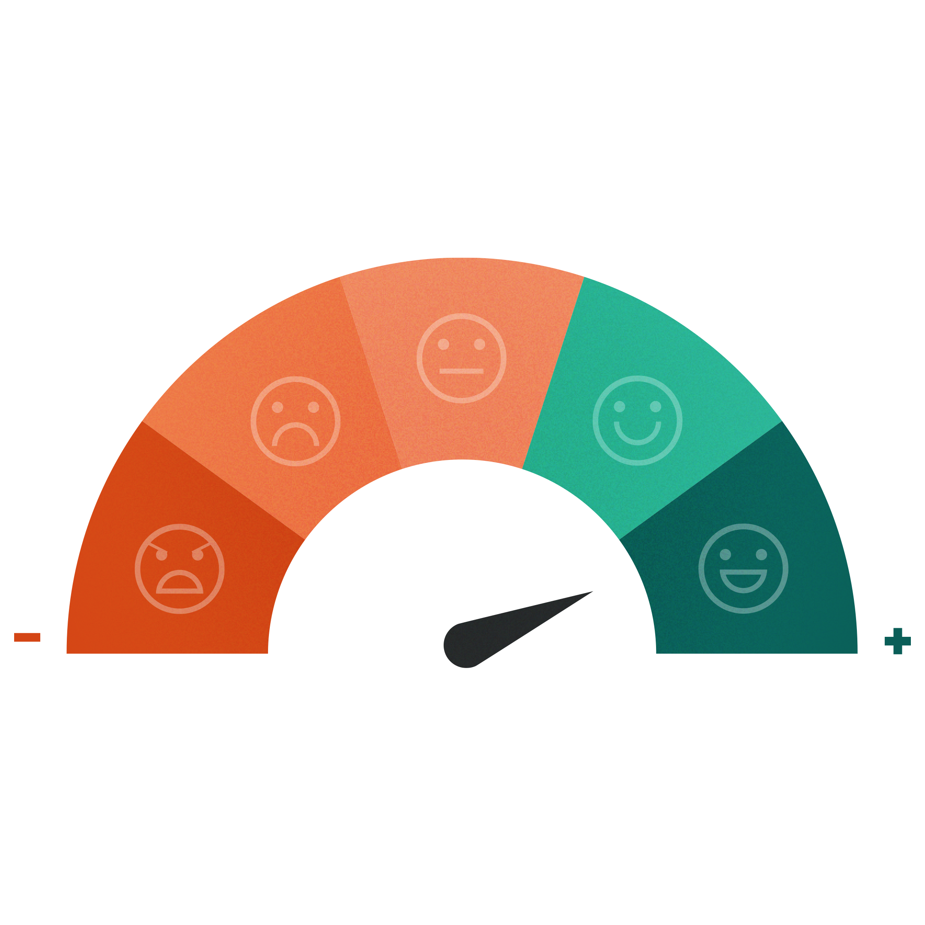

EVERYTHING YOU NEED
IN ONE PLACE
Notes:
SuperOffice CRM is a modern solution that is designed to fuel your sales, marketing and customer service processes.
All successful businesses share the same goal – to increase revenue and grow. To reach that goal, they need to treat every customer relationship as an opportunity.
SuperOffice CRM is a platform that is designed to help you convert your prospect and customer data into tangible actions and achieve your goals.
By connecting different customer data into one single view and optimizing workflows, SuperOffice CRM gives your sales, marketing and sales professionals immediate access to all customer-related insights, helping them to foster stronger relationships and take informed actions to grow revenue.
At the core – you need to give your people a 360-degree customer view:

Slide 16
















360° CUSTOMER OVERVIEW
Customer
Sale
Document
Person
Project
Request
CRM
Calendar
Mailings
Notes:
A 360-degree customer overview is a collection of all customer data in one place. It allows you to find all customer info, data on all past and present purchases, all conversations with customer service, as well as a record of customer behavior on social media channels.
It shows a relationship as an ongoing loop with all the touchpoints where the customer is in contact with the brand.
Without this shared collected view, it’s rather challenging to know what each team is doing and collaborate effectively. One effect we often see after implementing SuperOffice CRM at customers’ is the removal of information silos, which frees up the time otherwise spent on finding the necessary information to provide seamless customer experience.
In addition to what your CRM solution is able to support your processes with, it is also very much a question of how. How does it help you do things better, faster, save you time and allow your team to focus on what matters – namely building sustainable and profitable customer relationships. Let me give you a short introduction and overview of what we can bring to the table:
Starting with: CLICK

Slide 17
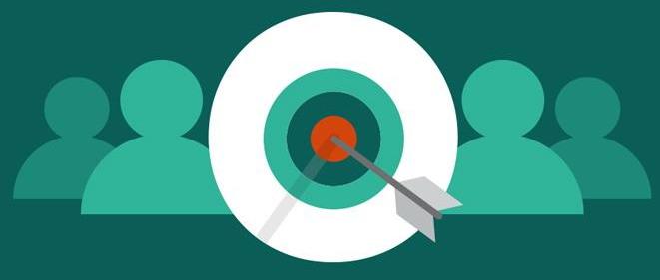
INBOUND AND OUTBOUND MARKETING
The bottom line of any business is to make money and marketing is essential to reach that goal.

Slide 18

74 % of companies name conversion of leads to sales as their highest priority.
Almost 40% of all companies struggle with prospecting.
How can you more easily (and automatically) collect leads?

Slide 19
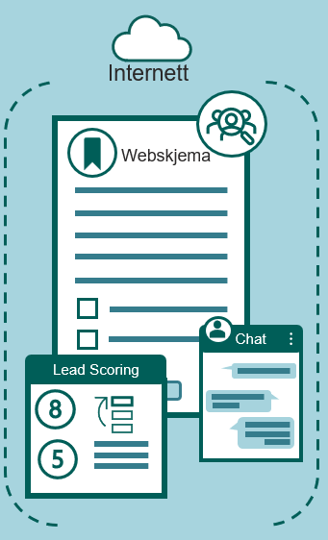

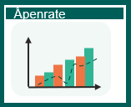

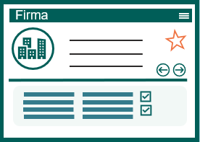
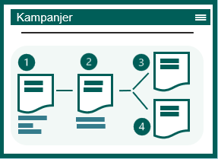


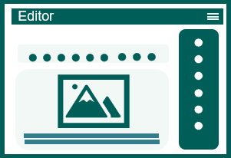
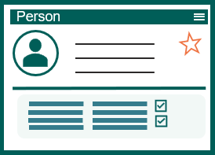


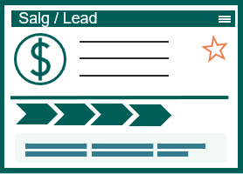
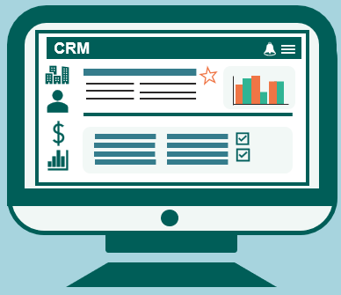




SuperOffice Marketing
Collecting Leads (Inbound)
Outbound
Clicks update the CRM system
Statistics by campaign
CRM database
Email flows
Notification right person
E-post editor
Segmentation
CRM database
Junk mail tagged
Notification to person
Privacy email
(GDPR)
E-marketing consent automatically controlled before dispatch
Notes:
SuperOffice Marketing can help you with this as well as enable you to communicate with your prospects and customers with the right message at the right time.
Let me go through this in a little bit in more detail: CLICK

Slide 20




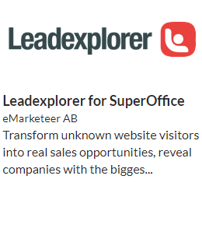
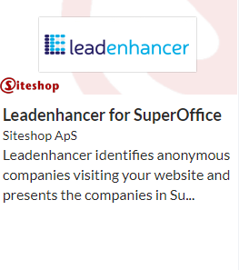








Collecting Leads / Inbound Mkt
Useful Apps
Internet
SuperOffice App Store
CRM database
Notification right person
Web Form
Company
Person
Sale/Lead
Chat
Lead Scoring
Notification to person
Privacy e-mail
(GDPR)
Seamless connection between CRM and selected App*
* Separate agreements, prices and terms apply to App purchases
Notes:
Automate how you collect leads:
Web forms in themselves are not something new - most companies use them.
What’s new is meeting your customers’ expectations in terms of quality of response, availability and response time.
Therefore, imagine that you offer to post digital forms on your website and give potential and existing customers an interactive experience where they can easily fill out and submit forms directly from their device, no matter where they are.
These are linked directly to your CRM system so that the information is created immediately, and notifications regarding privacy, legal basis and consent are sent to the customers automatically.
This makes it easier to collect data and be GDPR compliant. The system will create a task in the CRM database and send a notification to the person in your company who is responsible for the follow-up.

Slide 21
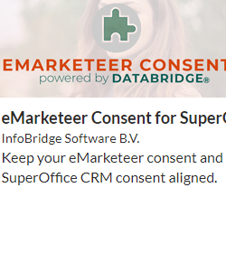
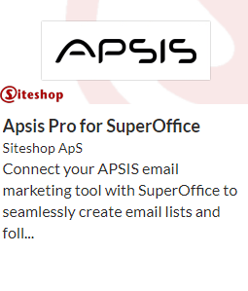










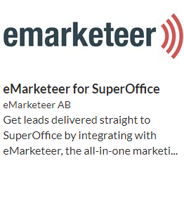


SuperOffice Marketing (Outbound)
Useful Apps
Statistics by campaign
Clicks update the CRM system
E-mail flows
SuperOffice App Store
Openrate
E-mail editor
Campaigns
Segmentation
Editor
CRM database
Selection
CRM
Junkmail tagged
E-marketing consent automatically controlled before dispatch
Seamless connection between CRM and selected App*
Marketing Professional
* Separate agreements, prices and terms apply to App purchases
Notes:
SuperOffice Marketing is designed to help you get your message out and connect with the right customers, at the right time.
Knowing exactly what you want to achieve with your mailing is the key to the success of any marketing campaign. It is basically about defining the target group (Who will receive information from you), What do I want to communicate (the message you want to convey), When will I carry out the actual campaign / mailing (experiences you have made from previous about when recipients read the email). And, last but not least, How do I measure the effect of the campaign (how many read, clicked on, ignored, failed, etc.).
SuperOffice CRM helps you find the right target group through powerful search and selection feature that draws on all kinds of information, including customer consents, interests, as well as demographics. You can even include past behavior when finding that target audience – for example, past attendance of events or meetings, or purchasing history – exactly because it is a part of your overall CRM solution and not a stand-alone email tool.
Then with the help of the easy to use drag-and-drop email editor you can create your message. You either can start by using any of the ready-made "out-of-the-box“ templates available or create your own. With its “privacy by design” features, SuperOffice CRM helps you respect various consent statuses when you send mailings. Respect of your customers’ privacy is fundamental in building trust. You can also measure the effect of your email communication through standard reports and statistics.

Slide 22
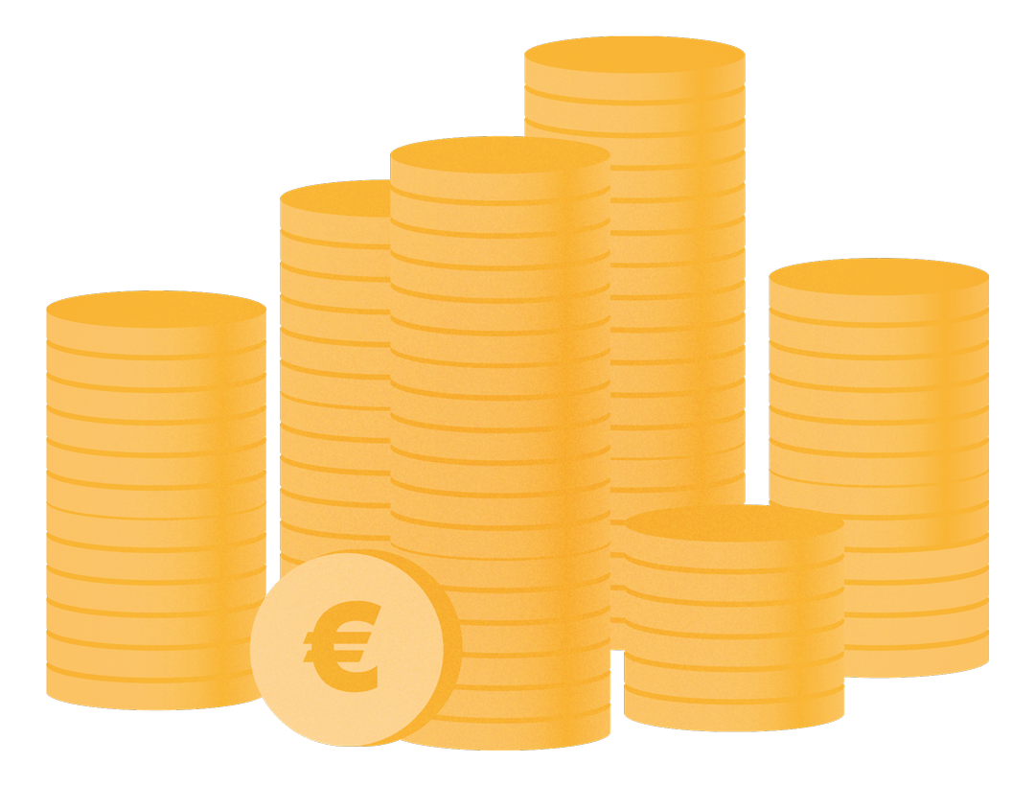
SALES IS KING!
Companies that implement a structured sales process
increase revenue,
performance and
forecasting accuracy.

Slide 23

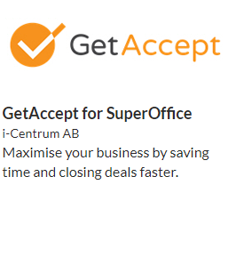
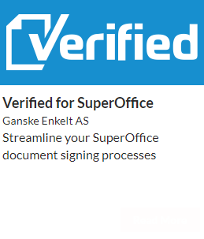
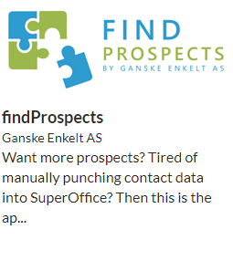
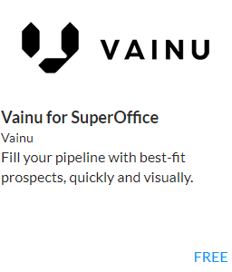


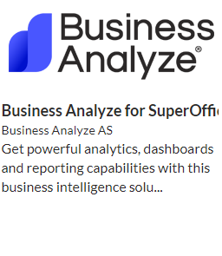
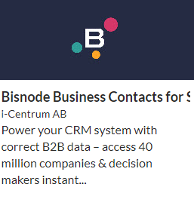







SuperOffice Sales
Relevant Apps for sales
Sales opportunity registered
Customized Dashbord
SuperOffice App Store
Standard Dashbord
Salg
Prognose
Proposals
Products & prices
10%
30%
60%
80%
10%
30%
60%
80%
99%
Tilbud
Produkt
$
Salgs process
(Guide)
%
Stakeholders
Seamless connection between CRM and App chosen
Product register
Sales Essentials
Sales Premium
* Seperate agreements, prices and terms apply when buying Apps
Notes:
Let’s take a closer look at SuperOffice Sales.
Starting with Sales Stakeholders: In complex sales processes or in project sales, it's necessary to have control over all parties involved (partners, internal, suppliers, etc.) By using Stakeholders, you will always have a complete overview of companies, people and roles being involved in the project. Especially when there are several people or teams involved in the sales projects.
Sales guide The guide takes the salespeople through each step of the sales process, automatically provides suggestions for documents that must be created along the way, while suggesting which activities should be carried out in each phase and which tools should be used to gain control and progress in the process. It’s a great help to work in a structured and smarter way. Build the sales guide on your best practices – it’s like cloning your top salespeople ☺
Quotes / Products: We know that preparing quotes is one of the more time-consuming and important tasks salespeople spend a lot of time on. SuperOffice CRM helps you by streamlining the offer process and assists sellers in preparing professional quotes/offers.
You select the product and quantity from the product register and enter discounts (can be retrieved directly from the ERP system), then an offer is created automatically. At the same time, the pipeline is updated with the amount and sale date. Once the quote has been generated and sent to the customer, SuperOffice CRM will remind you to follow up on it. SuperOffice CRM also provides an overview of the different versions of the offer, so you always know what you have offered when. These tools can help your salespeople stay on top of the sales process and create a smooth and professional purchasing experience for your customers.
Reports / Forecasts: You also get a detailed overview of results, pipeline and activity levels for each individual employee or team through standard Dashboards with Drilldown functionality. This helps you make the right decisions on where you may need to improve processes or solve issues, as well as how you can take advantage of new opportunities.
And in addition, there are a range of apps relevant to help Sales people save time or provide better customer experiences together with SuperOffice. These apps are seamlessly connected to SuperOffice and unlike past integration projects, are standardized and robust connections.
By giving your salespeople the tools they need to close more deals and optimize workflows, SuperOffice Sales frees up the time for them to focus on turning relationships into revenue.

Slide 24

WORLD CLASS CUSTOMER SERVICE
Positive customer experiences drive repeat business, enhanced customer loyalty and improved business growth.
Notes:
A RightNow Technologies Customer Experience Report found that 86% of U.S. adults are willing to pay more for a better customer experience and 73% of U.S. adults said a friendly customer service made them fall in love with a brand.
Not only will brands get happy, loyal customers but will see increased business.

Slide 25



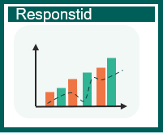

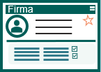


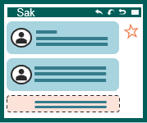
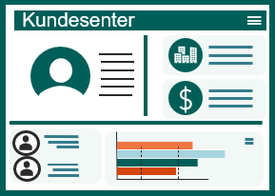



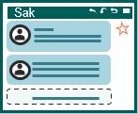
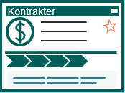

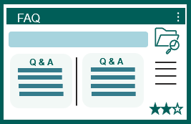
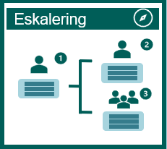



SuperOffice Service
Superoffice Service for employees
SuperOffice Service for customers
Customer log-in
Receipt to sender
Notification to agent
Standard Dashbord
Information about persons incl. GDPR (consent)
Company information
Inc. requests
History
CRM information available for end-customers
Scripts og Macros
Categorization
Priority
Registration of requests
Agreements
Status
Form
FAQ / Knowledge base
Collaboration
Communicate via live chat
Statistics
Order forms
Notes:
SuperOffice Service provide you the tools your team needs to deliver great customer experiences, everytime. Add the Customer Engagement Platform side, and you also empower your customers to service themselves on their terms. Let me provide you with a more detailed overview of some of the possibilities:

Slide 26























SuperOffice Service
Customized Dashboard
Receipt to sender
Notification to agent
Standard Dashbord
History
Inc. requests
Responstid
Scripts og Macros
Sak
Automasjon
Categorization
Priority
Status
Eskalering
FAQ
Q & A
Q & A
Time-based priority
FAQ / Knowledge base
Collaboration
Service Essentials
External links / autoreply
Automatic and rule-based escalation
Service Premium
Notes:
Service
Our CRM solution is built to receive, track and follow up on customer inquiries regardless of the channel (email, phone, chat, webform, etc.). The employees will have access to the functions needed to respond quickly, consistently and efficiently. At the same time, you get an overview of the entire process, based on the real-time data, so that you have full control over customer requests and your employees’ performance.
SuperOffice Service is flexible and easy to customize. You can set up workflows, triggers and tasks that suit you and your business needs. Automatic answers and intelligent case flow ensure that your customers always get the attention they deserve, and that the right person helps them at the right time.
Each request is automatically assigned a unique reference number and a place in the queue system. The number tracks all communication related to the inquiry. The layout makes employees more focused and efficient, and you avoid personal preferences and unanswered inquiries. With automatic categorization and assignment to the right person, you save a lot of time and resources. Setting up email accounts and filtering by keywords is easy, and you no longer have to waste time sorting and distributing your inquiries. If a request is left unanswered after a defined time period, the system will automatically escalate the case.
Statistics: You can use built-in functions in SuperOffice Service to gain insight into how companies and teams perform in real time. A brief glance at the dashboard gives you an immediate insight into the status of inquiries and open cases in the queue. SuperOffice CRM also automatically analyzes historical data. The system shows you exactly how the inquiries have developed, and how the service team has performed over time, while highlighting what you can improve.
By optimizing the support you provide to your customers with SuperOffice Service, you will retain more customers and increase your revenue.

Slide 27

67% of customers prefer self-service rather than talking to a business representative.
How can your business meet ever-increasing self-service requirements 24/7 without hiring a lot of people?

Slide 28




Customer Engagement Platform
Person Info including GDPR ( consent)
Login
Person
Company info
CRM information available to your customers
Company
Customer Portal
Registration of request
Request
Contracts & agreements
Contracts
Chat
Dashboard
Web Form
Live Chat
Order form
Statistics / Usage
Notes:
SuperOffice CRM, powered by its Customer Engagement Platform, is your best way to connect with your customers. To empower them to service themselves.
If we take what we know about the customer's behavior and expectations of their suppliers.
Imagine a solution where customers (within B2B) log in to a portal (like “my page”) where the information in your CRM is available to them.
Here the customer gets immediate insight into Company information, employees in their company, the opportunity to change their own data.
As well as extended customer service where the logged in person can get access to the history of their inquiries/requests, as well as is able to file a new request.
They can chat with the vendor, fill out order forms, book appointments, get an overview of their invoice history and agreements / contracts, as well as insights into reports and dashboards.
This gives the customer the opportunity and tools to conduct excellent customer service via their own self-service portal.
And when your customers feel connected to your company, it gets easier to make your relationships mutually beneficial and turn them into revenue.

Slide 29
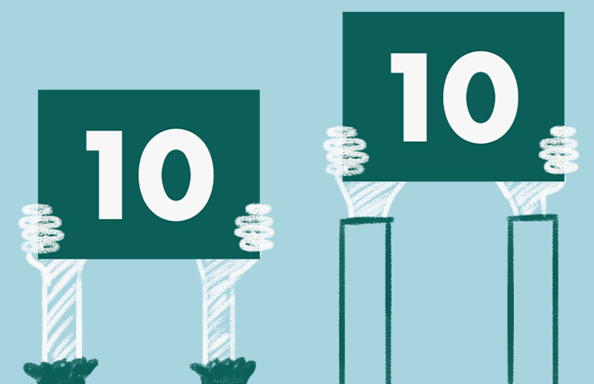
Customers expect ever faster and better response, at the same time there is pressure on costs like never before.
How do you deliver more and better with less?

Slide 30






Better service with SuperOffice AI
Incoming request
Request
Chatbot
Confirmation of a request submitted
Text analysis and translation
Sentiment
Categorization
Notes:
SuperOffice AI
With ever rising demands on customer service, how can CRM and AI technology help you exceed your customers’ expectations?
Take, for example, a company that operates in several countries, but their customer service / support agents are located one location and they have to attend to all customer inquiries. Yet, customers expect to be served in their local language.
A request from a customer is submitted.
This is an important customer who has a big problem and expects a quick and high-quality response.
Based on a service that uses natural language processing, the computer will work and interpret text as we humans do. By extracting opinions, content and sentiment expressed in the text.
The agents will get an opportunity to translate the request into their own language. You can also connect this function to the Chatbot in the system.
By embedding AI into your CRM solution and processes, SuperOffice AI makes complex tasks simple, freeing you to focus on what matters most – providing services that build strong and profitable relationships.

Slide 31

Connecting CRM with IoT enables you to be proactive and allows you to resolve issues before they arise.
Notes:
The Internet of Things and CRM.
Technology is connecting not just people, but also the things we use. IoT, in practice, means that all things/gadgets that we interact with daily are online: the freezer, refrigerator, heater, etc.
IoT can also be used to help improve our real human experiences through the services we provide.
So, how does the CRM and IoT connection help you offer exceptional customer service?

Slide 32




Proactive Customer Service - IoT
CRM system
Customer Intelligence
Intelligent chairs
Company
Dashboard
CRM system
Request
Notification on
new request
Notes:
Let’s take a look at an example.
We have a customer who delivers chairs to their customers. Each chair has a built-in computer chip that will then be able to measure usage behavior, errors and omissions.
Let's look at how this, together with CRM technology, has helped this customer increase customer satisfaction and improve their own reputation.
When a fault or defect is discovered in the chair, it will automatically be able to report this to the supplier by creating a case in their CRM system.
The case will be linked to the correct chair, and we will notify the case officer via SMS. The content and priority of the case depends on the type of error registered by the chair.
The supplier will then be able to act correctly based on the type of error.
The behavior and history of the chairs are stored and displayed in the CRM system in real time.
Statistics and Dashboards can be extracted and monitored so that the supplier has 100% insight at all times.
Solving a problem before it arises is the ultimate customer service excellence. ☺
SuperOffice CRM is a modern and forward-thinking CRM solution that lets you embrace technology with your processes and people.

Slide 33
A CRM SUITE THAT UNITES BUSINESS PROCESSES
Notes:
To sum up, with SuperOffice CRM you gain a modern, forward-thinking CRM solution that unites your business processes, utilizes the latest technology & helps you grow your business.
SuperOffice CRM offers the tools to optimize your processes and bridge the gap between customer data and revenue.
Because it is a standard cloud-based application, it allows you to get started fast and to follow the best practices of hundreds of thousands of CRM users.
A wide range of ready standardized apps available in our App Store help you connect your SuperOffice CRM with your other business tools. And with the help powerful customization tools, you can also customize your CRM solution to fit your business needs and expand it as your business grows.

Slide 34
SuperOffice Implementation Method (SIM)
PHASES/STAGES
01
IDENTIFY
02
INITIATE
03
DESIGN
04
IMPLEMENT
05
ONBOARDING
IDENTIFY NEED AND SCOPE SOLUTION
DESCRIBE PROJECT AND INITIATE
SPECIFIY AND DESIGN SOLUTION
CONFIGURE AND REALIZE SOLUTION
SECURE LONG-TERM EFFECT
Time spent by customer in the project:
STEERING COMMITTEE
Owner of the project
PROJECT MANAGERS
In charge of the project
PROJECT TEAM
Works on the project
REFERENCE GROUP
Participates in the project
Estimated time spent on the project
2 hours / month
Estimated time spent on the project
6-8 hours / week
Estimated time spent on the project
2-5 hours / week
Estimated time spent on the project
To be decided
Notes:
One of the ways we ensure our customer achieve success with SuperOffice is providing a helping hand from the start and through all phases of your CRM implementation.
We bring with us a well established and proven methodology – we call it SuperOffice implementation Method – or SIM for short, that oulines what everyone will do each step of the way.
Key phases include:
IDENTIFY: Were we gain an overview and understanding of your needs and what the solution should contain. We do this phase also to ensure that we are alighned and to offer you realistic quottions on the products and services required in addition to define a realistic timeline. You work with one of our experience project managers at this stage.
INITIATE: During this phase we work to make the goals more concrete, the key KPIs, scope and we agree on how to organise the project. We seek your top management involvement – as this is always critical - and that you create a project team to ensure a sueccessful change management which ineviatbly a project like this is.
DESIGN: This stage we perform various workshops to align KPIs, and the workflows and specific requirements that will be supported by SuperOffice CRM. This will be the basis for the design and automations to add as well as user-training.
IMPLEMENT: The execution of various workshops to meet specific needs for example for data import, integrations, automations, templates and so on
ONBOARDING: Finally we work to ensure the success of your change management journey and onboarding of your new CRM solution and CRM strategy. WE do this through various workshops and user-training.
Together with your team, we are here to help you get the most of your CRM solution.

Slide 35
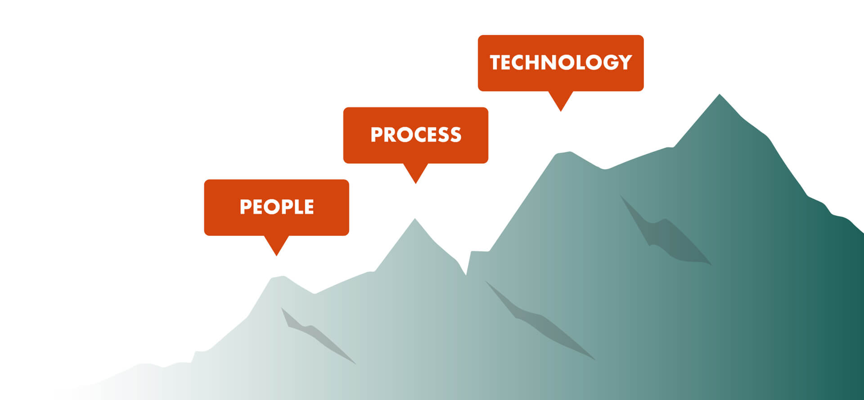
A CRM PARTNER THAT HELPS YOU GROW
Notes:
We have 30+ years of experience in growing business. After several thousand CRM implementation projects, we have gathered substantial knowledge of how to do things right.
We also know that success with CRM does not just depend on the software, but on how the CRM-provider helps you to translate your CRM-ambition, challenge you to be pragmatic, helps you focus on supporting the processes and ensures that your people are involved and on board.
So, when you buy into SuperOffice, you also buy into a partnership with people who truly understand your business and are there to help you maximize the value of our CRM solution.
And that’s what we’d love to help you do. ☺

Slide 36
Purpose and effect of implementing CRM
Main goals and core challenges
Description of solutions
Increase market share from 10-15% to 30% over 5 years
To achieve this, you have to optimize processes for service and support.
Today you work in different systems which means that you work inefficiently and lack common routines, rules and processes with regards to case management
Desired effect of the implementation
KPIs
Increased internal capacity by streamlining the use of resources on service and support
Increased customer satisfaction through better insight and automated processes
Increased control over the customer base and data will streamline communication with customers
Common routines and processes will contribute to achieving their growth goal by reducing risk and increasing efficiency.
Risk

