Slide 1

PRODUCT UPDATE
SuperOffice Norway
10.11.2021 Oslo

Slide 2
Agenda
News in 10.0.2
  Dashboards
  Configurable Screens
  SharePoint
CRM Triggers in Mobile CRM
  Support for Business logic
Forms Improved
Chat Improved

Slide 3
Rollout plan Configurable screens
Rollout of configurable screens will start after all customer are on 10.0.2
Pilot goes forward – All customers can get it from now by contacting us
All “Wave 0” sites got configurable screens in Wave 0 - from October 5th
All new and migrated customers got configurable screens from October 6th
New OC tag (CSstep5) Customers with this tag will be activated in Step 5
After all waves have been done, we turn on the Configurable Screens based on # of udef fields on company or contact:
Step 1 (8. Nov): Less than 15 udef fields (about 2500 sites)
Step 2 (15. Nov): Less than 25 udef fields (about 450 sites)
Step 3 (22. Nov): Less than 50 udef fields (about 400 sites)
Step 4 (29. Nov): More than 49 udef fields (about 200 sites)
Step 5 (29. Nov): All customers that have requested this wave - Tag CSStep5
All customers will now have SCIL based company and contact card and Configurable screens as a free trial (31.12.21)

Slide 4

DASHBOARDS

Slide 5
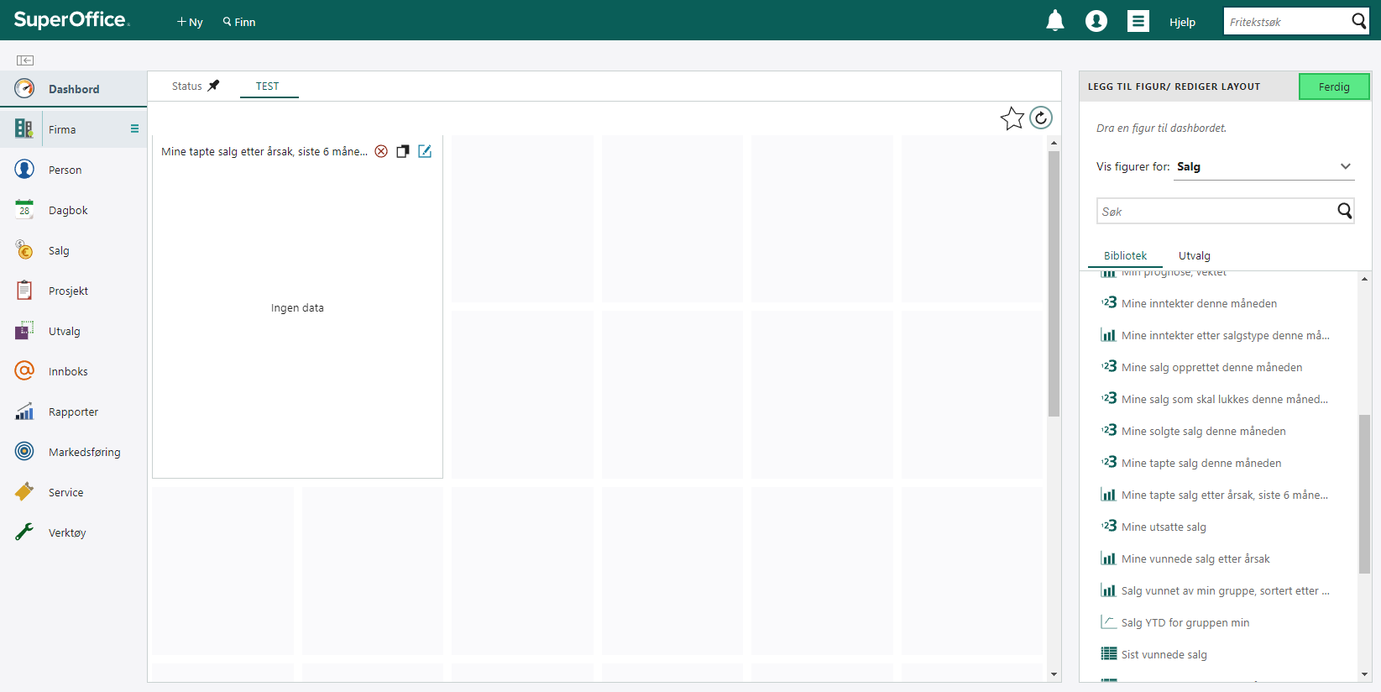
Copy Tile

Slide 6
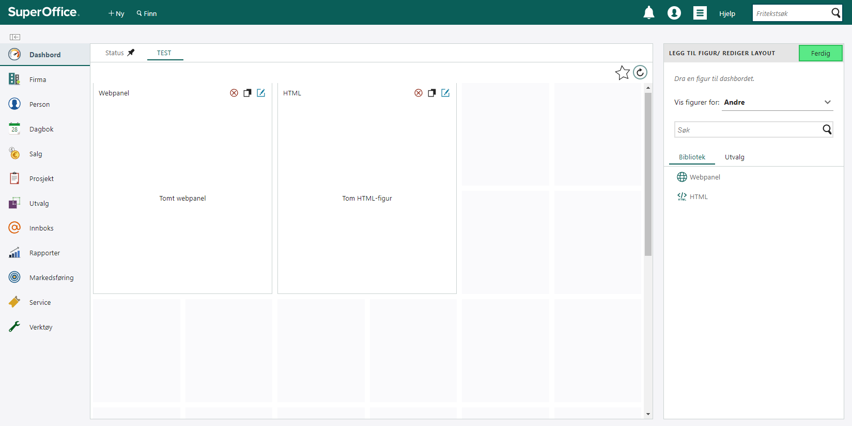
New Dashboard tiles: Webpanel & HTML

Slide 7
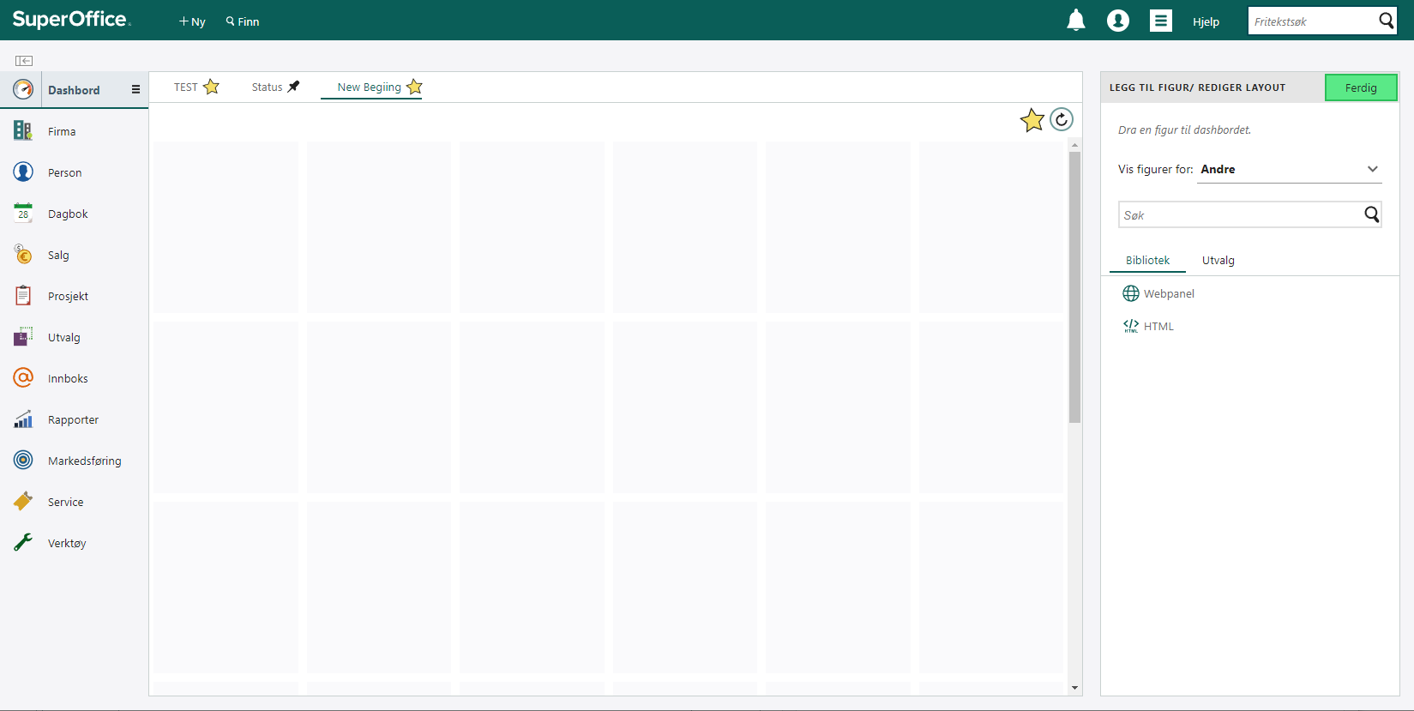
Drag & Drop Dashboard tiles however you would like to view them.

Slide 8
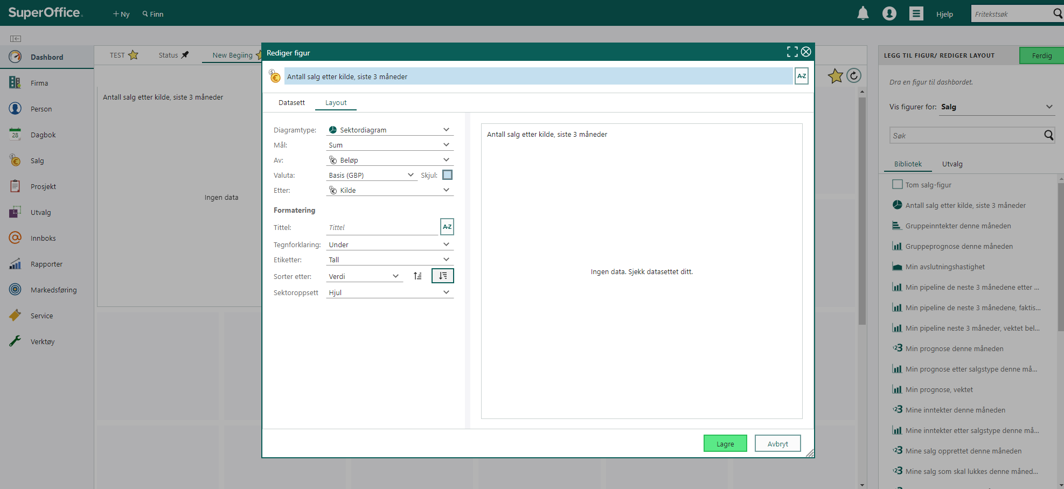
Option to hide currency

Slide 9
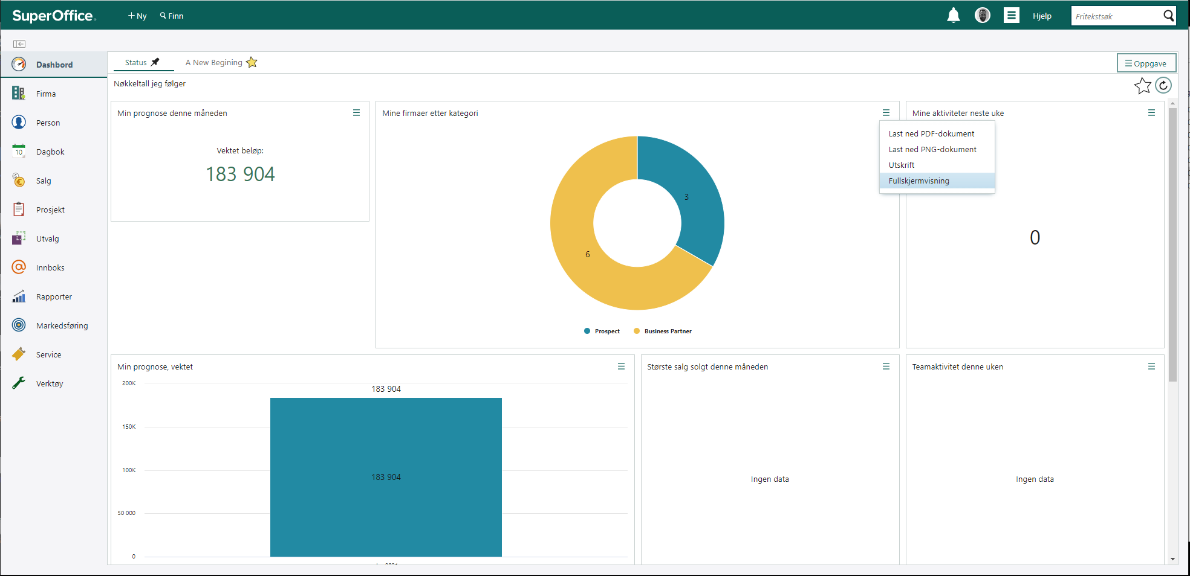
Option to view in full screen mode

Slide 10
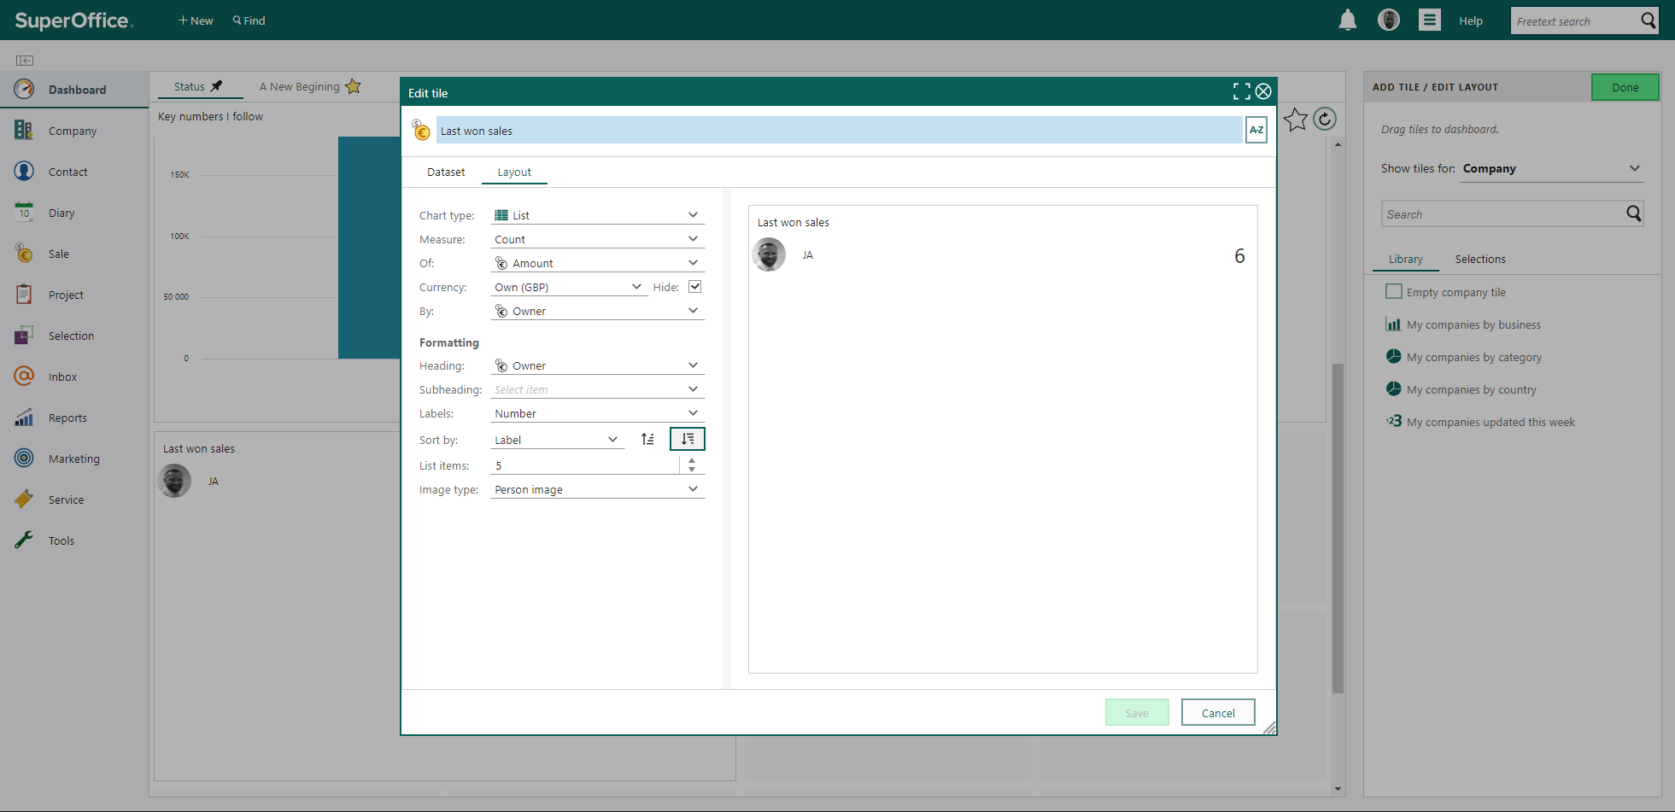
View person image

Slide 11
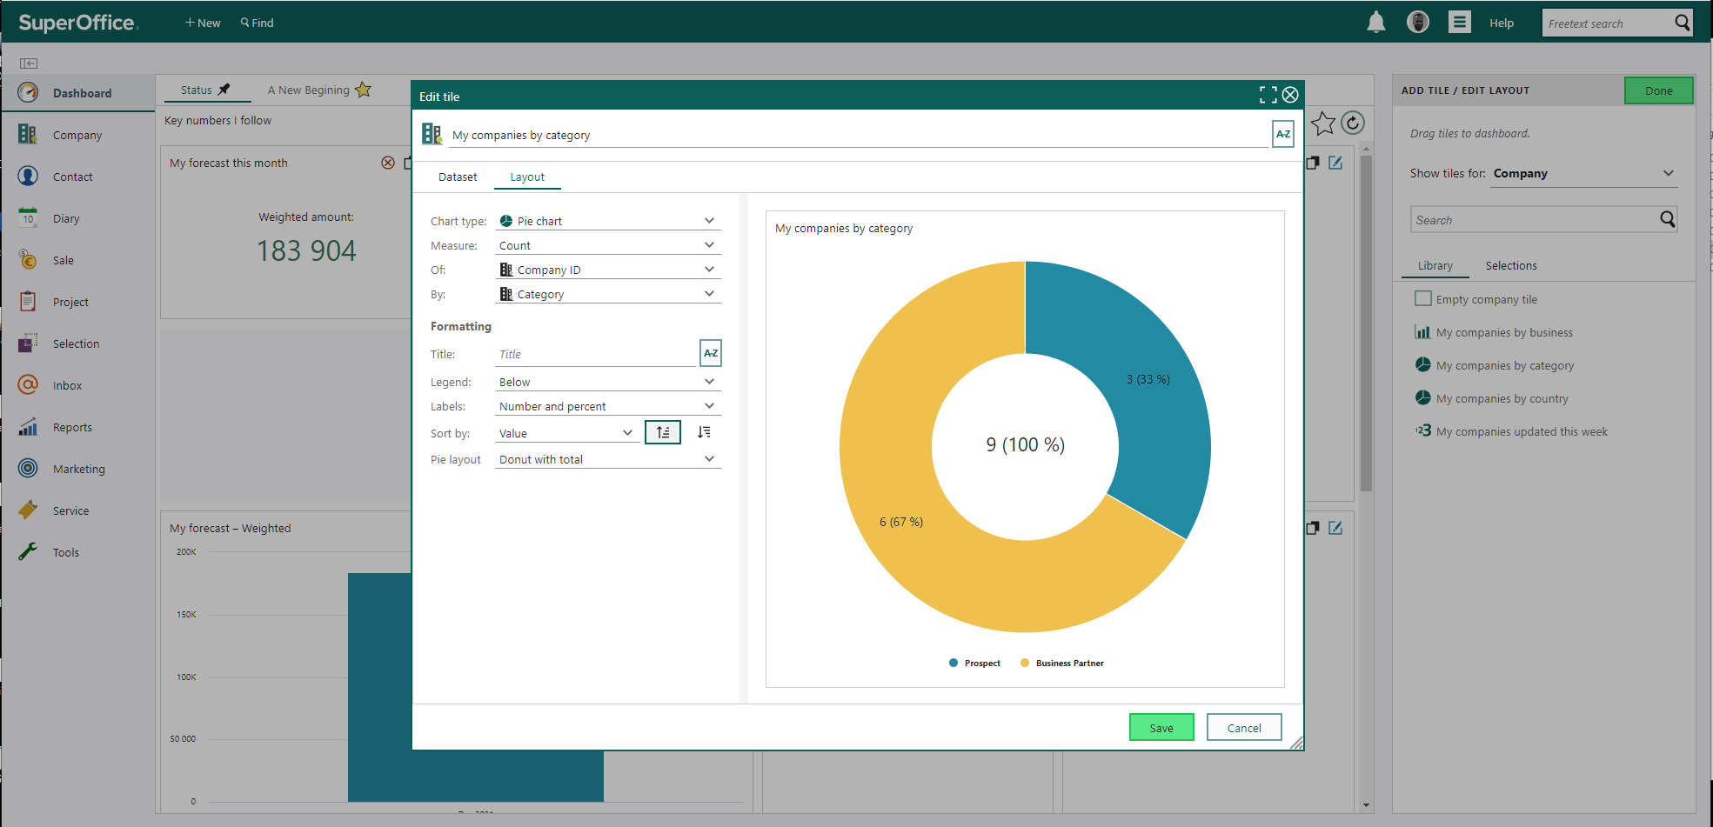
View total in Donut

Slide 12

CONFIGURABLE
SCREENS
Notes:
Another new features is…Configurable screens
Before - the opportunity to define what to see or not to see on main screens have been limited, but with Configurable screens you can configure the layout of your main screens.
…And save time and focus on the information that is important for you.

Slide 13
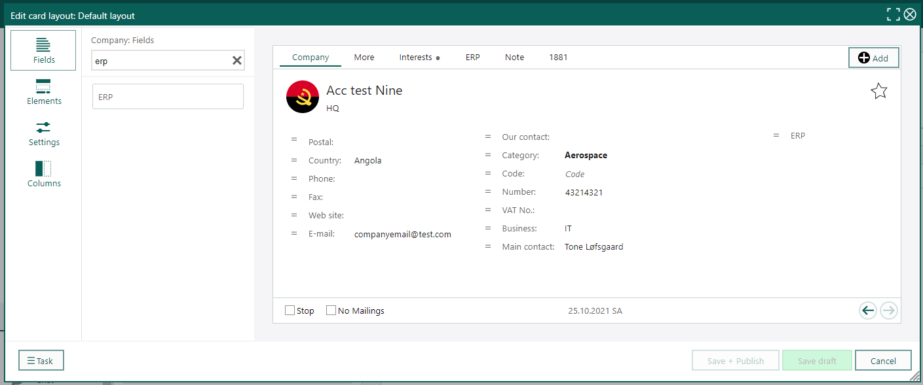
Configurable Screens
ERP component available in Screen Designer

Slide 14
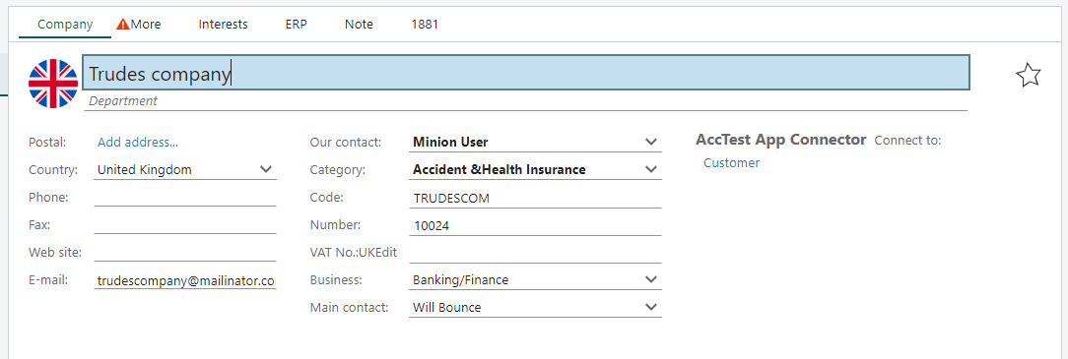
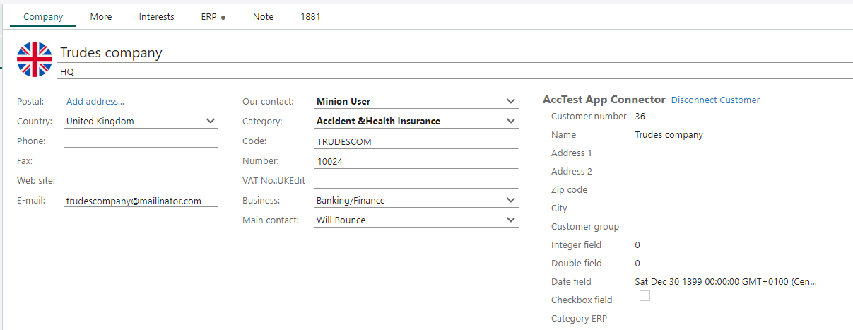
ERP component available in Screen Designer
Notes:
You cannot choose what fields you like to show, you get all the ERP fields as a block or none at all, so make sure you have enough room for them.

Slide 15
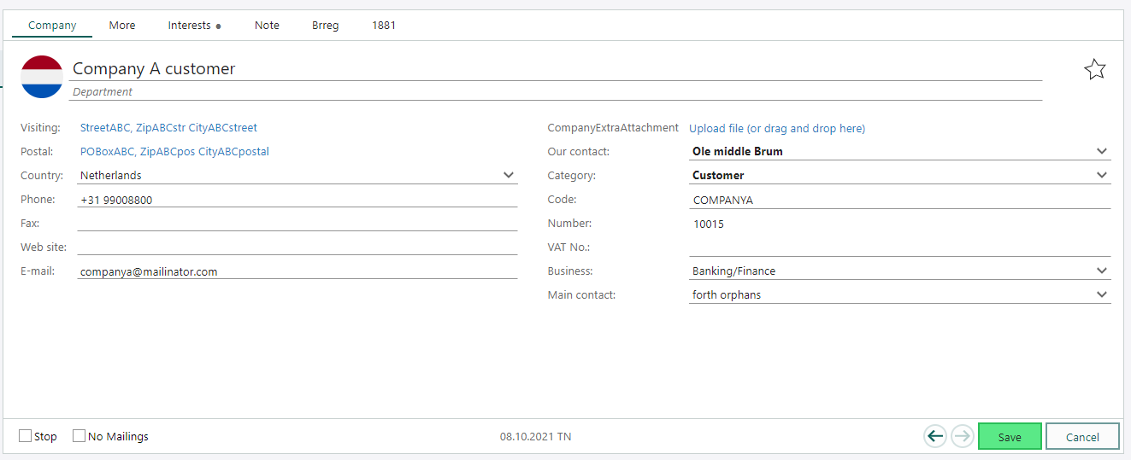
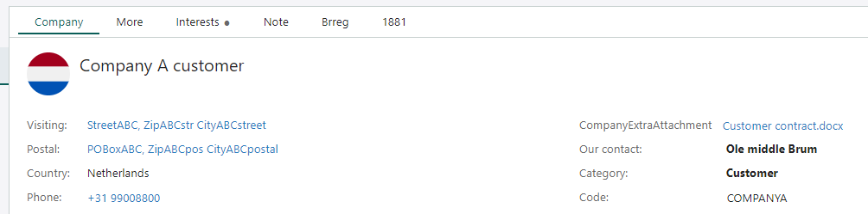
Configurable Screens
Support for Custom (extra) field of type Attachment

Slide 16
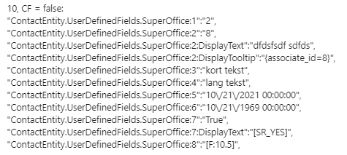
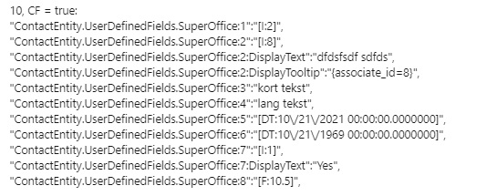
Configurable Screens
Issue with Udef values in Eventdata
We will adjust in version 10.0.2, ensuring same values as before for UserDefinedFields. This will ensure compatibility with already existing scripts.
For the future: ContactEntity.CustomFields, the common name and API for both user defined fields and extra fields. CustomFields will keep standarized culture formatting as it is now.

Slide 17
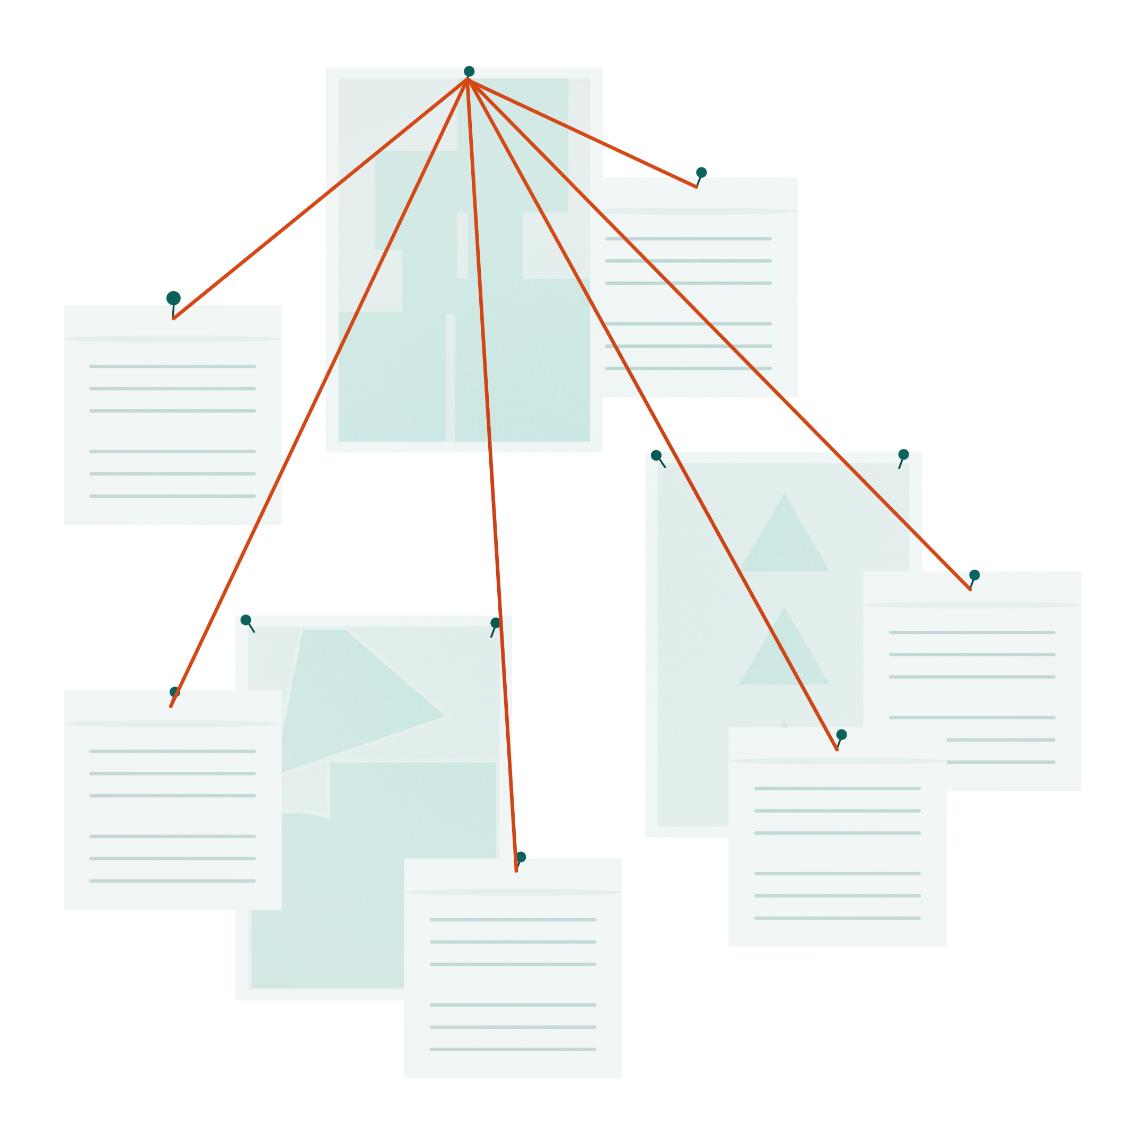
SHAREPOINT

Slide 18
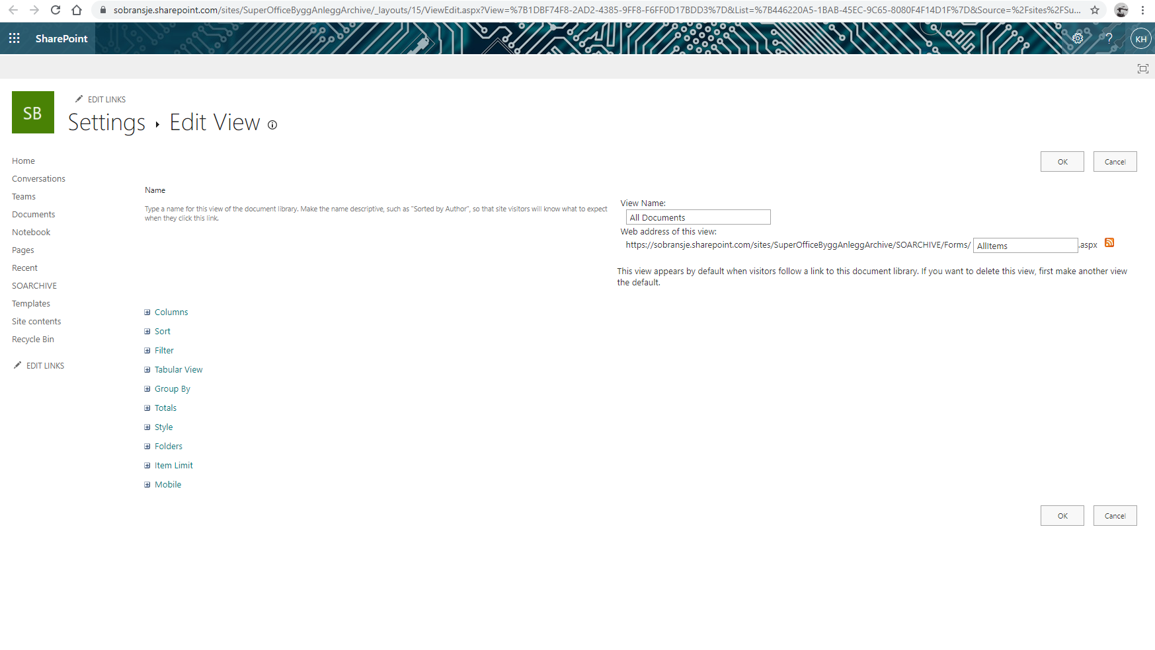
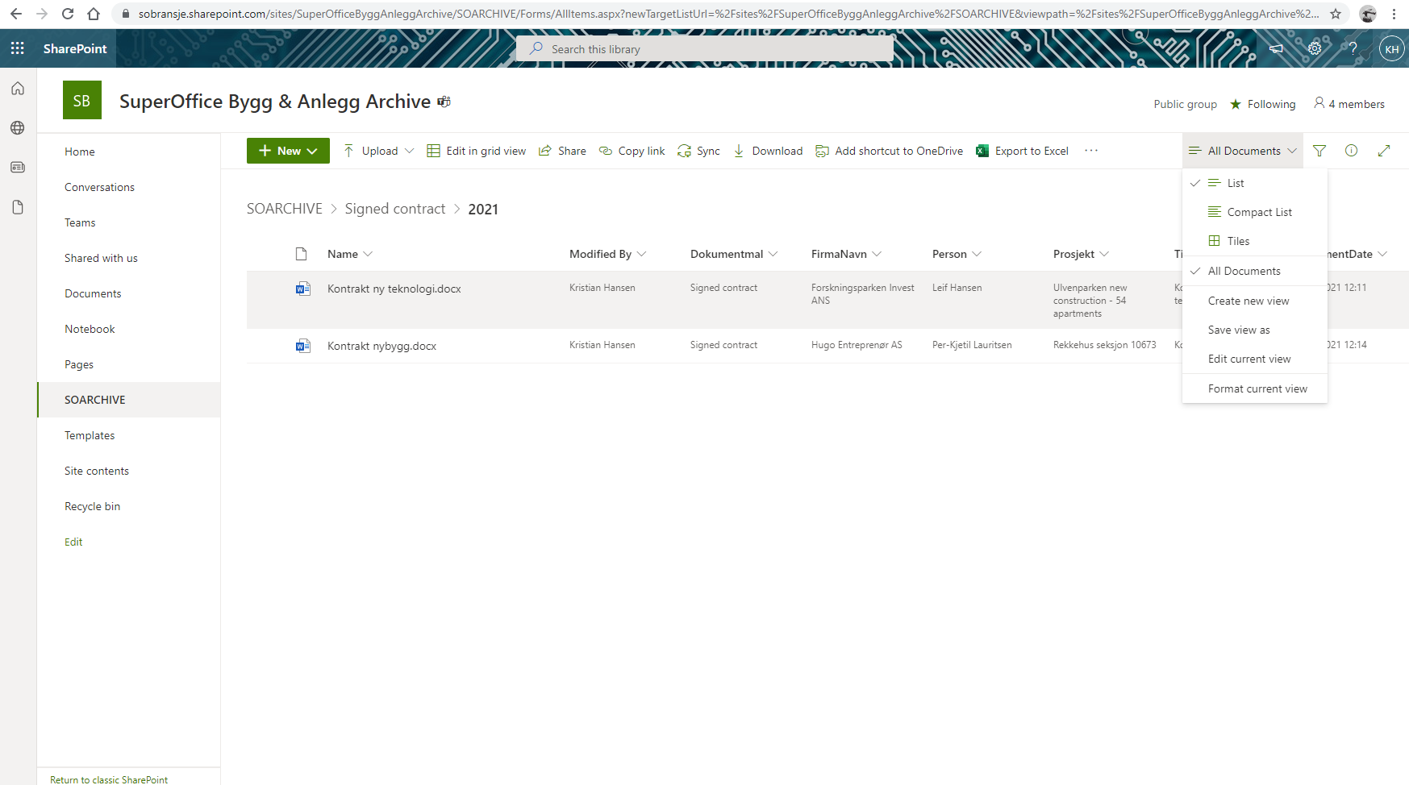
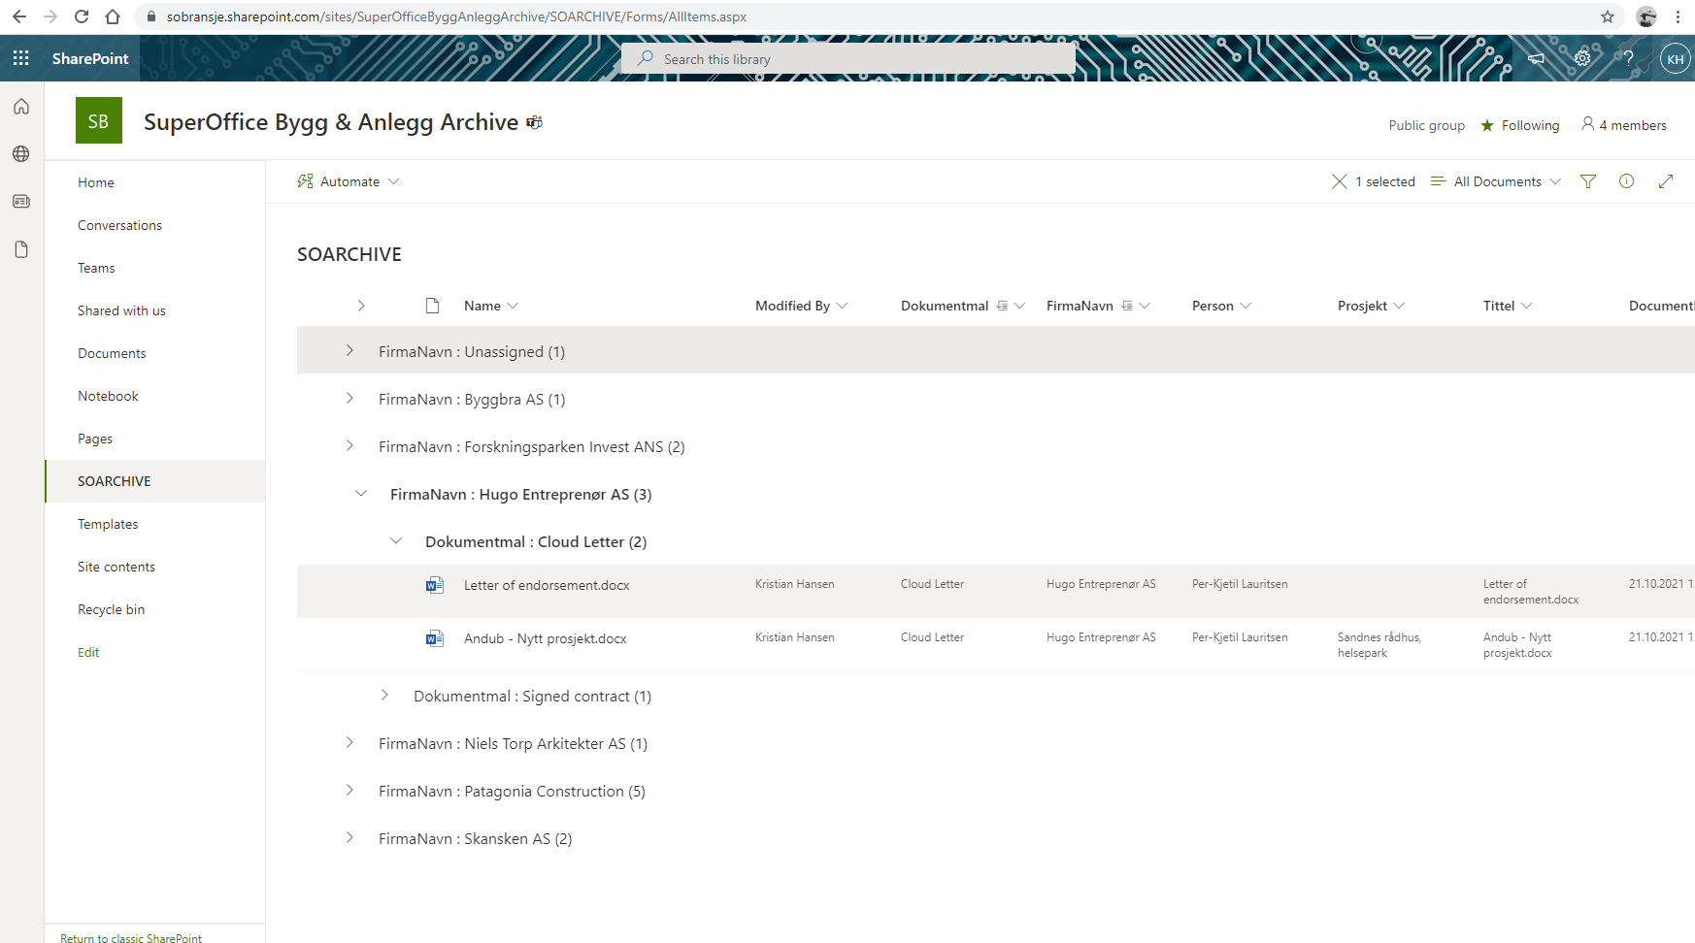
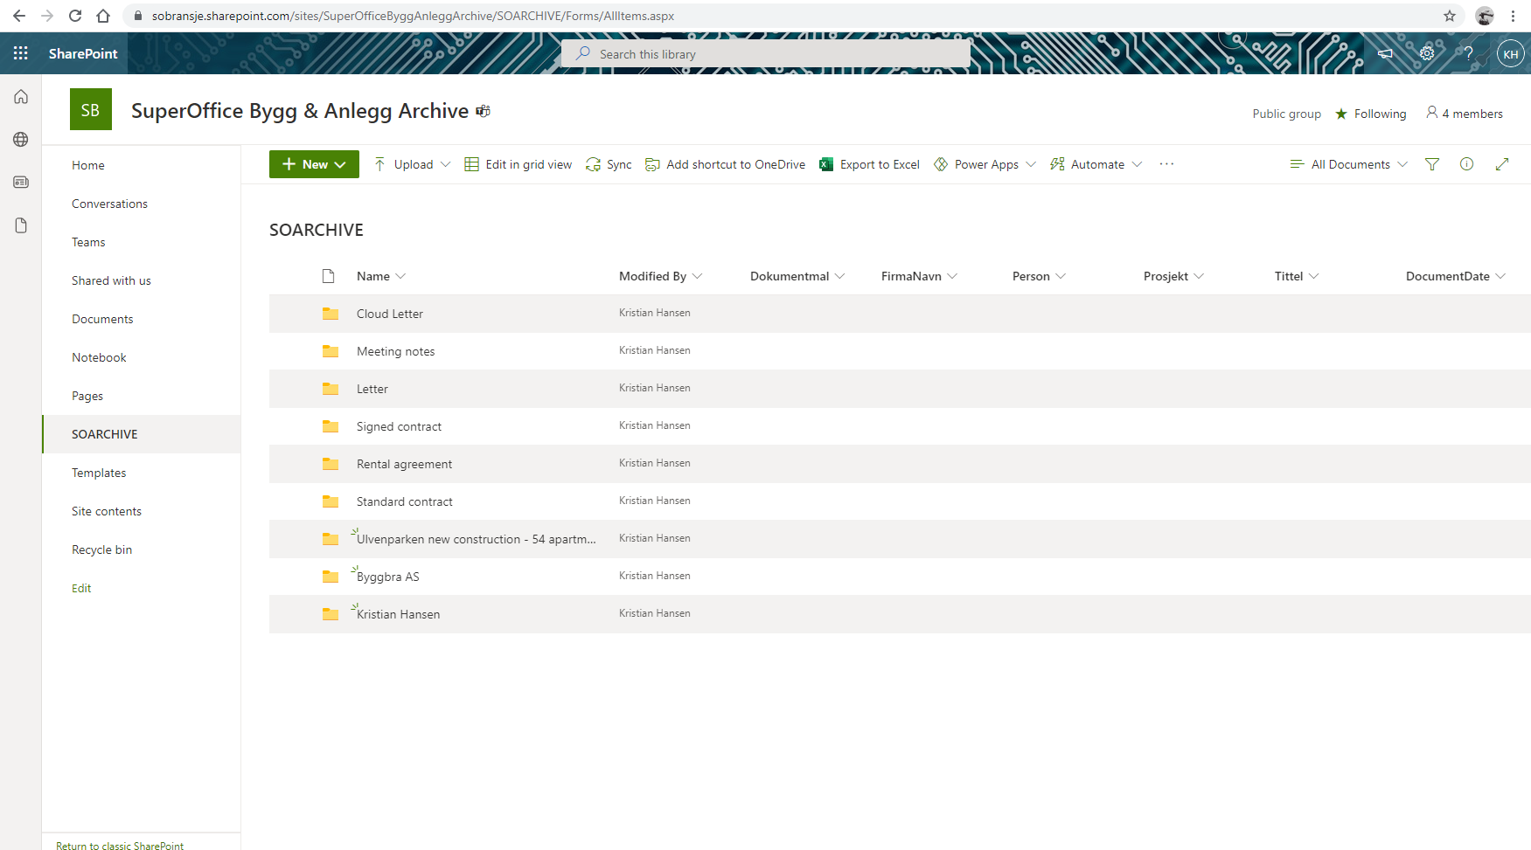
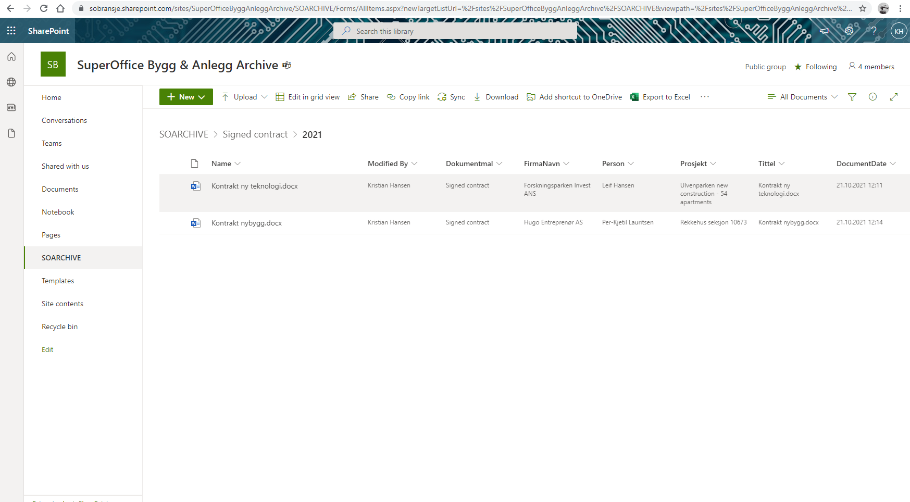

Slide 19

MOBILE CRM

Slide 20
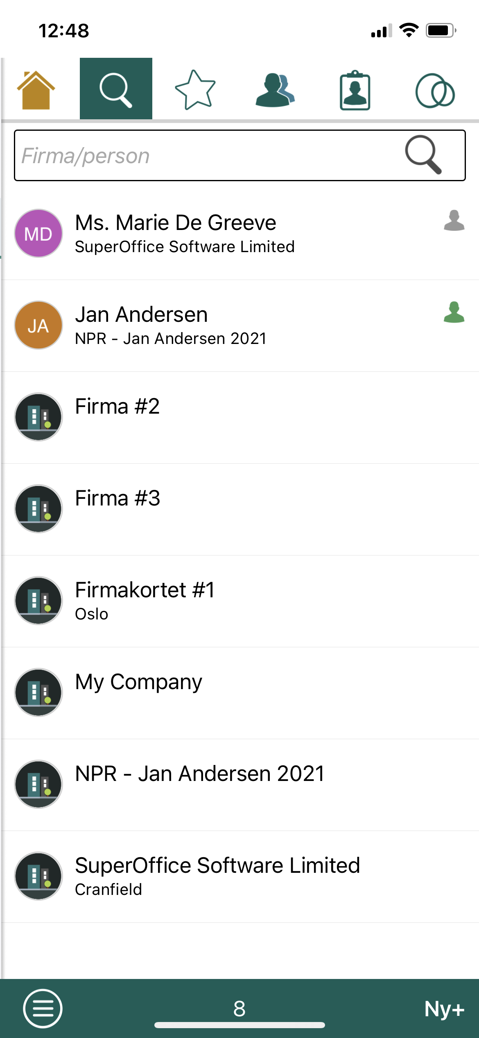
Triggers & Macros
Create a new company in Mobile CRM

Slide 21
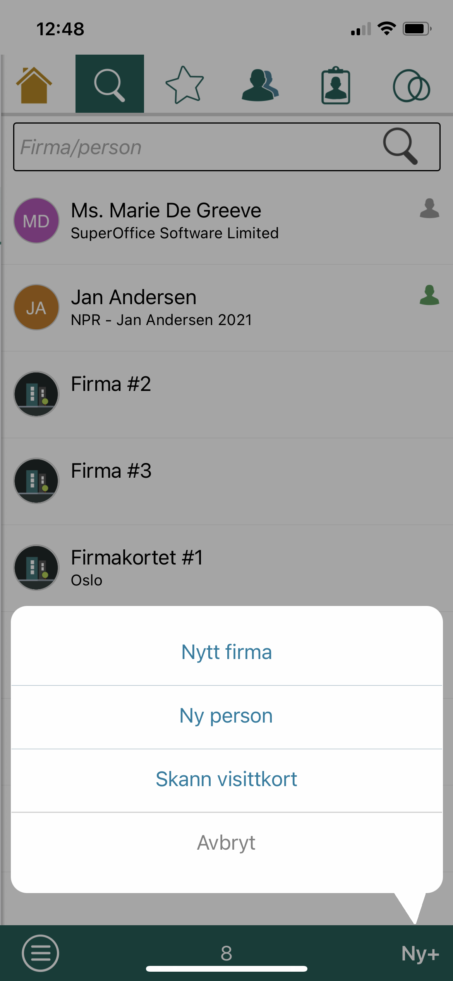
Triggers & Macros
Create a new company in Mobile CRM

Slide 22
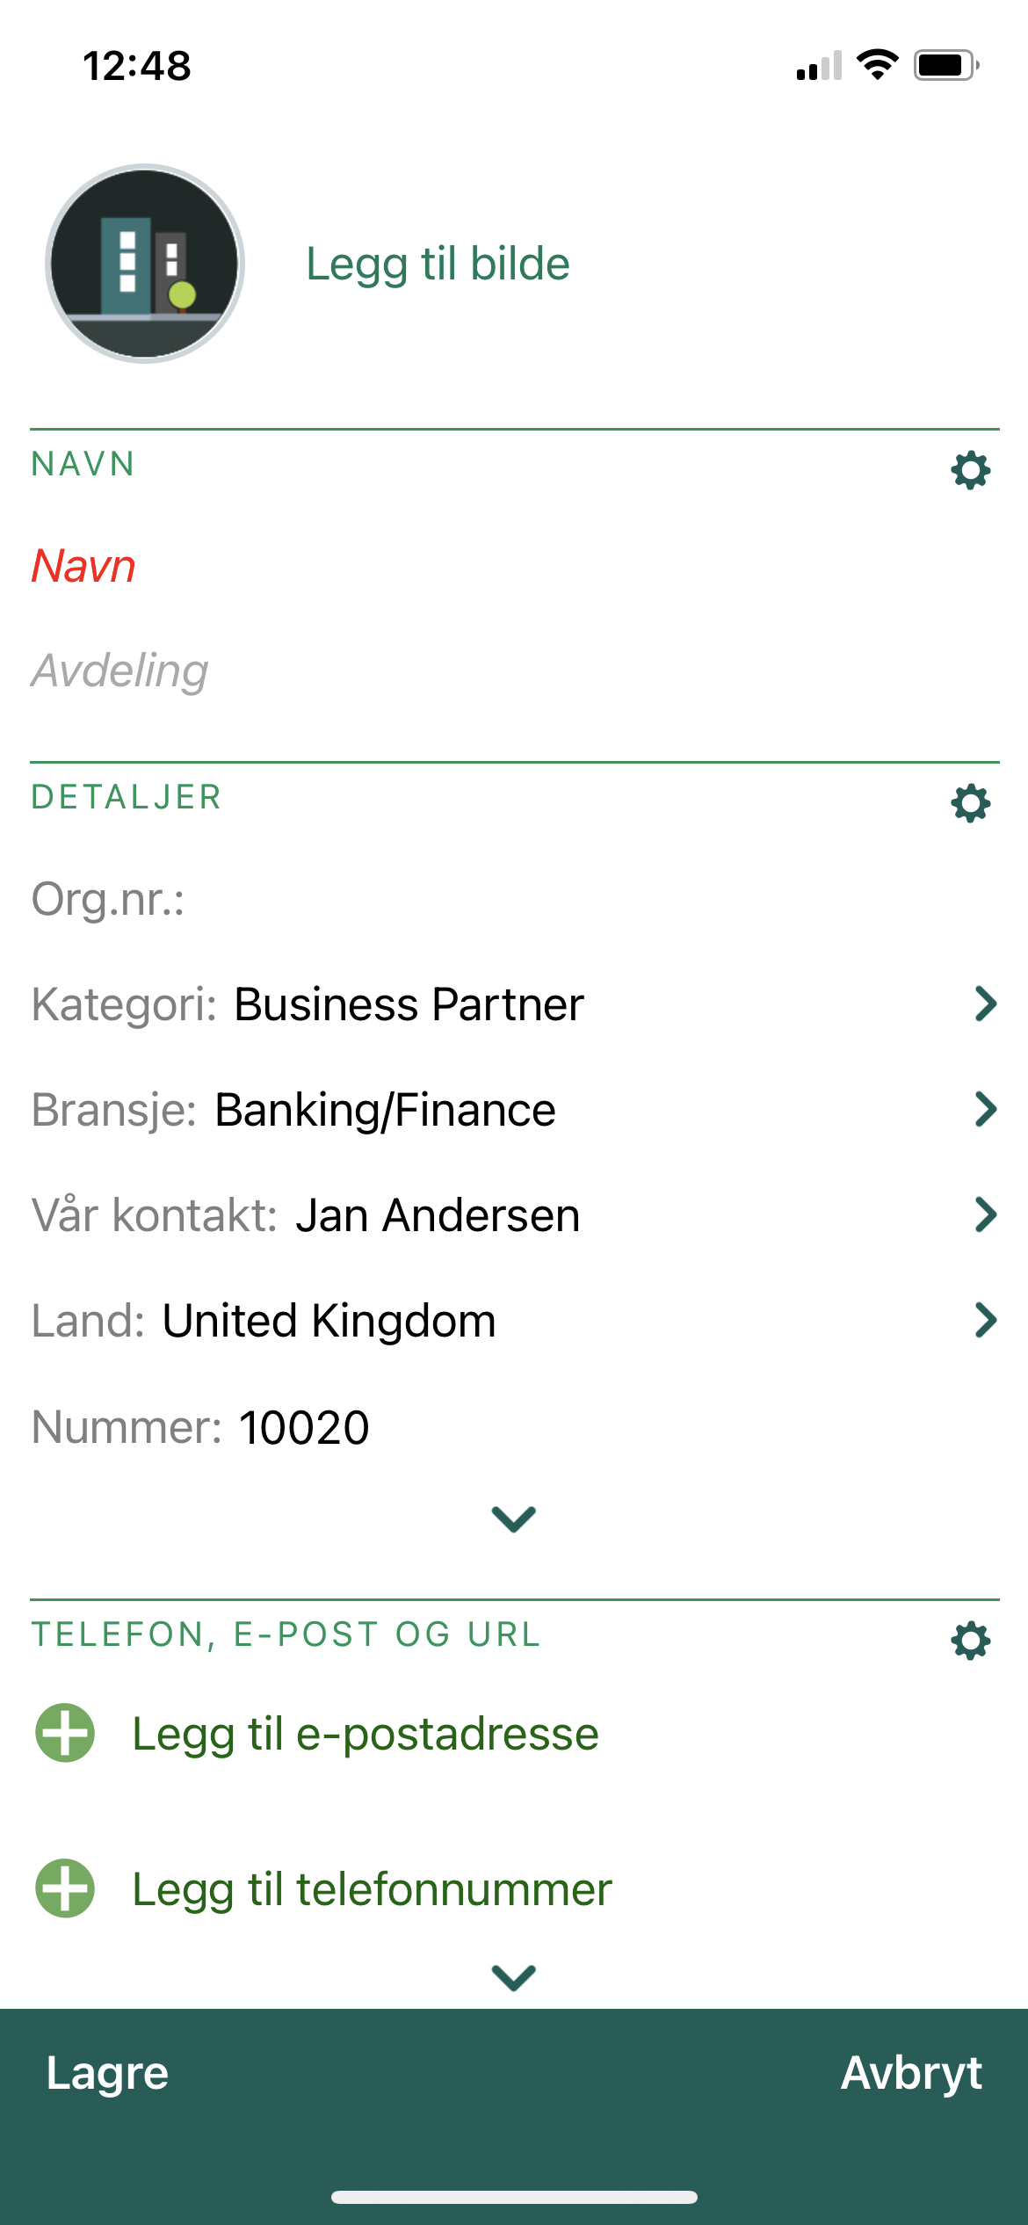
Triggers & Macros
Create a new company in Mobile CRM

Slide 23
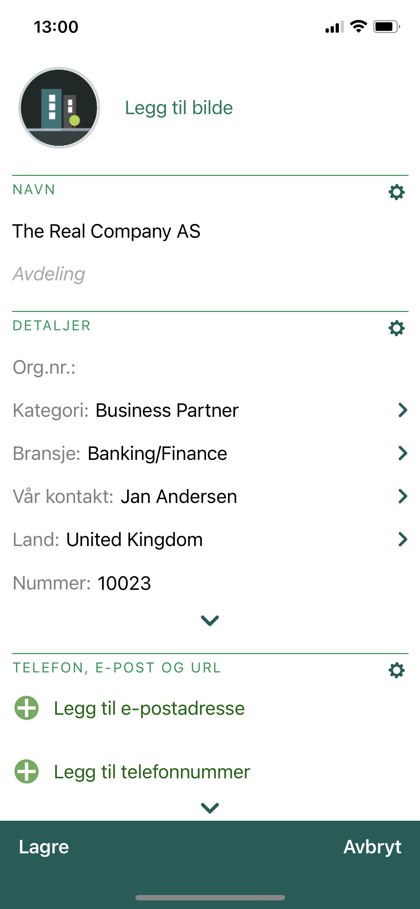
Triggers & Macros
Create a new company in Mobile CRM

Slide 24
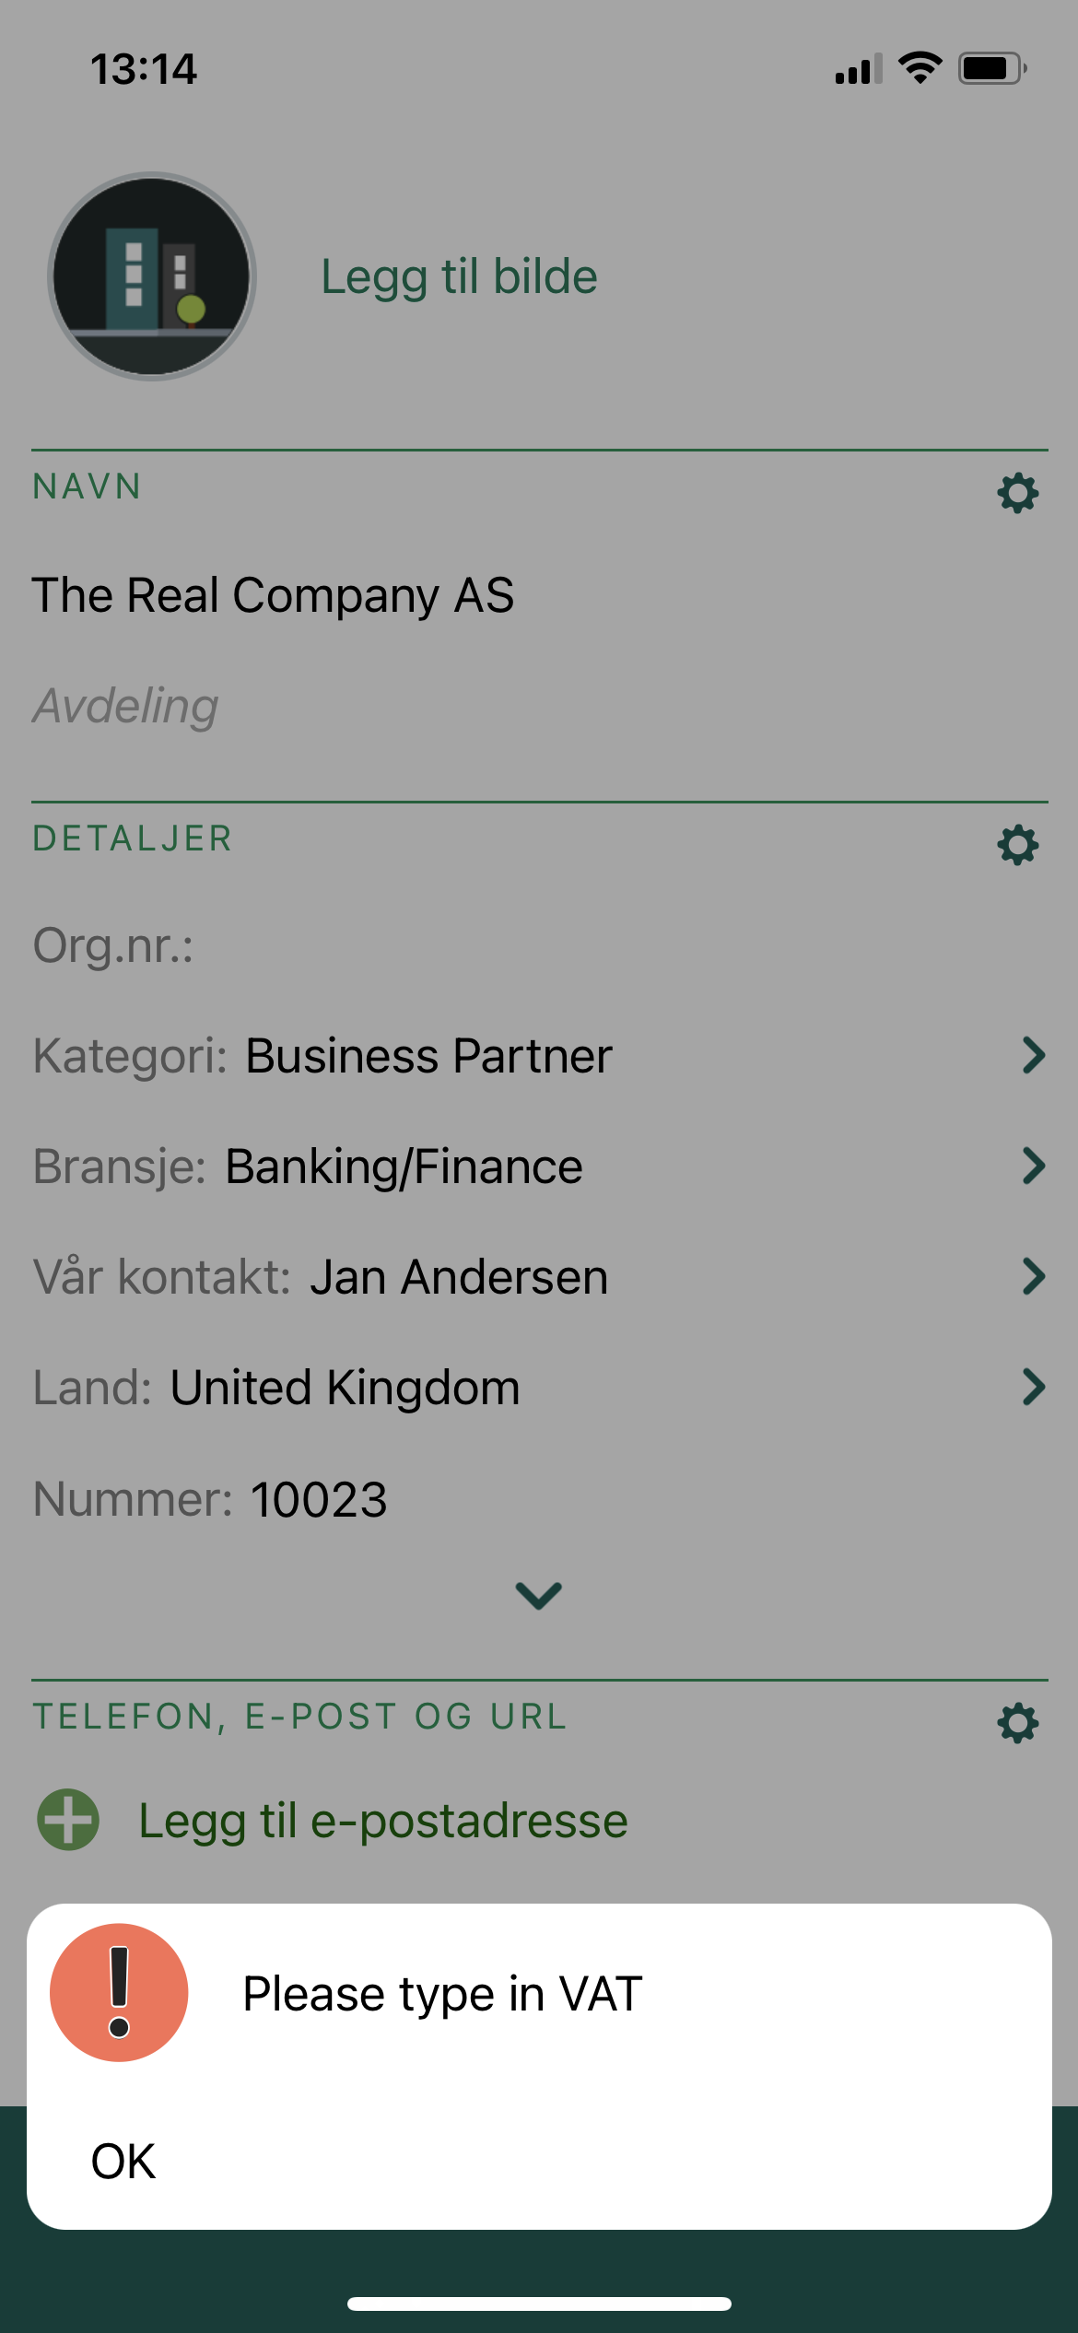
Triggers & Macros
Script prevents user from creating new company without adding VAT.
This secure business logic

Slide 25
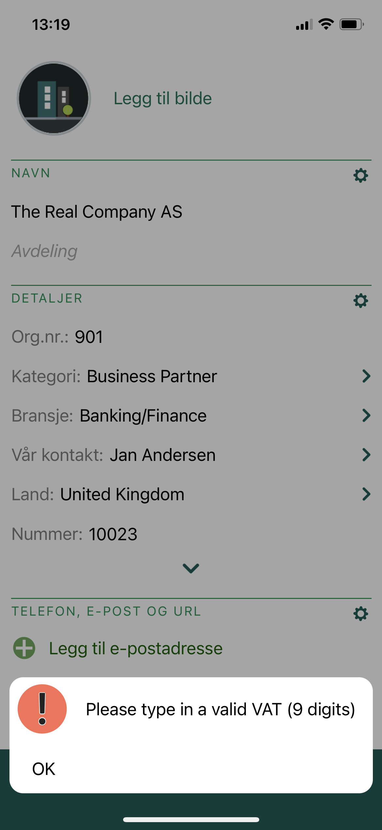
Triggers & Macros
Script prevents user from creating new company without adding VAT and validates the input ( 9 digits)
This secure business logic

Slide 26
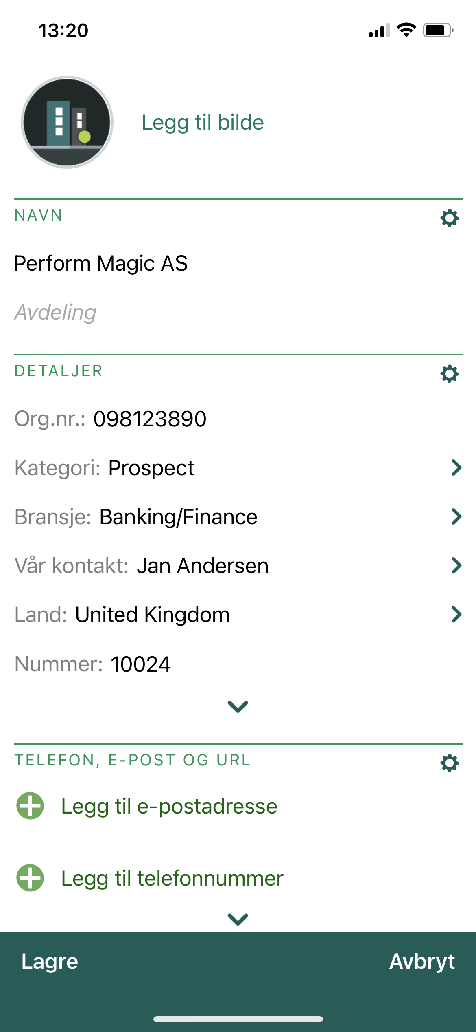
Triggers & Macros
Script will create a new sale when user creates a new potential customer (Category = Prospect)

Slide 27
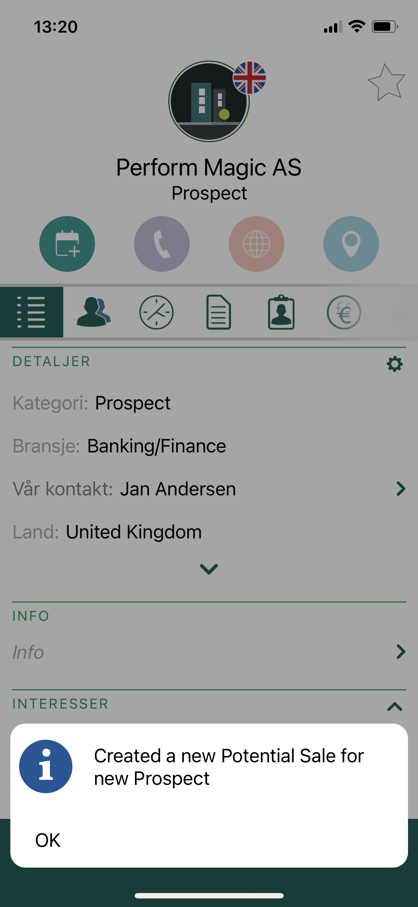
Triggers & Macros
Script will create a new sale when user creates a new potential customer (Category = Prospect)

Slide 28

FORMS
IMPROVED

Slide 29
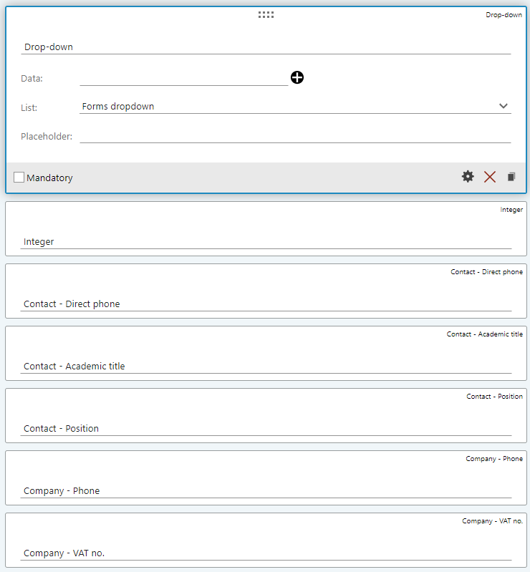
Support for more fields
Added new fields
  Contact – Direct phone
  Contact – Academic title
  Contact – Position
  Company – Phone
  Company – VAT no
  Integer
  Dropdown – with user defined list as source

Slide 30
Data quality – small improvements
Validation of phone numbers
  This makes it easier to get valid data in and less corrupt data both in the form fields and in the creation of new companies and persons in SuperOffice CRM.
Default values for Category and Business
  When creating a new contact and/or company based on the form fields, you can set up the default category and business on the tab for Actions. With this option, you can group the form submissions and new contacts to one specific category and/or business. For example, if you have a form for prospects, you select prospects as your category. You can then easily create selections based on this category and/or business.
Requests created by forms get correct source as Origin
  Easier to create reports to group requests based on source (E-mail vs Forms)

Slide 31
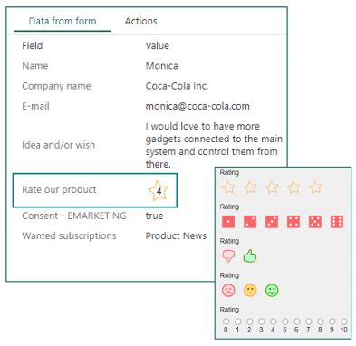
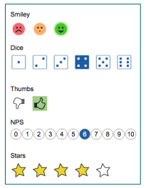
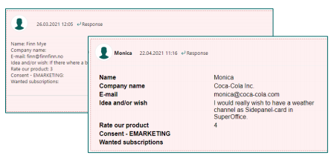
Visual – small improvements
Form submission shows icon instead of number so it’s easier to understand
New rating icons with fresher look
Form response stored in messages with improved formatting

Slide 32
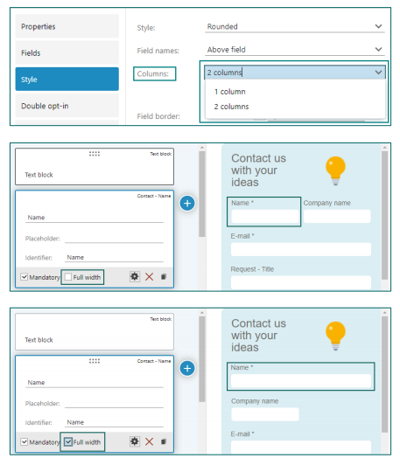
Support for two column forms
Possible to define 1 or 2 columns on forms to allow for more flexibility in designing forms
Possible to display fields with fullwidth

Slide 33
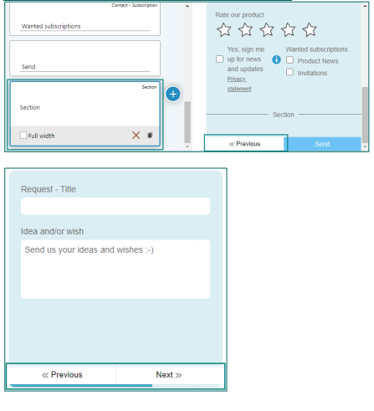
Support for multi-page forms
Possible to design forms with multiple pages by using new element Section as divider
Optional to show progress bar

Slide 34
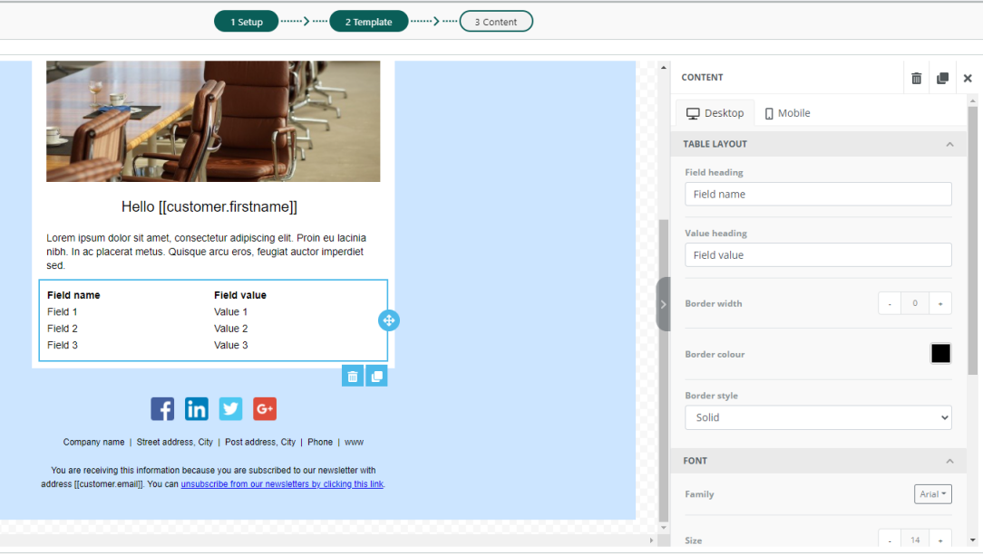
Improved Form response mailings
Support for new tool in Mailing editor to include data from form. Useful for sending customer a receipt about form submission.
Possible to perform some styling on form submission data.

Slide 35
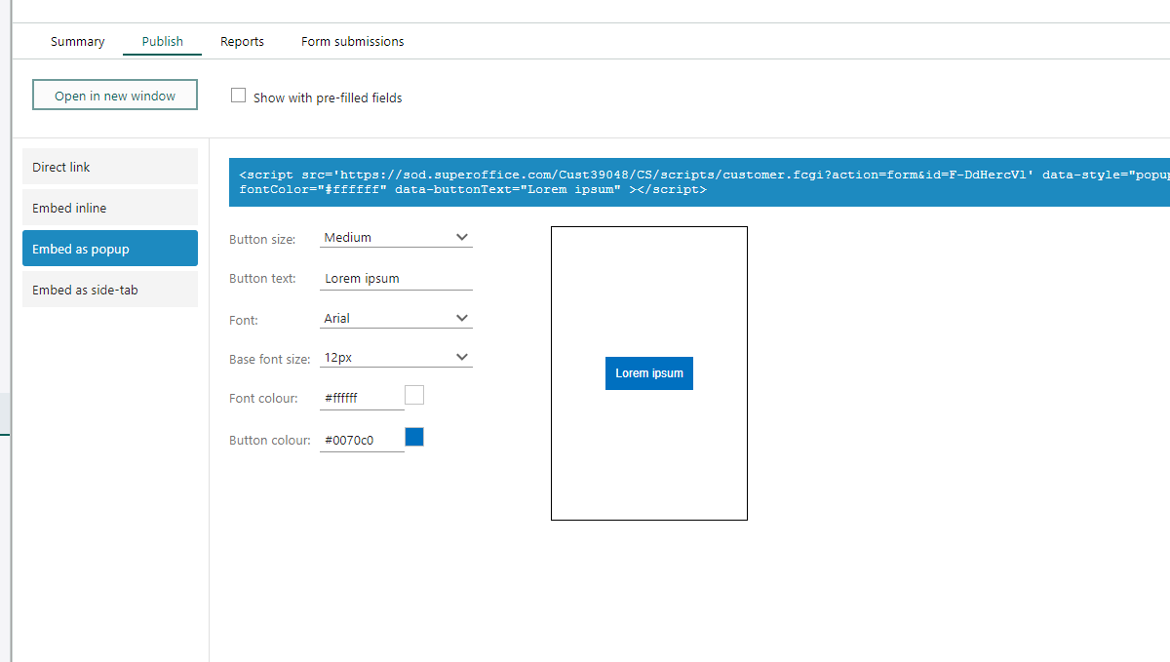
Support for more publishing options
Added option to embed as popup CTA

Slide 36
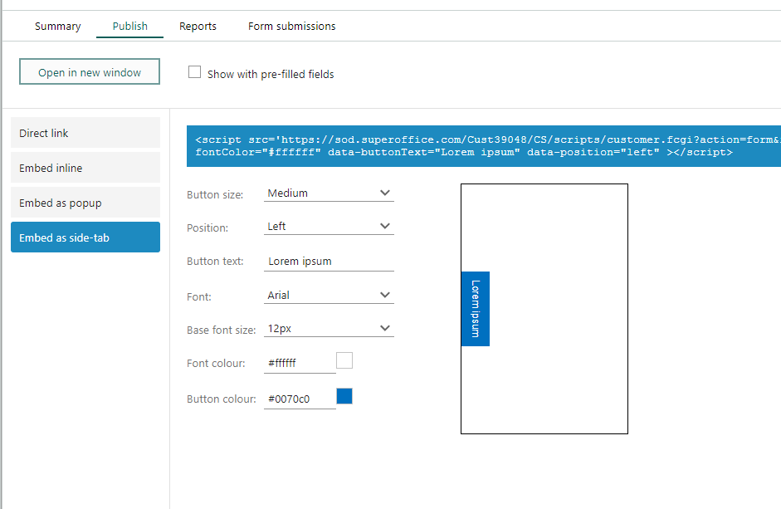
Support for more publishing options
Added option to embed as sidetab

Slide 37

CHAT
IMPROVED

Slide 38
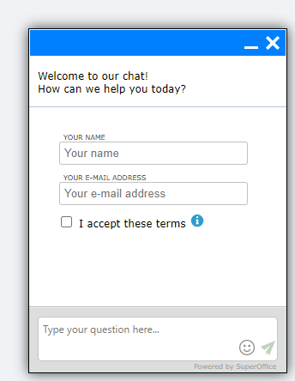
Improved features
Transfer
  Add option for managers to transfer active chats
Lunch hours
  Add option to define lunch hour in addition to opening hours
Agent
  Display which channel chat session originates from
  Add option to only show agent first name in widget
Customer
  Display timestamp on messages in widget in timezone from browser

Slide 39
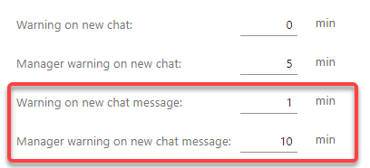
Notifications
Our widget relies on browser notifications like many of our competitors.
We have added some more options to allow for configuration of notifications for ongoing chat sessions as well as new.

Slide 40
The End
Thank you!

