Slide 1


WHAT’S NEW
IN SUPEROFFICE 10
Notes:
SuperOffice 10 is packed with new and exciting features that are designed for tomorrow’s CRM needs and will help you turn your relationships into revenue.
In this webinar we will show you what’s new with an introduction to SuperOffice 10 – the new features, improvements and what’s to come.

Slide 2
Agenda
Introduction
Focus areas
The road ahead
SuperOffice 9 – a recap
Introduction to SuperOffice 10
New features
Improvements to existing features and resources
What’s to come
Pilot program
Get started with the new features

Slide 3
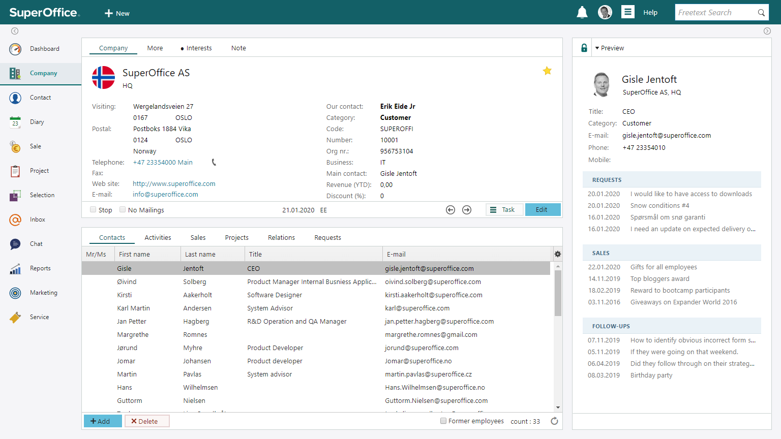
SuperOffice 9 - recap
A solution architecture and a
CRM platform built for the future​
Taking advantage of brand-new technological innovations
Enhanced with new features,
improvements and more services
to help you connect data, people and processes in a way that enables you to create sustainable, long-term relationships with your customers, prospects and suppliers ​
Notes:
In June 2020, we released a new generation that came with bigger changes to the entire SuperOffice CRM platform, employing new technologies, introducing changes to the UI and UX design and new features – all to improve the overall user experience and meet the changing business needs of our customers.
We called it Generation 9.
Before we introduce what’s new in SuperOffice 10, let’s take a quick recap of the biggest changes in 2020, up until now.

Slide 4

G9 features
Modernized user interface
New flexible side panel
Group and filter in a new way
New Find and Selection
SuperOffice for Outlook
Mobile CRM
E-mail editor and designer
Video meeting integration
Notes:
Modernized user interface :The SuperOffice CRM interface was refreshed to give you a whole new user experience. A brand-new color palette, clearer navigation, and flexible screen spacing to help you manage and navigate your screen easier.
New flexible side panel: You got even more information in a single screen with the new side panel that replaced the mini card
For example, the Contact option now gives you a lot more information. Besides the person’s contact details, you can also see the most recent activities connected to them, such as service requests, sales, follow-ups and projects – giving you an instant overview in one place without having to navigate between different screens.
This new feature helps you manage the information you have in front of you faster and better to help you handle the customer relationship you are dealing with at any time.
Group and filter in a new way: We added new options to filter, sort and organize data inside archives, so you can group and pull the information you need and act on it.
This allows you to choose how you want the data to be displayed and grouped to help you focus on the task you’re working on.
Find and Selections :We introduced a better search experience. By adding easy-to-use search templates and more intuitive steps, we’ve simplified the way you can search for, display, and organize your CRM data.
This improved feature now can provide real insights as well as assist many different task executions so that you can do more, faster and better than before.
Outlook for SuperOffice: We also introduced the new zero footprint integration between SuperOffice and Outlook to allow you to work effortlessly and efficiently between your Outlook and SuperOffice CRM.
With no installations on your computer, you always access the last version of this elegant and seamless integration between your Office 365 mail and SuperOffice.
A feature that lets you work productively and secure that information is stored in your CRM database as a natural part of your working processes.
For example, when you receive an email, you will instantly see key information, such as the contact’s details and the latest sales and activities linked to them. What you get is an instant overview of all relevant information, allowing you to offer more personalized responses and communication.
Mobile CRM: And pocket CRM lives on, but got a new name and a fresher look - Mobile CRM only supports 9 and has new colors, the ability to edit Office 365 docs and customize what should appear on contact and company card – to adjust it to your needs - on the go
We also introduced the ability to use Mobile CRM app in Black Mode for those who prefer this setting on their phone.
The new SuperOffice CRM mailing editor: Is a more flexible and intuitive editor to help you create beautiful and personalized messages to your target audiences.
From the user-friendly drag and drop interface, content blocks that can easily be reused, millions of royalty free images and many ready new templates to choose from to easy to use social media buttons the new designer will help you create your emails faster and better than before.
In addition, actionable links allow you to create workflow follow ups so that your team can act upon the response you get the way you want to.
Video meetings : Video calls and meetings have become a big part of the new way we work and communicate .. So this function made it much easier to arrange meetings - directly from SuperOffice!
That was just a short summary of key new features and improvements you got in G9….

Slide 5
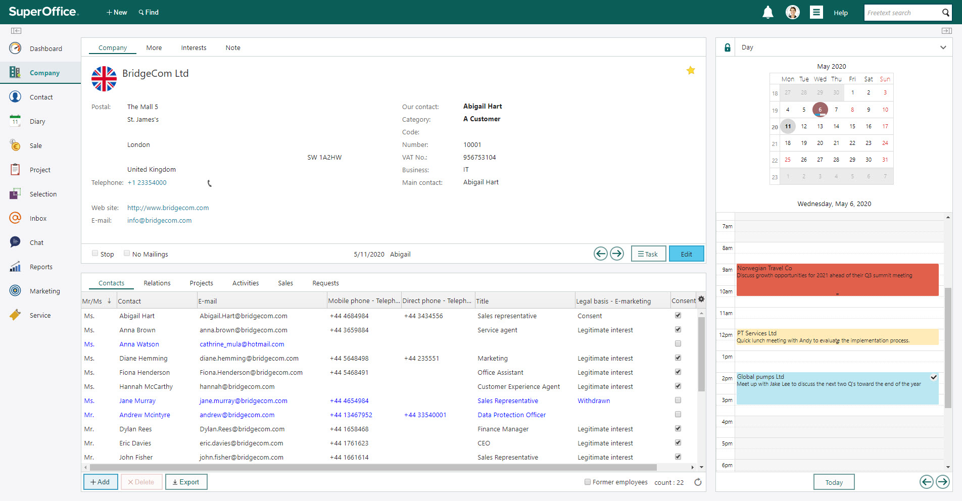
Modernized user interface
Notes:
The SuperOffice CRM interface was refreshed to give you a whole new user experience. A brand-new color palette, clearer navigation, and flexible screen spacing to help you manage and navigate your screen easier.

Slide 6
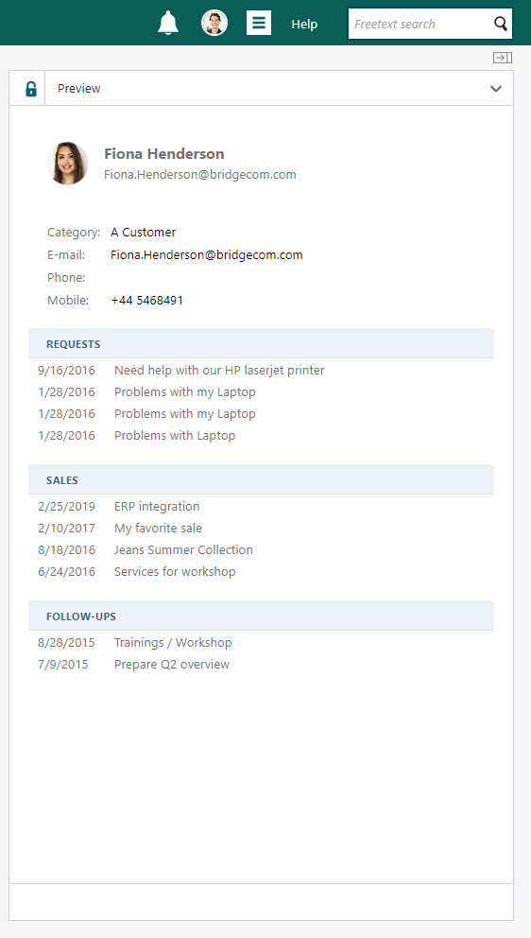
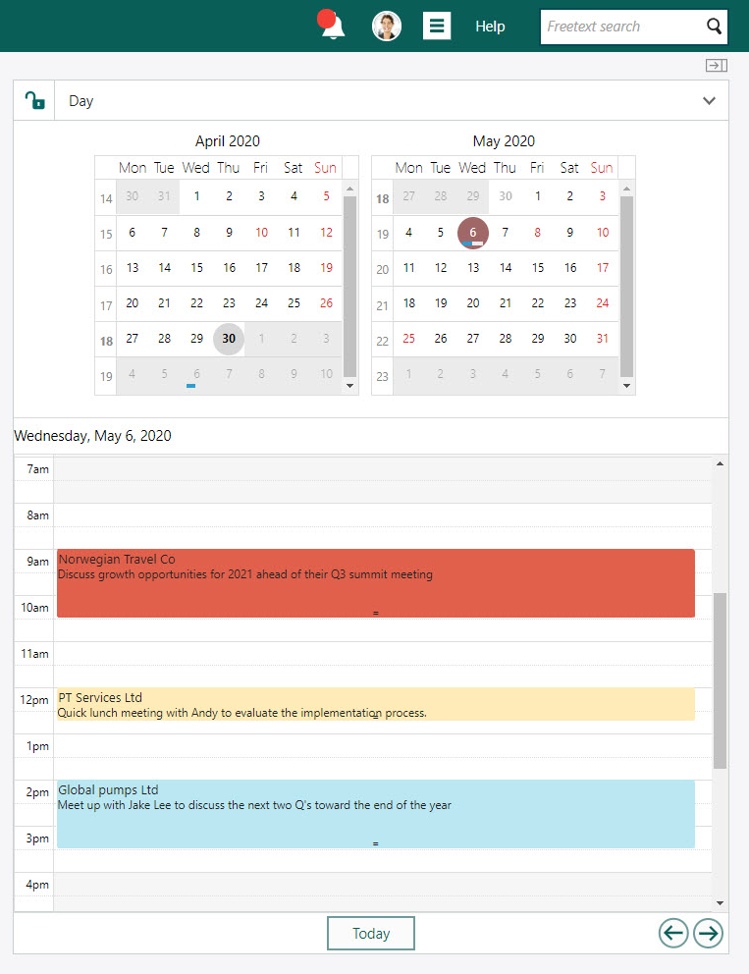
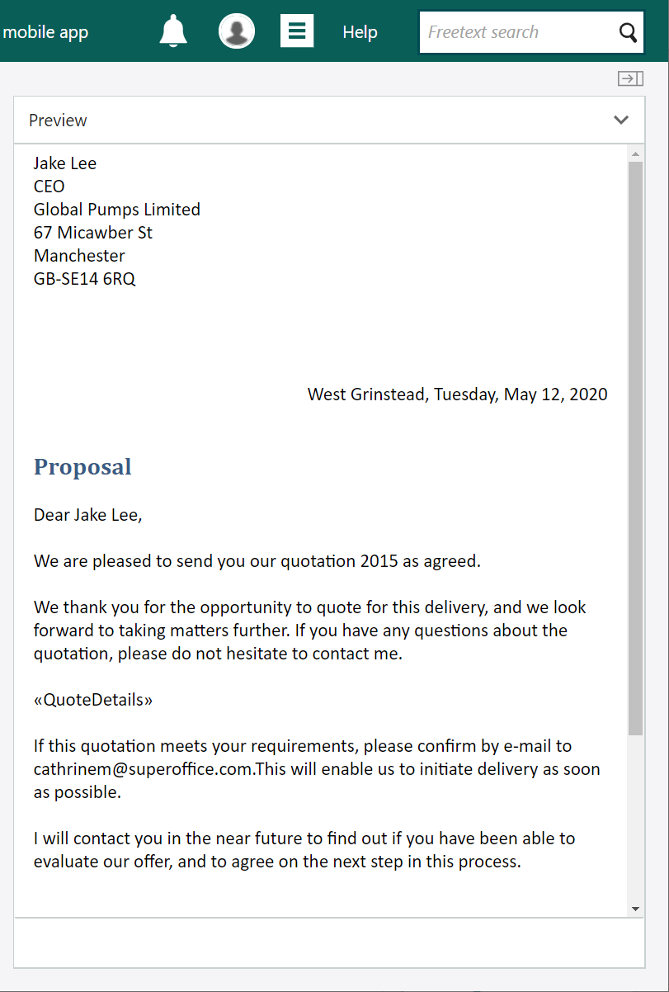
A functional and flexible side panel
Notes:
You got even more information in a single screen with the new side panel that replaced the mini card
For example, the Contact option now gives you a lot more information. Besides the person’s contact details, you can also see the most recent activities connected to them, such as service requests, sales, follow-ups and projects – giving you an instant overview in one place without having to navigate between different screens.

Slide 7
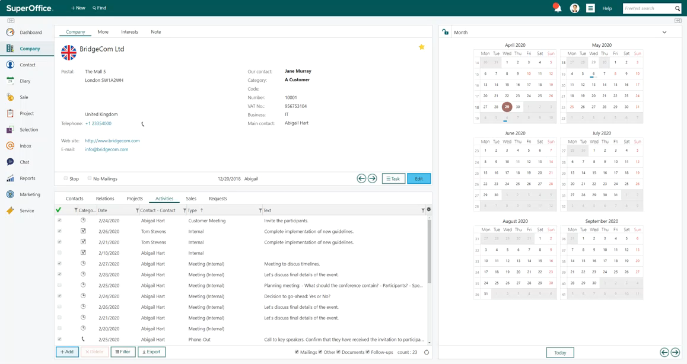
Group information and get better overviews
Notes:
We added new options to filter, sort and organize data inside archives, so you can group and pull the information you need and act on it. Choose how you want the data to be displayed and grouped to help you focus on the task you’re working on.

Slide 8
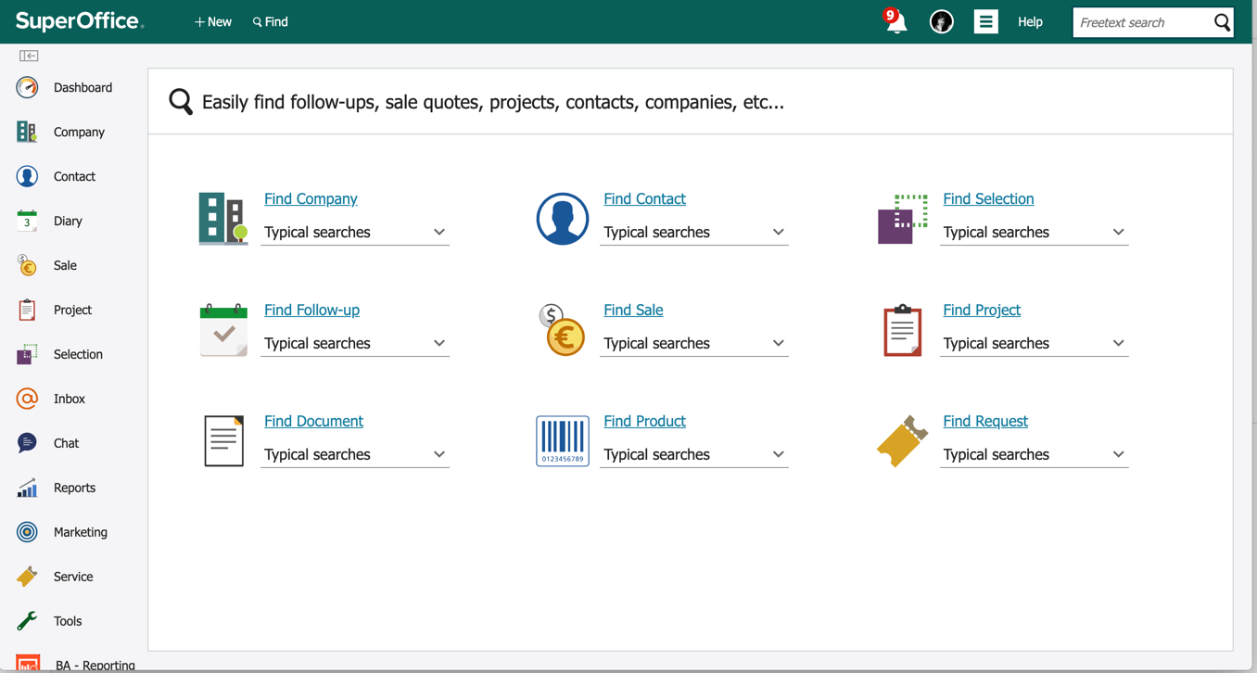
One process for Find and Selection
1. Start a search
2. Verify the result
3. Only save the searches that matter
Notes:
Find and Selections
A better search experience
By adding easy-to-use search templates and more intuitive steps, we’ve simplified the way you can search for, display, and organize your CRM data.

Slide 9
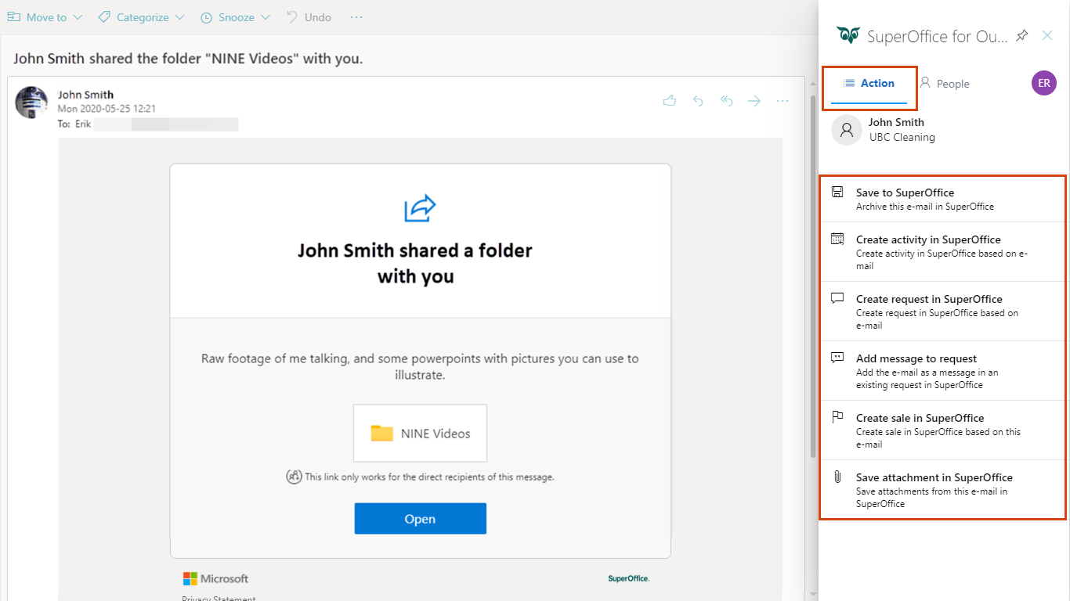
SuperOffice for Outlook
Save new contacts, e-mails, sales, activities or requests – directly from Outlook
Notes:
Outlook for SuperOffice
With the new add-in, you can work effortlessly and efficiently between your Outlook and SuperOffice CRM.
This new “zero footprint” Outlook add-in for Office 365 users, offers a fully integrated solution that requires no installation on your computer ( no more maillink).
For example, when you receive an email, you will instantly see key information, such as the contact’s details and the latest sales and activities linked to them. What you get is an instant overview of all relevant information, allowing you to offer more personalized responses and communication.

Slide 10
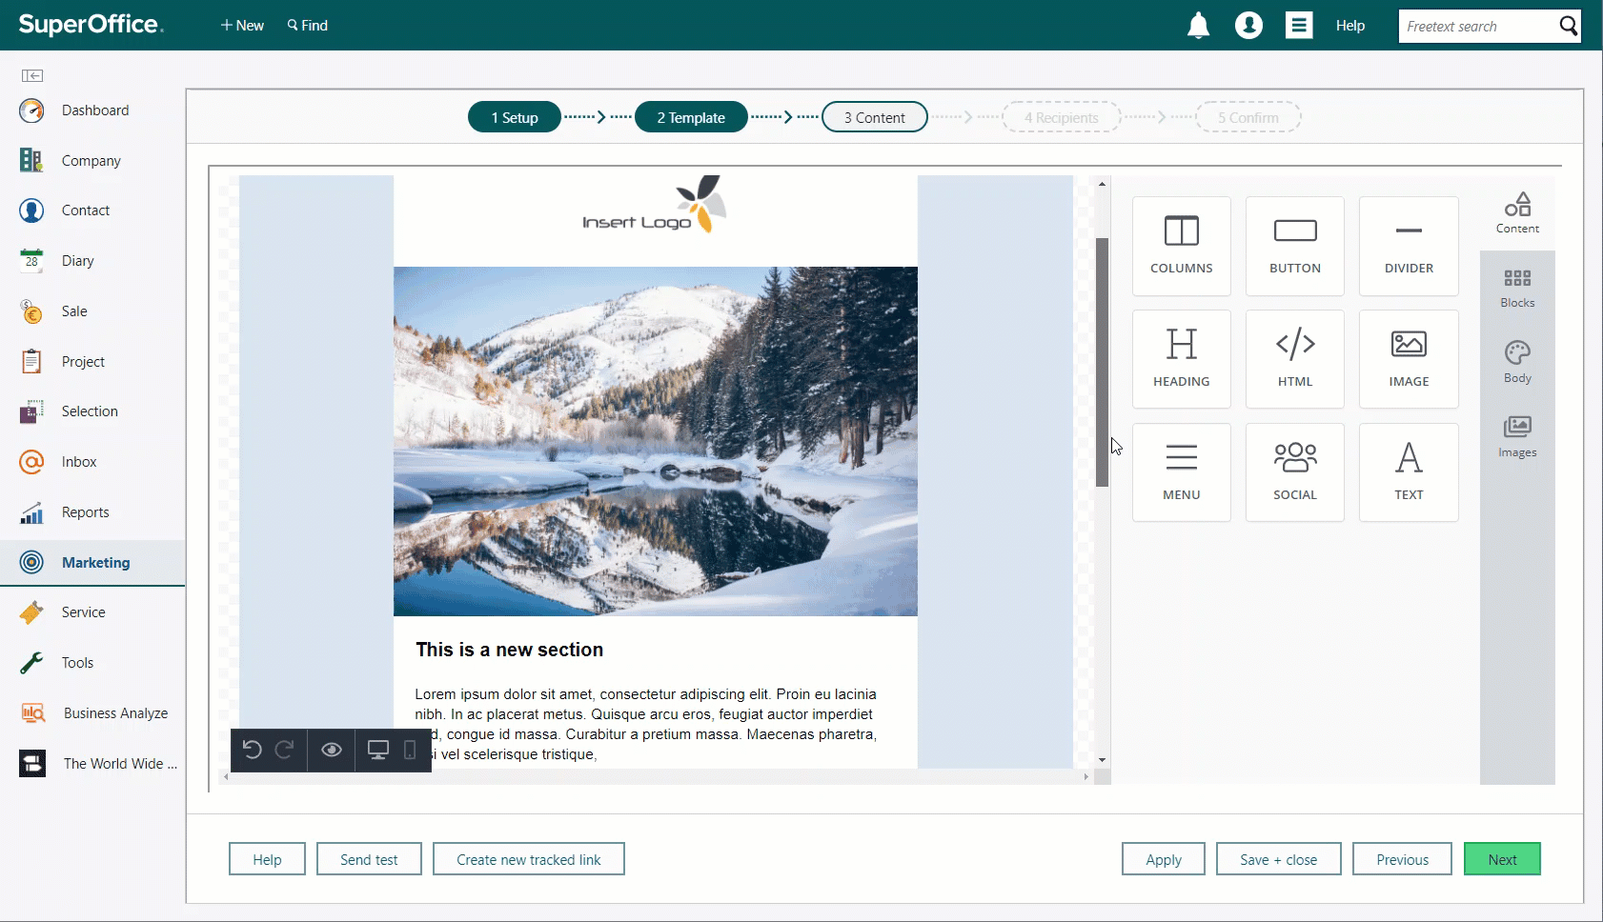
Better campaigns start with a better editor
Notes:
The new SuperOffice CRM mailing editor:
More flexible and intuitive
More drag and drop
Content blocks that let you build to suite your brand style
Easier implementation of buttons and tracked links
A huge library of royalty-free images
Easy editing for colors, text and stickers
Resize and crop directly in the editor

Slide 11
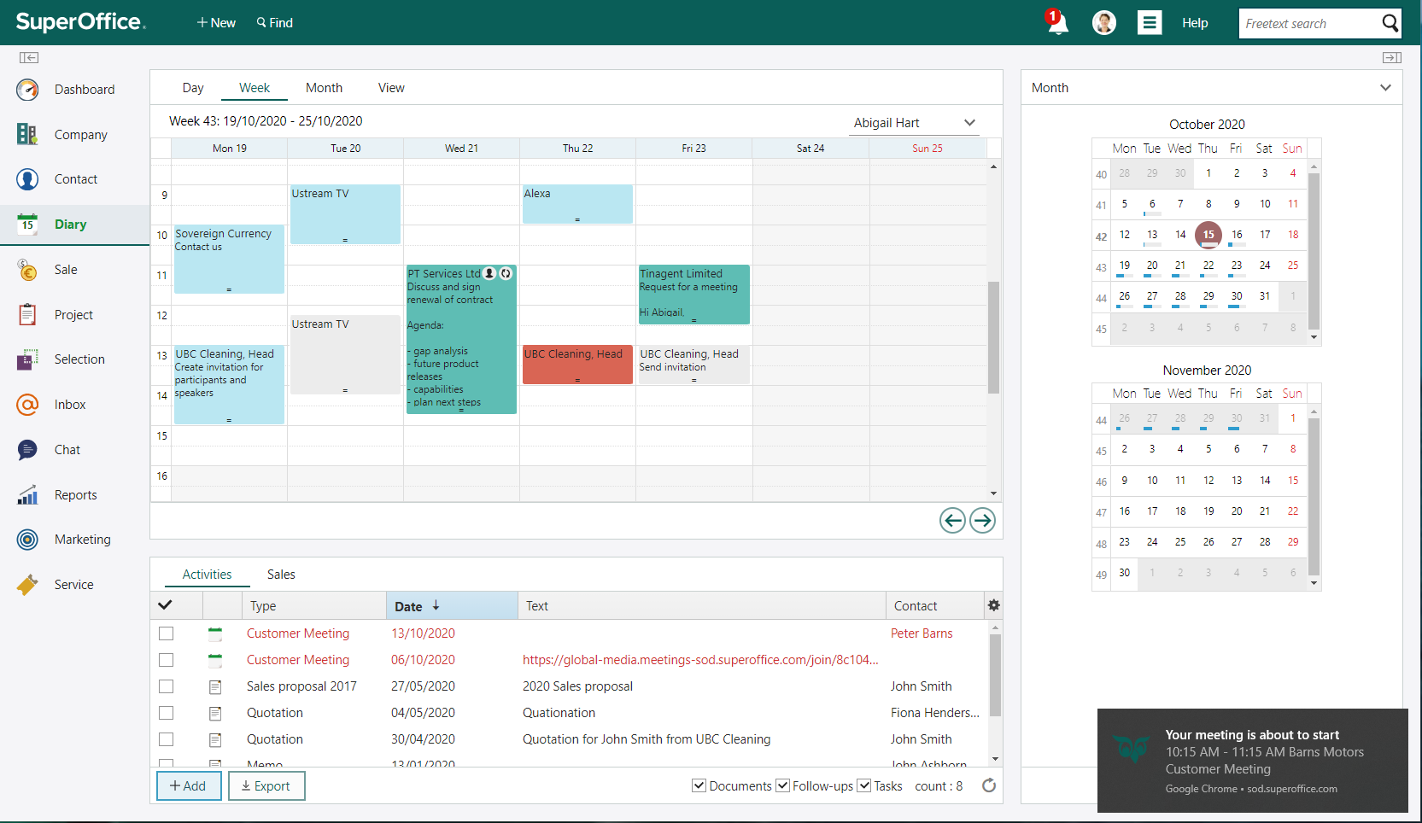
Notes:
Video meetings
Video calls and meetings have become a big part of the new way we work and communicate .. So this function made it much easier to arrange meetings - directly from SuperOffice!
That was a short summary of all the new features and improvements you got in G9…

Slide 12

SuperOffice 10
Helping you turn relationships into revenue.
Notes:
And now – let’s introduce you to the first release of SuperOffice 10 !
A CRM that helps you turn relationships into revenue.
Because this is actually the red thread in new feature in our product – the aim is to help you create, built and develop the relationships you have with your customers and business relationships
So in this release, we have some exiting new features and some improvements to existing ones with that in mind. Helping you do more and better than before, with the use of the technology available to you in SuperOffice.
We are also changing the packaging and pricing model with this release, which we’ll explain more later.
Let’s start with a quick look at the features and dependent upon your time and your interest, I can explain in more detail the different new capabilities you have access to now or soon.

Slide 13
SuperOffice 10 features
Advanced customizable dashboards
Configurable screen designer
Artificial intelligence capabilities
Request handling in Mobile CRM
Flexible integration tool in Databridge
Improvements in Search and online Forms
Sharepoint Integration
Sales targets
In pilot:
Coming soon:
Notes:
So, with the first release of SuperOffice 10, you will get access to a number of new features, all designed to help you do even more than today to support your customer relations.
Advanced Dashboards: First of all, you’ll get access to the ability to customize and create your own dashboards to visualise the date important to you to track. This new capability is very powerful and opens up new attention and insights into how you drive your business processes.
Configurable Screens: Another important new feature is the ability to design the main screens in your SuperOffice to fit different teams better than today. Cut out the information noise and design the layout of these screens to fit you.
SuperOffice AI: We are introducing a range of AI capabilities that help you do more, faster and better when responding to tickets. This includes sentiment analysis, language recognition and translation, automatic categorisation as well as a chatbot connector. Features that help you automate and save your agents time when delivering their customer services.
Request handling in Mobile CRM: Also related is the new request handling in Mobile CRM ensuring that you can find, view and respond to tickets anywhere and anytime. There may be an occasion that timing is everything.
Databridge: Ensure that data flows between SuperOffice and other back-office systems with the use of Databridge. An easy to set up tool that lets you import or export anything between SuperOffice and your other cloud services which help ensure data quality, save time used on manual updating and avoid information stuck in different systems.
Search and Form improvements; Quick search has improved so that you no longer need to use the % sign to search across the database. And If you are using forms at the moment, there has been some important improvements to the visual look and feel of forms as well as increased flexibility. If you’ve not discovered forsm yet, then lets for sure talk about what this feature can provide your business. ☺
Sharepoint integration: Also available now is the pilot program for our new Sharepoint Integration. If you are already using or thinking of using Sharepoint, then this new feature will ensure you can get the best of both worlds.
Sales targets: And of course, soon to come is the sales targets that allow you to track pipeline and sales against your targets. We are already signing up pilots for this new feature as well.
And if that’s not all, then there are new apps in the App Store, a new and improved App Store design, as well as a new and improved Customer Center where you can register support requests with our own team which is a first release of major improvement of our Community site – which we are turning into a new Help Center and Community. More on that later.
With the time available to us today, we can do this several ways –
I’m happy to give you a deeper look into each one of these features– or if there are any of these you are particularly interested in hearing more about, we can focus on these – and come back to some of the other later. What do you think?
EACH BOX IS HYPERLINKED TO THE SLIDES FOR THE TOPIC. THE LITTLE BLUE ARROW TAKES YOU BACK TO THIS OVERVIEW SO YOU CAN JUMP AROUND THIS SLIDE DECK TO FIT YOUR MEETING.

Slide 14
SuperOffice 10 features
Advanced customizable dashboards
Configurable screen designer
Artificial intelligence capabilities
Request handling in Mobile CRM
Flexible integration tool in Databridge
Improvements in Search and online Forms
Sharepoint Integration
Sales targets
In pilot:
Coming soon:
Notes:
THIS SECOND SLIDE IS THERE SO YOU DON’T HAVE TO BUILD UP THE SLIDE EVERYTIME YOU WALK BETWEEN THEM.
So, with the first release of SuperOffice 10, you will get access to a number of new features, all designed to help you do even more than today to support your customer relations.
Advanced Dashboards: First of all, you’ll get access to the ability to customize and create your own dashboards to visualise the date important to you to track. This new capability is very powerful and opens up new attention and insights into how you drive your business processes.
Configurable Screens: Another important new feature is the ability to design the main screens in your SuperOffice to fit different teams better than today. Cut out the information noise and design the layout of these screens to fit you.
SuperOffice AI: We are introducing a range of AI capabilities that help you do more, faster and better when responding to tickets. This includes sentiment analysis, language recognition and translation, automatic categorisation as well as a chatbot connector. Features that help you automate and save your agents time when delivering their customer services.
Request handling in Mobile CRM: Also related is the new request handling in Mobile CRM ensuring that you can find, view and respond to tickets anywhere and anytime. There may be an occasion that timing is everything.
Databridge: Ensure that data flows between SuperOffice and other back-office systems with the use of Databridge. An easy to set up tool that lets you import or export anything between SuperOffice and your other cloud services which help ensure data quality, save time used on manual updating and avoid information stuck in different systems.
Search and Form improvements; Quick search has improved so that you no longer need to use the % sign to search across the database. And If you are using forms at the moment, there has been some important improvements to the visual look and feel of forms as well as increased flexibility. If you’ve not discovered forsm yet, then lets for sure talk about what this feature can provide your business. ☺
Sharepoint integration: Also available now is the pilot program for our new Sharepoint Integration. If you are already using or thinking of using Sharepoint, then this new feature will ensure you can get the best of both worlds.
Sales targets: And of course, soon to come is the sales targets that allow you to track pipeline and sales against your targets. We are already signing up pilots for this new feature as well.
And if that’s not all, then there are new apps in the App Store, a new and improved App Store design, as well as a new and improved Customer Center where you can register support requests with our own team which is a first release of major improvement of our Community site – which we are turning into a new Help Center and Community. More on that later.
With the time available to us today, we can do this several ways –
I’m happy to give you a deeper look into each one of these features– or if there are any of these you are particularly interested in hearing more about, we can focus on these – and come back to some of the other later. What do you think?

Slide 15

ADVANCED
DASHBOARDS
Access key information, customize reports faster and use data to make smarter decisions.
Notes:
and that’s the new advanced Dashboards.
Advanced Dashboards will let you access key information, customize reports faster and use data to make smarter decisions.
Dashboards, of course, have been around for a while. To improve this feature, we asked our users and they told us that you wanted more advanced features and more flexibility than today. So that’s what we’ve done.

Slide 16
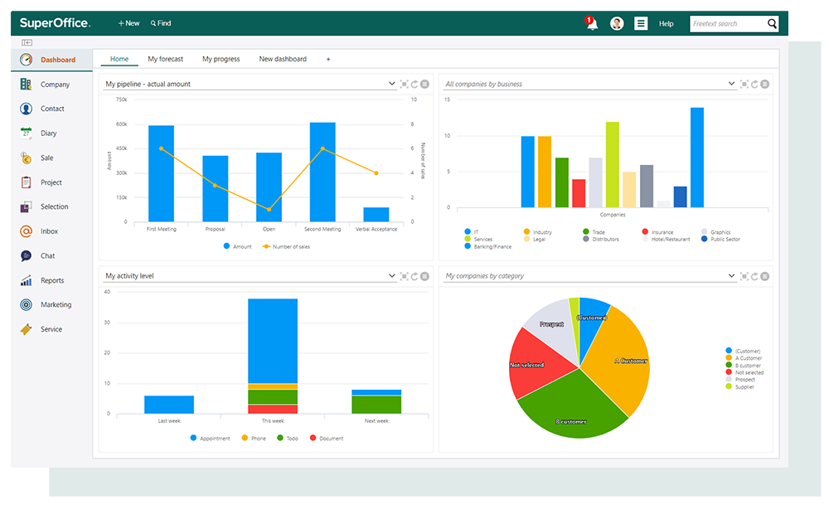
Dashboards 1.0
Standard dashboards and reports are available for every user
Out of the box solution​
Individual setup​
Large number of tiles included​
No possibility to adjust layouts
Standard dashboards and reports are available for every user
Out of the box solution​
Individual setup​
Large number of tiles included​
No possibility to adjust layouts
Notes:
Dashboard 1.0: (before)
Standard dashboards and reports are available for every user
Out of the box solution​
Individual setup​
Large number of tiles included​
No possibility to adjust layouts
You wanted:
More flexibility
More ready-made templates​
Make it possible to use “any” field for Filter, Grouping and Aggregation in tiles​
“Dashboard administrators” to define and push dashboards to users/user groups​
Dashboard capabilities on Mailings, Forms and Chat​
Dashboard that shows performance against Sale Targets
And because we know KPI’s and monitoring results of effort​ is so important for the growth your business, but also for maximizing the value of your CRM activities -

Slide 17
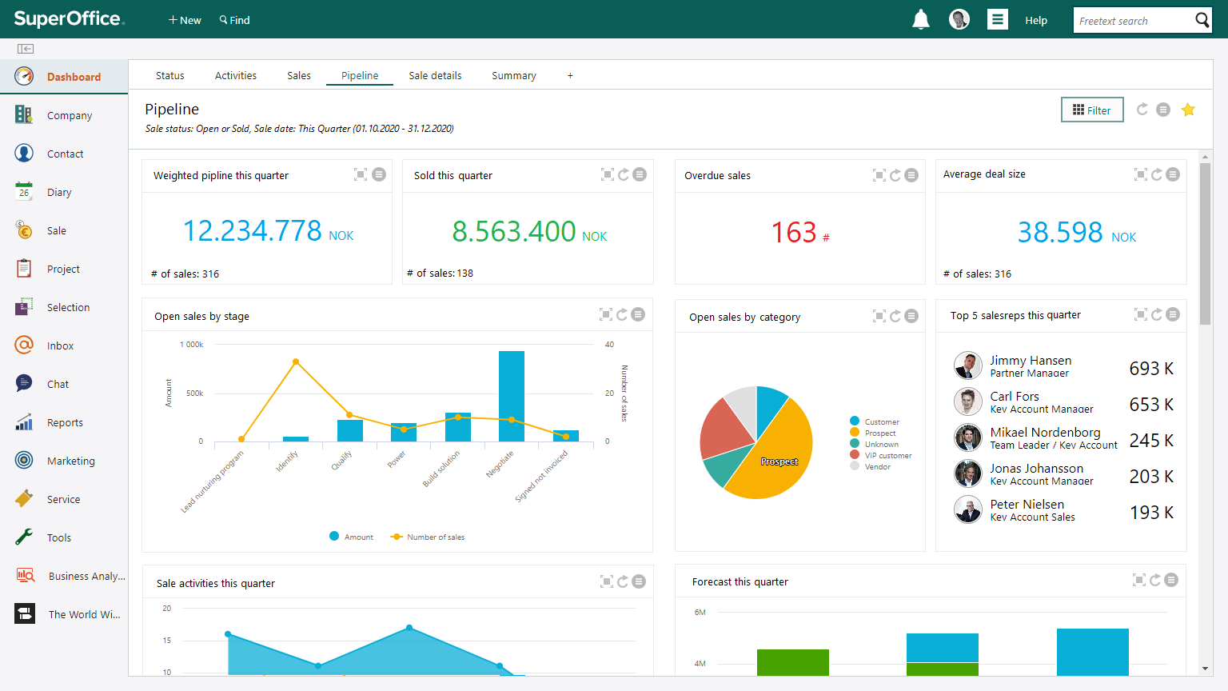
View data that matters to you
Customize dashboards to fit your reporting needs. Tools to create them faster and to use more of the data stored in SuperOffice to support your decision making.
Configure tiles/charts​
Configure and share dashboards​
New chart entities and chart types​
Templates and default dashboards ​
Notes:
..
It is now possible to create new dashboard reports for different user groups and individuals, a report for sales or just for service teams for example. And you can share your dashboard setup with others!
In addition, this version allows you to draw on more data fields when creating your reports, for example, you can create reports on service requests fields and you get a greater number of charts and reports templates to use from an online library.
There are more options available to create different charts and reports either from a template or from scratch... and there's greater flexibility for how many tiles you want to show in each report.
Reports can be defined as favorites so they are faster to find, and you can drill down and see the details behind each report, where you can sort and filter to fit your needs
*you will need to start dashboard config from scratch or use templates. You still have access to your old ones in a separate view. We will show you how in a demo later.
→ DEMO

Slide 18

CONFIGURABLE
SCREENS
Save time and focus on the information that is important for you
Notes:
Another new features is…Configurable screens
Before - the opportunity to define what to see or not to see on main screens have been limited, but with Configurable screens you can configure the layout of your main screens.
…And save time and focus on the information that is important for you.

Slide 19
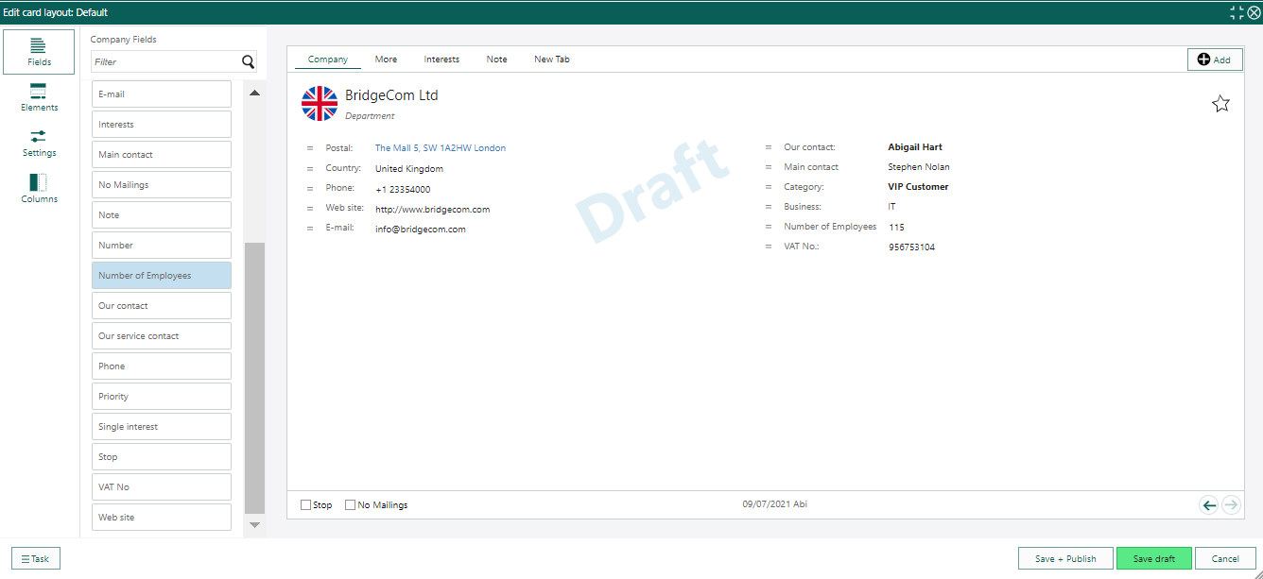
Design the layout to fit your information needs
More options to configure the
soluton to fit your specific needs​
Hide fields never in use, make important custom fields
easy to access ​
Use different screen layouts for different user groups
Make users more effective​ with less information noise
Notes:
This new functionality allows you to configure the layout of your main Company and Contact screens and define what’s best suited to be viewed by different groups of users.
-Different companies and different teams have different information needs and process support needs. ​​
And we know that Information that’s ideal for one group can be noise to another group.​
​
Instead of compromises that doesn’t please anyone, the better solution is to customize screens that are optimal for each user group.
With configurable screens you can:
Get more options to configure the solution to fit your specific need​ like; Add new fields, Position fields where you want,
Hide fields never in use, make important custom fields easy to access ​
Use different screen layouts for different user groups.
Make users more effective​ and help them find information easily
Customers need Expander Services to use this feature.
Note: Fields in the More tab on the company and contact card will change a bit.
In specific, customers who have user defined fields and extra fields in Service will see them listed by rank in the More tab.
You can keep the layout as is, change the rank order or use the screen designer to change the layout the way you want to use it.
→ DEMO

Slide 20
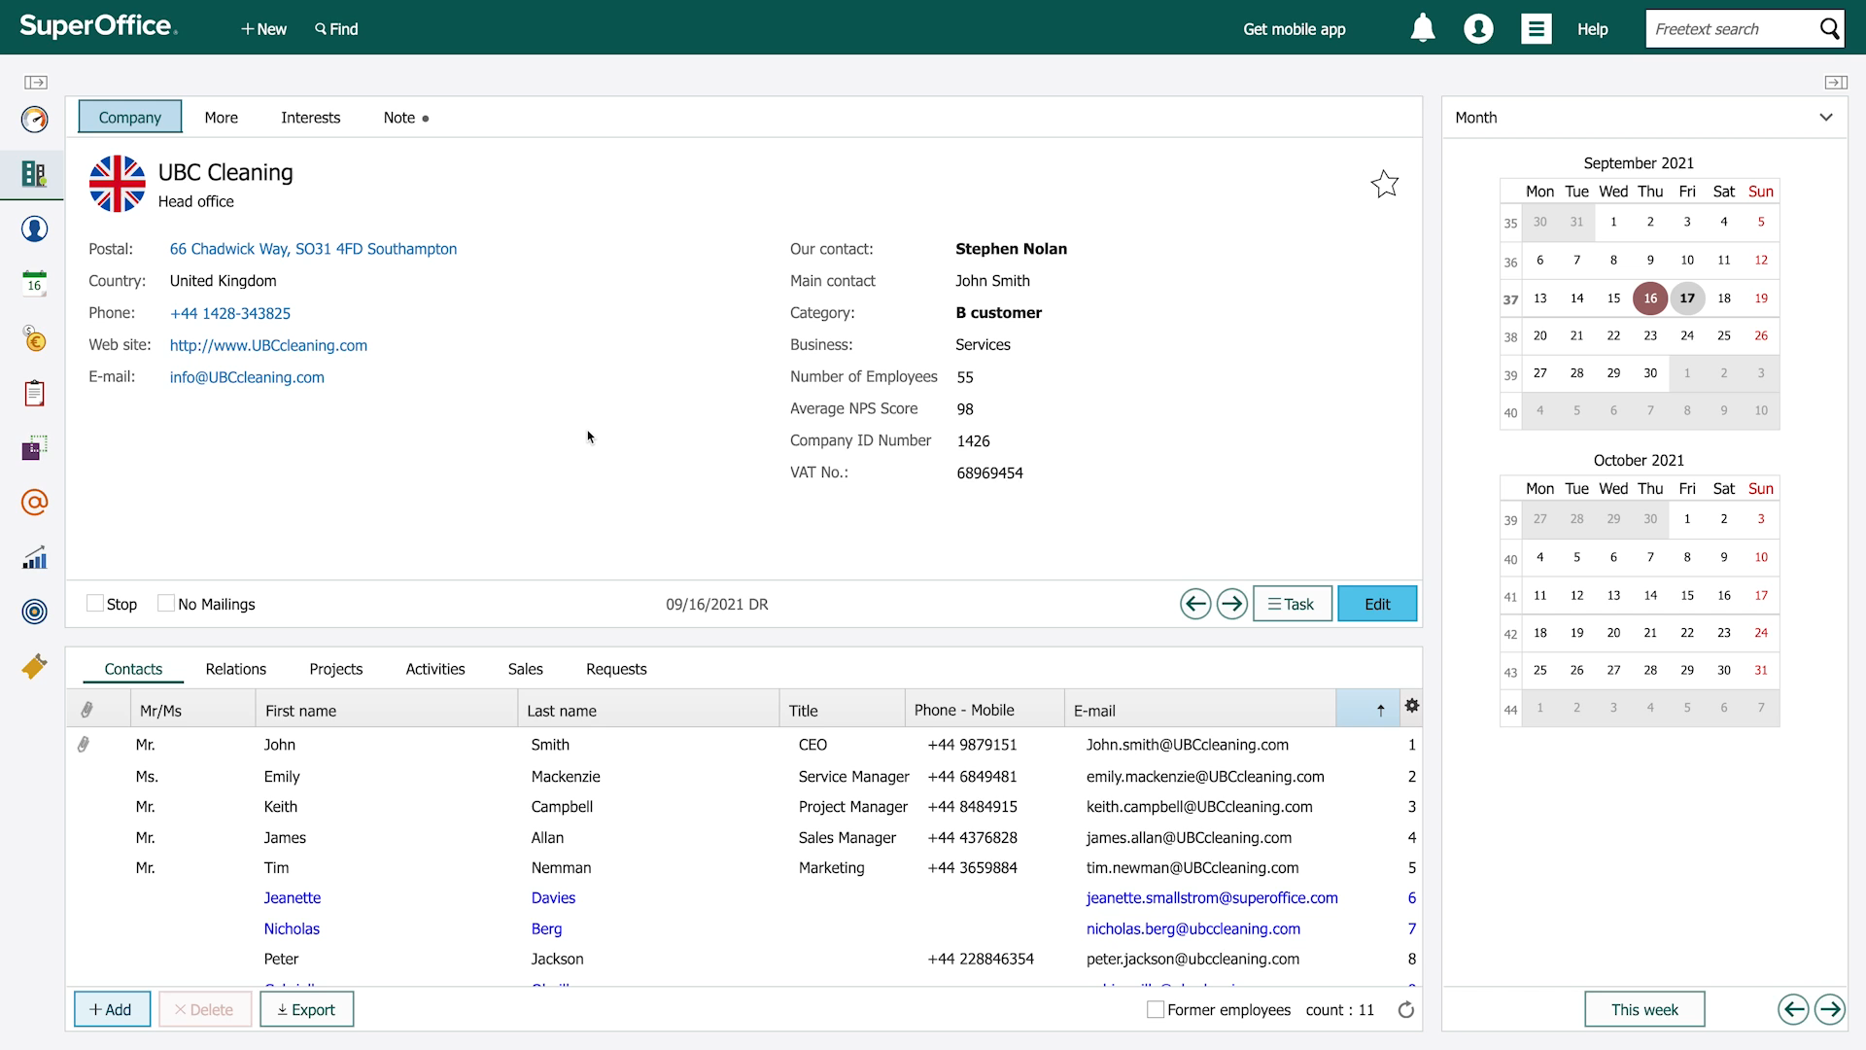
New layout – new possibilities
Your existing user defined fields and extra fields from Service are now listed by rank
Sort the ranking order to suit or use the Screen Designer to configure the layout of your More tab to suit your teams.
Notes:
As part of the releasing configurable screens, you’ll discover that the More tab on your main Company and Contact screens will display the User defined fields – and any extra fields from services in the ranking order.
If you have many fields this will be new and not always exactly how you’ll want it.
To make it fit your needs better you can re-order the rank so that the list is in the order you want
Or you can make the new screen design feature to configure the layout to fit.
This change will appear as your company has been given access to the Configurable Screen feature. IF you want this sooner let us know otherwise, more information about this will come.
Note that you need to subscribe to what is now known as Development Tools (previously known as Expander Services) to get access to Configurable Screens.

Slide 21

ARTIFICIAL INTELLIGENCE
Enjoy the power of AI inside your CRM solution
Notes:
AI: There is a lot of “hype” around Artificial Intelligence these days.
The complexity of AI have often been a hurdle for companies. But with our approach of embedding AI into SuperOffice CRM, everything is simplified, and everyone can benefit from it.
The most important changes AI will bring to CRM involve automation (elimination of time-consuming manual tasks), as well as improvement of existing conversation tools / Chatbots.
We first introduced the pilot program this spring and now it’s finally available in SuperOffice 10.

Slide 22

Get more productive with SuperOffice AI
Embedded into SuperOffice to make it accessible to all
Automates processes and saves time
Improve data quality
Be more proactive in your customer engagement
Notes:
AI as a service doesn't require any knowledge to implement it.
Integration with publicly available AI services like Google, Microsoft cognitive services
AI will help make sense of data, make people more proactive, and automate work processes to save time.​
Improve data quality: Mobile Business Card scanner - Capture Customer Data by taking a picture in Mobile CRM and update SuperOffice automatically. (included in Mobile CRM for 10)​
Upcoming: (Work effortlessly by talking to SuperOffice via your Mobile CRM on an iPhone). And more….
Be more proactive in your customer engagement -→ next slide

Slide 23
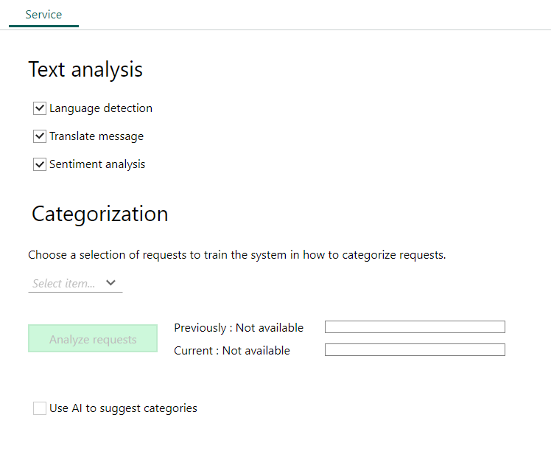
Provide better
Customer Service
Ability to detect the language and translate messages
Sentiment analysis of incoming requests to improve how you respond
Sentiment score: show how the mood is right now
Automate incoming request categorization to respond faster
Notes:
Add advanced AI functionality to SuperOffice Service and not only increase productivity, but also provide a better service.
With the help of AI:
it will be possible to automatically translate incoming requests into different languages – which can reduce the dependency on having the language skills in-house – and will help answering incoming requests in foreign languages better and faster.
Sentiment analysis of incoming requests to improve how you respond
The SuperOffice AI text analyzer can also evaluate the state of mind of a person who sent you a message with an emotion indicator, helping you to prioritize more urgent or problematic requests first.
Sentiment score: show how the mood is right now
if index < 20 : Unknown
else if index >= 20 : Positive
else if index <= -20 : Negative
else neutral
Automate incoming request categorization to respond faster

Slide 24

Deliver customer service 24/7
Help customers efficiently using the Chatbot Connector
Integrate your Chatbot service of choice with SuperOffice Chat and SuperOffice Service to provide your customers a chat service 24/7.
And… seamlessly enable customers to get help via your request handling if needed.
Notes:
You will also be able to use a Chatbot to help customers visiting your website. The bot service of your choice is seamlessly integrated with SuperOffice Chat and SuperOffice Service.
By using data, the chatbot will be able to predict the next question and provide additional information the customer may need.
*Integration with publicly available AI services like Google, Microsoft cognitive services to process our CRM data and automate more of the manual processing your users spend time on today.
​​
This approach does not require special knowledge from your side to benefit from it and SuperOffice AI is ready to be used.​

Slide 25

MOBILE CRM
REQUEST MANAGEMENT
Improve response time and increase customer satisfaction on the go ​
Notes:
This is a feature asked for by many customers through feedback channels like NPS and more. ​
In order to meet or exceed customer expectations for fast service and response rates, means it is not always acceptable to wait to respond to a request for when someone is in front of their PC/work station again.
​
In short, being on the road, or away from your desktop shouldn't stop you from responding or follow-up on incoming questions from business contacts. ​
That’s why we have made it easy for you with Request management in Mobile CRM..

Slide 26

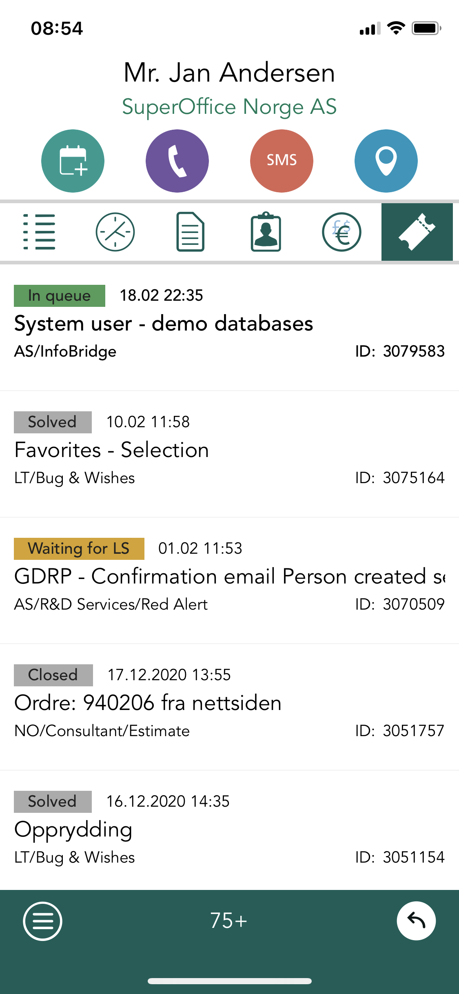
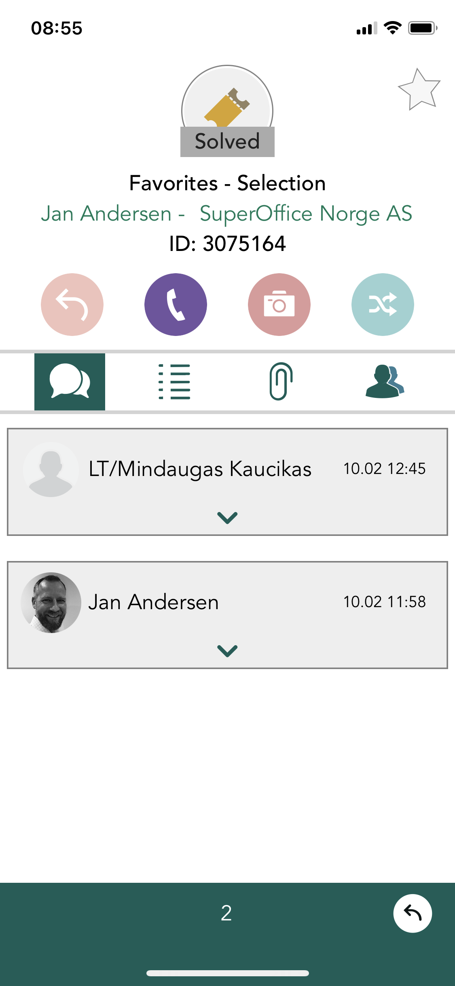
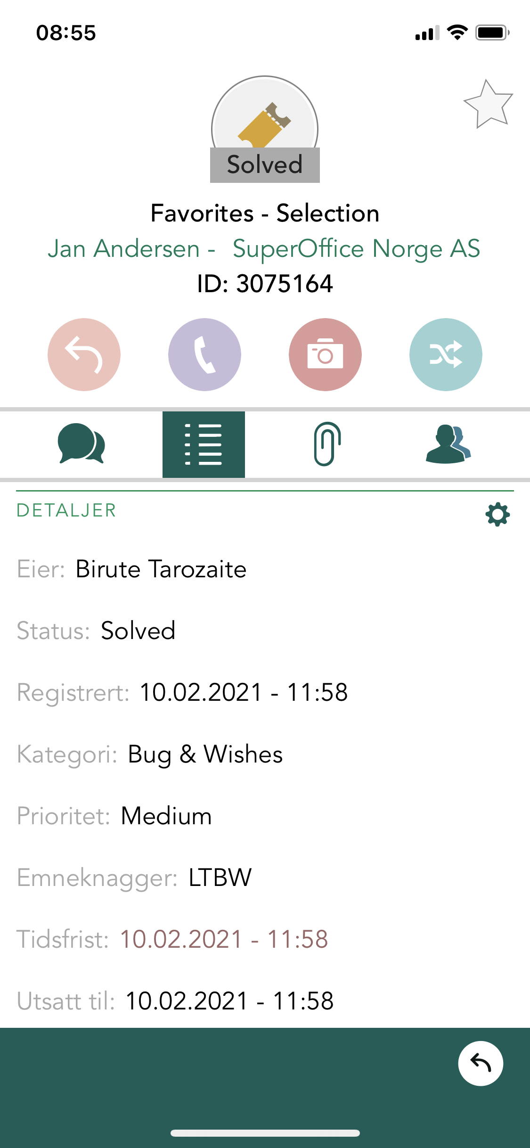
Handle requests anytime and anywhere
Search, find and view tickets on your mobile device​
View messages and attachments
Possible to configure which fields should be displayed​
Displays all requests connected to company or contact
Notes:
-Answer and follow-up dialogues and tickets anytime and anywhere​
​-Give customers a faster response ​
​-Contribute to improved/higher customer satisfaction​
​
In the app you can:
-Search, find and view tickets on your mobile device
-Respond, comment, tag or edit key fields on an incoming request
-Displays all requests connected to company or contact
By accessing Requests in the mobile you will have a better 360 view of what is happening regardless of your location
DEMO

Slide 27

SUPEROFFICE
DATABRIDGE
Integrate SuperOffice CRM with other platforms or data sources in just a few minutes
Notes:
With SuperOffice Databridge you can access all vital information in one place.
In essence, Databridge is a supercharged import/export tool that you can schedule and set up to run automatically – thereby ensuring that you Exchange information between SuperOffice CRM and your other cloud solutions and set up integrations to fit your different business needs.

Slide 28
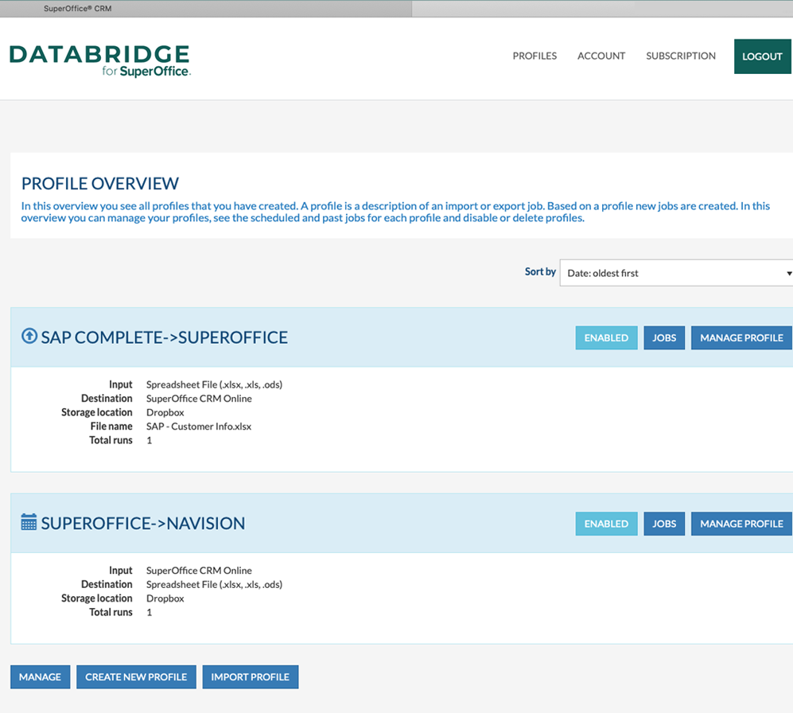
Reduce manual data entry
Exchange data between SuperOffice CRM and your other cloud-based applications
Fully cloud-based, no local installation.
Scheduled, manual, or triggered import and export.
Support for online storage services like Dropbox, Google Drive, Microsoft One-Drive, and (S)FTP
Notes:
Databridge add-on is a generic integration tool that lets you set up and schedule automatic data transfers between SuperOffice CRM and any other cloud solution you might use.
For example, you can exchange data between SuperOffice CRM and your ERP or E-commerce system, or another back-end solution that holds or shares information with SuperOffice CRM.
Enable SuperOffice CRM users to view information from other databases, helping to improve your CRM adoption, increase productivity, reduce manual data entry and flip-flopping between various applications.
DataBridge for SuperOffice CRM is a clean, quick, and intuitive way to interact with your data in multiple ways. It provides you with import and export opportunities for all SuperOffice CRM objects.
This solution is fully cloud-based and requires no installation.
Scheduled, manual, or triggered import and export.
Support for online storage services like Dropbox, Google Drive, Microsoft One-Drive, and (S)FTP
DEMO→
The solution to rapidly create, manage and deliver sophisticated SaaS integration to support higher performance and revenue without a single line of code. DataBridge is always online and requires zero maintenance to ensure low risk implementation, fixed price and without adding work to your own developer’s backlog.

Slide 29
Recent and improved features and resources
Notes:
Now we have seen the existing new features in SuperOffice 10, but we have also improved existing features and resources..
Let’s take a look!

Slide 30
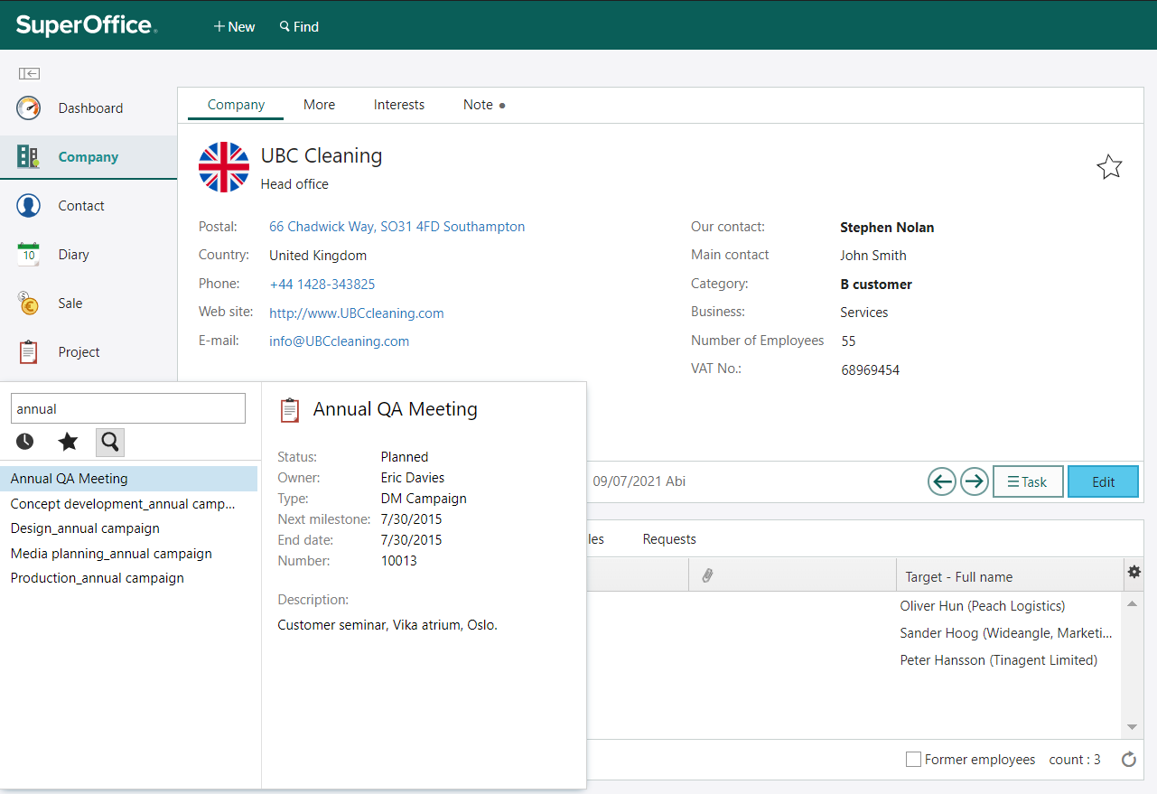
Find information faster with improved search
Improved search, with improved performance and avoiding the need for using '%' in the search value​
- Free text searches within: Text fields, Number fields, Addresses, mail, Phone, URLs, Info texts​
- Navigator search for Company, Person, Sale, Project, Selection
Notes:
When capturing and storing data is increasingly automatic and easy, the challenge of making it available and finding the data or information you need increases.
Sometimes you need to search without structure –in a more intuitive and google-like manner.
Before, you needed to use % to get the exact match in SuperOffice, but with our new improved way of searching, you can do
​
- Free text searches within: Text fields, Number fields, Addresses, mail, Phone, Urls, Info texts​
- Navigator search for Company, Person, Sale, Project, Selection

Slide 31
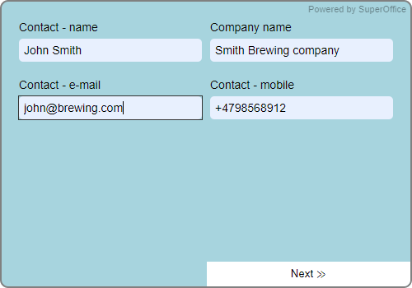
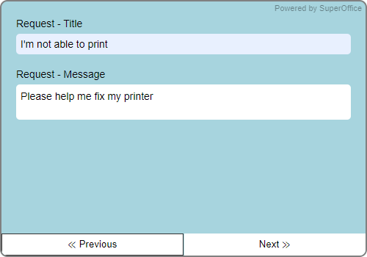
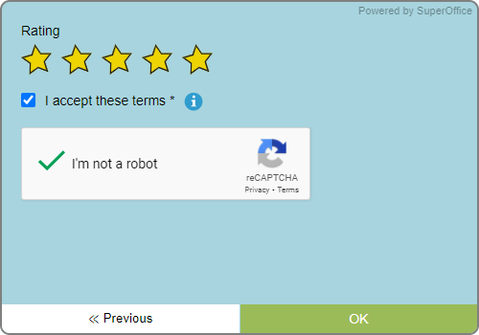
Get valuable feedback using web forms
Additional features for web forms include:
More fields to choose from
Improved visual design on rating buttons
Present your fields in two columns
The possibility to use sections or multiple pages on a form
Notes:
I’d also like to mention that there’s been a range of smaller, but still very valuable improvements added to our online forms feature over the last few months.
For example, you can now choose even more fields, Improved visual design on rating buttons, Present your field in two columns,
use sections or multiple pages on a webform, similarly to online surveys. And we currently are working on new ways to publish your web forms as well.

Slide 32

NEW APPS
More connections and overall improved store experience
Notes:
With SuperOffice Databridge you can access all vital information in one place.
In essence, Databridge is a supercharged import/export tool that you can schedule and set up to run automatically – thereby ensuring that you Exchange information between SuperOffice CRM and your other cloud solutions and set up integrations to fit your different business needs.

Slide 33
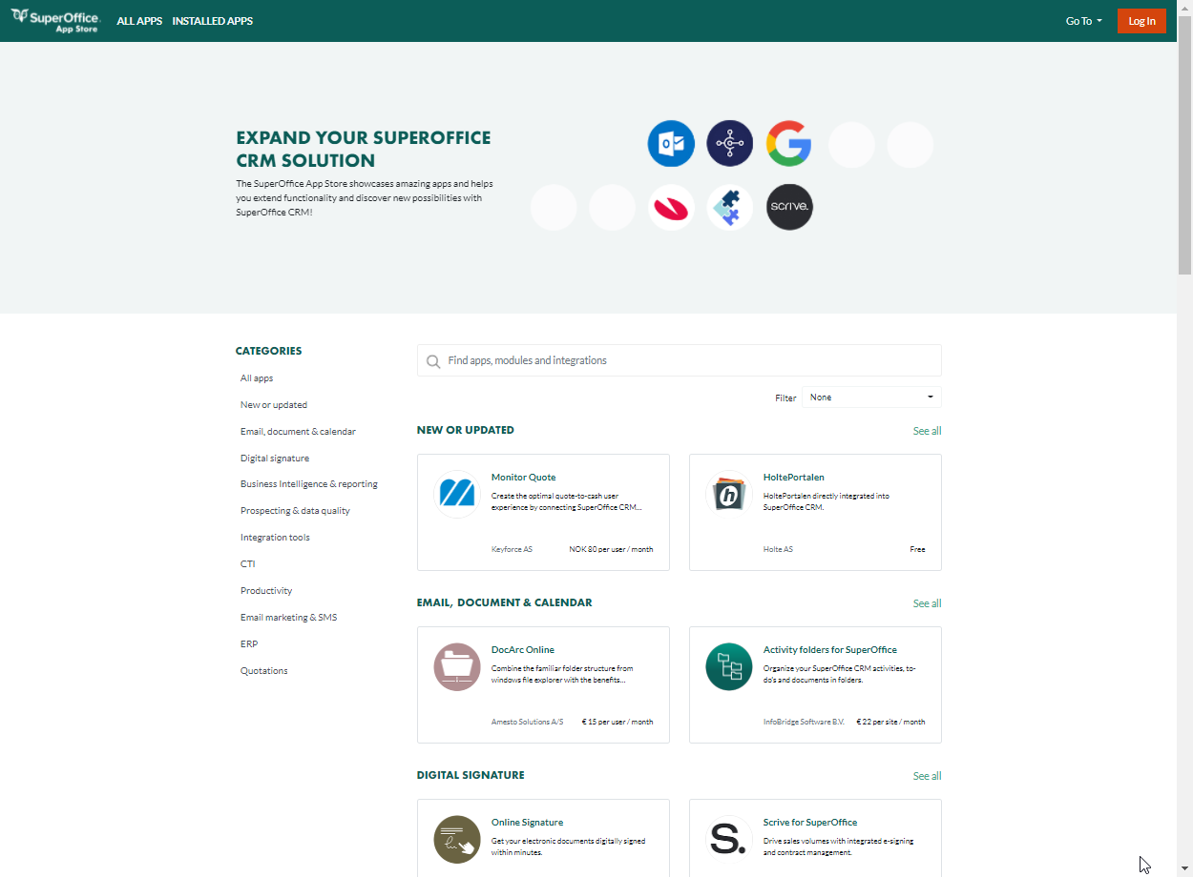
Scale up and customize your solution
With App Store 2.0 you can enjoy even more apps that will help you increase your productivity, customize your
CRM solution and offer a better online experience.
Notes:
SuperOffice App Store
We have over 120 apps in our app store – and with the new App Store you can enjoy even more apps that will help you increase your productivity, customize your CRM solution, and offer a better online experience. ​
​
It now has a new fresh design to help the store experience, ​
New searching capabilities and valuable app insights in spotlight articles.
And we’ve got some new apps on the shelves: ​
​
For example, you can soon connect SuperOffice CRM with Slack, WordPress, MailChimp, Trello and MS Teams

Slide 34
What’s to come – future releases
Notes:
With the new features and improvements we have released so far, there is still more to come!
So here you will get a sneak peak of the features that are going to be released soon….

Slide 35
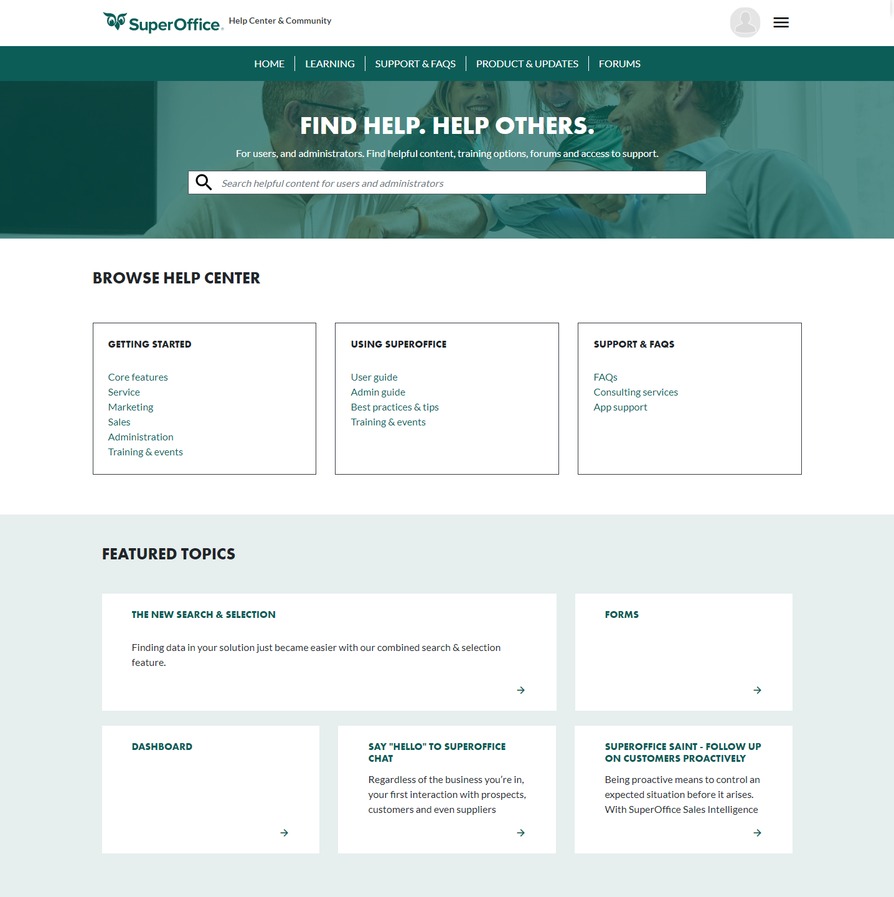
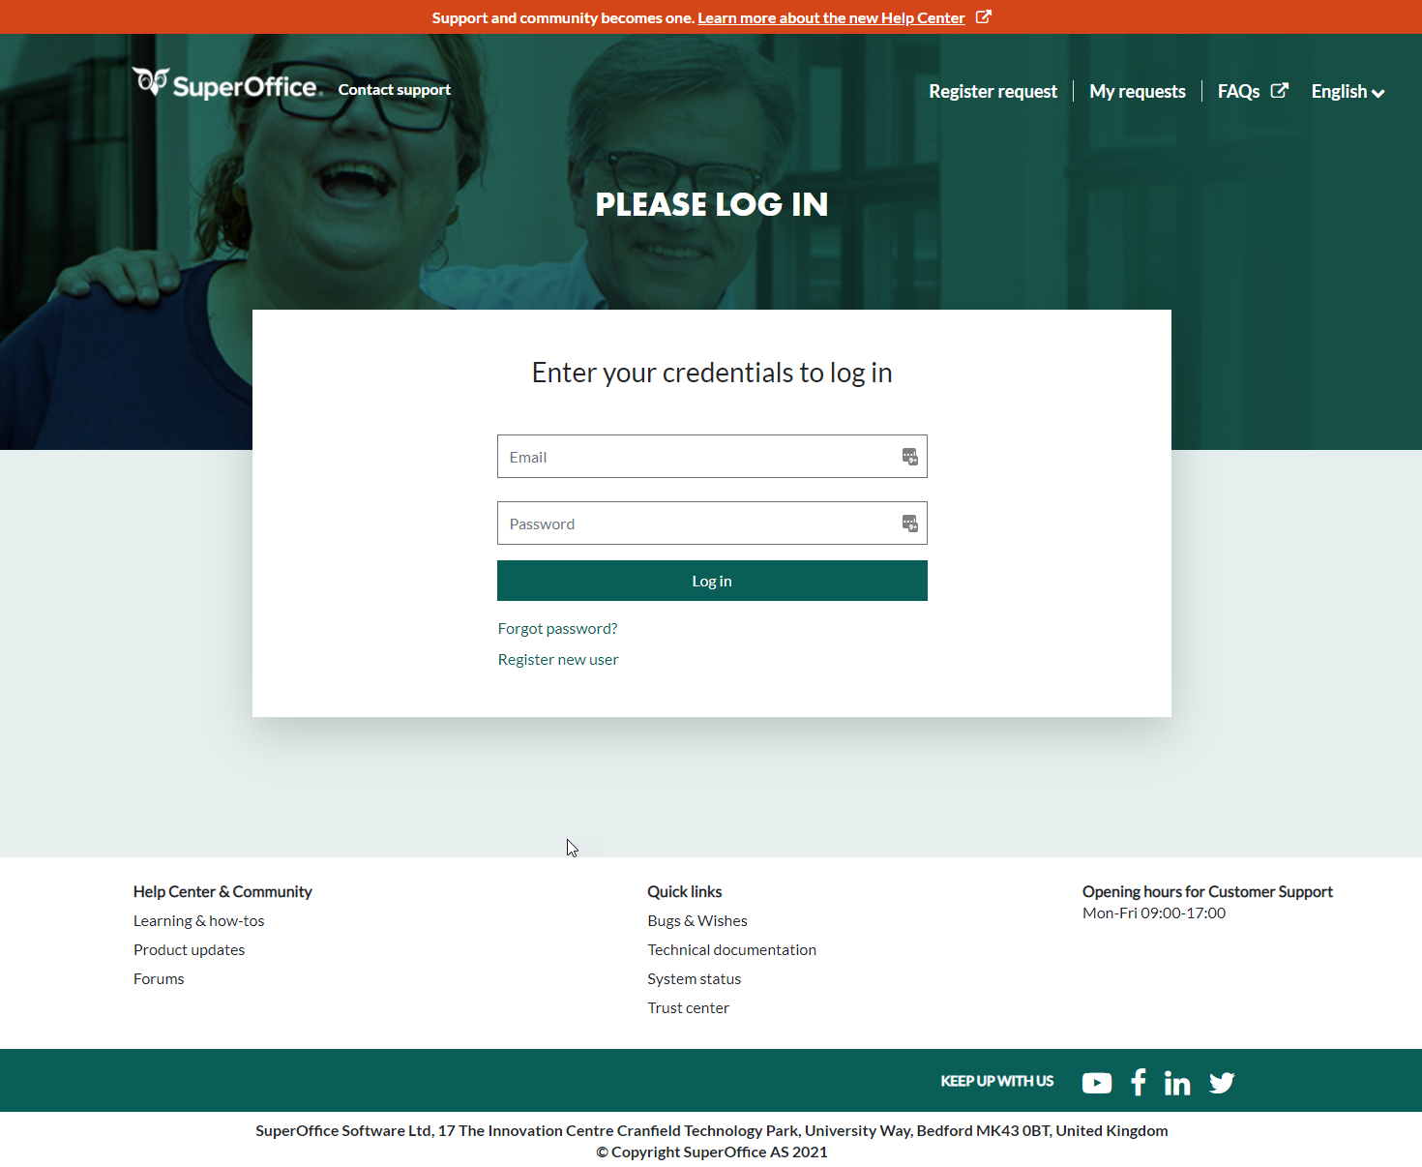
Available soon:
New Help Center & Community
A better user experience​
A better search experience
Customer forums, where you can ask and answer questions.​
First release: a new Customer Center
Notes:
New Help Center – We’re taking our support services to a new level with a new design, one site for both support and communication, and public forums for customers.
When you want to contact Support, either by clicking on “contact Support” inside your SuperOffice CRM solution, or when clicking on the link for Support on our website, you will first notice a fresh new design, that matches our overall brand look. The colours are darker, calmer and we have paid even greater attention to accessibility in the new design.
You can access our library of Frequently Asked Questions
our Chatbot is trained to help you get around the available learning materials and FAQs
you can register a ticket directly to our support team
- You can also see the status of all your current or past requests and you can add comments or information too.
The new design aims to make the process faster and easier than before and certainly help you find the help you need.
Community:
Next up and available soon is a brand new Community site. This will also get a new and updated look and feel as well as improved user experience, search experience and how you access and consume various learning content.
Together with the new Community site, we will also finally introduce many new forums. This will be a place where you can ask different CRM related questions you are concerned with as well as contribute with your own experience and knowledge about CRM and in using SuperOffice CRM.

Slide 36

SHAREPOINT
INTEGRATION
Enable true document collaboration​ and information sharing across your entire organization
Notes:
Right now, we’re working on the SharePoint Integration that we think will be really interesting for many customers who are already using or planning to use SharePoint as their document and collaboration tool.
​
SharePoint offer more advanced document management capabilities but rely on each company creating sensible filesharing rules.​
SuperOffice offer templates and automatically links documents to main CRM entities, making it easy to find and use in connection with CRM processes. ​
​
However, storing documents in two system means people loose track of where something is, waste time finding documents, they need rules for what and when and risk of information silos. ​

Slide 37
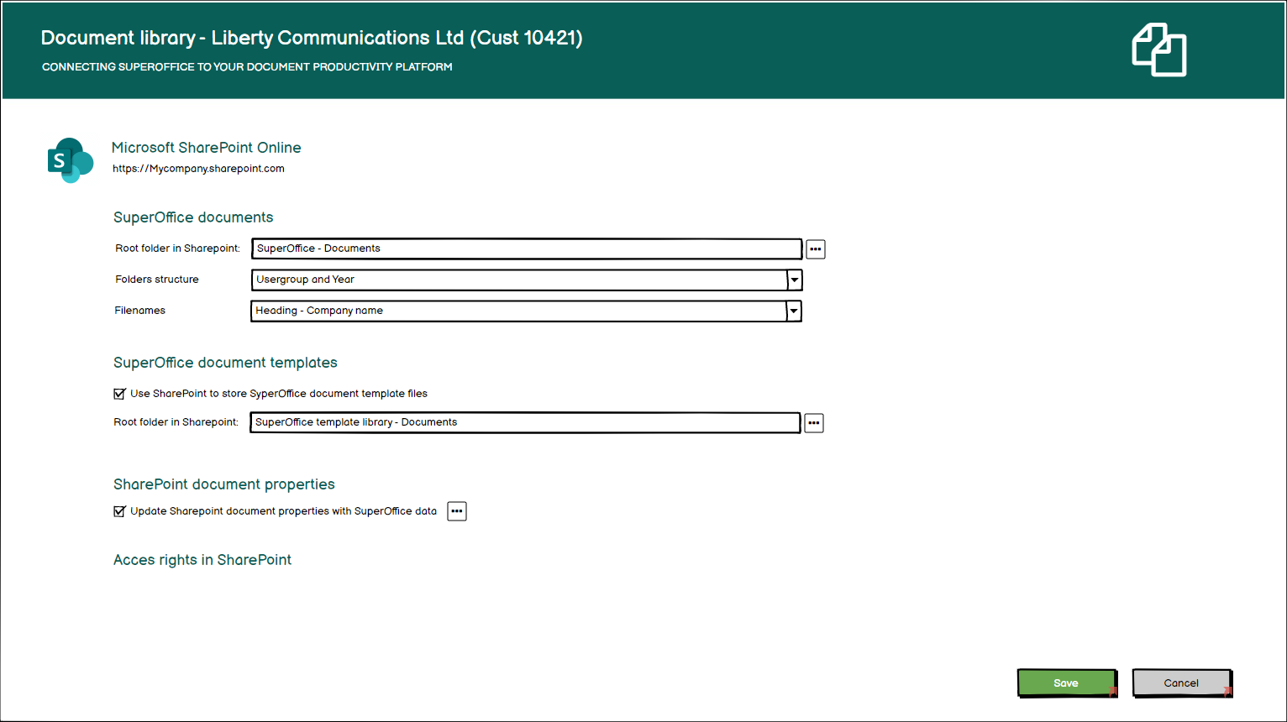
Notes:
With the Sharepoint integration:
-You enable true document collaboration​ and information sharing across your entire organization​
-As a SuperOffice user, you don't have to think about where the documents are located.​​
All documents and emails you write or archive from SuperOffice will be stored in your SharePoint Online repository, where you have total control.​
Everyone in your company can access these documents; Even those who do not use SuperOffice. ​​
You will also be able to work together in the same document at the same time, share documents with anyone and have access to older versions of the document at any time. ​
-Reduce (remove) the IT management and user support related to an integration between your document management system and your CRM solution, because zero-footprint application means there is nothing to download, install, or having to help individual users with queries concerning the integration.

Slide 38

SALES TARGETS
Gain focus, motivation and prioritize the right actions with sales targets
Notes:
Too many companies lack good routines for working in a structured and targeted way with sales. Sales people are flying blind because they can’t see how they are performing against targets. ​
Without this insight, they might miss the opportunity to adjust their course, priorities, or actions which in turn may make them miss their revenue targets.
So we are very excited about this new upcoming feature that many of you have asked for! ( Including our own sales team)

Slide 39
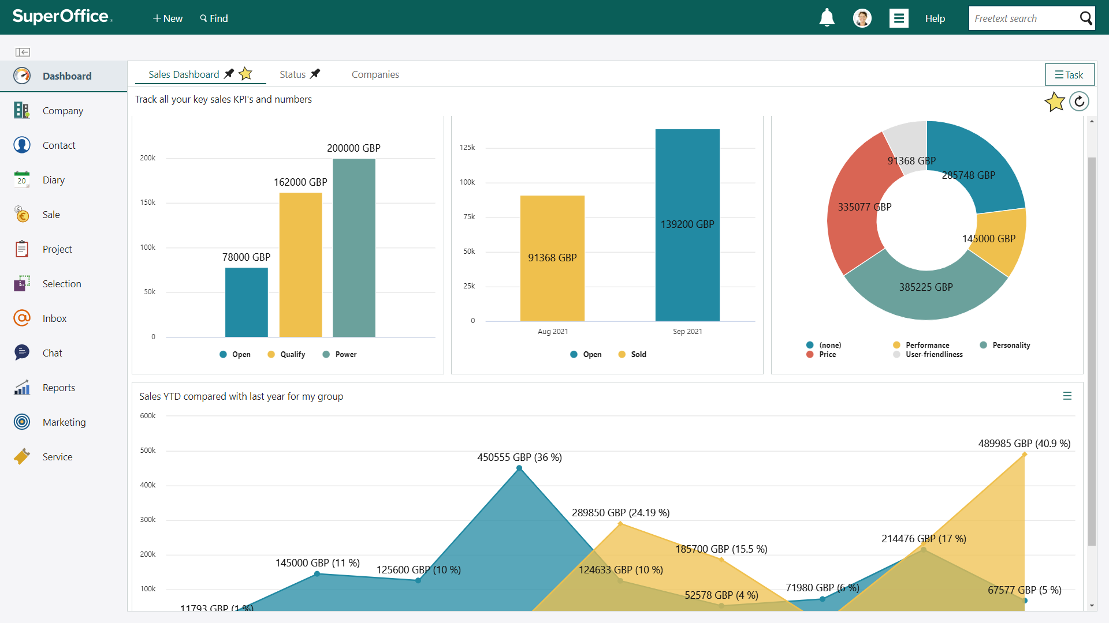
Sales targets in SuperOffice
Notes:
With the new feature Sales Targets in SuperOffice, you can get a good overview of your important KPIs and set targets like activity level, sales and average deal size, so that you can proactively improve your sales efforts.
To help you focus and prioritize the right actions, we'll introduce business units. ​
Sales targets can be set up for Business units, teams and individuals. ​
For sales targets you can add a 12 month period, with the possibility to sum up months to make quarterly budgets/targets.
This is all I can share right now and of course there will be more information on this as we are getting closer to release. But be sure to look out for news in your inbox, on our Community and on social media ;)

Slide 40

Join a pilot program
Get early access to the latest versions of our software by joining our pilot programs.
Notes:
You can also check our current and planned pilot programs..
What is a pilot program?
Pilot programs give CRM Online customers early access to new features and releases before general release. The feedback helps us identify issues, fix them and make the software even better.
The pilot programs vary in length and scope depending upon what software needs testing. Because a pilot version tested in your production environment will affect all users, it needs to be a decision that is taken in agreement with IT and/or Management and not just by individual users.
As a matter of fact, we are now looking for customers who are interested in testing the new SharePoint integration. So, people who would like to test this new feature can contact us and sign up.
You can learn more on our website. You will also find FAQs and other current pilot programs you can join.

Slide 41

HOW TO GET STARTED
Online customers have access now
Onsite version available later this year
Notes:
Now I am guessing everyone is curious about how to get started and when it’s available?
Good news for online users.. You are already updated..or will be very very shortly- (we update in waves)
As usual you will get a splash screen linking to more information about version 10.
For those who are on-site with SuperOffice installed locally, you will get access to download SuperOffice 10 and upgrade your installation later this year. Estimated release is November, but no reason not to plan your upgrade to the latest version already now. So please get in touch with your SuperOffice representative to plan and book a date with a consultant to update to SuperOffice 10.
So for those of you who have access, please note that this is not your typical update with lot’s of new visible changes, like you saw with SuperOffice 9.
Take Dashboards, for example – first your old dashboards are of course still there, like before. The ability to create new dashboards is an user-specific access rights that your company need to assign you. _Your CRM administrator does that. Then of course you are able to create new dashboards from scratch or use templates like you saw in the demo.
Some of the features we’ve introduced are also optional add-ons. And some, like AI and Sharepoint integration, which also are cloud-only features.
Which brings me to the next big change with SuperOffice 10 – which also comes with a new packaging and price model

Slide 42

New Packaging
& Pricing
We still offer:
3 stand-alone solutions;
Sales, Marketing and Service
​
​The important principle of 360-degree customer
view remains the same in all plans
​What's new:
Within each solution there are different tiers - the Essential and the Premium plan.
All solutions can add different add-ons
Notes:
It’s worth saying a little bit about the new SuperOffice packages – as we have made some significant changes to these from the past.
Till now we have had 3 main user plans, Sales, Marketing and Service, and by subscribing to one of them, you got access to everything, whether you needed it or not.
This approach we recognize is not flexible enough or matches our customers real needs.
So we have made a change and a new packaging and pricing structure, that in principle will not affect you that much as an existing customer of SuperOffice.
Because whatever features you have access to today, are features that you will of course have access to tomorrow.
Your company just have more options to consider when they want to make a change in your subscriptions or buy new user plans.
-We still offer 3 stand-alone solutions; Sales Marketing and Service
-The important principle of 360-degree customer view remains the same in all plans
What's new is:
-within each solution there are different tiers - the Essential and the Premium plan.
The user plans contain CRM functionality, that is user-role oriented and configurable and consist of different sets of features based on what tier a customer has.
-All solutions can add different add-ons (like AI or InfoBridge) that can be made available for all your users if you so desire – that’s up to you.
Otherwise, the main thing to remember is that whatever features you use today, you will be able to use tomorrow – in addition to many if not all of the the brand-new features released with SuperOffice 10.

Slide 43
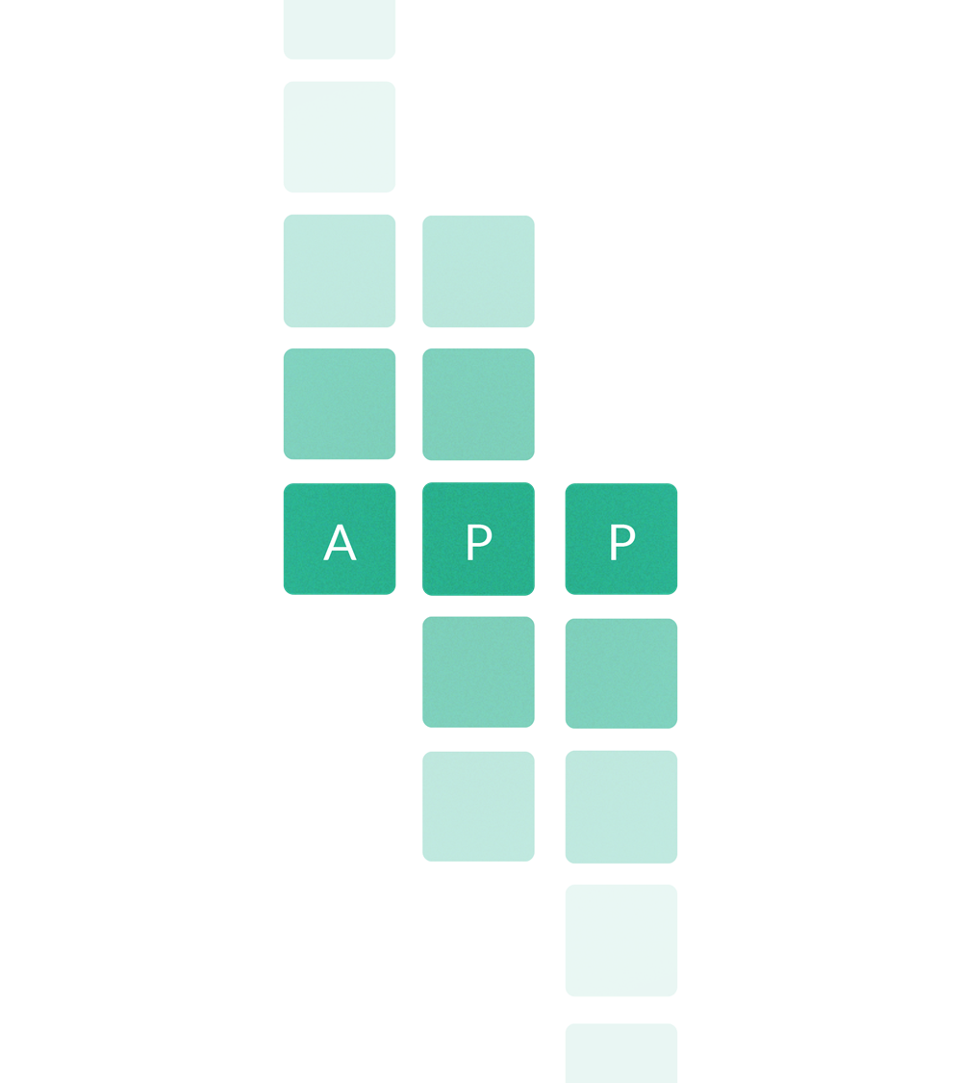


A PLATFORM FOR GROWTH
Notes:
To sum up, with SuperOffice 10 you get a modern, forward-thinking CRM solution that unites your business processes, utilizes the latest technology & helps you grow your business.
Advanced dashboard ​
Configurable screens​
SuperOffice Databridge​
SuperOffice AI​
Mobile CRM request management​
Improved Search​ and web forms
New Help and Community site​
App Store 2.0 + (new apps..)
Sales targets​ and Sharepoint integration to come
SuperOffice CRM offers the tools to optimize your processes and bridge the gap between customer data and revenue.
And with the help powerful customization tools, you can also customize your CRM solution to fit your business needs and expand it as your business grows.

Slide 44

A CRM PARTNER THAT HELPS YOU GROW
Notes:
And remember that we are here to help and share of our knowledge and experience.
If you want to learn more about each feature, we have more webinars planned, so you can get an in-depth walkthrough.. Check our website for more info of upcoming events.
And of course, we would welcome the opportunity to help you get started with any of these features discussed today.

Slide 45
Thank you
Notes:
Thats all we have for now.
Thank you for following along and that you are as exited as us to get started with SuperOffice 10!
Wish you all a super day ☺

