Slide 1

SuperOffice 10
A new price and packaging model
Notes:
With SuperOffice 10 we are introducing a new price and packaging model.
What does it look like?
How does it work?
What does this mean for you?

Slide 2

Why change?
overall_0_132439578454489237 columns_1_132439557979278443 20_1_132439581861943688 24_1_132439581864097917 28_1_132439581866092602
Different customers have different needs. The current “flat” price model contain little granularity or flexibility to allow for such differences.
The new structure offer our more options to pick the feature sets and modules that fit different requirements – no more, no less.
The technical architecture also allow for a better build for future feature sets and add-ons.
Notes:
Six years ago we changed our product and price model to offer a structure with one single user plan per main processes: sales, service and marketing. Each plan included all features for each process area, whether you needed them and used them or not. This “all or nothing” approach is something we now wanted to change.
Less is not always more, even though we do like to simplify complex things. But in the case of our product packaging, we realized that “one size does not always fit all” and that the differences in our customers' needs should be better reflected in our product offering.
So, that’s what we did
CLICK

Slide 3
Our customer promise:
As an existing customers you will continue to have access to all the same features as before – including your add-ons.
Notes:
Before going into more details, let’s first establish a few things that have not changed.
As our existing customer, you will not lose access to any features you enjoy today. That has not changed.

Slide 4
Three solutions – One CRM suite
Sales
Service
Marketing
Notes:
We continue to help customers fuel their sales processes, provide better customer services and communicate more effectively with customers by using SuperOffice CRM - like before – but we are now presenting it as 3 solutions

Slide 5
Three solutions – One CRM suite
Yes, SuperOffice is a complete CRM suite. This is one of our strengths
We know that customers are often not looking for solutions in all 3 business areas at the same time, but may address different areas at any given time
Each plan can stand at it´s own feet…
Add more plans as you transform your business and need more and better systems to support your growth
The 3 plans matches the 3 main business areas we assist with:
Sales
Service
Marketing
Notes:
With three plans like this, we allow our customers to scale up as they need it -

Slide 6

Notes:
Furthermore, we have not changed the principle that all users share a set of core features across whatever user plan they have.
Any user, regardless of plan, will have access to all data, activities, sales, requests, mailings etc. on a company or contact.
This is what we call a 360⁰ view on a customer.
What will differ, is the set of features the user has access to. This depends on what plan the user is subscribing to.

Slide 7
Common features across all plans and tiers
Users across all plans will have a common set of features:
Contact management
Companies and contacts
Relations
Custom fields
Consent management
Calendar
Diary and tasks
Invitations
Video meeting integration*
Mobile CRM
iOS App
Android App
Document management
Documents and templates
Language support
MS SharePoint documents*
Google Workplace documents*
Email
SuperOffice inbox
SuperOffice for Outlook 365
SuperOffice for Google
Search / Selections
Static Selections
Dynamic selections
Selection tasks
Send email to (max 500)
Reporting and dashboards
Dashboards with default charts
Standard reports
Print
* cloud only feature
Notes:
As you might notice: Projects and Project management is not a part of these features – instead they appear when we look into the two tiers available: CLICK

Slide 8
Two editions
Essentials
Premium
Notes:
We know that the majority of companies have similar needs to a great extent and most of them benefit from using a standard software tool like SuperOffice CRM.
However, we also see that our customers vary greatly and, as a result, differ in what they use in our software and to what extent. Taking that on board, we have redefined the features into different feature sets that allow for a better fit for different needs.
There are now two editions of the Sales and Service solutions, each with the feature set that provides capabilities to meet varying needs.
The Essentials edition offers customers the most important tools they need to take control over the sales processes and incoming requests, so they can create sustainable customer relationships and retain more happy customers. No more, no less. It’s ideal for customers with less complex requirements and who want to get started easily.
Companies with more complex processes, more diverse teams and requirements will benefit from the Premium edition, which contains additional tools needed to manage prospects from quote to close and to streamline and automate their service processes – equipping teams with everything they need to create and build sustainable long-lasting relationships.

Slide 9
Sales features
Essentials Edition
Sales and opportunity management
Sales forecasting
Dashboards with default tiles
Currency support
Sales secretary
In addition to all from Core features
Premium Edition
Sales guide
Sales forecasting on product level
Dashboards with custom tiles
Stakeholders
Sale targets and KPI's
Activity Monitors (SAINT)
Combined selections
Project management
Quote Management
  Create and manage quotes
  Products and pricelists
  Alternatives and versions
  Approval
  Templates
In addition to all from the Essential edition
Notes:
The differences

Slide 10
Service features
Essentials Edition
Request / Ticket management
Categorization
Auto reply and reply templates
Mobile CRM Request management
Standard Service reports
Dashboards with default tiles
Premium Edition
Automated rule-based escalation
Auto-assign to agent
Warnings and notifications – Time limits
Knowledge base (FAQs)*
Activity Monitors (SAINT)
Dashboards with custom tiles
Combined selections
Project management
In addition to all from the Essential edition
* Customer Engagement Platform will give access to Knowledge base (FAQ) even in the Essentials plan

Slide 11
Within one plan: All users must be on the same edition.
Notes:
Decide between Essentials OR Premium for the entire solution within one plan

Slide 12

Marketing – a new model
Notes:
The Marketing solution contains the feature sets needed to perform more specialized functions required in creating successful marketing communication. This includes all the capabilities needed to get messages out and connect with the right customers at the right time.
Whilst it is common to price a marketing solution based on the number of contacts a company potentially can send to, we realized that there were a few challenges coming with such a model.
The true value of the new Marketing solution is not just in the number of features and automations available, and but also in the communications sent. This is why the marketing plan now is split into a platform and a user plan, in addition to the metered payment for mailings sent.
The subscription includes a generous number of mailings you can send (10 000 per month), which means that additional payment is only activated when a company uses the solution to send out a lot of communication.

Slide 13
Marketing features
Mailings (personalized mass email)
Mailing service included (MailGun)
Drag and drop email designer
Company specific mailing templates
Free mailing template library
Free image library built in
Google analytics tracking
Tracking of open-rate and link-clicks
Custom actions on link-clicks
Dashboards with custom tiles
Bounce management
Spam complaints management
Forms (Web forms)*
Form submissions management with custom actions
Consent management in forms
Company specific form templates
Free form template library
Double opt-in and landing pages on forms
Automatic Reply email on submissions
Combined selections (Create/Edit)
Project management
* Marketing users only. Sales and Service users need CEP/Forms as add-on
Notes:
Only users with a marketing plan have access to mailings (change from today)
Forms are included for users with the marketing plan. CEP is not needed for Marketing users to use forms.
The price for access to the marketing plan and emails included are the same for large and small customers

Slide 14
Your plan will be equivalent to the feature set(s) you have today.
Notes:
After the upgrade, your new plans will reflect what you already had access to, so the only thing that will be different for a user is the name of the user plan they have. For example, a Sales user will now be using Sales Premium and a Service user will now be using Service Premium.
Access to features otherwise in different plans, will still be available to you because you are an existing customer. You will not loose any features you have today.

Slide 15
Multi plan users:
When the same person needs access to more than one plan…
Notes:
Remember that All users of a solution need to be on the same edition. It is however possible to move from one edition to another.
It is also possible to mix editions between solutions and a user may subscribe to more than one plan.

Slide 16
A user on a Complete plan today will be converted to a Multi-plan user.
Notes:
For example, current users with a Complete user plan are now defined as multi-plan users and continue to have access to all the feature sets as before the upgrade to SuperOffice 10.

Slide 17

An add-on is a software extension that adds extra features to a program.
It may extend certain functions within the program, add new items to the program's interface, or give the program additional capabilities
Notes:
It is worth noting up front that for all of the plans for Sales, Service and Marketing is prices per user and the capabilities are available for the named users of these plans.
But for add-ons these are priced as site licenses – meaning all users get access to these capabilities independent upon the plan a user may have – of course some of these are dependent upon the user getting the function right – but in principle these can be given to any one or all users.
So, let’s go through these add-on’s in more detail – starting with the one everyone should be familiar with by now: CLICK

Slide 18
Add-ons
 | Customer Engagement Platform
 | Customer Engagement Platform*
 | Forms – a stand-alone add-on**
 | Chat – stand alone add-on**
 | Calendar synchronization
 | Synchronizer*
 | Expander Services
 | Development Tools
 | APIs*
 | Database Mirroring Service
 | Databridge**
 | Cross-domain Identity Management (SCIM)
 | Production Sandbox Environment
 | SuperOffice AI
 | SuperOffice AI Platform*
 | AI Services: Request Text Analysis**
 | AI Services: Request Categorization**
 | AI Services: Chatbot Connector***

Slide 19
Customer Engagement Platform
Add-On
Metered
Customer Engagment Platform
Specific Modules
CEP Usage
Provides the ability to interact and engage with your customers via many different digital channels and touchpoints.
Includes Customer Centre, Chat and forms
Customer facing apps that can be bought and used as separate modules
Forms
Chat
Additional pay-per-use services apply according to consumption of these
# Form submissions
# Chat sessions
# Customer logins
Notes:
If you have this today, you will continue to have access to these features – however, there is a main change: if you are charged for these modules, the price has reduced significantly.
NOTE THAT MOST EXISTING CUSTOMERS GET THESE FOR FREE.

Slide 20
SuperOffice AI
Add-On
Metered
SuperOffice AI
Platform
AI Specific Service
Usage
The Platform service provides admin, provisioning and account management.
A set of AI Specific Services included.
Price per org/month.
Access to specific AI services available at all time.
Price per month/org.
Including free Usage
Additional pay-per-use services apply according to consumption of these
Notes:
SuperOffice AI is officially released with SuperOffice 10 and one of the main new features. It is cloud-only and require for customer to buy a Platform license which gives the access to the necessary functionality to use and manage the different AI services.
Companies can then choose one or more of specific services offered, all of which are prices per month per organization and includes a level of free usage per month.
The services offered with SuperOffice 10 include
Text Analyzer – for sentiment analysis and automatic language detection and translation services.
Request Categorization – using machine learning to help companies automate incoming tickets into the right queues. This AI service also requires implementation services.
These are AI services embedded in SuperOffice making it very possible for any company to get started with and benefit from AI technologies.
They can also buy a Chatbot Connector from SuperOffice - Erik do you want to say something more about the Chatbot connector or AI services in general?
The Chatbot connector provides the Infrastructure, services and APIs for Chatbot support. We are what we like to call chatbot agnostic, meaning that customers can choose their preferred chatbot vendor – and there are many of them out there. We have some preferred ones however, and the customer need implementation services to use this service.
If the customer want to make their customized version of this connector, they need also to subscribe to the Development Tools – which is the new name of Expander Services.

Slide 21
Synchronizer & Databridge
Add-On
Metered
Synchronizer
Databridge
Usage
This add-on is priced per user, and the number of users follows the total number of SuperOffice CRM users, independent upon individual plans selected.
Integration tool for SuperOffice for extracting, reading and flip-flopping between various applications.
Priced per site and includes a set of rows for import
Additional pay-per-use services apply according to consumption of these
Databridge # rows
Notes:
Synchronizer will now come with unlimited resource synchronization
Databridge has also been around for a while as a third party product. Now it is a SuperOffice product, covered by our main Agreement and supported by our support center.
In addition, the price is simplified instead of a user tier model and more accessible to all customers.
This new and fair prising also includes unlimited integration profiles (import/export jobs)
And a Metered component available, i.e. you pay more when you use more rather than up-front.)

Slide 22
DataBridge for SuperOffice
What does the 50.000 records represent?
With 50.000 records* a month a customer could do the following;
  Import or export 2.500 companies and persons daily
  When a customer would import or export daily 200 new companies, 50 new sales, 30 quotes, which each 30 articles, they will still 21.400 records left by the end of the month
  Import every hour (24/7), 75 new service tickets
*) Number of records or rows of data that is imported or exported.

Slide 23
Production Sandbox Environments
(FKA – Test Environment)
Add-On
Metered
Production Sandbox Environment
Extended Migration Service
API Usage
Innovate, customize and train in a safe environment.
- A copy of a customer tenant
- Test, explore and train safely
- Available for all cloud customers
- Subscribe to # of users and plans that fit
- Data and configuration copies and updated on a regular basis
Set of services to assist the migration from onsite to cloud (larger/complex projects).
-EMS priced as a fixed service (€2000 + vat)
- A Production Sandbox Environment included in the EMS package during the migration project
– Sandbox sold later as a stand alone product
Not activated

Slide 24
Expander Services
Add-On
Metered
Development Tools*
Development products
API Usage
Enables customers and partners to extend, configure and automate SuperOffice CRM
CRMScript Custom Screens
Custom Apps Config. Screen
Sandbox for Dev SuperMacro
ExtraTables
Stand alone products that helps customer utilize and integrate SuperOffice CRM.
Sandbox Production Environment
Database Mirroring
SCIM
DataBridge
API Usage is monitored.
Payment for usage will be introduced in 2022 in line with other pay-per-use services.
Notes:
Expander Services has gone from being a product to a product category and contain set of tools to encompass a range of products:
First of all – what we have called Expander Services today – is now called Development Tools.
This contains a range of tools allowing customers to configure and customize their solution to fit – and these tools range from being as simple as someone like me, an administrator can use – to requiring more technical skills as well as the APIs used by developers.
Customers buying the Development Tools get access to all – including the new Configurable Screens feature that we launch with SuperOffice 10 – so everyone with Expander Services today – will get access to this new feature. Those without need to subscribe.
In addition, there are additional tools relevant to allowing customers to customize and make their solution fit their particular needs better – including
Sandbox environment – often referred to a test environment containing a copy of the customers set up and data that they can test, configure and train against safely and without disrupting their production
Database Mirroring Service of course
SCIM refers to a System for Cross-Identify Management and is common language to describe what an identity is and how to handle it. With SuperOffice you can user SCIM to automate user provisioning from Azure AD (or Google).
Finally, Databridge is placed here as part of the products within the Expander Services category.

Slide 25
Cross-domain Identity Management (SCIM)
Add-On
Metered
SCIM
Available for
API Usage
SCIM is a common language to describe what an identity is and how to handle it.
Cloud only
Requires Azure Active Directory (Azure AD) or Google.
Available upon request
Not activated

Slide 26
Pay-per-use (metered) is payment for use of service above level included in the monthly subscription price (overage usage).

Slide 27
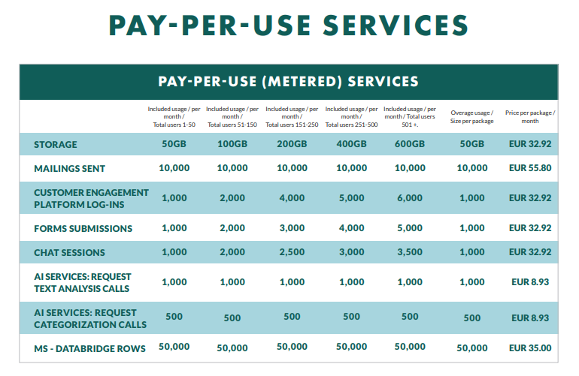
Notes:
What’s changed:
Volumes included in Mailings sent has been increased for all levels. The size of the additional package has also increased.
There are new pay-per-use services for SuperOffice AI and Databridge. The principles remain – a generous volume is included with additional package size and price for overage use.

Slide 28
Future API usage
SuperOffice plan to introduce API usage as a payable service during 2022.
The API Usage system/charge will not deviate substantially from similar CRM vendors in the market.
Metering and Reporting of API load will be included in SuperOffice 10 release in October 2021. Reports will be available to Customers, Partners, Developers and SuperOffice.
Notes:
Charing for API usage is an industry standard and you’ll find all other Saas vendors in the market charge a price for the use of APIs, independent upon type of software.
It is no our ambition to turn this into a major source of income.
The motivation for introducing an API usage service are related to:
Performance
Stability
Quality (sustainability)
Operational cost.
The proactive tools to control API traffic are: education, insights (monitoring, analytics)
The tools to make sure API traffic is not exceeding acceptable levels that affect everyone using the platform include: billing and throttling.
At the moment, we throttle and handle overage usage individually and during 2022 we will also introduce billing.

Slide 29
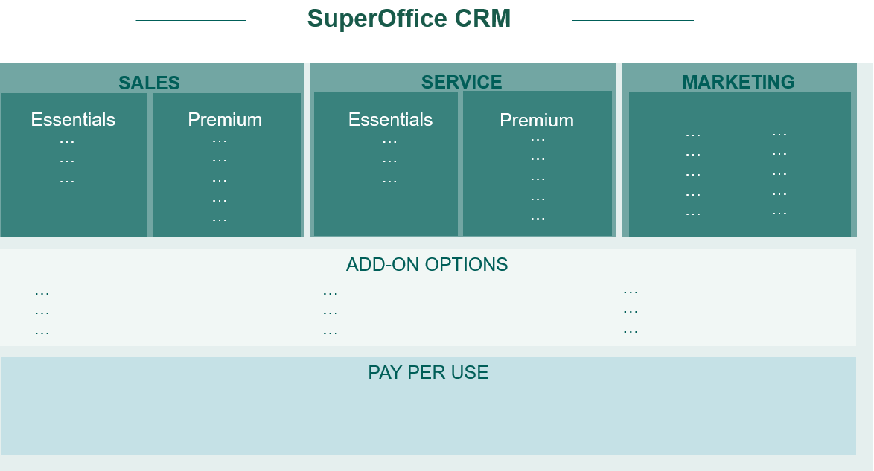
In summary: A more flexible and scalable model
Notes:
The user plan Standard is removed
This plan is dropped to turn the fucus on our 3 main solution areas
The user plan Complete is removed
This plan is replaced with multi plan users
Mailings is only available to users in the Marketing Plan – which is why you have Marketing in your subscription list
Project / Project management is only available in Premium (and Marketing) – but you will still have access to this feature
Combined selections is only available in Premium (and Marketing) – but you will still have access to this feature
We see this as an advanced feature to segmentation/reporting
With new OR capabilities in dynamic and static selections the need for combined is reduced.
This is advanced functionality that requires effort from the users.

Slide 30
Our customer promise:
As an existing customers you will continue to have access to all the same features as before – including your add-ons.
Notes:
Let’s just repeat what we started with – you will not loose access to any features you enjoy today and instead get access to more features and new and improved technologies. ☺
THE NEXT SET OF SLIDES NEEDS TO BE HIDDEN/ADJUSTED TO THE CUSTOMER IN QUESTION

Slide 31
Main changes: Mainly new names
The user plan Standard is removed
Users are converted to Sales Essentials (or Premium if you also already have other Sales/Complete users)
The user plan Complete is removed
This plan is replaced with multi plan users
Mailings is only available to users in the Marketing Plan
Your company will be given the necessary access to Mailings
Project / Project management is only available in Premium (and Marketing)
Your company will be given the necessary access to Project
Combined selections is only available in Premium (and Marketing)
Your company will be given the necessary access to Combined Selections
Expander Services is now called Development Tools
And new features, like Configurable screens, have been added
Notes:
If you have Standard + Sales users, then all users --> Sales Premium + Free mailings
If you have Standard + Service users, then Standard users --> Sales Essentials + Free mailings + Free project
If you have any Complete users, then all users --> Premium user plans
If you have Marketing or Complete users, then add Marketing platform
Remember: All users had Mailings in 9.x, so migration adds at least Free Mailings

Slide 32
Plans
SuperOffice CRM
Sales
Service
Marketing
Essentials
plan
Premium
plan
Essentials
plan
Premium
plan
Marketing plan
Feature list
…
…
…
Feature list
…
…
…
…
…
Feature list
…
…
…
Feature list
…
…
…
…
…
Feature list
…
…
…
…
…
Marketing Platform*
Customer Engagement Platform
Expander Services
Add-ons
Development Tools
CRMScript
SuperMacro
Expander tools
Custom Apps
Sandbox for Dev.
Expander Products
Sandbox for prod.
Database Mirroring
SCIM
DataBridge
Forms
Synchronizer
Chat
SuperOffice AI
Mailings volume
Form submissions
Chat sessions
Customer logins
AI Services calls
API Usage records
DataBridge records
Metered
Services
Coming
Storage volume
Notes:
The user plans contain CRM functionality, that is user-role oriented and configurable and consist of different sets of features based on what tier a customer has.
Add-ons: company/system oriented functionality. Site-license providing ALL users access.
Metered service. We always include a reasonable amount of usage as part of the license price. But since usage sometimes varies heavily between companies, it is fair that significant overage is paid by the company that benefits from it. We think it is both fairness and good psychology in this model.

Slide 33
How does the new price and packaging model affect you?

Slide 34

As a cloud customer:
Features are unchanged. You have been assigned the plan(s) that fit your current access to features.
The price you pay for your current subscription has not changed. other than the 2.9% increase announced.
You will already have been upgraded to SuperOffice 10 and given access to:
The advanced dashboards you can customize
The More tabs layout have changed on the Company and Contact card.
The ability to configure your main Company and Contact screen layout (temporary/because you subscribe to Development Tools)
New, additional users or add-on expansions will follow the current price list.
You can adjust licenses as always – bearing in mind that a downgrade will never be advised given your current price deal.
Notes:
REMEMBER:
NOT ALL customers get the advanced dashboards – they need to have users on a premium plan for this.
The changes in layout is only applicable to customers with UDEF fields and those with Extra Fields in Services – these are now all visible in the More tab and sorted by rank.
The customer may change the rank order – or they can use the Configurable Screen feature (free access to all til the end of the year) to define more how they want this to look.
Existing price level
All customers with an explicit agreement on a specific price level (framework agreements) will be able to buy on this price level until the expiration date of the commercial agreement.
Within these timeframes, we will have to agree on new terms, with the goal of reaching a mutually acceptable agreement.
Existing discount level
All customers with an explicit agreement on a specific discount % level (framework agreements) will be able to buy on the same discount % until the expiration date of the commercial agreement.
Within these timeframes, we will have to agree on new terms, with the goal of reaching a mutually acceptable agreement.
Customers on list price
All other customers, meaning who does not have an agreed price level or discount % level, will in essence have to by additional products according to the new SO 10 price list from October 2021.
In cases like this, we apply ordinary business tactics in upsell situations, and agree on Ts & Cs which bring our upsell deals to closing.

Slide 35
As an onsite subscription customer:
Features are unchanged. You have been assigned the plan(s) that fit your current access to features.
The price you pay for your current subscription has not changed significantly other than the 2.9% increase announced.
You can upgrade to Onsite 10 or migrate to the cloud version of SuperOffice CRM.
When you upgrade/migrate to SuperOffice 10:
Your user plans are converted to the equivalent to the new model
You get access to the advanced dashboards you can customize
The More tabs layout have changed on the Company and Contact card.
The ability to configure your main Company and Contact screen layout (temporary/because you subscribe to Development Tools)
New, additional users or add-on expansions will follow the current price list.
You can adjust licenses as always – bearing in mind that a downgrade will never be advised given your current price deal.
Notes:
REMEMBER:
MORE TAB changes in layout is only applicable to customers with UDEF fields and those with Extra Fields in Services – these are now all visible in the More tab and sorted by rank.
The customer may change the rank order – or they can use the Configurable Screen feature (free access to all til the end of the year) to define more how they want this to look.
NOT ALL customers get the advanced dashboards – they need to have users on a premium plan for this.
Existing price level
All customers with an explicit agreement on a specific price level (framework agreements) will be able to buy on this price level until the expiration date of the commercial agreement.
Within these timeframes, we will have to agree on new terms, with the goal of reaching a mutually acceptable agreement.
Existing discount level
All customers with an explicit agreement on a specific discount % level (framework agreements) will be able to buy on the same discount % until the expiration date of the commercial agreement.
Within these timeframes, we will have to agree on new terms, with the goal of reaching a mutually acceptable agreement.
Customers on list price
All other customers, meaning who does not have an agreed price level or discount % level, will in essence have to by additional products according to the new SO 10 price list from October 2021.
In cases like this, we apply ordinary business tactics in upsell situations, and agree on Ts & Cs which bring our upsell deals to closing.

Slide 36
As a customer on a maintenance agreement:
Features are unchanged. You have been assigned the plan(s) that fit your current access to features.
We will provide you with a very attractive migration/upgrade offering.
Your current version is very out of date!
You can either upgrade to Onsite 10 or migrate to the cloud.
In addition to accessing the latest version, please note:
Windows no longer available
New agreement
New, additional users or add-on expansions will follow the current price list.
You can adjust licenses as always – bearing in mind that a downgrade will never be advised given your current price deal.
Notes:
REMEMBER:
NOT ALL customers get the advanced dashboards – they need to have users on a premium plan for this.
The changes in layout is only applicable to customers with UDEF fields and those with Extra Fields in Services – these are now all visible in the More tab and sorted by rank.
The customer may change the rank order – or they can use the Configurable Screen feature (free access to all til the end of the year) to define more how they want this to look.
Existing price level
All customers with an explicit agreement on a specific price level (framework agreements) will be able to buy on this price level until the expiration date of the commercial agreement.
Within these timeframes, we will have to agree on new terms, with the goal of reaching a mutually acceptable agreement.
Existing discount level
All customers with an explicit agreement on a specific discount % level (framework agreements) will be able to buy on the same discount % until the expiration date of the commercial agreement.
Within these timeframes, we will have to agree on new terms, with the goal of reaching a mutually acceptable agreement.
Customers on list price
All other customers, meaning who does not have an agreed price level or discount % level, will in essence have to by additional products according to the new SO 10 price list from October 2021.
In cases like this, we apply ordinary business tactics in upsell situations, and agree on Ts & Cs which bring our upsell deals to closing.

Slide 37
Cloud vs Onsite in SuperOffice 10
Is the offering exactly the same?
Notes:
Only show this if you have a current onsite/buy customers.

Slide 38
No not exactly – This is Cloud Only:
Features and free add-ons:
Video meetings integration
SuperOffice for Outlook
SharePoint Documents
Google Workplace Documents
Mailing service (Mailgun)
Add-ons
SuperOffice AI
Expander Services
  Database Mirroring Service
  Cross-domain Identity Mngmnt (SCIM)
  Sandbox environment
Metered Services:
Metered services are only applicable for Cloud customers. Onsite customers are using their own services here.
Exception: Databridge
Apps from the SuperOffice App Store:
Apps listed here are only available for Cloud subscriptions.
Notes:
Also – note that if the customer is on BUY and WINDOWS – they will of course have to move to an ONSITE WEB or CLOUD WEB solution.

Slide 39

BUY SuperOffice 8: Stay, Migrate or Upgrade?
SuperOffice 10
Onsite Subscription
SuperOffice Cloud
SuperOffice 10
BUY customers
on SuperOffice 8

Slide 40

Additional Cloud benefits
Complete hosting – no need for inhouse servers or infrastructure related to CRM
Automatic upgrade of the software every 3rd week.
No cost, no hassle, always updated.
High level of security
Open APIs available for custom and standard Apps
Robust, cost-efficient and rich integration platform
Lower cost of ownership & sustainability
Notes:
The software-industry are without exception basing future
innovation on the cloud infrastructure.
On-premise solutions will inevitably become
dramatically more expensive to develop, maintain and operate.

Slide 41

SuperOffice Migration Offering
No cost for any migration technology or migration software. (Consulting is a payable service).
Migration-process is fully automated and fast.
The application offers the same user experience,
the same UI and features. It is the same app!
No need for user training
Database content and structure are migrated as an identical twin. No change..
Notes:
For years we have been paving clear migration roads and laying out red carpets to the cloud for all our customers.
Almost 2.000 customers have chosen to migrate from on-premise to cloud since 2016.
Shall we set up a time to talk about your migration plan?

Slide 42

The Complete
10 Price List
Notes:
Excel ark

Slide 43
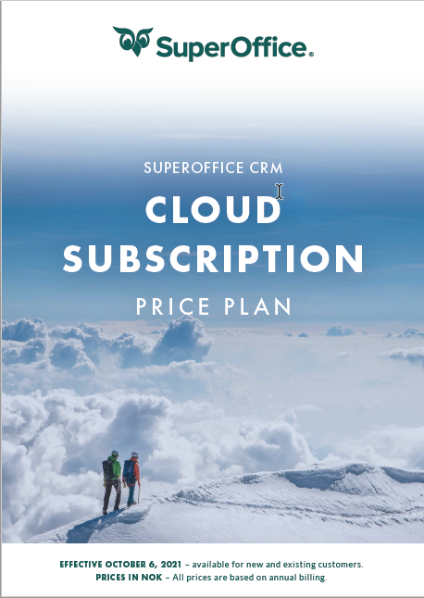
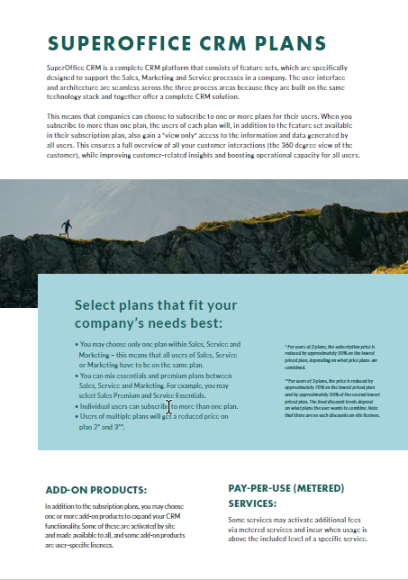
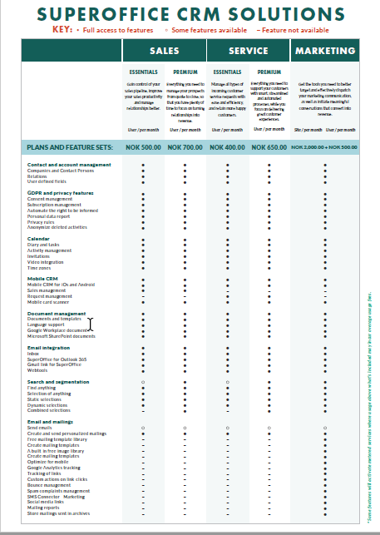
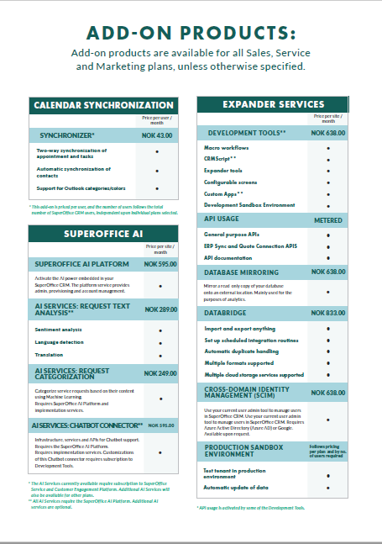
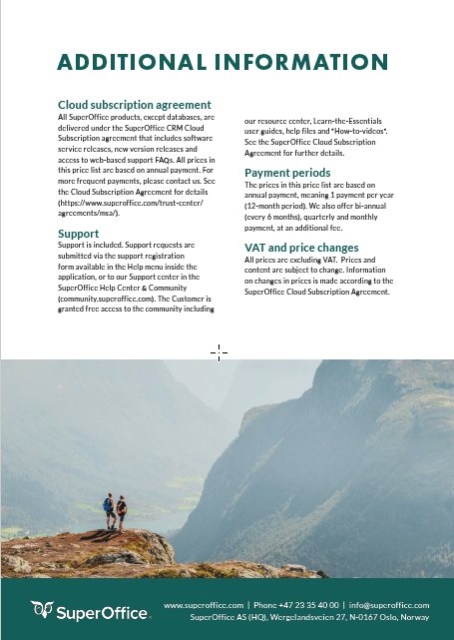
Where can you see the full price list?
Now available to view for customers via the Community
Notes:
https://community.superoffice.com/en/customer/local-content/prices/

Slide 44
Thank you

