Slide 1


HVORDAN DU KAN SKABE
LANGVARIGE RELATIONER
MED CRM

Slide 2
Agenda
Introduktion
Fokusområder
Vejen fremad
Challenges & opportunities

Slide 3

Processen fremad
Meeting 1
  Afdække målsætning for implementering?
  Hvad ønsker I at opnå? Hvilken effekt ønsker I at opleve?
  Hvad ønsker I at måle på? (KPI’s)
  Hvad skal vise, at projektet er blevet en succes?
  Hvilke processer ønsker I at forbedre?
  Integrationspunkter?
  Hvilke risici ser vi i dette projekt?
  SuperOffice Demo:
  Viser hvordan SuperOffice vil dække de ønskede processer og behov
  Præsentation af tilbud
  Underskrift af kontrakt
Meeting 2
Meeting 3
Meeting 4

Slide 4
RELATIONSHIPS
MATTER
Vi hjælper dig med at forvandle relationer til indtjening.
Notes:
We are what we “modestly call a Norwegian/European IT adventure,
More than 30 years experience and HQ and development department in Norway, offices in 8 countries.
Just under half a billion in turnover, 99% of customers choose cloud solution
We help companies find, catch and keep customers - that means we help you improve/professionalize your marketing, sales and customer service processes.
A “fun fact” is that from the very beginning SuperOffice was designed for the user (many systems are design for management (only)), aiming to make the users everyday tasks easier.
If your users wish to use the CRM solution, data is added, data quality is high, and the management get their updated dashboards and reports.

Slide 5

CRM
Det handler om at optimere virksomhedens værdi ved systematisk at udvikle kundeporteføljen
Kilde: MarkUp Consulting
Notes:
Before we talk about how to succeed with CRM we need to talk about what CRM is...
CRM is about developing your customerportfolio to the highest possible value, you can do this by adding new customers, selling more to those you have or being so good at customer care that you reduce customer churn.
Loyal customers also makes it easier to get more customers (word of mouth).
Before you start implementing CRM, you should have decided - from a business standpoint – what it is you want to achieve

Slide 6
Hvordan planlægger I at skabe vækst?
Kundens værdi
Mersalg til
eksisterende kunder
Kundeportefølje
Vinde nye
kunder
Reducere
kundeafgang
Kunde
livstid
Afvikle urentable
kunder
Kilde: MarkUp Consulting
Notes:
… In terms of customers, their value is measured in how much they buy from you and for how long
No matter what your strategy is, whether you sell to new or existing customers, customers must be recruited .. and retained
You must eventually prioritize; you choose to invest in the customers who have the greatest potential and disengage with those not profitable for you

Slide 7

CRM ER STRATEGI
Hvem ønsker du at være?
For hvem?
Og hvordan?
Enhver CRM succes starter med en klar ambition
Notes:
More than anything; CRM is a strategy...
It is about deciding who you want to be – what are your strengths in the market,
for whom – who are your customers (ICP), what segment are you going for?
And how will you succeed? Where are your competitive strengths?
We dare say, that in our 30+ years of experience we find that; All CRM successes start with a clear ambition: what do you want to get better at? Where are you going to beat the competition?

Slide 8

ANSATTE
CRM
KUNDER
Notes:
Also, if you’re going to deliver customer experiences that are better than the competitors', it is about understanding that CRM has "two faces":
- On one hand, it is how you enable your employees to deliver unsurpassed customer experiences with the help of insights, customer data, key figures and process support.
Example – In SuperOffice, all sellers start every morning with a dashboard showing which customers have become “orphans” over night, in other words what customers have not been followed up according to the customer program.
- On the other hand, it's how you enable customers to help themselves 24/7 by making information available and securing communication both ways.

Slide 9
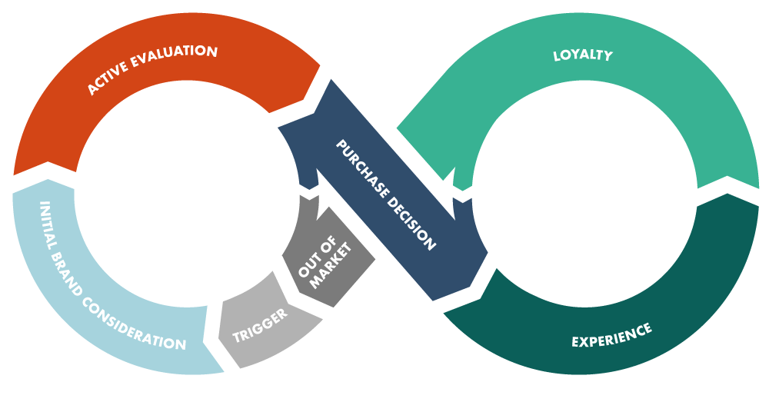

HAR I KORTLAGT
KUNDEREJSEN?
Notes:
One way to see both of these views/faces is by designing the customer journey; meaning - from the customer's point of view, think through (from start to finish) what it is like to be a prospect, to buy from - and to be a customer of your company.
How smooth and uninterrupted this experience/journey is what determines whether you are better than the competition.
A customer journey contains all the meeting points the customer has (and should have) with you as a supplier.
Many companies have not designed a full journey, but rather have routines for what to do when you get a lead, how to land a sale and how to hancle a complaint. The power lies in everything you do between these touch points as well.

Slide 10

En smidig
KUNDEREJSE giver en konkurrence- mæssig fordel
Findes der noget i værktøjskassen, eller må hver eneste virksomhed genopfinde hjulet?

Slide 11









EN PLATFORM TIL VÆKST
MARKETING
Kunde-
platform
AI as a Service
Brugervenlighed
SALES
SERVICE
Integrationer
(App Store & APIs)
Marketing Automation
Mobil
Nye funktioner
Produktivitetsplatform
(Office365/Google)
Notes:
The core functionality is the foundation / basis for everything we do.
Here, of course, lies a lot of functionality, productivity and improvement in sales, service and marketing.
In addition to this, there are areas that SuperOffice see as strategic and will work with for the next 2/3 years. These are also the dominant trends in CRM.
We will not go in depth on every single point, but want to highlight the ones we see as the most valuable when it comes to you being able to create good customer experiences and support your customer journey.
AI: There is a lot of “hype” around artificial intelligence these days. The most important changes AI will bring to CRM involve automation (elimination of time consuming and manual tasks) as well as improvement of existing conversation tools / Chatbots.
By using data, the chatbot will be able to predict the next question and provide additional information the customer may need. In the long run, these will be sophisticated enough so that we can not separate humans from machines.
Integrations: Available by offering standard integrations in the form of Apps (available in our own App Store), as well as well-documented and intuitive tools (APIs) for creating your own customizations, CRM systems will strengthen their position internally and include all interactions and transactions with customers.
This allows companies to get an overall customer overview and allows for more relevant, high quality customer service.
CEP: SuperOffice's platform for customer-facing applications. This includes; customer center, case management, Knowledge base, chat and web forms. Here we offer tools that can support and assist you in interacting with customers on the surfaces they operate.
Mobility: about 48% of the world's population owns or has access to a smartphone (almost 100% of the western world). Increased use of mobile phones, increased use of home offices and working across more geographical distance have redefined the way many companies think and run their business.
CRM technologies has evolved in line with the changing trends in the digital world. Access to CRM data and the ability to perform daily tasks on the phone has become a requirement.

Slide 12















Slide 13
Resultater fra Survey

Slide 14


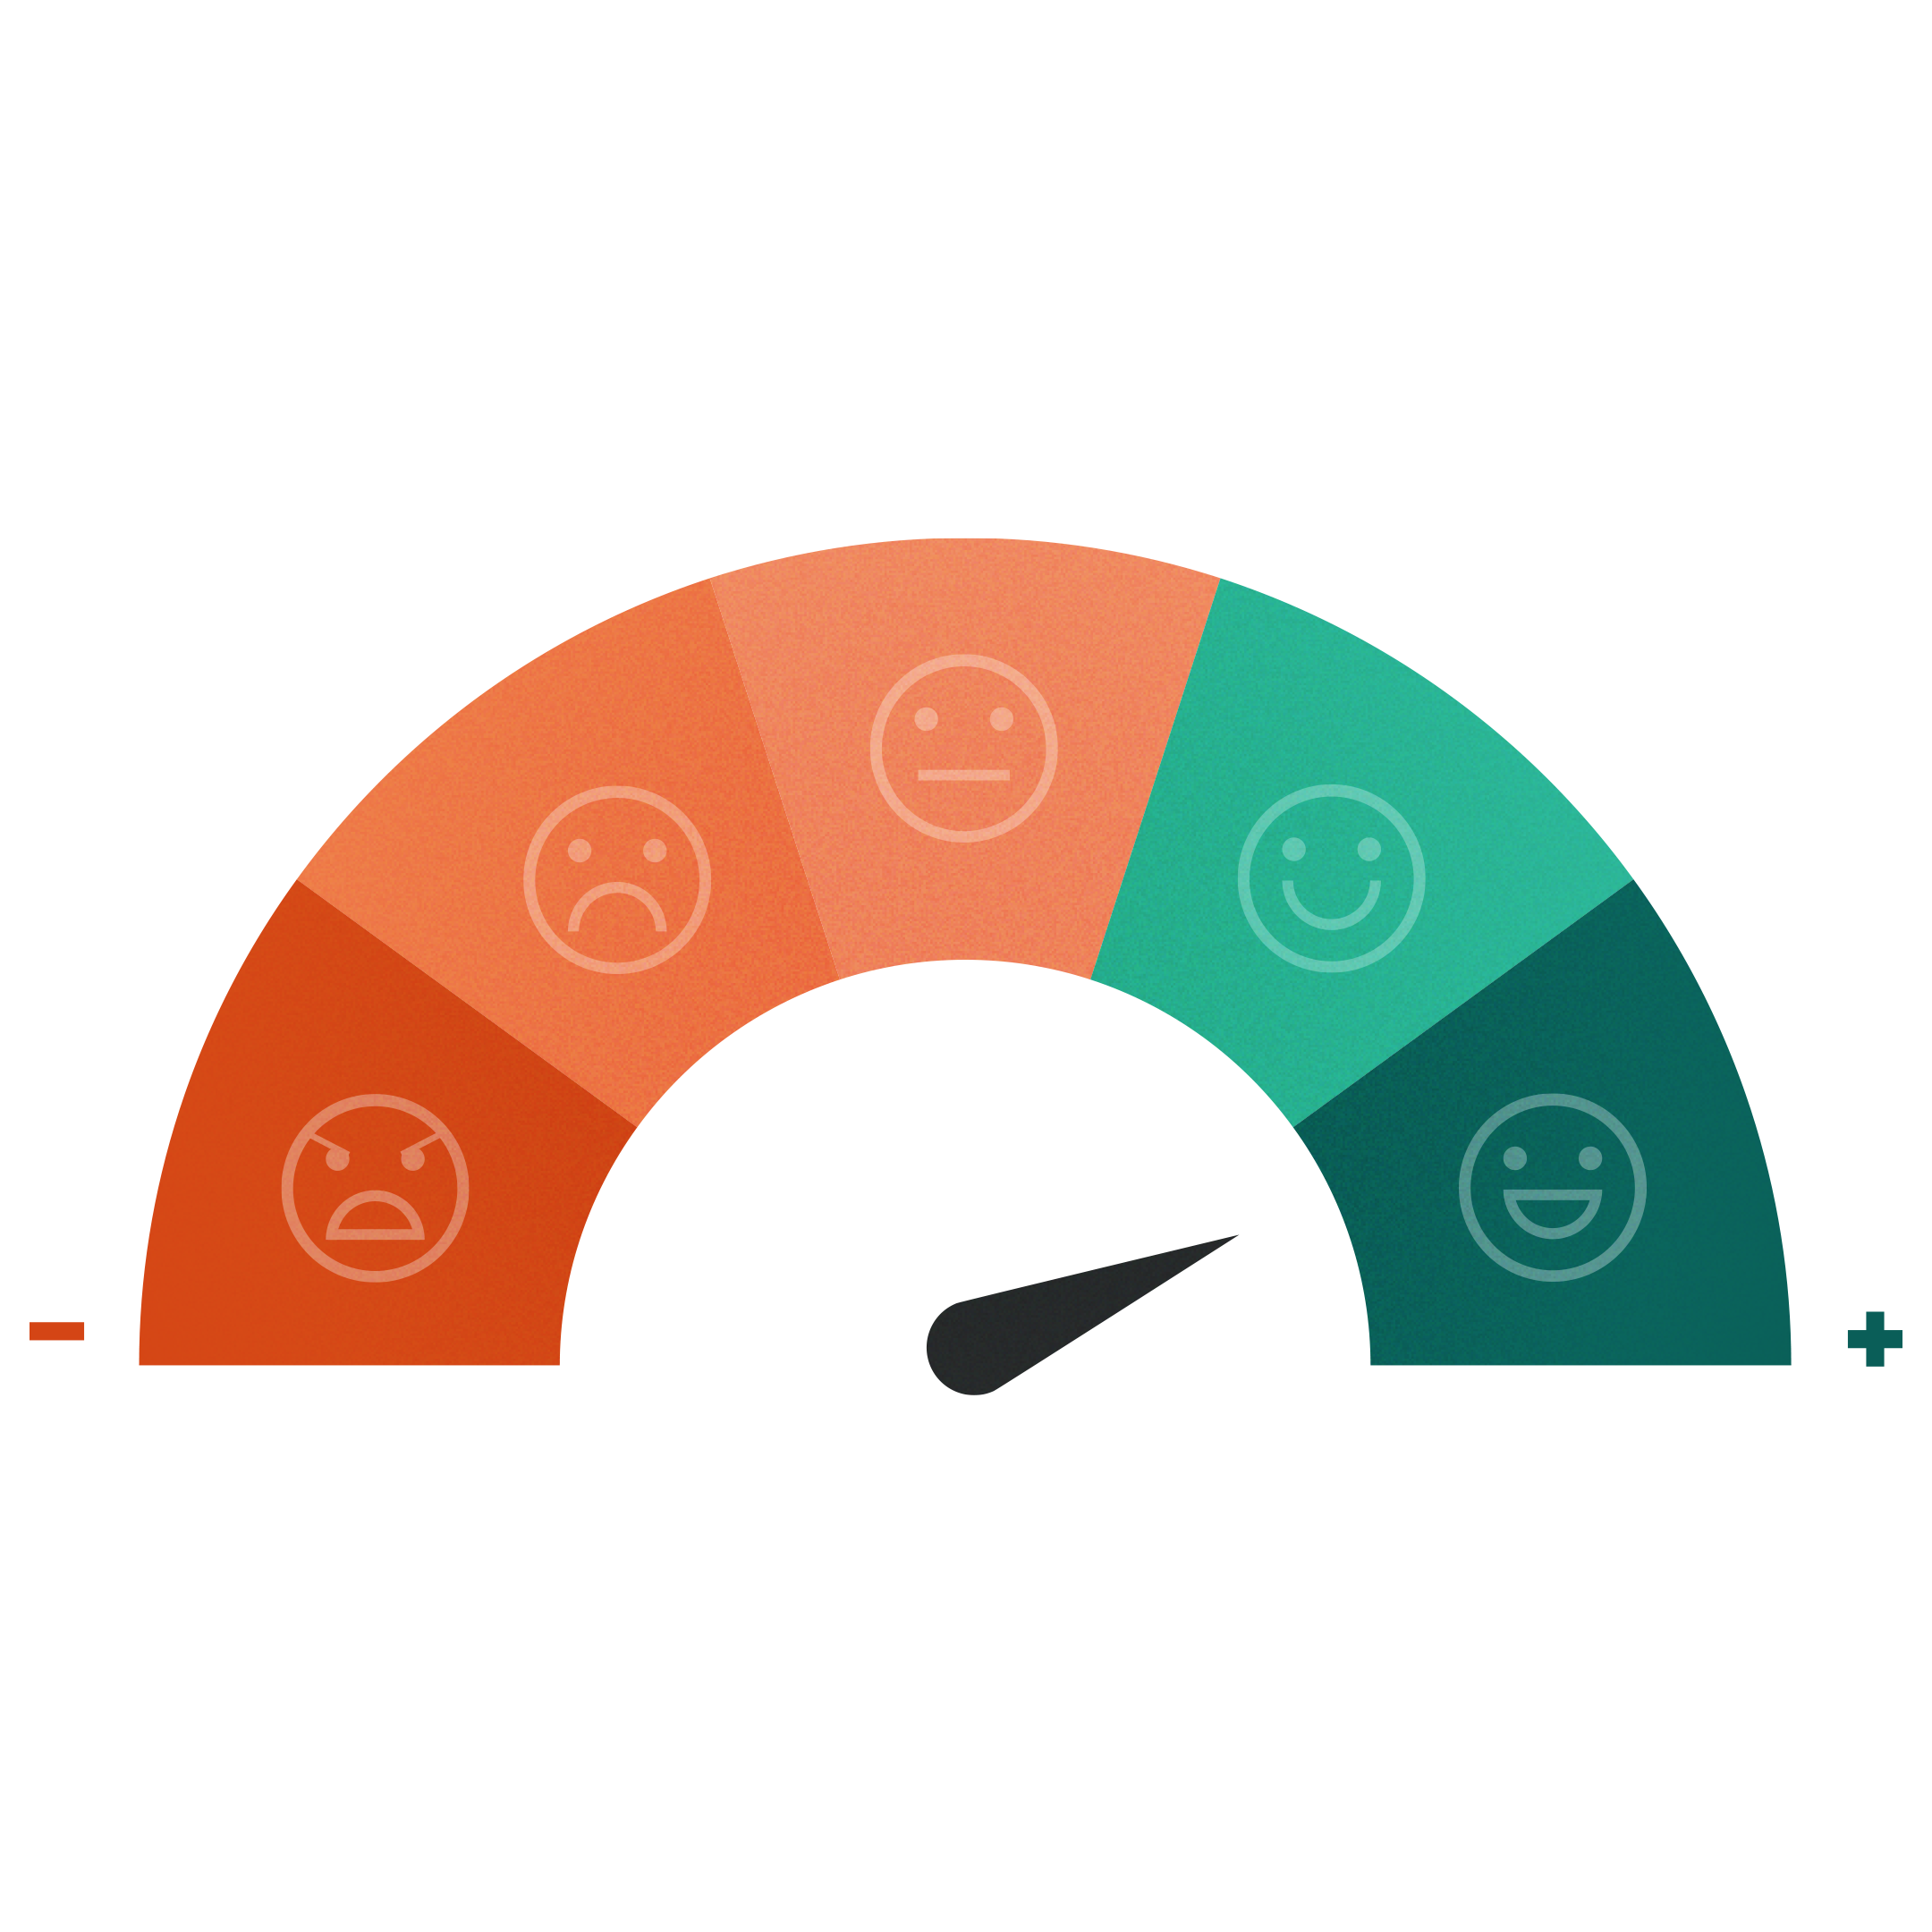
ALT HVAD DU HAR BRUG FOR
ÉT STED
Notes:
We help companies find, catch and keep customers - that means we help you improve/professionalize your marketing, sales and customer service processes.

Slide 15
















360° kundeoverblik
Kunde
Salg
Dokumenter
Person
Projekter
Sager
CRM
Kalender
Udsendelser
Notes:
360 degree customer overview
A 360-degree customer overview a collection of all customer data in one place. It allows you to find all customer info, data on all past and present purchases, all dialogue with customer service and customer behavior in social media. It shows a relationship as an ongoing loop with all the touchpoints where the customer is in contact with the brand. It can either be through purchases or marketing communication, through customer service or in social media.

Slide 16
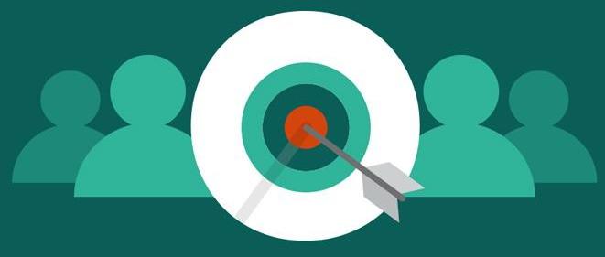
INBOUND OG OUTBOUND MARKETING
Ambitionen for enhver virksomhed er at tjene penge, og markedsføring er afgørende for at nå dette mål.

Slide 17

74 % af virksomhederne har konvertering af leads til salg som deres højeste prioritet.
Næsten 40% af alle virksomheder kæmper med prospektering.
Hvordan kan du nemmere (og automatisk) indhente leads?

Slide 18
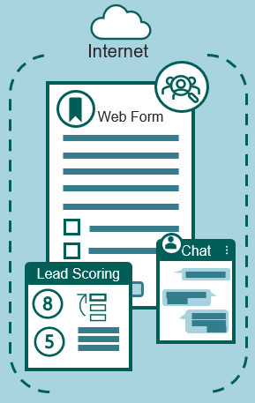

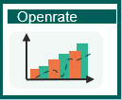

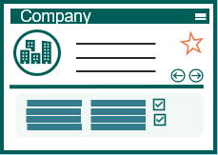
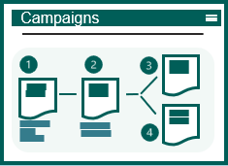


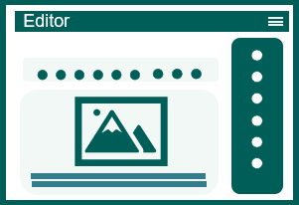


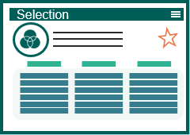
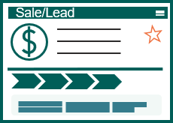
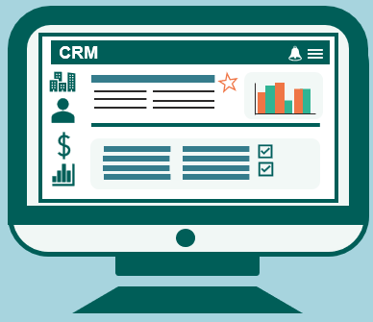




SuperOffice Marketing
Generering af leads / Inbound Mkt
Outbound
Klik opdaterer CRM system
Statistik pr.kampagne
CRM database
E-mail flows
Notifikation rette person
E-mail editor
Segmentering
CRM database
Junkmail
Notifikation til person
Privacy e-mail
(GDPR)
E-marketing samtykke automatisk kontrol før udsendelse

Slide 19




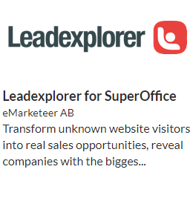
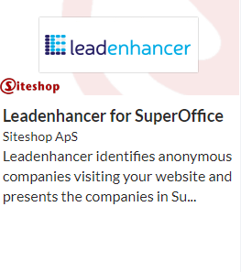








Generering af Leads / Inbound Mkt
Nyttige Apps
Internet
SuperOffice App Store
CRM database
Notifikation rette person
Web Form
Company
Person
Sale/Lead
Chat
Lead Scoring
Notifikation til person
Privacy e-mail
(GDPR)
Direkte integration mellem CRM og valgte App*
* Separate aftaler, priser og betingelser gælder for App køb
Notes:
Automation via Web Forms, chat and lead scoring:
Web forms in themselves are not something new, this is probably something most people have available and offer today.
But it is about meeting the customer's expectations in terms of response, availability and expected response time.
Therefore, imagine that you offer to post digital forms on your website and give potential and existing customers an interactive experience where they can easily fill out and return forms directly from the device, no matter where they are.
These are linked directly to the CRM system so that the information is automatically created, notifications sent to the customer regarding privacy, legal basis and consent.
This makes it easier to collect data, have control of all incoming leads and be compliant with the legislation (GDPR) and be notified in the form of an agreement, task directly in the system so that you can contact the customer immediately after submitting the form.

Slide 20
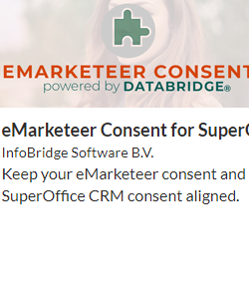
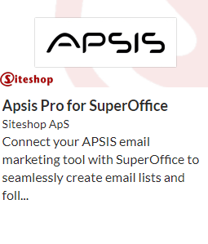










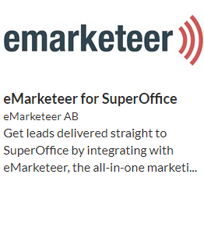


SuperOffice Marketing (Outbound)
Nyttige Apps
Statistik pr. kampagne
Klik opdaterer CRM system
E-mail flows
SuperOffice App Store
Openrate
E-mail editor
Campaigns
Segmentering
Editor
CRM database
Selection
CRM
Junkmail tagged
E-marketing samtykke automatisk kontrol før udsendelse
Direkte integration mellem CRM og valgte App*
Marketing Brugerkategori
* Separate aftaler, priser og betingelser gælder for App køb
Notes:
Outbound Marketing
Knowing exactly what you want to achieve with your mailing is the key to the success of any marketing campaign. It is basically about defining the target group (Who will receive information from you), What do I want to communicate (the message you want to convey), When will I carry out the actual campaign / mailing (experiences you have made from previous about when recipients read e -the mail). And last but not least; how do I measure the effect of the campaign (how many read, clicked on, failed, etc.). Target group is defined in selections based on the segmentation you want (consent, interests, geography, size, etc.) Message: Create your own designs or use ready-made "out-of-the-box" in our template library. Modern email editor allows you to easily design your own using drag and drop functionality. Measure the response using standard reports and statistics per. Mailing.

Slide 21

SALG I CENTRUM!
Virksomheder, som implementerer en struktureret salgsproces, øger salget, produktivitet og får mere nøjagtige forecasts.

Slide 22

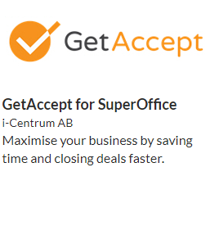
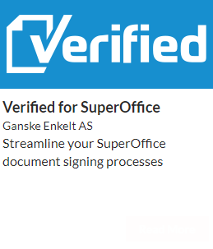
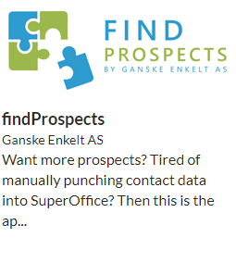
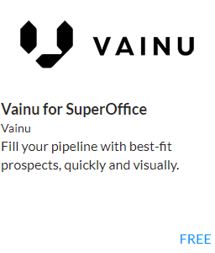


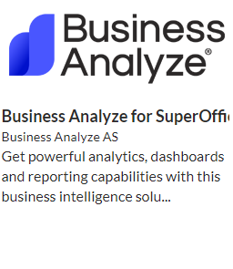
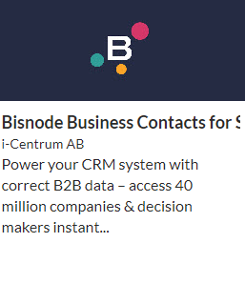







SuperOffice Sales
Nyttige Apps*
Tilpasset Dashboard
SuperOffice App Store
Salgsmulighed registreres
Standard Dashboard
Sale
Prognosis
Tilbud
Produkt & priser
10%
30%
60%
80%
10%
30%
60%
80%
99%
Tilbud
Product
$
Salgsproces
(Guide)
%
Interessenter
Direkte integration mellem CRM og valgte App*
Produktregister
Sales Standard
* Separate aftaler, priser og betingelser gælder for App køb
Sales Professional
Notes:
Sales
Stakeholders: In complex sales processes or in project sales, it’ss necessary to have control over all parties involved (partners, internal, suppliers, etc.) By using stakeholders, you will at all times have a complete overview of companies, people and roles being involved in the project.
Sales guide The guide takes the salespeople through each step of the sales process, automatically provides suggestions for documents that must be created along the way, while suggesting which activities should be carried out in each phase and which tools should be used to gain control and progress in the process. Work structured and smarter.
Quotes / Products: The offer process is streamlined and assists sellers in preparing professional quotes/offers. You select the product and quantity from the product register and enter discounts (can be retrieved directly from the ERP system), automatically an offer is being created and simultaneously the pipeline is being updated with the amount and sale date. Once the quote has been generated and sent to the customer, SuperOffice CRM will remind you to follow it up. SuperOffice CRM also provides an overview of the different versions of the offer, so you always know what you have offered when.
Reports / Forecast: Detailed overview of results, pipeline and activity level for each individual employee or per. team through standard Dashboards with Drilldown functionality. This helps you make the right decisions on where you may need to improve processes or solve issues, as well as how you can take advantage of new opportunities.
.

Slide 23

KUNDESERVICE I VERDENSKLASSE
Positive kundeoplevelser skaber mersalg, større kundeloyalitet og øget forretningsvækst.
Notes:
A RightNow Technologies Customer Experience Report found that 86% of U.S. adults are willing to pay more for a better customer experience and 73% of U.S. adults said a friendly customer service made them fall in love with a brand. Not only will brands get happy, loyal customers but will see increased business.

Slide 24



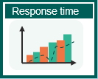




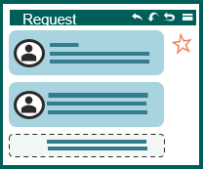
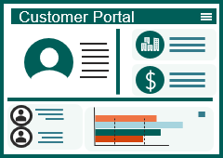



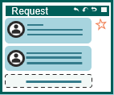


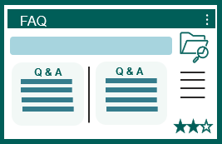
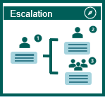



SuperOffice Service
Service for ansatte
Service for kunder
Login
Kvittering til afsender
Notifikation til medarbejder
Standard Dashbord
Person Info inkl. GDPR (samtykke)
Firmainfo
Indkommende sager
Historik
CRM information tilgængelig for dine kunder
Script og Makroer
Kategorisering
Prioritet
Registrering af sag
Kontrakter & aftaler
Status
Vidensbase (FAQs)
Samarbejde
Live Chat
Ordreformular
Statistik / Brug

Slide 25























SuperOffice Service
Tilpasset Dashboard
Kvittering til afsender
Notifikation til medarbejder
Standard Dashboard
Historik
Indkommende sager
Response time
Scripts & makroer
Request
Automation
Kategorisering
Prioritet
Status
Escalation
FAQ
Q & A
Q & A
Deadline Prioritet
Vidensbase (FAQs)
Samarbejde
Eksterne links / autosvar
Automatiseret rollebaseret eskalering
Service Standard
Service Professional
Notes:
Service
The solution is built to receive, track and follow up customer inquiries regardless of channel (e-mail, telephone, chat, form, etc.). The employees will have access to the functions needed to respond quickly, consistently and efficiently. At the same time, you get an overview of the entire process, based on real-time data, so that you have full control over customer requests and your employees. SuperOffice Service is flexible and easy to customize. You can set up workflows, triggers and tasks that suit you and your business. Automatic answers and intelligent case flow ensure that your customers always get the attention they deserve, and that the right person helps them at the right time.
Each request is automatically assigned a unique reference number and a place in the queue system. The number tracks all communication related to the inquiry. The layout makes employees more focused and efficient, and you avoid personal preferences and unanswered inquiries. With automatic categorization and assignment to the right person, you save a lot of time and resources. Setting up email accounts and filtering by keywords is easy, and you no longer have to waste time sorting and distributing your inquiries. If a request is left unanswered after a defined deadline, the system will automatically escalate the case.
Statistics: You can use built-in functions in SuperOffice to gain insight into how companies and teams do it, in real time. A brief glance at the dashboard gives you an immediate overview of the status of inquiries and cases in the queue. SuperOffice also automatically analyzes historical data. The system shows you exactly how the inquiries have developed, and the service team has performed over time, while highlighting what you can improve on.

Slide 26

67 % af kunderne foretrækker selvbetjening fremfor at tale med en repræsentant for virksomheden.
Hvordan kan din virksomhed imødekomme de stigende krav til selvbetjening 24/7 uden at ansætte en masse mennesker?

Slide 27




Customer Engagement Platform
Personinfo inkl. GDPR
(samtykke)
Login
Person
Firmainfo
CRM information tilgængelig for dine kunder
Company
Customer Portal
Registrering af sag
Request
Kontrakter & aftaler
Contracts
Chat
Dashboard
Web Form
Live Chat
Ordreformular
Statistik / Brug
Notes:
Customer center:
If we take what we know about the customer's behavior and expectations of their suppliers.
Imagine a solution where customers (within B2B) log in to a portal (like “my page”) where the information in your CRM is available to them.
Here the customer gets immediate insight into Company information, employees in their company, the opportunity to change their own data.
As well as extended customer service where the logged in can get access to history on their inquiries/requests as well as the ability to create new.
They can chat with the vendor, fill out order forms, book appointments, get overview of invoice history and agreements / contracts and not least insight into reports and dashboards.
This gives the customer the opportunity and tools to conduct excellent customer service via their own self-service portal.

Slide 28
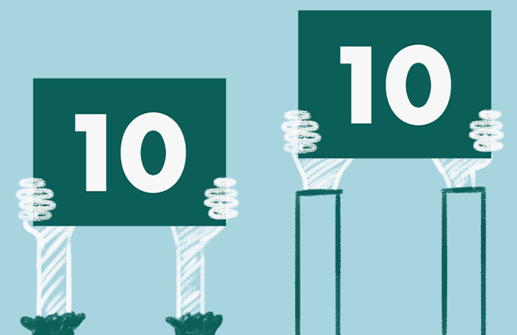
Kunder forventer stadigt hurtigere og bedre svar, samtidig er der pres på omkostningerne som aldrig før.
Hvordan leverer du mere og bedre med mindre?

Slide 29






Bedre service med SuperOffice AI
Indkommende sag
Request
Chatbot
Kvittering for indsendt sag
Tekstanalyse og oversættelse
Stemning
Kategorisering
Notes:
SuperOffice AI
There are constantly increased demands on customer service, How does CRM and AI technology help here?
Take for example a company that operates in several countries, which may have relocated all customer service / support agents to one location. Customers expect to be served in local language.
Imagine that staffing is reduced so that all resources are set to answer all customer inquiries. A request from a customer is submitted.
This is an important customer who has a big problem and expects quick and high-quality response.
Based on a service that uses natural language processing, the computer will work and interpret text as we humans do. By extracting opinions, content and sentiment based on text.
The case officer will be presented with the opportunity to translate this into their own language. It is also then possible to connect Chatbot in the system

Slide 30

Den rette brug af IoT med CRM giver dig mulighed for at være proaktiv og løse problemer, før de opstår.

Slide 31



Proaktiv kundeservice - IoT
CRM system
Kundeindsigt
Intelligente stole
Company
Dashboard
CRM system
Request
Notifikation om
ny sag
Notes:
The Internet of Things!
In practice, this means that all units that we interact with daily are Online. The freezer, refrigerator, heater, etc.
This example is taken from a customer who delivers chairs to their customers. Each chair has a built-in computer chip that will then be able to measure usage behavior, errors and omissions.
Let's look at how this, together with CRM technology, has helped this customer increase customer satisfaction and improve their own reputation.
When a fault or defect is discovered in the chair, it will automatically be able to report this to the supplier by creating a case in their CRM system.
The case will be linked to the correct chair and we will notify the case officer via SMS. The content and priority of the case depends on the type of error registered by the chair.
The supplier will then be able to act correctly based on the type of error.
The behavior and history of the chairs are stored and displayed in the CRM system in real time.
Statistics and Dashboard can be extracted and monitored so that the supplier has 100% insight at all times.
Solving a problem before it arises is the ultimate customer service.

Slide 32
EN CRM PAKKE DER SAMLER FORRETNINGSPROCESSER
Notes:
To sum up, with SuperOffice CRM you gain a modern, forward-thinking CRM solution that unites your business processes, utilizes the latest technology & helps you grow your business.
SuperOffice CRM offers the tools to optimize your processes and bridge the gap between customer data and revenue.
Because it is a standard cloud-based application, it allows you to get started fast and to follow the best practices of hundreds of thousands of CRM users.
A wide range of ready standardized apps available in our App Store help you connect your SuperOffice CRM with your other business tools. And with the help powerful customization tools, you can also customize your CRM solution to fit your business needs and expand it as your business grows.

Slide 33
SuperOffice Implementation Method (SIM)
FASER
01
IDENTIFY
02
INITIATE
03
DESIGN
04
IMPLEMENT
05
ONBOARDING
IDENTIFICER BEHOV/ OMFANG AF LØSNING
BESKRIV PROJEKT
OG INITIER
SPECIFICER OG DESIGN AF LØSNING
KONFIGURER OG REALISER LØSNING
SIKRE LANGSIGTET EFFEKT
Tidsforbrug for kunde i projektet:
STYREGRUPPE
Ejer af projektet
PROJEKTLEDERE
Ansvar for projektet
PROJEKTTEAM
Arbejder på projektet
REFERENCEGRUPPE
Deltagere i projektet
Estimeret tid forbrugt på projektet
2 timer / måned
Estimeret tid forbrugt på projektet
6-8 timer / uge
Estimeret tid forbrugt på projektet
2-5 timer / uge
Estimeret tid forbrugt på projektet
To be decided
Notes:
One of the ways we ensure our customer achieve success with SuperOffice is providing a helping hand from the start and through all phases of your CRM implementation.
We bring with us a well established and proven methodology – we call it SuperOffice implementation Method – or SIM for short, that oulines what everyone will do each step of the way.
Key phases include:
IDENTIFY: Were we gain an overview and understanding of your needs and what the solution should contain. We do this phase also to ensure that we are alighned and to offer you realistic quottions on the products and services required in addition to define a realistic timeline. You work with one of our experience project managers at this stage.
INITIATE: During this phase we work to make the goals more concrete, the key KPIs, scope and we agree on how to organise the project. We seek your top management involvement – as this is always critical - and that you create a project team to ensure a sueccessful change management which ineviatbly a project like this is.
DESIGN: This stage we perform various workshops to align KPIs, and the workflows and specific requirements that will be supported by SuperOffice CRM. This will be the basis for the design and automations to add as well as user-training.
IMPLEMENT: The execution of various workshops to meet specific needs for example for data import, integrations, automations, templates and so on
ONBOARDING: Finally we work to ensure the success of your change management journey and onboarding of your new CRM solution and CRM strategy. WE do this through various workshops and user-training.
Together with your team, we are here to help you get the most of your CRM solution.

Slide 34

EN CRM PARTNER, SOM HJÆLPER DIG MED AT SKABE VÆKST
Notes:
All that remains is to end with a CRM advice; after more than 30 years of experience and several thousand implementations/projects;
Success with CRM does not depend on the software, but on how the CRM-provider helps you to translate your CRM-ambition, challenge you to be pragmatic, help you focus on supporting the processes and ensures that your people are involved and onboarded.
Choose cloud-based, choose a supplier that has standardized a lot so you avoid unnecessary tailoring – like SuperOffice… ☺

Slide 35
Mål og effekt ved implementering af CRM
Hovedmål og største udfordringer
Løsningsbeskrivelse
Øge markedsandele fra 10-15% til 30% over 5 år
For at opnå dette må I effektivisere og strømline processer i service og support
I dag arbejder I i forskellige systemer, hvilket betyder, at I ikke arbejder effektivt og mangler fælles rutiner, regler og processer for sagshåndtering
Ønsket effekt ved implementering
KPIs
Øge intern kapacitet ved at strømline brugen af ressourcer til service og support
Større kundeloyalitet gennem bedre indsigt og automatiserede processer
Øget kontrol over kundebasen og data vil strømline kommunikationen med kunder
Fælles rutiner og processer vil bidrage til at nå vækstmål ved at reducere risici og forbedre effektiviteten.
Risici

