Slide 1


HOW TO CREATE
LONG TERM RELATIONSHIPS
WITH CRM

Slide 2
Agenda
Introductie
Focus punten
Het traject
Challenges & opportunities

Slide 3

Het proces
Meeting 1
  De doelen van de CRM implementatie
  Wat willen jullie bereiken met CRM?
  Wat willen jullie meten? (KPI’s)
  Welke eigenschappen maakt het project een succes?
  Welk process willen jullie verbeteren?
  Zijn er integraties benodigd?
  Welke mogelijke risico’s kent het project?
  SuperOffice Demo:
  Demonstratie van hoe SuperOffice jullie wensen en behoeften invult
  Offerte presentatie
  Tekenen van contract
Meeting 2
Meeting 3
Meeting 4

Slide 4
Relationships matter
We help you turn relationships into revenue.
Notes:
We like to start off by highlighting our core belief that “Relationships matter”.
It means that business growth requires strong and long-lasting relationships between people – and that is true no matter what industry you are in.
So, we are a high-tech company passionate about enabling and empowering people, both your employees and your customers.
In fact, from the very beginning, SuperOffice CRM was designed with the individual user in mind - as opposed to so many systems that are designed for management (only). Our design philosophy is to make everyday tasks easier and help users to be more productive. Our 30+ years of experience tells us that the improvement of personal productivity is still a core benefit and key strength of our product. And is something our customers value greatly.
It taps into the simple truth that when you empower your users, so that they want to use your CRM solution, data is added, quality is high, and management gets their up-to-date dashboards and reports they need to steer the company in the direction of revenue increase.
We are a Norwegian company, a European IT adventure we like to say. Our HQ and the development department are located in Oslo, and we have offices in 8 countries across Europe. Our turnover is just under half a billion (NOK?) and 99% of our customers choose the cloud solution.

Slide 5

CRM
gaat over het maximaliseren van de waarde van de onderneming door het systematisch ontwikkelen van de klantenportefeuille
Source: MarkUp Consulting
Notes:
Before we talk about how to succeed with CRM we need to talk about what CRM is...
CRM is about developing your customerportfolio to the highest possible value, you can do this by adding new customers, selling more to those you have or being so good at customer care that you reduce customer churn.
Loyal customers also makes it easier to get more customers (word of mouth).
Before you start implementing CRM, you should have decided - from a business standpoint – what it is you want to achieve

Slide 6
Wat is jullie groeistrategie?
Customer
value
Upsell to
existing customer
Customer portfolio
Win new
customers
Reduce
churn
Customer
lifetime
Disengage with
non-profitable customers
Source: MarkUp Consulting
Notes:
… In terms of customers, their value is measured in how much they buy from you and for how long
No matter what your strategy is, whether you sell to new or existing customers, customers must be recruited .. and retained
You must eventually prioritize; you choose to invest in the customers who have the greatest potential and disengage with those not profitable for you

Slide 7

CRM IS STRATEGY
Wie wil je zijn?
Voor wie?
Hoe?
Elk CRM-succes begint met een duidelijke ambitie
Notes:
More than anything; CRM is a strategy...
It is about deciding who you want to be – what are your strengths in the market,
for whom – who are your customers (ICP), what segment are you going for?
And how will you succeed? Where are your competitive strengths?
We dare say, that in our 30+ years of experience we find that; All CRM successes start with a clear ambition: what do you want to get better at? Where are you going to beat the competition?

Slide 8

Werknemers
CRM
Klanten
Notes:
Also, if you’re going to deliver customer experiences that are better than the competitors', it is about understanding that CRM has "two faces":
- On one hand, it is how you enable your employees to deliver unsurpassed customer experiences with the help of insights, customer data, key figures and process support.
Example – In SuperOffice, all sellers start every morning with a dashboard showing which customers have become “orphans” over night, in other words what customers have not been followed up according to the customer program.
- On the other hand, it's how you enable customers to help themselves 24/7 by making information available and securing communication both ways.

Slide 9
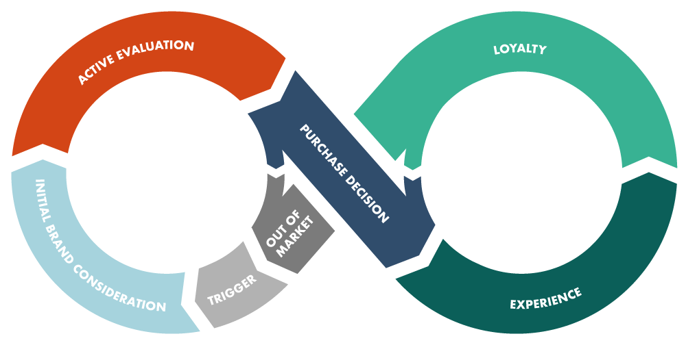

Wat is jullie
CUSTOMER JOURNEY?
Notes:
One way to see both of these views/faces is by designing the customer journey; meaning - from the customer's point of view, think through (from start to finish) what it is like to be a prospect, to buy from - and to be a customer of your company.
How smooth and uninterrupted this experience/journey is what determines whether you are better than the competition.
A customer journey contains all the meeting points the customer has (and should have) with you as a supplier.
Many companies have not designed a full journey, but rather have routines for what to do when you get a lead, how to land a sale and how to hancle a complaint. The power lies in everything you do between these touch points as well.

Slide 10

Een duidelijke
CUSTOMER JOURNEY levert een concurrentie voordeel op
Zit er iets in de SuperOffice toolbox, of moet elk bedrijf het wiel opnieuw uitvinden?

Slide 11









Het platform voor groei
Customer Engagement Platform
MARKETING
AI as a Service
Useability
SALES
SERVICE
Integrations
(App Store & APIs)
Marketing Automation
Mobile
New functions
Productivity Platform
(Office365/Google)
Notes:
SuperOffice CRM is a platform that helps you convert your prospect and customer data into tangible actions and achieve your goals.
By connecting different customer data into one single view and optimizing workflows, SuperOffice CRM gives your sales, marketing and service professionals immediate access to all customer-related insights, helping them to foster stronger relationships and take informed actions to grow revenue.
The platform offer your teams a set of the core functionality that’s the basis of our system which ensures a shared view and the ability to work productively as individuals and collaborate as teams.
In addition, we offer deep functionality to support and improve your processes within sales, marketing and service – individually and collectively. Whatever your business needs at this moment in time to grow.
Furthermore, SuperOffice contain a range of value-added capabilities that allow you design a CRM solution that fit your business now and in the future.
For example, you can benefit from capabilities such as:
AI: There is a lot of “hype” around Artificial Intelligence these days. The most important changes AI will bring to CRM involve automation (elimination of time-consuming manual tasks), as well as improvement of existing conversation tools / Chatbots.
By using data, the chatbot will be able to predict the next question and provide additional information the customer may need. In the long run, these will be sophisticated enough so that we can not separate humans from machines.
Integrations: Standard integrations are available in the form of apps (in our own App Store), as well as a number of well-documented and intuitive tools (APIs) for creating your own customizations.
All this allows companies to get an overall customer view and allows for more relevant, high quality customer service.
CEP: SuperOffice’s platform for customer-facing applications. It includes a customer center, case management, Knowledge base, chat and web forms. Here we offer tools that can support and assist you in interacting with customers on the surfaces they operate.
Mobility: about 48% of the world's population owns or has access to a smartphone (almost 100% of the western world). Increased use of mobile phones, increased use of home offices and working across more geographical distance have redefined the way many companies think and run their business today.
Our mobile app for phones and tablets lets you easily access all your important customer information at anytime and from anywhere. Get full access to your CRM data and perform urgent cases and tasks you have forgotten even if you’ve left the office and you’re away from your PC or Mac. Mobile CRM runs on Android and iOS.
All these are a part of the solution and ensures that your CRM solution support all aspects of your business you need and to help you turn your relationships into revenue.
And some customers who have been growing using SuperOffice CRM include: CLICK

Slide 12












Notes:
Adapt this slide for each vertical/customer
Have a look at the customers we have in your line of business / vertical / etc.
We understand you!

Slide 13
Results from Survey

Slide 14

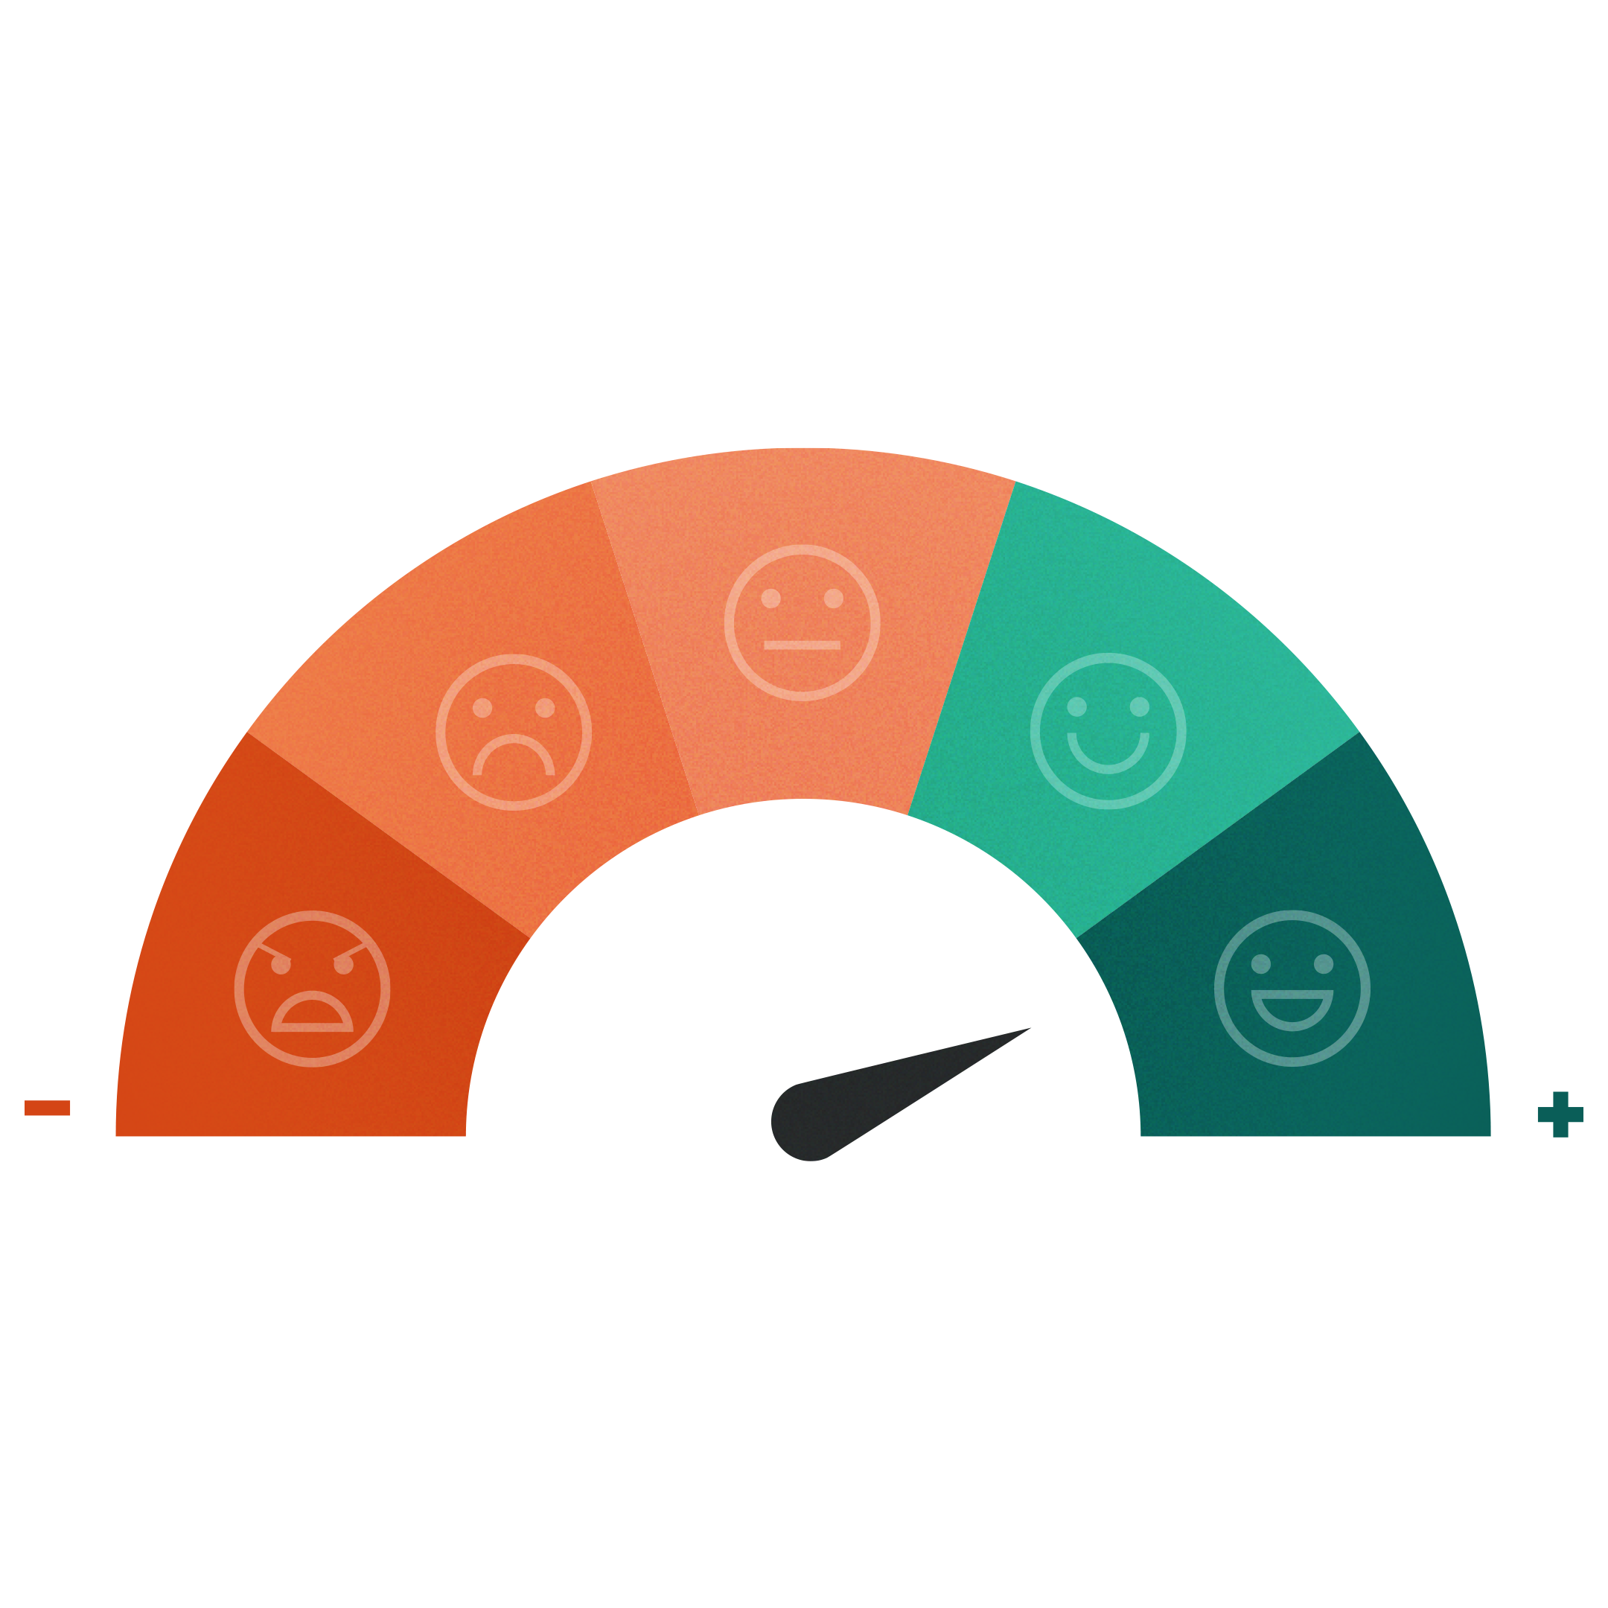

Alles beschikbaar op 1 plek
Notes:
SuperOffice CRM is a modern solution that is designed to fuel your sales, marketing and customer service processes.
All successful businesses share the same goal – to increase revenue and grow. To reach that goal, they need to treat every customer relationship as an opportunity.
SuperOffice CRM is a platform that is designed to help you convert your prospect and customer data into tangible actions and achieve your goals.
By connecting different customer data into one single view and optimizing workflows, SuperOffice CRM gives your sales, marketing and sales professionals immediate access to all customer-related insights, helping them to foster stronger relationships and take informed actions to grow revenue.
At the core – you need to give your people a 360-degree customer view:

Slide 15
















360° Customer Overview
Customer
Sale
Document
Person
Project
Request
CRM
Calendar
Mailings
Notes:
360 degree customer overview
A 360-degree customer overview a collection of all customer data in one place. It allows you to find all customer info, data on all past and present purchases, all dialogue with customer service and customer behavior in social media. It shows a relationship as an ongoing loop with all the touchpoints where the customer is in contact with the brand. It can either be through purchases or marketing communication, through customer service or in social media.

Slide 16
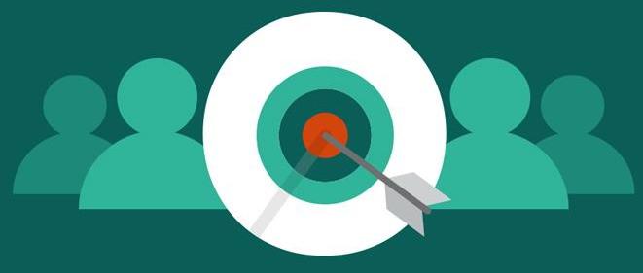
INBOUND AND OUTBOUND MARKETING
De bottom line van elk bedrijf is om geld te verdienen en marketing is essentieel om dat doel te bereiken.

Slide 17

74% van de bedrijven heeft conversie van leads naar sales als hoogste prioriteit
Bijna 40% van alle bedrijven worstelt met prospecting.
Hoe kunt u gemakkelijker (en automatisch) leads verzamelen?

Slide 18
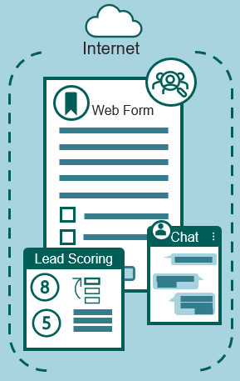

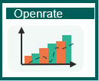

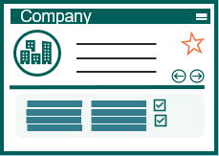
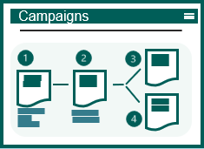


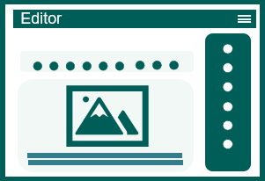
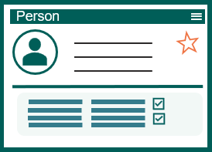

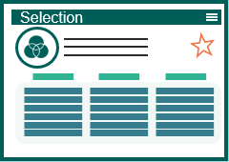
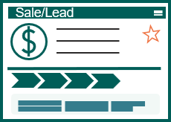
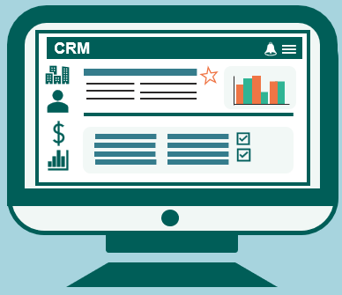




SuperOffice Marketing
Collecting Leads / Inbound Mkt
Outbound
Clicks update the CRM system
Statistics by campaign
CRM database
E-mail flows
Notification right person
E-mail editor
Segmentation
CRM database
Junkmail tagged
Notification to person
Privacy e-mail
(GDPR)
E-marketing consent automatically controlled before dispatch

Slide 19




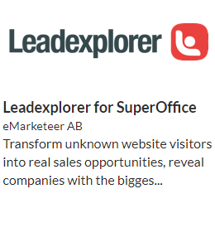
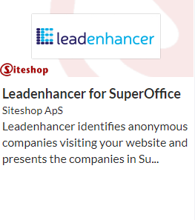








Collecting Leads / Inbound Mkt
Useful Apps
Internet
SuperOffice App Store
CRM database
Notification right person
Web Form
Company
Person
Sale/Lead
Chat
Lead Scoring
Notification to person
Privacy e-mail
(GDPR)
Seamless connection between CRM and selected App*
* Separate agreements, prices and terms apply to App purchases
Notes:
Automation via Web Forms, chat and lead scoring:
Web forms in themselves are not something new, this is probably something most people have available and offer today.
But it is about meeting the customer's expectations in terms of response, availability and expected response time.
Therefore, imagine that you offer to post digital forms on your website and give potential and existing customers an interactive experience where they can easily fill out and return forms directly from the device, no matter where they are.
These are linked directly to the CRM system so that the information is automatically created, notifications sent to the customer regarding privacy, legal basis and consent.
This makes it easier to collect data, have control of all incoming leads and be compliant with the legislation (GDPR) and be notified in the form of an agreement, task directly in the system so that you can contact the customer immediately after submitting the form.

Slide 20
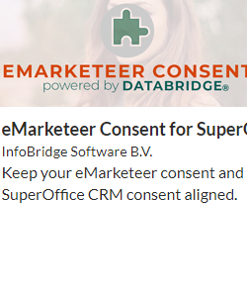
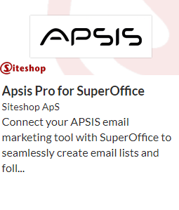










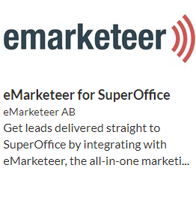


SuperOffice Marketing (Outbound)
Useful Apps
Statistics by campaign
Clicks update the CRM system
E-mail flows
SuperOffice App Store
Openrate
E-mail editor
Campaigns
Segmentation
Editor
CRM database
Selection
CRM
Junkmail tagged
E-marketing consent automatically controlled before dispatch
Seamless connection between CRM and selected App*
Marketing Professional
* Separate agreements, prices and terms apply to App purchases
Notes:
SuperOffice Marketing is designed to help you get your message out and connect with the right customers, at the right time.
Knowing exactly what you want to achieve with your mailing is the key to the success of any marketing campaign. It is basically about defining the target group (Who will receive information from you), What do I want to communicate (the message you want to convey), When will I carry out the actual campaign / mailing (experiences you have made from previous about when recipients read the email). And, last but not least, How do I measure the effect of the campaign (how many read, clicked on, ignored, failed, etc.).
SuperOffice CRM helps you find the right target group through powerful search and selection feature that draws on all kinds of information, including customer consents, interests, as well as demographics. You can even include past behavior when finding that target audience – for example, past attendance of events or meetings, or purchasing history – exactly because it is a part of your overall CRM solution and not a stand-alone email tool.
Then with the help of the easy to use drag-and-drop email editor you can create your message. You either can start by using any of the ready-made "out-of-the-box“ templates available or create your own. With its “privacy by design” features, SuperOffice CRM helps you respect various consent statuses when you send mailings. Respect of your customers’ privacy is fundamental in building trust. You can also measure the effect of your email communication through standard reports and statistics.

Slide 21
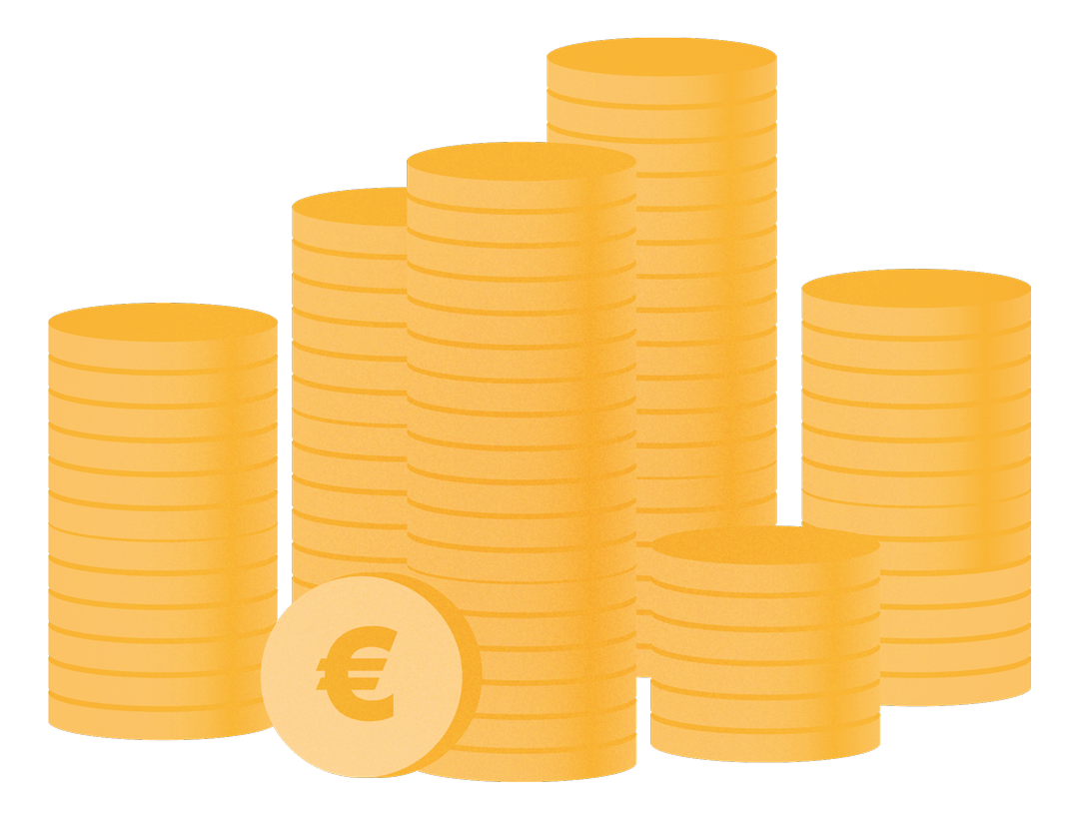
SALES IS KING!
Companies that implement a structured sales process
increase revenue,
performance and
forecasting accuracy.

Slide 22

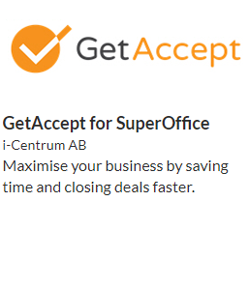
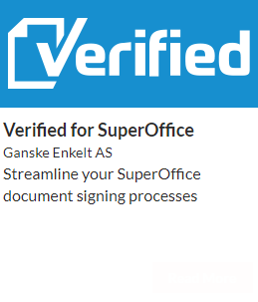
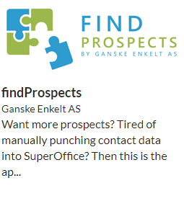
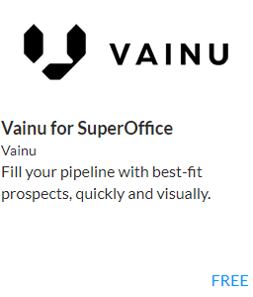


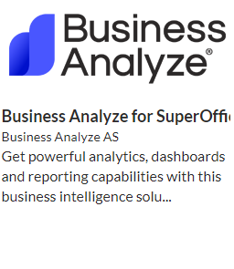
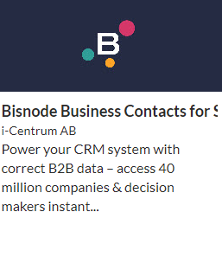







SuperOffice Sales
Useful Apps*
Custom Dashboard
SuperOffice App Store
Sales Opportunity registered
Standard Dashboard
Sale
Prognosis
Quote
Product & Prices
10%
30%
60%
80%
10%
30%
60%
80%
99%
Tilbud
Product
$
Sales Process
(Guide)
%
Stakeholders
Seamless connection between CRM and selected App*
Product register
Sales Standard
* Separate agreements, prices and terms apply to App purchases
Sales Professional
Notes:
Sales
Stakeholders: In complex sales processes or in project sales, it’ss necessary to have control over all parties involved (partners, internal, suppliers, etc.) By using stakeholders, you will at all times have a complete overview of companies, people and roles being involved in the project.
Sales guide The guide takes the salespeople through each step of the sales process, automatically provides suggestions for documents that must be created along the way, while suggesting which activities should be carried out in each phase and which tools should be used to gain control and progress in the process. Work structured and smarter.
Quotes / Products: The offer process is streamlined and assists sellers in preparing professional quotes/offers. You select the product and quantity from the product register and enter discounts (can be retrieved directly from the ERP system), automatically an offer is being created and simultaneously the pipeline is being updated with the amount and sale date. Once the quote has been generated and sent to the customer, SuperOffice CRM will remind you to follow it up. SuperOffice CRM also provides an overview of the different versions of the offer, so you always know what you have offered when.
Reports / Forecast: Detailed overview of results, pipeline and activity level for each individual employee or per. team through standard Dashboards with Drilldown functionality. This helps you make the right decisions on where you may need to improve processes or solve issues, as well as how you can take advantage of new opportunities.
.

Slide 23

WORLD CLASS CUSTOMER SERVICE
Positieve klantervaringen zorgen voor meer klantenbinding, betere klantenloyaliteit en meer bedrijfsgroei.
Notes:
A RightNow Technologies Customer Experience Report found that 86% of U.S. adults are willing to pay more for a better customer experience and 73% of U.S. adults said a friendly customer service made them fall in love with a brand. Not only will brands get happy, loyal customers but will see increased business.

Slide 24



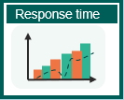




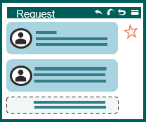
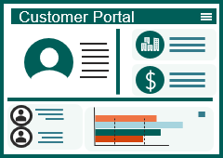



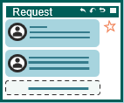
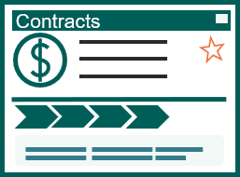

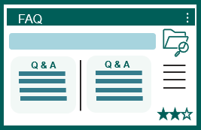
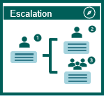



SuperOffice for Service
Employee-facing Service
Customer-facing Service
Login
Receipt to sender
Notification to agent
Standard Dashbord
Person Info including GDPR (consent)
Company info
Inc. requests
History
CRM information available to your customers
Script og Macros
Categorization
Priority
Registration of request
Contracts & agreements
Status
Knowledge base (FAQs)
Collaboration
Live Chat
Order form
Statistics / Usage

Slide 25




































SuperOffice Service
Customized Dashboard
Receipt to sender
Notification to agent
Standard Dashbord
History
Inc. requests
Responstid
Scripts og Macros
Sak
Automasjon
Categorization
Priority
Status
Eskalering
FAQ
Q & A
Q & A
Time-based priority
FAQ / Knowledge base
Collaboration
Service Essentials
External links / autoreply
Automatic and rule-based escalation
Service Premium
Notes:
Service
Our CRM solution is built to receive, track and follow up on customer inquiries regardless of the channel (email, phone, chat, webform, etc.). The employees will have access to the functions needed to respond quickly, consistently and efficiently. At the same time, you get an overview of the entire process, based on the real-time data, so that you have full control over customer requests and your employees’ performance.
SuperOffice Service is flexible and easy to customize. You can set up workflows, triggers and tasks that suit you and your business needs. Automatic answers and intelligent case flow ensure that your customers always get the attention they deserve, and that the right person helps them at the right time.
Each request is automatically assigned a unique reference number and a place in the queue system. The number tracks all communication related to the inquiry. The layout makes employees more focused and efficient, and you avoid personal preferences and unanswered inquiries. With automatic categorization and assignment to the right person, you save a lot of time and resources. Setting up email accounts and filtering by keywords is easy, and you no longer have to waste time sorting and distributing your inquiries. If a request is left unanswered after a defined time period, the system will automatically escalate the case.
Statistics: You can use built-in functions in SuperOffice Service to gain insight into how companies and teams perform in real time. A brief glance at the dashboard gives you an immediate insight into the status of inquiries and open cases in the queue. SuperOffice CRM also automatically analyzes historical data. The system shows you exactly how the inquiries have developed, and how the service team has performed over time, while highlighting what you can improve.
By optimizing the support you provide to your customers with SuperOffice Service, you will retain more customers and increase your revenue.

Slide 26

67% van de klanten geeft de voorkeur aan zelfbediening boven een gesprek met een vertegenwoordiger van de onderneming.
Hoe kan uw bedrijf 24/7 aan de steeds hogere self-service-eisen voldoen zonder veel mensen in dienst te nemen?

Slide 27









Customer Engagement Platform
Person Info including GDPR ( consent)
Login
Person
Company info
CRM information available to your customers
Company
Customer Portal
Registration of request
Request
Contracts & agreements
Contracts
Chat
Dashboard
Web Form
Live Chat
Order form
Statistics / Usage
Notes:
SuperOffice CRM, powered by its Customer Engagement Platform, is your best way to connect with your customers. To empower them to service themselves.
If we take what we know about the customer's behavior and expectations of their suppliers.
Imagine a solution where customers (within B2B) log in to a portal (like “my page”) where the information in your CRM is available to them.
Here the customer gets immediate insight into Company information, employees in their company, the opportunity to change their own data.
As well as extended customer service where the logged in person can get access to the history of their inquiries/requests, as well as is able to file a new request.
They can chat with the vendor, fill out order forms, book appointments, get an overview of their invoice history and agreements / contracts, as well as insights into reports and dashboards.
This gives the customer the opportunity and tools to conduct excellent customer service via their own self-service portal.
And when your customers feel connected to your company, it gets easier to make your relationships mutually beneficial and turn them into revenue.

Slide 28
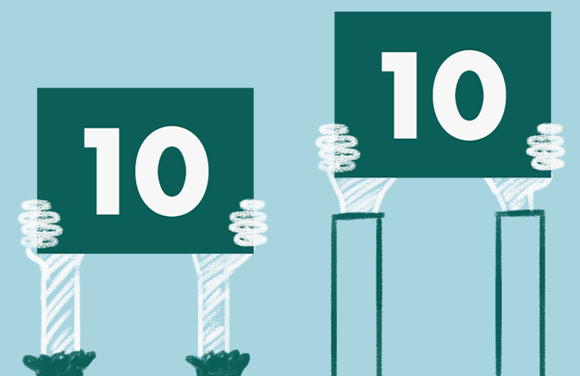
Customers expect ever faster and better response, at the same time there is pressure on costs like never before.
How do you deliver more and better with less?

Slide 29






Handling Incoming Requests– AIaaS
Inc. request
Request
Chatbot
Receipt on
submitted request
Text analysis and translation
Sentiment
Categorization
Notes:
SuperOffice AI
There are constantly increased demands on customer service, How does CRM and AI technology help here?
Take for example a company that operates in several countries, which may have relocated all customer service / support agents to one location. Customers expect to be served in local language.
Imagine that staffing is reduced so that all resources are set to answer all customer inquiries. A request from a customer is submitted.
This is an important customer who has a big problem and expects quick and high-quality response.
Based on a service that uses natural language processing, the computer will work and interpret text as we humans do. By extracting opinions, content and sentiment based on text.
The case officer will be presented with the opportunity to translate this into their own language. It is also then possible to connect Chatbot in the system

Slide 30

Door het juiste gebruik van IoT met CRM kunt u proactief zijn en problemen oplossen voordat ze zich voordoen.
Bijna alsof je in een kristallen bol kijkt...

Slide 31



Proactive Customer Service - IoT
CRM system
Customer Intelligence
Intelligent chairs
Company
Dashboard
CRM system
Request
Notification on
new request
Notes:
The Internet of Things!
In practice, this means that all units that we interact with daily are Online. The freezer, refrigerator, heater, etc.
This example is taken from a customer who delivers chairs to their customers. Each chair has a built-in computer chip that will then be able to measure usage behavior, errors and omissions.
Let's look at how this, together with CRM technology, has helped this customer increase customer satisfaction and improve their own reputation.
When a fault or defect is discovered in the chair, it will automatically be able to report this to the supplier by creating a case in their CRM system.
The case will be linked to the correct chair and we will notify the case officer via SMS. The content and priority of the case depends on the type of error registered by the chair.
The supplier will then be able to act correctly based on the type of error.
The behavior and history of the chairs are stored and displayed in the CRM system in real time.
Statistics and Dashboard can be extracted and monitored so that the supplier has 100% insight at all times.
Solving a problem before it arises is the ultimate customer service.

Slide 32
Een CRM platform wat jouw bedrijfsprocessen verbind
Notes:
To sum up, with SuperOffice CRM you gain a modern, forward-thinking CRM solution that unites your business processes, utilizes the latest technology & helps you grow your business.
SuperOffice CRM offers the tools to optimize your processes and bridge the gap between customer data and revenue.
Because it is a standard cloud-based application, it allows you to get started fast and to follow the best practices of hundreds of thousands of CRM users.
A wide range of ready standardized apps available in our App Store help you connect your SuperOffice CRM with your other business tools. And with the help powerful customization tools, you can also customize your CRM solution to fit your business needs and expand it as your business grows.

Slide 33
SuperOffice Implementation Method (SIM)
PHASES/STAGES
01
IDENTIFY
02
INITIATE
03
DESIGN
04
IMPLEMENT
05
ONBOARDING
IDENTIFY NEED AND SCOPE SOLUTION
DESCRIBE PROJECT AND INITIATE
SPECIFIY AND DESIGN SOLUTION
CONFIGURE AND REALIZE SOLUTION
SECURE LONG-TERM EFFECT
Time spent by customer in the project:
STEERING COMMITTEE
Owner of the project
PROJECT MANAGERS
In charge of the project
PROJECT TEAM
Works on the project
REFERENCE GROUP
Participates in the project
Estimated time spent on the project
2 hours / month
Estimated time spent on the project
6-8 hours / week
Estimated time spent on the project
2-5 hours / week
Estimated time spent on the project
To be decided
Notes:
One of the ways we ensure our customer achieve success with SuperOffice is providing a helping hand from the start and through all phases of your CRM implementation.
We bring with us a well established and proven methodology – we call it SuperOffice implementation Method – or SIM for short, that oulines what everyone will do each step of the way.
Key phases include:
IDENTIFY: Were we gain an overview and understanding of your needs and what the solution should contain. We do this phase also to ensure that we are alighned and to offer you realistic quottions on the products and services required in addition to define a realistic timeline. You work with one of our experience project managers at this stage.
INITIATE: During this phase we work to make the goals more concrete, the key KPIs, scope and we agree on how to organise the project. We seek your top management involvement – as this is always critical - and that you create a project team to ensure a sueccessful change management which ineviatbly a project like this is.
DESIGN: This stage we perform various workshops to align KPIs, and the workflows and specific requirements that will be supported by SuperOffice CRM. This will be the basis for the design and automations to add as well as user-training.
IMPLEMENT: The execution of various workshops to meet specific needs for example for data import, integrations, automations, templates and so on
ONBOARDING: Finally we work to ensure the success of your change management journey and onboarding of your new CRM solution and CRM strategy. WE do this through various workshops and user-training.
Together with your team, we are here to help you get the most of your CRM solution.

Slide 34
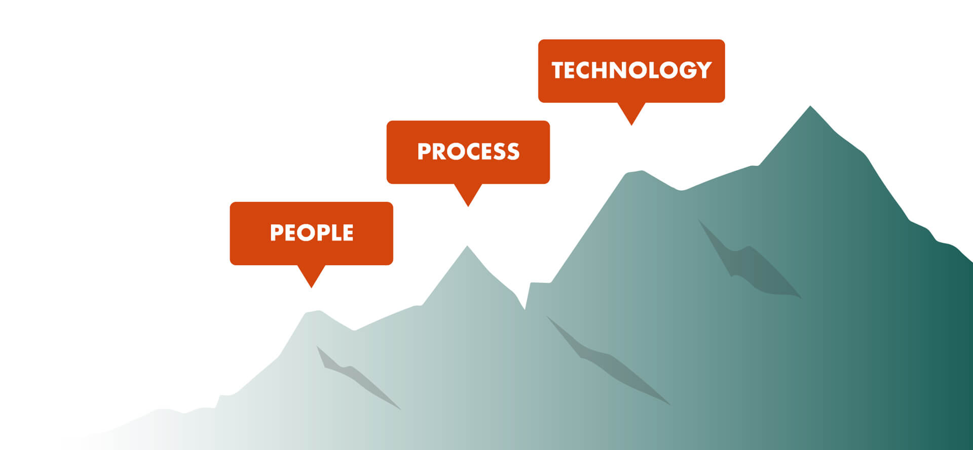
Een CRM partner die je helpt te groeien
Notes:
We have 30+ years of experience in growing business. After several thousand CRM implementation projects, we have gathered substantial knowledge of how to do things right.
We also know that success with CRM does not just depend on the software, but on how the CRM-provider helps you to translate your CRM-ambition, challenge you to be pragmatic, helps you focus on supporting the processes and ensures that your people are involved and on board.
So, when you buy into SuperOffice, you also buy into a partnership with people who truly understand your business and are there to help you maximize the value of our CRM solution.
And that’s what we’d love to help you do ☺

Slide 35
Purpose and effect of implementing CRM
Main goals and core challenges
Description of Solutions
Increase market share from 10-15% to 30% over 5 years
To achieve this, you have to streamline and streamline processes for service and support
Today you work in different systems which means that you work inefficiently and lack common routines, rules and processes with regard to case management
Desired effect of the implementation
KPI’s
Increase internal capacity by streamlining the use of resources on service and support
Increased customer satisfaction through better insight and automated processes
Increased control over the customer base and data will streamline communication with customers
Common routines and processes will contribute to achieving their growth goal by reducing risk and increasing efficiency.
Risk

Slide 36
Activiteitenplan
Activity​ | Week​ | Completed​ | Responsible​ | Go/​ No go​ | Billable​
Doel van CRM | XX​ | ​ | SO/Elho​ | ​ | ​
Samenvatting doel en opgesteld plan | XX​ | ​ | SO​ | ​ | ​
Workshop om procesverbeteringen, KPI's, integratiepunten, technische verduidelijkingen, risico's en succesfactoren aan het licht te brengen | XX​ | ​ | SO/Elho​ | *​ | ​
Samenvatting workshop | XX​ | ​ | SO​ | *​ | ​
Go op samenvatting en verdere stappen | XX​ | ​ | Elho​ | *​ | ​
Presentatie oplossing SuperOffice | XX​ | ​ | SO​ | *​ | ​
Contact referent | XX​ | ​ | SO/Elho​ | *​ | ​
Offerte presentatie/ investering | XX​ | ​ | SO​ | *​ | ​
Getekend contract | XX​ | ​ | SO/Elho​ | *​ | ​
Start implementatie | XX​ | ​ | SO/Elho​ | *​ | ​
Live | XX​ | ​ | SO/Elho​ | *​ | ​
* Indicates a mutual "go / no go" decision for implementation. |  | Approved by Customer:

