Slide 1
SUPEROFFICE 10
Launch plan
Updated October 5

Slide 2
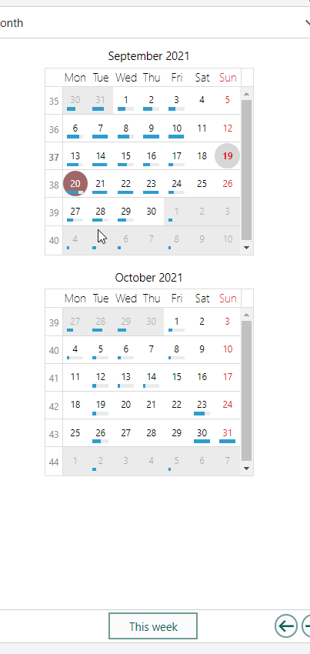
Key dates
Technical upgrade
SuperOffice Online Environment ready
Wave 0
SuperOffice One
NEW Customers
SuperOffice 10 includes:
New pricelist
Dashboards (Part 1)
Configurable Screens (toggled on)
New App Store
New customer support center
Wave 1
First 30 Customers
Wave 4
All existing cloud customers on 10

Slide 3
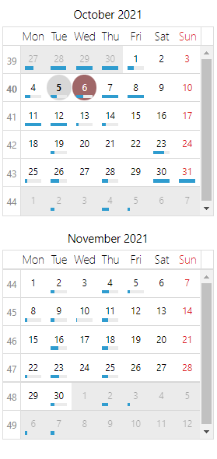
Configurable screens roll-out
Step 1
Customers with less than 15 udef fields
Step 2
Customers with less than 25 udef fields
To align communications of the changing More tab together with the release of the configurable screens, we will roll-this feature out in steps, ensuring that all customers most affected are given information about it BEFORE they see their More tabs changed.
Step 3
Customers with less than 50 udef fields
Step 4
Customers with more than 49 udef fields

Slide 4
Target audiences
INTERNAL + PARTNERS
EXISTING CUSTOMERS
MARKET
Goal: Understand the price change and feel comfortable in having pricing conversations with customers in the sales process
Goal: Show SUO as a modern CRM player
Supporting goal: That they’ve made the right decision
Communicate price change.
Onsite, Buy, Cloud customers
Goal: Show SUO as a modern CRM player
ACTIVITIES:
Phase 2 of the website design
New pricing page on website
New concept video
Launch plan to market through social media
Internal workshops
Trainings w/ Attensi games
Price list updates
Template updates
Readiness Program and webcast materials:
Contractual letters
1 x teaser video + social
1x what’s new video + email + social
1x webcast video + event invite + reminder
Splash screen
Notes:
Based on our agreement in management meeting and the results that we have seen for previous launches, we will not do the same kinds of activities that we have been doing before.
In the above are the activities that we have planned for each target audience.
The biggest job is what we do on our webiste and getting awareness for our positioning in the open market.
For existing customers, we will have a speicfic angle, based upon the positioning for each customer segment. We have asked OMI for help on this.

Slide 5
Internal + Partners Readiness Program
Session 1 Sep 10
Session 3 Sep 24
Understanding and mastering the new price list
Materials:
Summary PPT
Migration rules for existing customers
Materials:
PPT for 1:1 meetings
Session ppt with case studies
Pre-launch Aug 30
Session 2 Sep 17
Session 4 Sep 24
Introduction to the readiness program and the SuperOffice 10 Price Model
Materials:
Attensi games
Early price list version
New positioning info
How to use the new price list with new customers
Materials:
10 Price list, Excel + PDF
Product configurator, Excel
M1 ppt
Session ppts with case studies
Using the new price list with Internal Systems
Materials:
Session ppt and examples
Proposal templates
All updated 9 price lists
Onsite 10 prices lists

Slide 6
Materials provided in time for launch
Sales enablement materials
New marketing materials
Product information via NPRs
Readiness program presentations
SuperOffice 10 cloud price lists
(Excel + Pdf)
SuperOffice 10 onsite price lists
(Excel + Pdf)
Product configurator (Excel)
Migration calculator (Excel)
Proposal templates (word)
M1 meeting ppt template (new customers)
SuperOffice 10 – news and new price list 1:1 presentation (existing customers)
Product Configurator (SuperQuote)
New website content
Concept video
Social Media messages
Teaser video
What’s new video / article
SuperOffice 10 new products article
What’s New email announcement
What’s New webinar
Product documentation materials
What’s new documentation
Learn the Essentials update
Help update

Slide 7
Configurable screens roll-out communication
Mailings
Resources to assist
Informing customers that More tab changes and that they can use the configurable screens to change the layout to suite them with resource on how to get started.
  Two versions reflecting whether access to configurable screens is a free time limited access or not.
Reminding customers who have not subscribed to Development tools to remind them that their free access is about to stop and encourage them to buy this feature.
Short video with an overview of the feature
Webinar with more detailed explanation of what, why and how to use
How-to guides
FAQs
Services provided by SuperOffice and Partner consultants

Slide 8
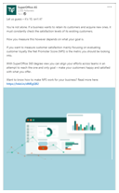

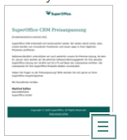

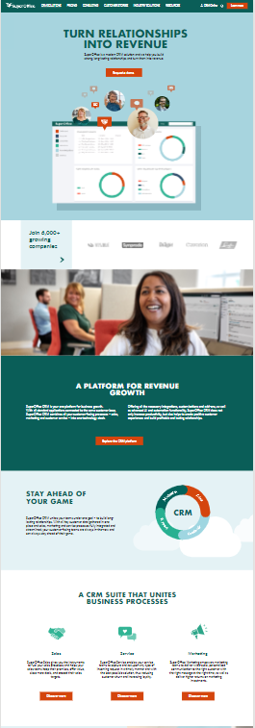
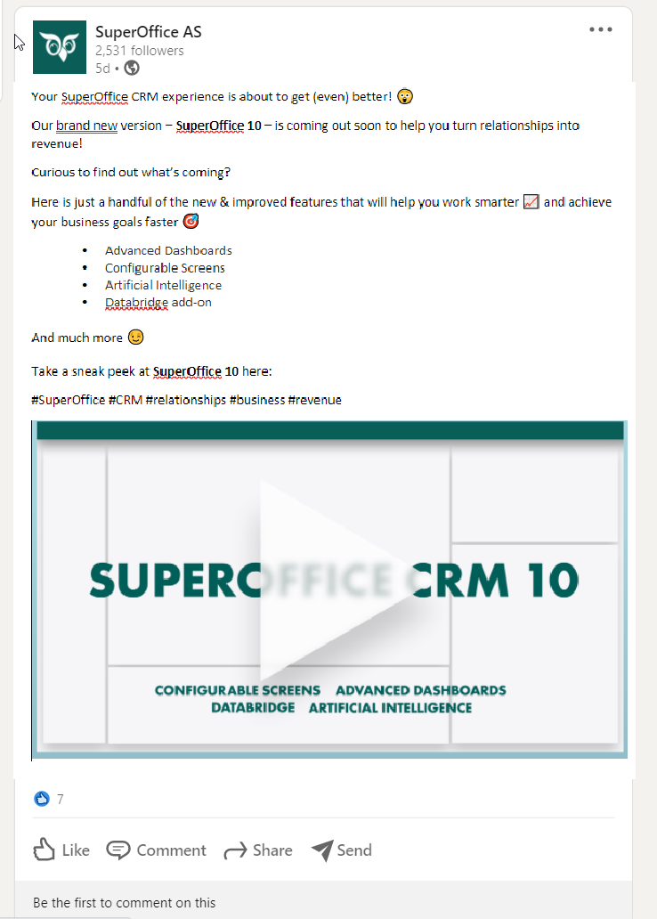
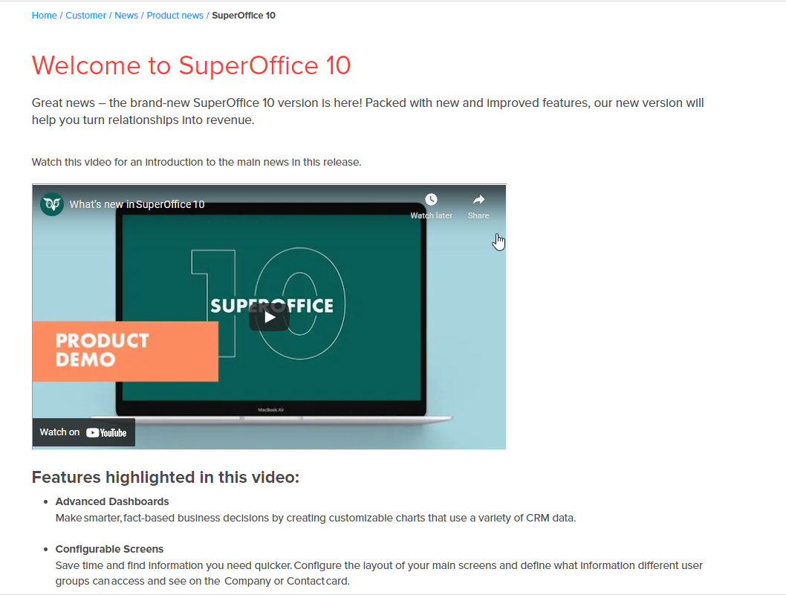
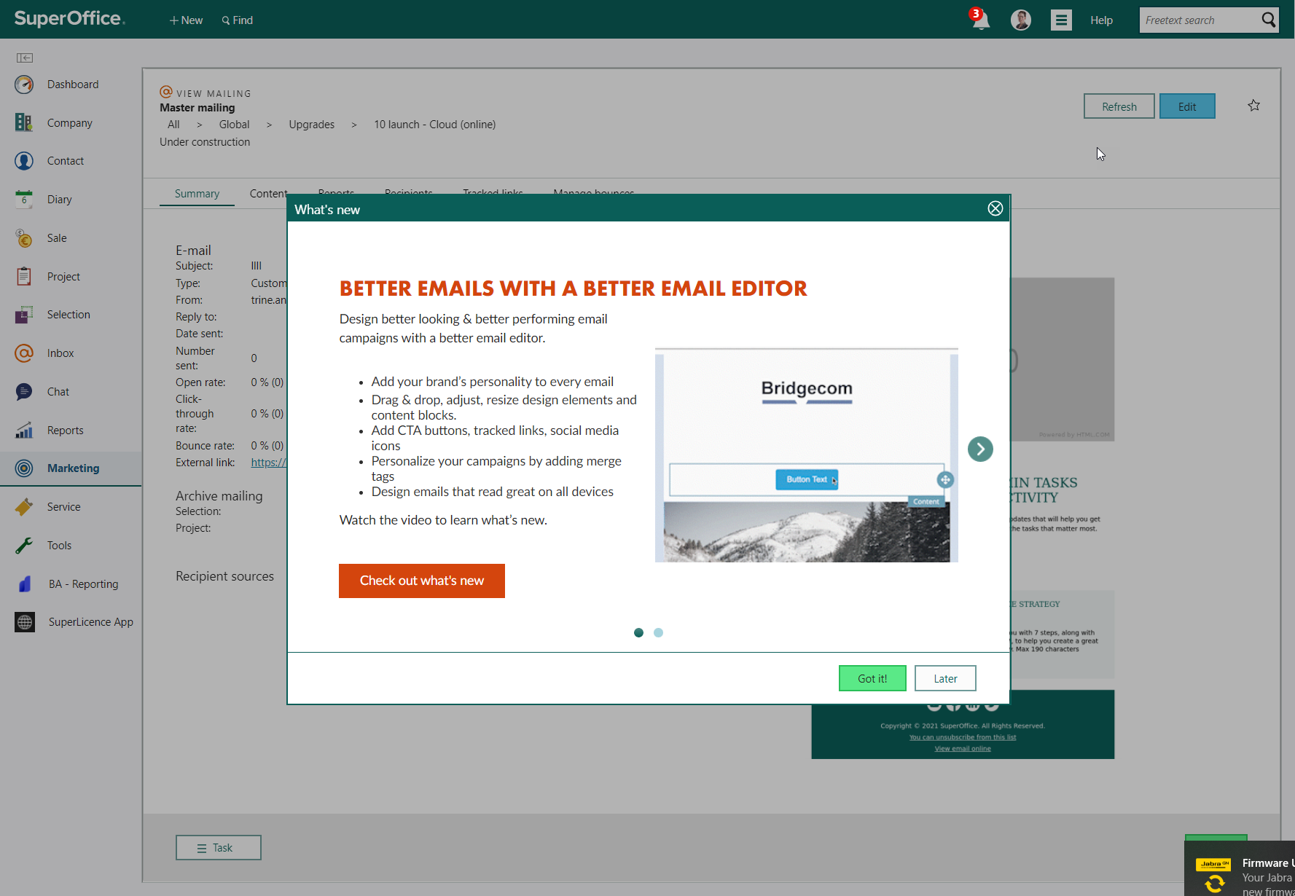
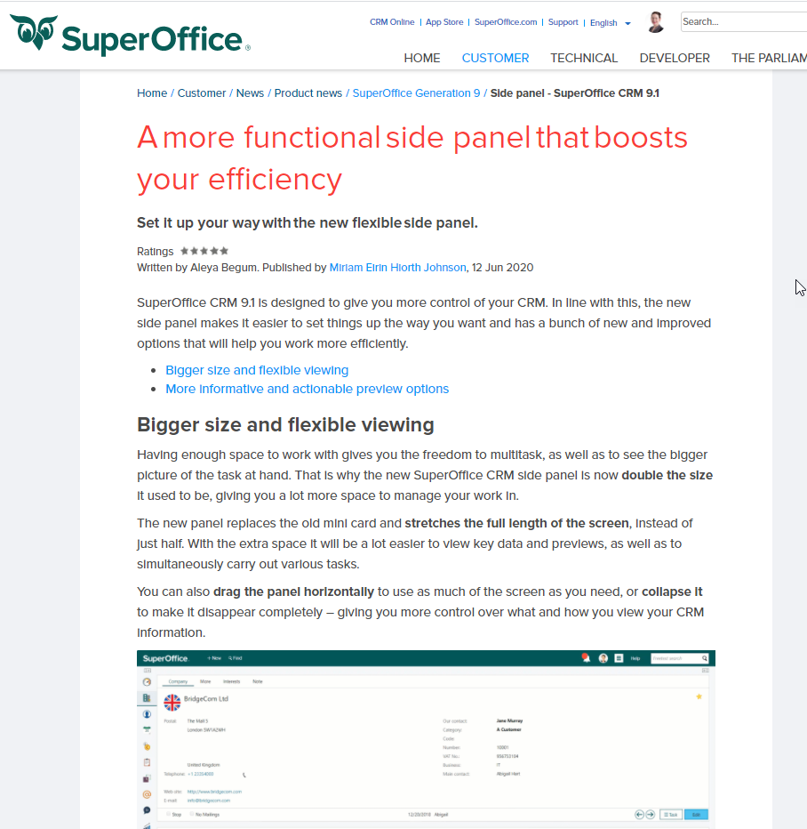
Communication flow
SoMe – 10 Announcement
Email to key stakeholders: 2.9% price increase
Email -10 Announcement Cloud (online) customers
Email to key stakeholders – SuO 10 and new price list
Webinars – SuperOffice 10
Webinars – Configurable screens
General Social Media campaign start
Aug 31
Sep 27
Sep 30
Oct 4
Oct 12
Mid Oct
End Oct
Nov →
What’s new video in 10 – Article on Community
Mailing informing about Config screens and More tab
SuperOffice 10 splash screen message
Reminder mail about free access to Development Tools
SoMe – 10 Teaser
SuperOffice 10 new names - Article on Community
Website update

Slide 9
Available via Launch Kit + SuperOffice One

