Slide 1
DESCRIPTION OF SOLUTION
SuperOffice CRM

Slide 2

The process ahead
Meeting 1
  Uncover main goal of the implementation
  What do you want to achieve? What effects do you want to realize?
  What are you going to measure? (KPI’s)
  What will characterize that the project has been a success?
  What processes do you want to improve?
  Integration points?
  What risks do we see in this project?
  SuperOffice Demo:
  Make visible how SuperOffice will cover the desired processes and needs
  Proposal presentation
  Signing the contract
Meeting 2
Meeting 3
Meeting 4

Slide 3
Delivery from SuperOffice summarized
Main goal and core challenges
Description of solution/processes
Increase market share from 10-15% to 30% over 5 years
To achieve this, you have to streamline the processes for service and support
Today you work in different systems which means that you work inefficiently and lack common routines, rules and processes when it comes to case management
Estimated effect of the implementation
Key Performance Indicators (KPI’s)
Increase capacity by streamlining the use of resources on service and support
Increased customer satisfaction through better insight and automated processes
Increased control of the customer base and data will streamline communication with customers
Common routines and processes will contribute to achieving growth goal by reducing risk and increasing efficiency.
Risk

Slide 4
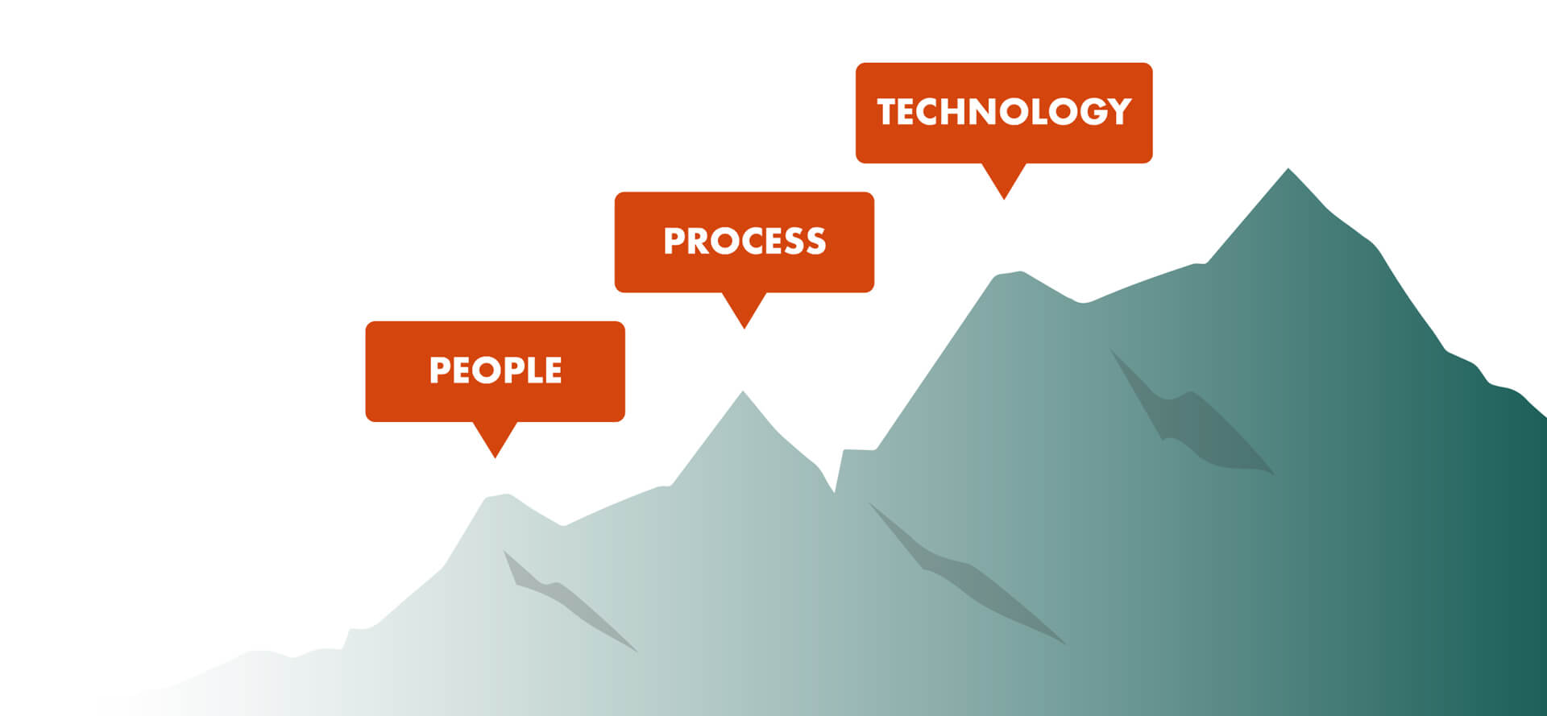

A CRM PARTNER THAT HELPS YOU GROW
Notes:
Updated: We do not just want to sell you software but be your partner that helps you to grow and succeed with your CRM investment.
Success with CRM does not depend on the software, but on how the CRM-provider helps you to translate your CRM-ambition, challenge you to be pragmatic, help you focus on supporting the processes and ensures that your people are involved and onboarded.
And this is the focus of today – how we can ensure your success… CLICK -

Slide 5

How do you plan to grow your value?
Customer
value
Upsell to
existing customer
Customer portfolio
Win new
customers
Reduce
churn
Customer
lifetime
Disengage with
non-profitable customers
Source: MarkUp Consulting
Notes:
Updated: … As mentioned in our last meeting, customers value is measured by (1) how much they buy from you and (2) for how long they have been doing that.
No matter what your strategy is, customers must be recruited, developed and retained.
You must eventually prioritize. Meaning, you must choose to invest in the customers who have the greatest potential and disengage with those not profitable for you
Furthermore, as culture in your company reflects you ability to implement your strategy, we know that success is linked to your culture, and your solutions like your CRM solution, need to become a part of your culture, how you do business in your company - CLICK

Slide 6

CRM Success demands the following:
A clear ambition
Defined goals and KPIs
Defined work processes
Customer program and categorization
Ability to measure
Continuous follow-up and improvement
Notes:
Updated: So, let’s look at the nitty-gritty. ☺ As culture is not built on a summers or christmas party or a kick-off,
Instead, it is built through your
defined processes and the routines that secure your teams doing the right things over time – what you measure
Which builds and sustain the behaviour you want in your company,
Which again influences (as well as are influenced by) attitudes,
And these are elements that culminates your company culture
Which means that if you break this down – to CRM success is about supporting your culture that allow you to nurture and build profitable relationships.
And we like to break it down and discuss these points here in more details:

Slide 7
0
What is the goal of implementing CRM / SuperOffice?
Uncover goals - what do you want to achieve?
What effects do you want to realize?
GOAL
Note: Uncovered in meeting 1, if not must be done now

Slide 8
1
Which KPIs should be supported in SuperOffice CRM?
What ensures success in your team?
What do you need to measure to succeed?
KPI‘s
Notes:
Updated formatting

Slide 9
Every CRM success starts with a clear ambition
Here are some key success areas we develop with our customers
Customer programs
Customer journey
Marketing metrics
Sales metrics
Service metrics
Categorisation
Customer Profile
Activities measured
Forgotten customers
NPS score
Improve areas and flow between:
Marketing, Sales and Service
Automation: Campaigns, Consent, Self Service
Enrichment: Chat, Forms, Scripts
Mails sent
Opening rate
Click Through Rate (CTR)
Bounce
Incoming leads
Convertions to sale ($)
Average sale ($)
Quotes / Offers sent
Quotes won / lost
Win / Loss review (competitors / reason)
Pipeline Management
Number of Activities
Number of incoming tickets
Number of tickets solved
Tickets by category/ agent
Time to Answer
Time to Close
FAQ’s used
Notes:
CRM is not software, it’s strategy. It’s deciding what works for you, and creating routines, a solution and measurement based on best practice.

Slide 10
Description KPI‘s
KPI 1:
KPI 2:
KPI 3:
KPI 4:

Slide 11
2
Which processes should be supported in SuperOffice CRM?
Marketing Processes
Lead Generation, Campaigns, Mailings, Forms, Chat, etc.
Sales Processes
Prospecting, Lead management, Opportunity Management, Proposals, Pipeline Management, Quote to cash, etc.
Service Processes
Request/Ticket Management, Complaints, Field service, IT Helpdesk, Customer Center, FAQ etc.
Customer Program / Loyalty
Categorization of customeres (value), Activities, Customer Program, Forgotten Customers etc.
PROCESSES
Notes:
Updated formatting

Slide 12

Process description Marketing
Inbound?
Outbound?
Chat?
Forms?

Slide 13
Process description Sales
Sales Guide?
Project Guide?
Quote?
Reports; Selections, Dashboard, Separate BI-solution?

Slide 14

Process description Service
Customer Center?
Automation?
Reports; Selections, Dashbord, Separate BI-solution?

Slide 15

Process description Customer Program
Categorization?
Activity / Customer Program?
Forgotten Customers (Orphans)?
Reports; Selections, Dashbord, Separate BI-solution?

Slide 16
Reports - Decision
Example:
The customer has decided to start with the SuperOffice Selections and standard built-in Dashboards.
After the first experience with SuperOffice, a joint evaluation is done to see if the standard or the customized reporting solution is sufficient or if a new decision must be made.
Notes:
Updated

Slide 17
3
Which systems should SuperOffice be integrated with?
MS Office
Office 365, Outlook / Exchange, Sharepoint
ERP
Customer categorization, master data, sales figures, financial key figures
Technical clarifications
MAC /PC Citrix, other?
SuperOffice App Store
https://online.superoffice.com/appstore
Other systems
https://community.superoffice.com/de/developer/documentation
INTERFACES
INTEGRATIONS
Notes:
App-Store: https://online.superoffice.com/appstore
Office-Integrasjon: https://online.superoffice.com/appstore/superoffice-as/office-365-integration
Outlook-Integration: https://online.superoffice.com/appstore/superoffice-as/superoffice-for-outlook
Kalender-Sync: https://online.superoffice.com/appstore/infobridge-software-b-v-/synchronizer-for-superoffice
Updated formatting.

Slide 18
Interfaces / Integrations
Office 365
  Azure AD login
  Document Archive in SharePoint?
  SuperOffice for Outlook
ERP
  Which system?
  What data shall be visualized in SuperOffice?
  Import / synchronization?
Technical Clarifications
  MAC / PC?
  Citrix?
  Distribution Web Tools/Mail Link
Other Integrations
  Standard Apps
  API’s
  Automated import/ export

Slide 19
4
Initial import of customer data?
Which data should be imported?
From what sources?
How will they be imported?
From one central import template or several systems?
Format on the import data?
IMPORT
Notes:
Updated format and missing ?

Slide 20
Import of customer data
Data source
  ERP system
  Production system
  CRM
Type of data
  Company
  Person
  Sales / lead
  Activities
Format
  CSV
  TXT
  XML
  XLS

Slide 21
5
Are there risks we should be aware of or plan for?
Dependencies on other systems / processes
Lack of internal resources in the project team?
Lack of time to participate/produce in the project?
Lack of customer project manager?
Financial; budget for implementation?
RISK
Notes:
Updated formatting and spelling

Slide 22
Risk
What does each of you think is the biggest obstacle to SuperOffice CRM being a success?
Are there risks / difficulties associated with having to change behavior?
What do we need to do together to make this a success?

Slide 23
6
Number of users
Management, Sales, Marketing, Service
Project Management and Project Team
Dedicated Project Manager, Members of the project team, Steering Committee, Roles, Tasks and Contact persons
Project Plan and Resources
Who makes the decision?
USERS AND IMPLEMENTATION

Slide 24
SuperOffice Implementation Method (SIM)
PHASES/STAGES
01
IDENTIFY
02
INITIATE
03
DESIGN
04
IMPLEMENT
05
ONBOARDING
IDENTIFY NEED AND SCOPE SOLUTION
DESCRIBE PROJECT AND INITIATE
SPECIFIY AND DESIGN SOLUTION
CONFIGURE AND REALIZE SOLUTION
SECURE LONG-TERM EFFECT
Time spent by customer in the project:
STEERING COMMITTEE
Owner of the project
PROJECT MANAGERS
In charge of the project
PROJECT TEAM
Works on the project
REFERENCE GROUP
Participates in the project
Estimated time spent on the project
2 hours / month
Estimated time spent on the project
6-8 hours / week
Estimated time spent on the project
2-5 hours / week
Estimated time spent on the project
To be decided
Notes:
Konkretisering av faser

Slide 25
Groups of users and add-ons
Solution | Plans | Number
Sales | Essentials / Premium | XX
Marketing |  | XX
Service | Essentials / Premium | XX
Multi-plan users | Combination? | 1 + XX
Add-On solutions |  | Suggested
Synchronisation
SuperOffice AI services | Text analyser, Categorization, Chatbot
Customer Engagement Platform | Customer Center, Forms, Chat
Expander Services options | Development Tools, Sandbox, SCIM, Databridge, Database Mirroring Services
Notes:
Updated slide

Slide 26
The process ahead
Meeting 1
  Uncover main goal of the implementation
  What do you want to achieve? What effects do you want to realize?
  What are you going to measure? (KPI’s)
  What will characterize that the project has been a success?
  What processes do you want to improve?
  Integration points?
  What risks do we see in this project?
  SuperOffice Demo:
  Make visible how SuperOffice will cover the desired processes and needs
  Proposal presentation
  Signing the contract
Meeting 2
Meeting 3
Meeting 4

Slide 27
Let us book the necessary activities now
Activity​ | Week​ | Completed​ | Responsible​ | Go/​ No go​ | Billable​
Needs clarification - the goal of the project​ | XX​ | ​ | SO/XXX​ | ​ | ​
Summary of purpose and proposed tentative activity plan​ | XX​ | ​ | SO​ | ​ | ​
Workshop to uncover process improvements, KPIs, integration points, technical clarifications, risk, success factors​ | XX​ | ​ | SO/XXX​ | *​ | ​
Summarize findings from workshop​ | XX​ | ​ | SO​ | *​ | ​
Acceptance for workshop report and further progress​ | XX​ | ​ | XXX​ | *​ | ​
Present the preliminary solution concept / Demo​ | XX​ | ​ | SO​ | *​ | ​
Visit / contact reference customer​ | XX​ | ​ | SO/XXX​ | *​ | ​
Implementation plan approved by IT​ | XX​ | ​ | XXX​ | *​ | ​
Approval of legal conditions​ | XX​ | ​ | XXX​ | *​ | ​
Offer presentation / solution proposal​ | XX​ | ​ | SO​ | *​ | ​
Sign contract ​ | XX​ | ​ | SUO/XXX​ | *​ | ​
* Indicates a mutual "go / no go" decision for implementation. |  | Approved by Customer:

Slide 28
Delivery from SuperOffice summarized
Main goal and core challenges
Description of solution/processes
Increase market share from 10-15% to 30% over 5 years
To achieve this, you have to streamline the processes for service and support
Today you work in different systems which means that you work inefficiently and lack common routines, rules and processes when it comes to case management
Standardize processes by supporting workflow and the desired queuing system as described in the requirements specification.
Ability to add priorities, escalation routines, pre-defined templates and automatic answer templates for cases
Reports and Dashboards that show, for example, equipment defects or the number of cases per employee
Integration with ERP system Visma Business and time management
Reduce the number of systems by gathering all cases for support and service in one place in a common CRM database.
Estimated effect of the implementation
Key Performance Indicators (KPI’s)
Increase capacity by streamlining the use of resources on service and support
Increased customer satisfaction through better insight and automated processes
Increased control of the customer base and data will streamline communication with customers
Common routines and processes will contribute to achieving growth goal by reducing risk and increasing efficiency.
Number of Tickets / Requests resolved
Number of Requests per. category / Case Officer / Equipment
Response time
Risk
Project organization (resources allocated)
The scope of the project

