Slide 1
Session 3
SO 10 onboarding program
Price and product migration rules for existing customers
and white space opportunities

Slide 2
Content
Pricing rules
White space
Buy & Onsite
Product migration rules
Partner tools

Slide 3
What we are addressing in this session
Cloud 9 to Cloud 10
Buy
to Cloud subscription
Buy
to Onsite subscription
Buy 7/8 to
Buy 10
Onsite 9 to Onsite 10
Scenarios
Topics
Product config changes & rules | ✔️ | ✔️ | ✔️ | NA | ✔️
Pricing changes current solution | ✔️ | ✔️ | ✔️ | NA️ | ✔️
Whitespace & Upsell to existing customers | ✔️ | ✔️ | ✔️ | NA️ | ✔️
Tools we use to guide us in the customer dialogue | ✔️ | ✔️ | ✔️ | NA️ | ✔️
Focus areas today

Slide 4

Cloud 9 to Cloud 10

Slide 5
Pricing changes – current solution

Slide 6
Pricing rules
Existing SO 9 configuration upgraded to SO 10
Subscription fee is the same
Plus 2,9% price increase
Very simple & very likeable

Slide 7
Whitespace & Upsell on SO 10

Slide 8
White space – User plans
User plan mix | Customers | % of C
Sales P users only | 1.260 | 32,81 %
Full Mulitplan + Sales P mix | 771 | 20,08 %
Full Multiplan all users | 438 | 12,71 %
Sales E only | 478 | 12,45 %
Full Mulptiplan + Sales P + Service P mix | 171 | 4,45 %
Full Mulltiplan + Marketing + Sales P mix | 129 | 3,36 %
Full Multplan + Service P mix | 117 | 3,05 %
Marketing + Sales E mix | 94 | 2,45 %
Service P only all users | 85 | 2,21 %
Marketing + Sales P mix | 74 | 1,93 %
Marketing only | 59 | 1,54 %
Full Multiplan + Marketing + Sales P + Service P mix | 48 | 1,25 %
Sales P + Service P mix | 20 | 0,52 %
Full Multiplan + Marketing mix | 17 | 0,44 %
Sales E + Service P mix | 13 | 0,34 %
Marketing + Sales P + Service P mix | 8 | 0,21 %
Full Multiplan + Marketing + Service P mix | 6 | 0,16 %
Marketing + Sales E + Service P mix | 1 | 0,03 %
Marketing + Service P mix | 1 | 0,03 %
3.840 customers
Sales E only..
12%
Full MP
13%
Sales P
only..
33%
Plenty of opportunities to target
Notes:
12% of the customers only have Sales E = upsell potential for Sales P, Service E/P & Marketing users
33% of the customers only have Sales Premium = upsell potential for Service E/P & Marketing users
13% of the customers have all users on a Full Multiplan solution
In terms of users, there is a massive upsell potential – based on both experience and where we have Wallet share established

Slide 9
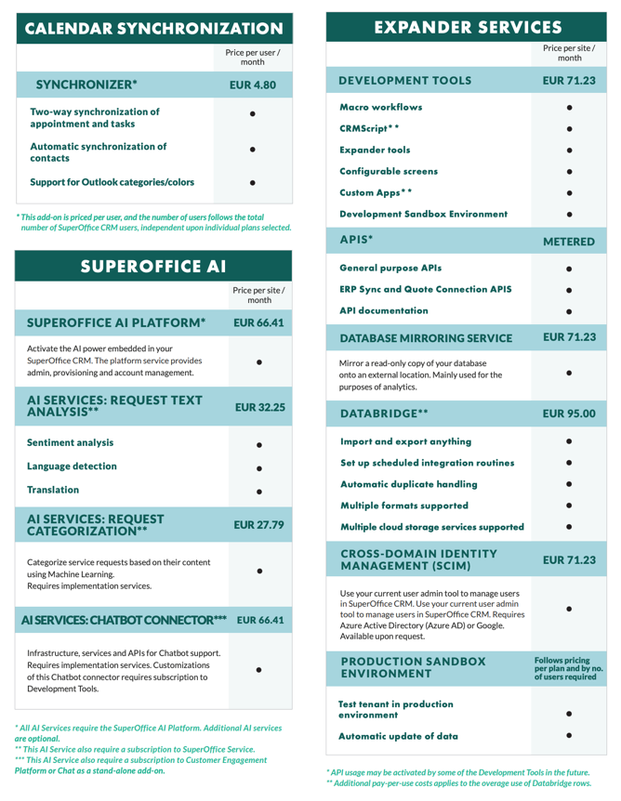
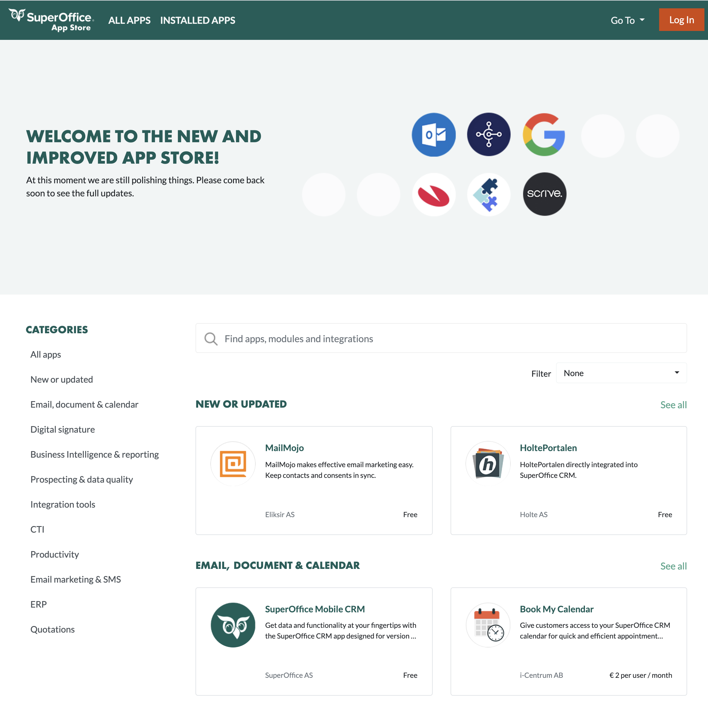
White space – Add-ons
3.840 customers
Free CEP
42%
DataBridge
4,6%
App Store products
27%
Development Tools
23,2%
Synchronizer
45%
Notes:
Also a significant opportunity landscape in the add-on and App Store product space
All of these solutions are backed by solid Value propositions – which also drive stickiness in the customer base...

Slide 10
Handling upsells
We are very «inclusive» when it comes to the subscription fee of the current solution.
For upsells, the SO price list does apply.

Slide 11
We will inform..
All existing Cloud and Onsite subscription customers about the new price list.
This information will be distributed – by email – on September 27 and 28.

Slide 12
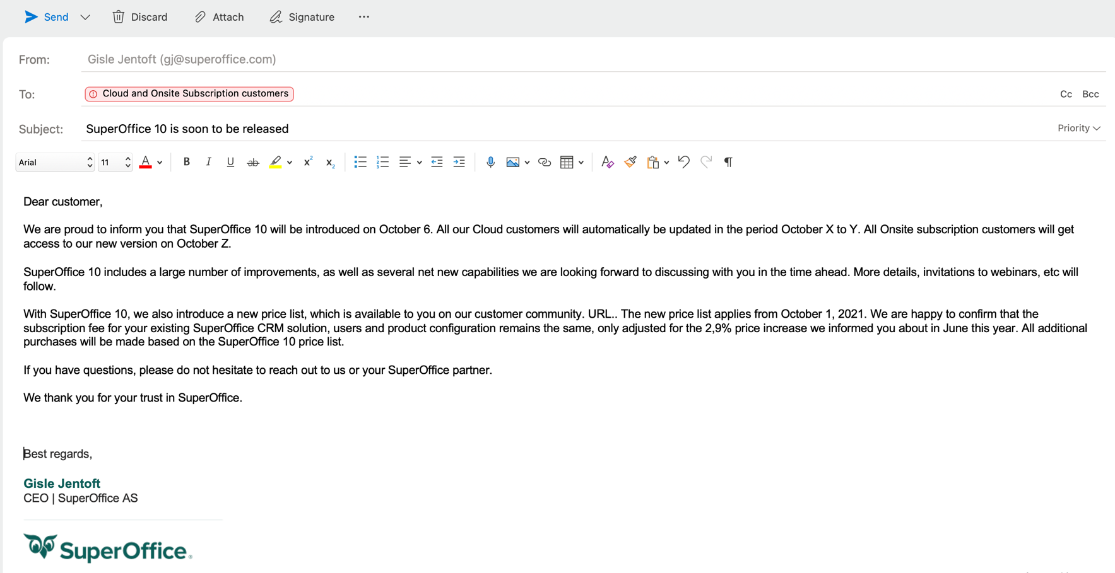
Email text – distribution on Sept 27/28
Dear customer,
We are proud to inform you that SuperOffice 10 will be introduced on October 6. All our Cloud customers will automatically be updated in during October and all Onsite subscription customers will get access to our new version in November.
SuperOffice 10 includes a large number of improvements, as well as several net new capabilities we are looking forward to discussing with you in the time ahead. More details, invitations to webinars, etc will follow.
With SuperOffice 10, we also introduce a new price list, which is available to you on our customer community (link to be inserted in email). The new price list applies from October 1, 2021. We are happy to confirm that the subscription fee for your existing SuperOffice CRM solution, users and product configuration remains the same, only adjusted for the 2,9% price increase we informed you about in June this year. All additional purchases will be made based on the SuperOffice 10 price list.
If you have questions, please do not hesitate to reach out to us or your SuperOffice partner.
We thank you for your trust in SuperOffice.
Best regards
SuperOffice XX
Local CCD

Slide 13
What it means...
Existing price level
Existing discount level
Customers on list price
All customers with an explicit agreement on a specific price level (framework agreements) will be able to buy on this price level until the expiration date of the commercial agreement.
Within these timeframes, we will have to agree on new terms, with the goal of reaching a mutually acceptable agreement.
All customers with an explicit agreement on a specific discount % level (framework agreements) will be able to buy on the same discount % until the expiration date of the commercial agreement.
Within these timeframes, we will have to agree on new terms, with the goal of reaching a mutually acceptable agreement.
All other customers, meaning who does not have an agreed price level or discount % level, will in essence have to by additional products according to the new SO 10 price list from October 2021.
In cases like this, we apply ordinary business tactics in upsell situations, and agree on Ts & Cs which bring our upsell deals to closing.

Slide 14
Offering +20 Sales Premium users
Case description
Current price
After price adjustment
Upsell price (10)
Comments
Customer I
Volume fixed price agreement valid for 36 months – we are 30 months into it (3.150+ users)
Fixed Price
200,00
NOK/user/month
After price adjustment
200,00
NOK/user/month
SO 10 Price (700,00)
200,00
NOK/user/month
Start negotiation and adapt to SO 10 price plan by end of March ´22
Customer II
Fixed level agreement for 24 months with index adjustment– we are 20 months into it (350 users)
Fixed Price
400,00
NOK/user/month
After price adjustment
411,60
NOK/user/month
SO 10 Price (700,00)
411,60
NOK/user/month
Start negotiation and adapt to SO 10 price plan by end of Jan ´22
Customer III
Fixed discount agreement - 8% discount on list price
Price after discount
473,80
NOK/user/month
After price adjustment 487,54
NOK/user/month
SO 10 Price (700,00)
644,00
NOK/user/month
The customers is offered the agreed discount on SO 10 list price
Customer IV
No discount
List price
515,00
NOK/user/month
After price adjustment
529,93
NOK/user/month
SO 10 Price (700,00)
700,00
NOK/user/month
As this customer has no discount, we offer at list price.
Note! Net new products are not part of existing agreements!
DataBridge, SuperOffice AI, etc....
Here we are free to offer at higher prices.

Slide 15
New discounting process
As part of the implementation of our new pricing model, we will also implement a new discounting structure across the group.
The background is that we need to align across markets and meet all customers – also multinational – with the same voice and the same discounting levels.
The levels and models will be developed in Q4/21 and will be ready for implementation in SO One by January 2022.

Slide 16
Financial Friction
Not a main driver, but sugar on the cake …
Payment models..

Slide 17
Increase the migration factor!
How can the general uplift in SuperOffice 10 pricing also increase
the migration factor?
From 2.5 to 3.0 ..
New default thinking: “We can offer you a 42% discount on our new SuperOffice CRM Cloud pricing”
(and make a 2-3 years agreement)
If you (as a sales manager or account manager) focuses on the factor alone, no uplift is achieved
On-premise customers will always compare focus on current maintenance cost (buy) and subscription fee (onsite) and the trick is

Slide 18
How can we use SuperOffice 10 to move our BUY & ONSITE customers in the right direction?

Slide 19
4 scenarios
Migrate and Upgrade to SuperOffice 10
SuperOffice 8 BUY → SuperOffice 10 Cloud
SuperOffice 9 Onsite Subscription → SuperOffice 10 Cloud
SuperOffice 8 BUY → SuperOffice 10 Onsite Subscription
SuperOffice 9 Onsite Subscription → SuperOffice 10 Onsite

Slide 20
BUY SuperOffice 8: Stay, Migrate or Upgrade?
SuperOffice 10
Onsite Subscription
SuperOffice Cloud
SuperOffice 10
BUY customers
on SuperOffice 8

Slide 21
Why is staying on BUY so negative?
It is not being developed
No new features
High security risk
Risk of churn
The plan is to announce SuperOffice 8 End-of-Life
on Feb 1 2023
Official information will be published on Feb 1 2022
EOL means:
No patches
No support
No new licenses

Slide 22
Migrate or Upgrade?
SuperOffice 10
Onsite Subscription
SuperOffice Cloud
SuperOffice 10
BUY customers
on SuperOffice 8

Slide 23
Migrate to Cloud
SuperOffice Cloud
SuperOffice 10
1-step fast track to cloud.
Complete set of features.
Enjoy all the benefits of Cloud.
Take advantage of a very favourable deal.
The preferred option.
Solid upsell and CV.
Avoid on-premise solutions.
BUY customers
on SuperOffice 8

Slide 24
Let’s just quickly remind ourselves of how strong our Cloud offering is..
Migration Offering
The Benefits of the Cloud
The differences between our onsite and cloud products

Slide 25
SuperOffice Migration Offering
No cost for any migration technology or migration software. (Consulting is a payable service).
Migration-process is fully automated and fast.
The application offers the same user experience,
the same UI and features. It is the same app!
No need for user training
Database content and structure are migrated as an identical twin. No change..
Strongest there is!
For years we have been paving clear migration roads and laying out red carpets to the cloud for all our customers.
Almost 2.000 customers have chosen to migrate from on-premise to cloud since 2016.
Use our material on the Parliament:
Cloud Migration Campaign – Launch Kit
Notes:
Can we improve our sales & marketing tools?
Customer succes stories
The Storytelling
Campaigns & Activities
Key Account programs and attention

Slide 26
Cloud Benefits
Complete hosting – no need for inhouse servers or infrastructure related to CRM
Automatic upgrade of the software every 3rd week.
No cost, no hassle, always updated.
High level of security
Open APIs available for custom and standard Apps
Robust, cost-efficient and rich integration platform
Lower cost of ownership & sustainability
The core elements..
The software-industry are without exception basing future
innovation on the cloud infrastructure.
On-premise solutions will inevitably become
dramatically more expensive to develop, maintain and operate.

Slide 27
Not quite – these products are Cloud Only:
“Onsite & Online pricelists are the same”
Features and free add-ons:
Video meetings integration
SuperOffice for Outlook
SharePoint Documents
Google Workplace Documents
Mailing service (Mailgun)
Add-ons
SuperOffice AI
Expander Services
  Database Mirroring Service
  Cross-domain Identity Mngmnt (SCIM)
  Sandbox environment
Metered Services:
Metered services are only applicable for Cloud customers. Onsite customers are using their own services here.
Exception: Databridge
Apps from the SuperOffice App Store:
Apps listed here are only available for Cloud subscriptions.
And the list is growing ..
Notes:
What about the Business Analyze products? – are they still on our ONSITE pricelist?
Yes, they are still there with the same names as before, but with a small increase in price to follow the generall price list for 9 (and therefore 10).

Slide 28
So what is holding our customers back?
Cloud Readiness Survey (June 2021)
Cost
Integrations
Lack of cloud strategy
Complex, integrated internal on-premise based system landscape
Recent investment in servers and infrastructure that needs to be written off

Slide 29
BUY customers can also upgrade to
SuperOffice 10 Onsite Subscription
SuperOffice Motivation
Strengthen customer relation
Moving forward, avoid status quo
Reducing churn risk, securing ARR
Preparing cloud migration (new CV)
Upsell from the 10 Price list
A 2-step process to cloud
The Onsite Subscription pricing features:
Low entry, flexible terms, same price, same features/price
Eliminate legacy Windows technology
Immediate change of integrations is not required
The perfect stage for preparing for cloud if needed
Being able to deliver on-premise is a competitive advantage for SuperOffice and a benefit for our customers
Price is likely to increase in coming years due to increasing development and operational costs
2
SuperOffice 10
Onsite Subscription
SuperOffice Cloud
SuperOffice 10
1
BUY customers
on SuperOffice 8

Slide 30
Onsite customers upgrading to SuperOffice 10
SuperOffice Motivation
Moving forward, avoid status Quo
Reducing churn risk
Preparing for cloud migration
Strengthen customer relation
Upsell from SuperOffice 10 Price list
A 2-step process to cloud
The perfect stage for preparing for cloud
Time to cloud-enable custom integrations and eliminate technical debt
Time to write-off investments in own servers and infrastructure (optimize TCO)
Continuosly upgrading to the newest SuperOffice version increases security level, reduces total cost of ownership and makes the cloud-step easy
2
SuperOffice 10
Onsite Subscription
SuperOffice Cloud
SuperOffice 10
1
SuperOffice 9
Onsite Subscription

Slide 31
The Relase Plan

Slide 32
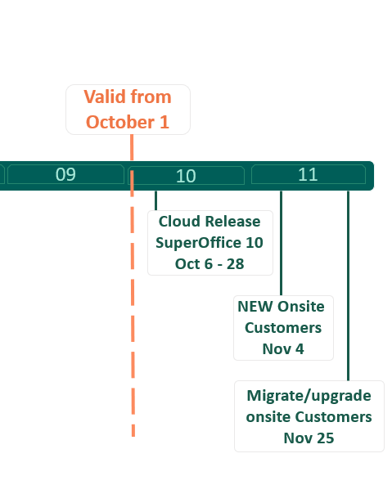
Release Plan

Slide 33
Tools we use in the dialogue with customers

Slide 34
Upgrading from 9 to 10
The rules – product configurations

Slide 35
New free licenses introduced
Introduced for existing 9.x customers ONLY
This is done to:
Keep room for upsell by leaving open white space
Total discount becomes smaller on current licenses (ref. existing customers should pay the same)
New free licenses are:
Free Mailings – Malings feature as in 9.x (not full marketing)
Free Projects – Projects as in 9.x (add/edit/delete). This also includes access to use Combined Selections (as in 9.x)

Slide 36
9.x to 10.x migration rules
9.x User Plan
10.x User Plan
Standard
Sales
Service
Marketing
Complete
-> Sales Essentials
+ Free Mailings, Free Projects (incl combined selections)
-> Sales Premium + Free Mailings
-> Service Premium + Free Mailings
-> Marketing
Marketing Platform
-> Sales Premium + Service Premium + Marketing
Marketing Platform

Slide 37
Basic guidelines
If you have Standard + Sales users, then all users --> Sales Premium + Free mailings
If you have Standard + Service users, then Standard users --> Sales Essentials + Free mailings + Free project
If you have any Complete users, then all users --> Premium user plans
If you have Marketing or Complete users, then add Marketing platform
Remember: All users had Mailings in 9.x, so migration adds at least Free Mailings

Slide 38

Let´s have a test …

Slide 39
Scenario 1
9.x
10.x
10 Standard CRM
10 Sales Essentials
  + Free mailings
  + Free projects (combined selections)

Slide 40
Scenario 2
9.x
10.x
10 Sales
10 Sales Premium
  + Free mailings

Slide 41
Scenario 3
9.x
10.x
10 Service
10 Service Premium
  + Free mailings

Slide 42
Scenario 4
9.x
10.x
10 Marketing
10 Marketing
1 Marketing Platform

Slide 43
Scenario 5
9.x
10.x
10 Complete
10 Sales Premium + Service Premium + Marketing
1 Marketing Platform

Slide 44

So far, so good ?

Slide 45
Scenario 6
9.x
10.x
5 Standard
10 Sales
15 Sales Premium
  + Free Mailings

Slide 46
Scenario 7
9.x
10.x
5 Standard
10 Service
5 Sales Essentials
  + Free mailings
  + Free projects (combined selections)
10 Service Premium
  + Free mailings

Slide 47
Scenario 8
9.x
10.x
5 Standard
10 Service
3 Complete
5 Sales Premium
  + Free Mailings
10 Service Premium
  + Free Mailings
3 Sales Premium + Service Premium + Marketing
Marketing Platform

Slide 48

Well done !

Slide 49
Module / Add-ons Migration Rules
9.x Modules
10.x Modules
CEP, Free-CEP
Forms, Free-Forms
Chat, Free-Chat
Expander Services
DB Mirroring
CEP, Free-CEP
Forms, Free-Forms
Chat, Free-Chat
New name: Developer Tools
DB Mirroring
Unchanged

Slide 50
Modules
Module
Reason
CEP, freeCEP
Chat, Forms, freeChat, freeForms
Expander Services
DB Mirroring
SCIM
Synchronizer
Databridge
Sandbox
Same as before
Same as before
New name: Developer Tools
Same as before
New
New
New
Sandbox/Test environment

Slide 51
Scenario 9
9.x
10.x
5 Standard
10 Service
1 CEP
5 Sales Essentials
  + Free mailings
  + Free projects (combined selections)
10 Service Premium
  + Free mailings
1 CEP

Slide 52
Scenario 10
9.x
10.x
5 Service
5 Complete
1 Chat
5 Service Premium
  + Free mailings
5 Sales Premium + Service Premium + Marketing
1 Marketing Platform
1 Chat

Slide 53

What about 8 Buy customers?

Slide 54
Scenario 10
8.Buy
10.x
5 Standard
5 Sales Essentials
  + Free Mailings
  + Free Project (incl Combined Selections)

Slide 55
Scenario 11
BUY 7.x
9.x
10.x
15 users
5 win
3 pocket
10 ej user
1 cust ctr
5 Sales
10 Service
1 CEP
5 Sales Premium
  + free mailings
10 Service Premium
  + free mailings
1 CEP

Slide 56
Scenario 12
8.Buy
10.x
​5 Complete ​
2 Marketing ​
3 Service
4 Sales
5 Sales Premium + Service Premium + Marketing
2 Marketing
3 Service Premium (+ Free Mailings)
4 Sales Premium (+ Free Mailings)
Marketing Platform
Free Chat, Free Forms (as in 9.x) for all users

Slide 57
Scenario 14
8.Buy
10.x
Customer Center ​
5 Complete ​
2 Marketing ​
3 Service
4 Sales
CEP
5 Sales Premium + Service Premium + Marketing
2 Marketing
3 Service Premium (+ Free Mailings)
4 Sales Premium (+ Free Mailings)
Marketing Platform

Slide 58

Awesome!

Slide 59

Migration Rules Graduation – Congratulations!

Slide 60
Do we have any tools to assist partners?
Partner license guiding service
Product Configurator – in Excel
Migration Calculator – in Excel

Slide 61
Partner license guiding service
This is a communication channel that can be useful in two scenarioes
  Existing customers wants to order more licenses – how can the partner know what the customer has at that time – and what to sell more of…
  If the partner for any reason need to know what user plans their customers have after the upgrade (ie to identify white space, visiting a customer etc..)

Slide 62
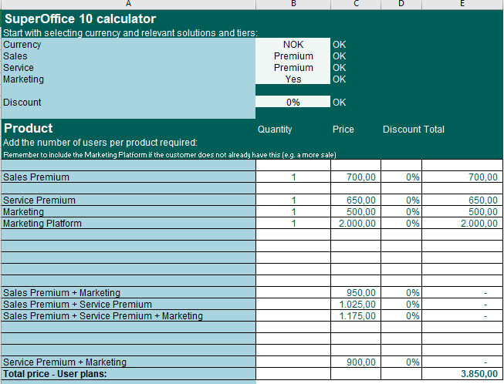
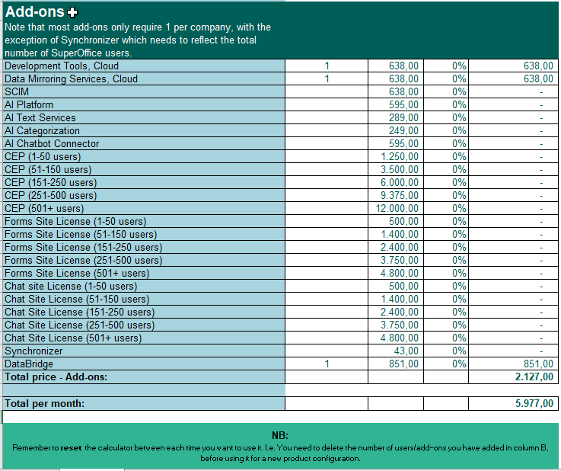
Product Configurator for partners - excel tool
This is a tool you can use to define multi plan users and addons/modules
It will together with the Price list be a valuable tool in Quoting SO 10

Slide 63
Migration Calculator - excel tool
This is a tool you can use if you have sent out proposals/quotes for version 9 and close the deal after SuperOffice 10 has been released
It is not possible to provision a Cloud 9 after October 6th – therefore, you need to update the proposal
  To reflect the 2,9% price increase
  Replace 9 plans with 10 plans and
  Calculate the new discount to reflect the agreed end price of the active proposal.
You can do all this by using the Excel migration calculator – see next slide for example

Slide 64
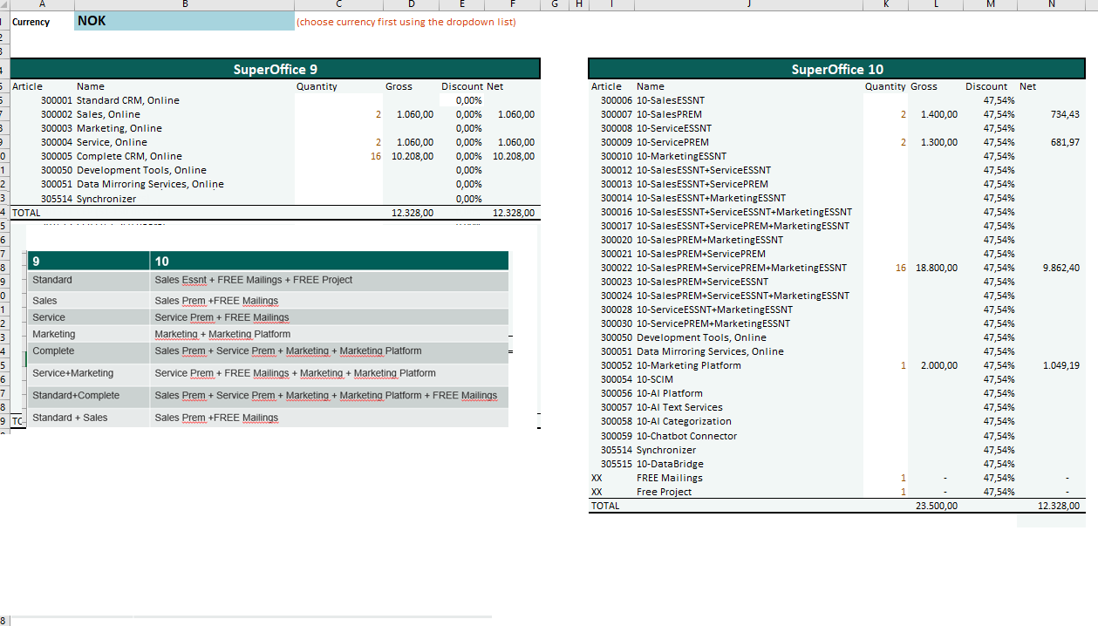
Migration Calculator - excel tool
Ie converting 2 sales, 2 service, 16 complete to SO 10

Slide 65
EOS
End of Session

