Slide 1
SuperOffice 10 Readiness Program
Session 2
Using the new price model with new customers

Slide 2

NET NEW CUSTOMERS
ARE VITAL
TO GROW
Notes:
Every company with a growth ambition needs to master two things; win new customers and keep the ones they have. When it comes to growing faster than the market and your competitors, closing Net New Business is key.
The CRM market has an expected growth rate year over year of approx 15%, so winning new logos should be at the top of everybodys priority list.

Slide 3
Introduction
ICP
Personas
Positioning

Slide 4

Who is our Ideal Customer Profile?
Notes:
Remind ourselves who we think are the most relevant customers to target – and whilst we have talked about this quite a lot and I included it in our blog posts, this is also important to our partners who we work with and attends this readiness program.

Slide 5

ICP is not just about size and industry….
Target audience
Potential Customers
Ideal Customer (ICP)
Those with pains we solve
Those who have pain + a good fit
(i.e., have a budget, 20-250 employees, location, industry sectors, serious about CRM)
Those with pain, fit and who are willing to enter into a dialogue to discuss a solution
Personas
Those ICP with match of values, attitudes and profiles to match ours.
E.g., Relationships matters. Customer centric.
.
Notes:
When we often talk about ICP, it's very typical to mention the size and industry, so called Firmographics, but our ICP is more than that.
Our ideal customers are prospects experiencing pains we can solve, and who are ready, willing, and able to buy our product and services
Simply put: And ideal customer is one who we bring a lot of value and one who brings a lot of value to us.
Why bother with an ICP?
Knowing who it is that has the most success with our products and services will help align sales and marketing as well as focus our effort to get the most out of our investments. It is also the most profitable for our company and our partners.
So, what are the characteristics of our ideal customer?

Slide 6
Our Ideal Customer Profile
Company type
Size
Process
Pain
Additional
B2B’s
Private co’s
Europe
HQ in country market
All industries
20-250 employees
Smaller = not attractive enough.
Larger = more competition and harder to win
Sales
Service
Marketing
Digitalization
Revenue
Efficiencies and automation
Customer Satisfaction
Control
GDPR /Customer data
Cloud/security
Want trusted partner
Ideally 1st time buyer
Relationship based
Triggers:
  Changes in key roles
  Fresh money
  M&A’s
Professional CRM – willing to invest time and money to make it work
Standardized processes, digitalization, need to scale, looking for improvements

Slide 7

What characterizes the people we engage with?
Notes:
To get an update on the buyer personas, I took a deep dive into recent new biz sales and identified the key decision makers, what was focused on, who they were as people, their digital profiles and so on. A bit of internet stalking…. And that allowed me to come up with some more general buyer personas:

Slide 8



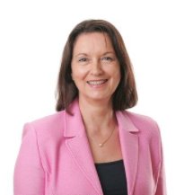

Buyer personas
Hans Fischer
Switzerland
CEO
Manufacturing
Jonas Lindgren
Swedish
CEO
IT
Daan de Vries
Dutch
Commercial director
Wholesale
Anna Bergström
Swedish.
Owner
Health sector
Christian Meyer
German
MD
IT security
In common:
Mostly men, in their late 30s to late 40s. MD/CEO.
Drivers of change. Looking for better ways to sell and service customers.
All IT savvy and pro-digitalization. People orientated.
Value not well articulated or captured by work process…
They have arrived at SuO via different channels.

Slide 9
WHAT BUYERS ARE LOOKING FOR
From the qualitative market study with key decision makers:
Integrations with existing solutions
Collaboration tools
Easy customizations (API’s, Scripting, etc.)
CRM accessible on multiple devices
Flexibility in the system
Training and support
Local presence and local support
Help for implementation
Someone that understands their business;
CRM advisor
Awareness of technology advances
Notes:
And these are factors we need to present to them in our communications.
So, now we know what companies we want to attract, we have some people in mind, and have some things we know they are looking for when considering a new CRM vendor.
This then has allowed us to re-define and come up with a new positioning for SuperOffice in the market place:

Slide 10

PRODUCT POSITIONING
Notes:
Positioning is something that we in Marketing is particularly concerned about because it is our key beacon signal to attract customers.
It’s also strategic to the company in that it says what market space and category we operate in.
Which is rather important and challenging because, as you all know, the markets that we are in are intensely crowded.

Slide 11
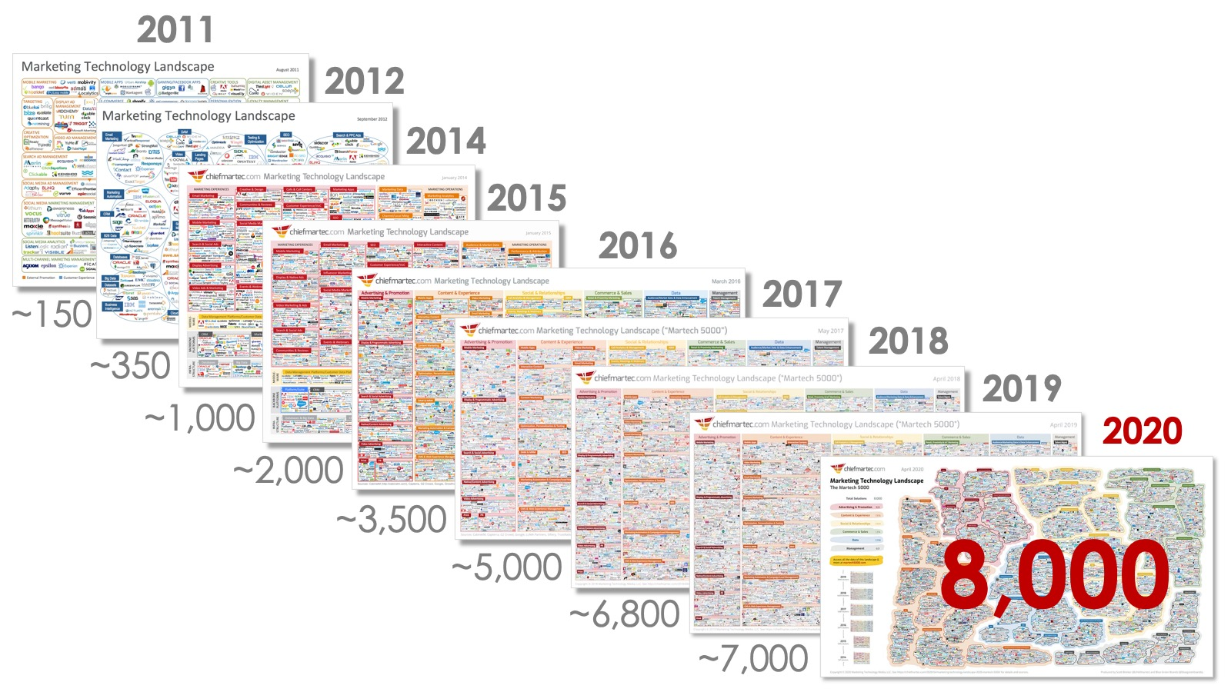
Notes:
The number of vendors within the CRM and Marketing technology landscape have exploded the last decade or so –so imagine being a customer looking for a vendor – Where do they start ?
So, Market categories help customers focus….
But even is we just look at the Sales Tech landscape, it’s incredibly crowded and confusing.
in order to stand out to potential customers, we need a clear positioning that resonates with the customers we want to do business with. I.e. we need to know and be able to communicate what we do best in the world to someone who cares a lot about what we have to offer.
So alongside the pricing discussions, we have crystalized our positioning as:

Slide 12
DESIGNED FOR TOMORROW’S CRM NEEDS.
BUILT ON 30+ YEARS OF EXPERIENCE IN GROWING EUROPEAN BUSINESSES.
For B2B businesses that want to work smarter and be more efficient, SuperOffice CRM offers a 360-degree view of all customer data and centralizes customer insights in one place, while helping them optimize and automate their workflows and processes with the help of the newest technology.
SuperOffice CRM is a modern solution that is designed to fuel sales, marketing and customer service processes.
We help organizations establish, nurture and grow long-lasting, profitable customer relationships, by offering an agile CRM solution that will adapt to a company’s growing business needs and help generate more revenue.

Slide 13


Value proposition
We turn relationships into revenue
SuperOffice is a modern CRM solution based on 30+ years of experience in growing European businesses.
Combining a 360-degree customer view, innovative technology, process improvements and an understanding of people, we help you turn relationships into revenue.

Slide 14
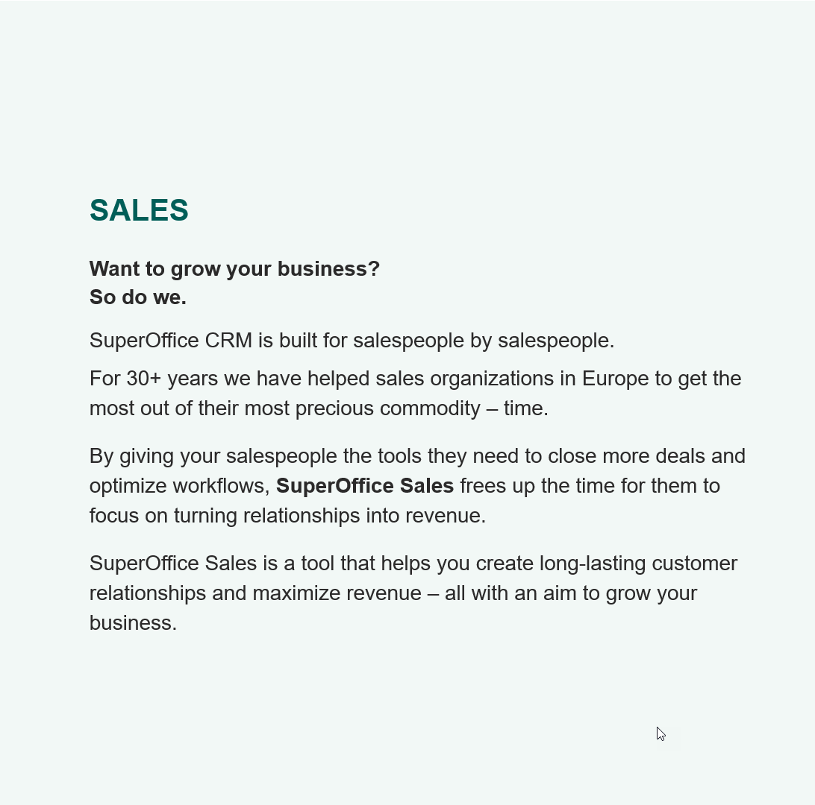
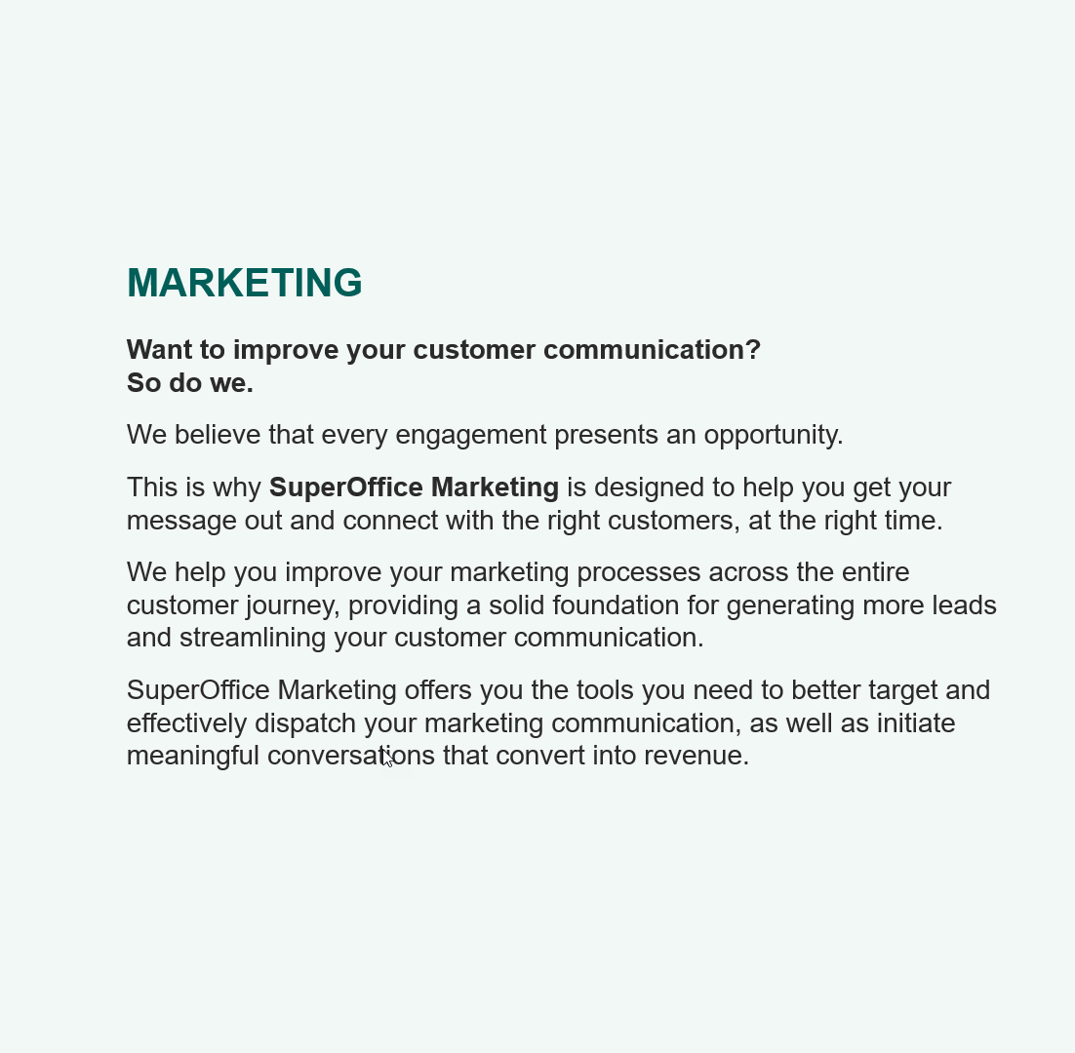
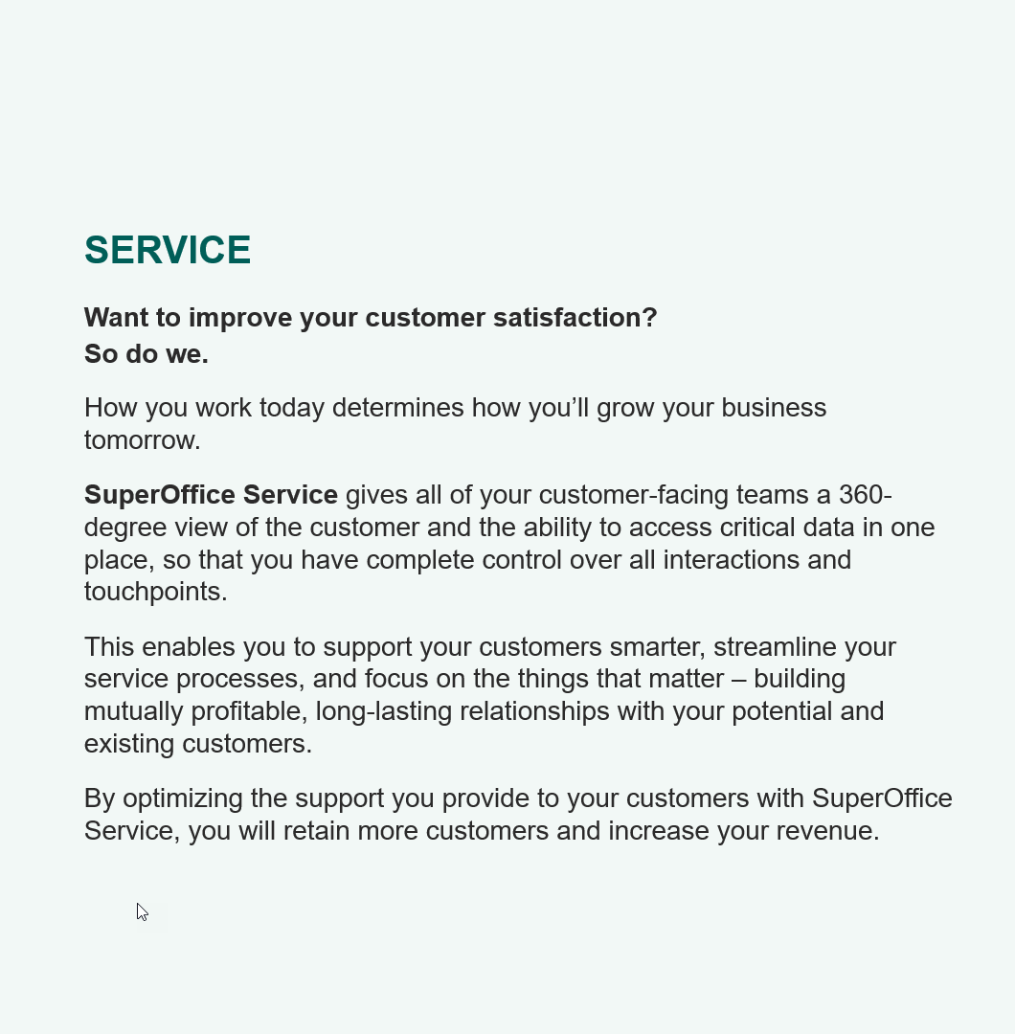
Sales, Marketing and Service
Notes:
CATHRINE: I’m not going to read this out loud, but I have shared this with you all in the launch kit and most importantly, we use this to guide our marketing narrative and the story we all tell to the market about SuperOffice CLICK

Slide 15
Product
Sales
SALES
Want to grow your business?
So do we.
SuperOffice CRM is built for salespeople by salespeople.
For 30+ years we have helped sales organizations in Europe to get the most out of their most precious commodity – time.
By giving your salespeople the tools they need to close more deals and optimize workflows, SuperOffice Sales frees up the time for them to focus on turning relationships into revenue.
SuperOffice Sales is a tool that helps you create long-lasting customer relationships and maximize revenue – all with an aim to grow your business.

Slide 16
Product
Service
SERVICE
Want to improve your customer satisfaction?
So do we.
How you work today determines how you’ll grow your business tomorrow.
SuperOffice Service gives all of your customer-facing teams a 360-degree view of the customer and the ability to access critical data in one place, so that you have complete control over all interactions and touchpoints.
This enables you to support your customers smarter, streamline your service processes, and focus on the things that matter – building mutually profitable, long-lasting relationships with your potential and existing customers.
By optimizing the support you provide to your customers with SuperOffice Service, you will retain more customers and increase your revenue.

Slide 17
Product
Marketing
MARKETING
Want to improve your customer communication?
So do we.
We believe that every engagement presents an opportunity.
This is why SuperOffice Marketing is designed to help you get your message out and connect with the right customers, at the right time.
We help you improve your marketing processes across the entire customer journey, providing a solid foundation for generating more leads and streamlining your customer communication.
SuperOffice Marketing offers you the tools you need to better target and effectively dispatch your marketing communication, as well as initiate meaningful conversations that convert into revenue.

Slide 18

Core Story
THE SHORT PITCH
SuperOffice CRM is a modern, forward-thinking CRM solution built on 30+ years of experience in helping European businesses build strong and profitable customer relationships.
Offering a 360-degree customer view to your sales, marketing and service teams, the solution is designed to help you maximize the value of your customer data and give you actionable insights to turn relationships into revenue.
SuperOffice CRM offers the tools to optimize your processes and bridge the gap between customer data and revenue. It’s an agile, scalable solution that will grow together with your business.
When you buy into SuperOffice, you buy into a partnership with people who truly understand your business and are there to help you maximize the value of your CRM solution.
Notes:
CATHRINE: Which in short can be expressed as
READ out.
Now whilst positioning is not copy and messaging directly, it guides our messaging and for sure you’ll recognize it in our updated marketing content and sales enablement content that we have prepared for this launch:

Slide 19
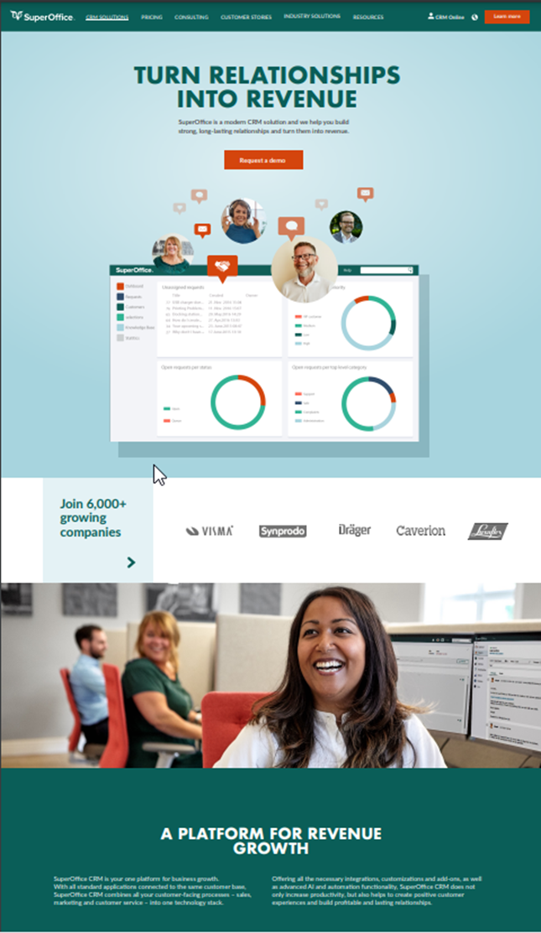
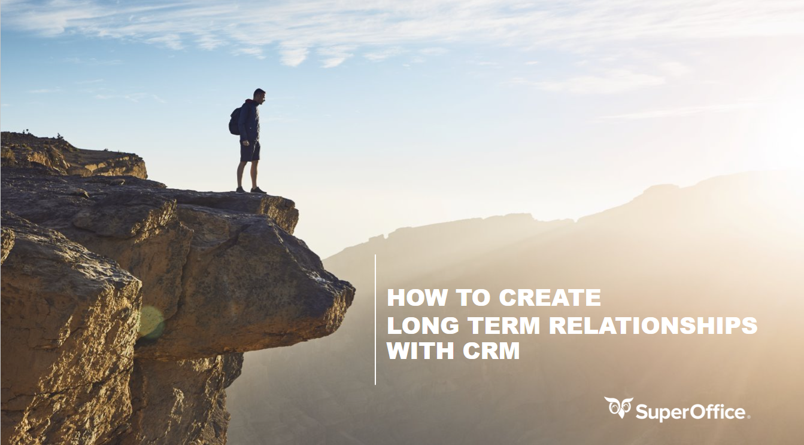
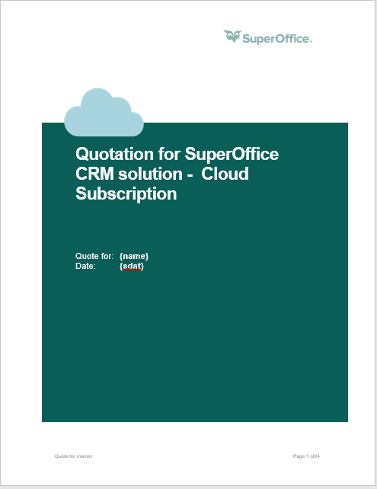
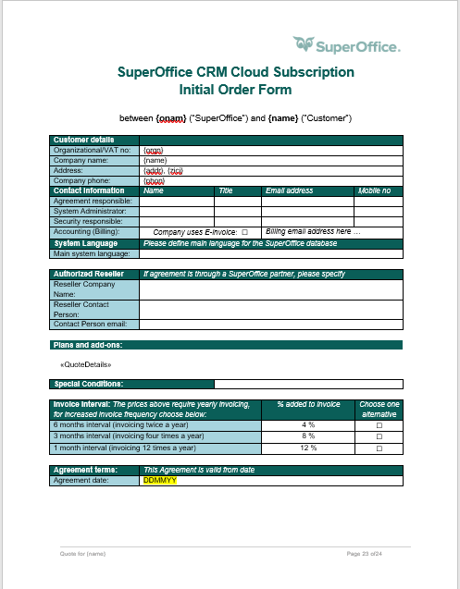
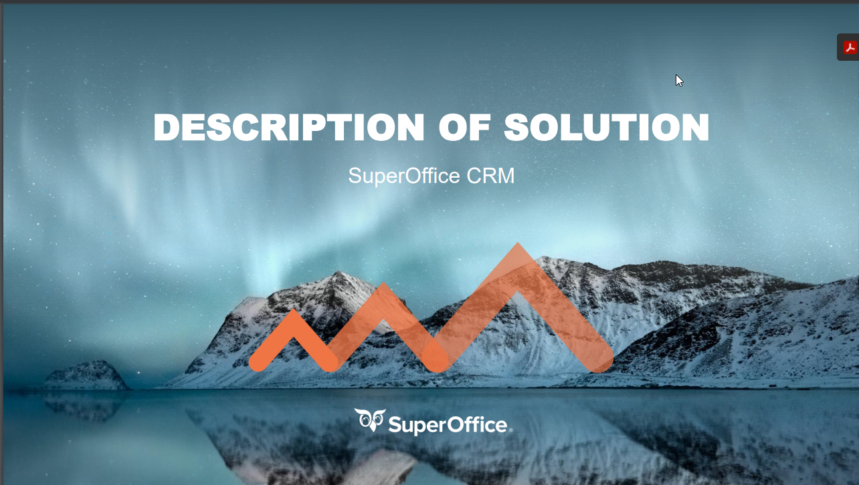
Tools to help you close the deals
Notes:
CATHRINE With this backdrop, let us share a little bit of the updates that will be made available to you shortly:
CLICK

Slide 20

Website update
New positioning
New content
New concept video
Updated pricing
Notes:
CATHRINE: First – we will publish an updated website on October the 4th.
This will reflect the new positioning, our product and updated pricing as we have referred to earlier. There are more updated content to come, but key changes have been made that hopefully will resonate better with our ICP so that they want to engage with us.
The aim is to convert interest into actual leads that sales sit down with – CLICK:

Slide 21
Updated
M1 Presentation
Business Oriented
Updated story
Shows functionality in Essentials vs Premium User Plans
Notes:
The M1 meeting is often the make or break meeting with potential customers, it’s our chance to create interest and enthusiasm around CRM and SuperOffice.

Slide 22
Our Sales Meetings
Meeting 1
  M1 Meeting
  What do you want to achieve? What effects do you want to realize with CRM?
  Description of Solution (Specification of delivery)
  What are you going to measure? (KPIs)
  What processes do you want to improve?
  Integration points?
  What risks do we see in this project?
  SuperOffice Demo:
  How SuperOffice CRM will cover your desired processes and needs
  Proposal presentation
  Signing the contract
Meeting 2
Meeting 3
Meeting 4
Notes:
These are our main sales meetings with customers.
And it’s especially the M1 / the first presentation that has changed due to SO 10.

Slide 23
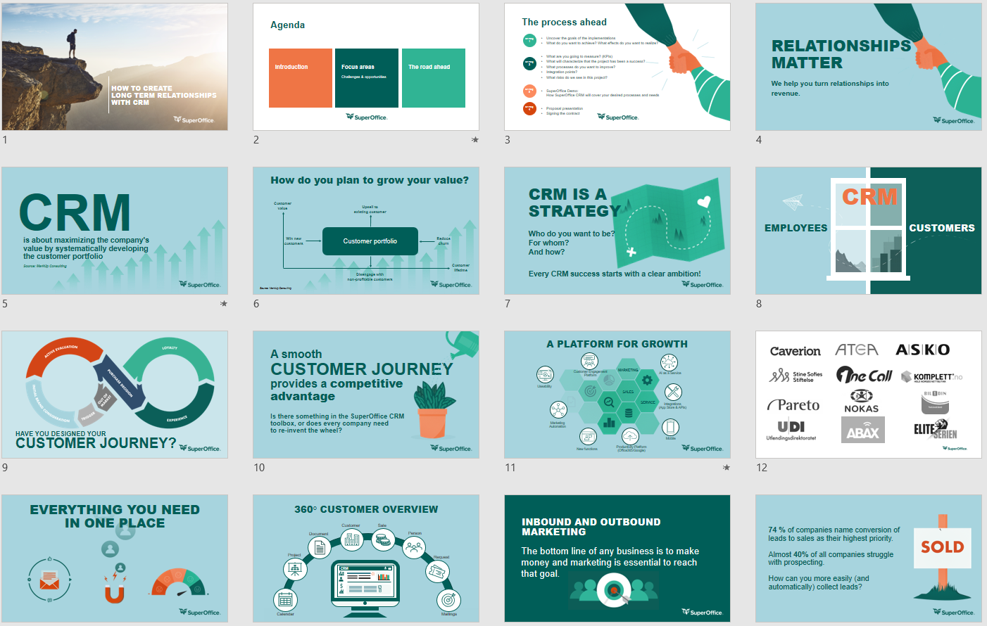
The Updated M1 Presentation
Focus on story telling, creating interest, showing a high-level overview of our solutions.
Focus on understanding the customers needs and what effects the CRM solution should have.
(This is relevant also for most existing customers, as they don’t know all we can deliver.)
Notes:
So at an overview you can see that the slides are meant for conversations and discussions rather than reading – no death by powerpoint here…
In addition to picking up some of the positining, the biggest change is how we explain the user plans and the functionality in the solution…

Slide 24


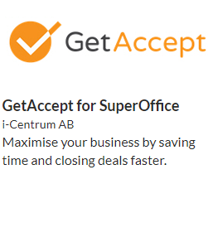
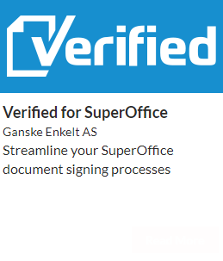



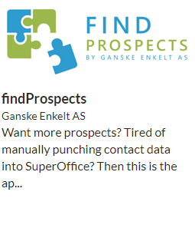
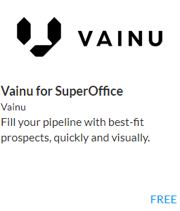



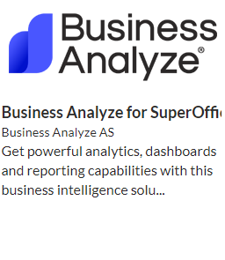
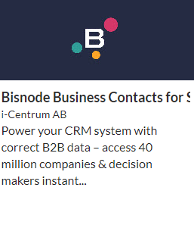











SuperOffice Sales
Relevant Apps for Sales
Sales opportunity registered
Customized Dashbord
SuperOffice App Store
Standard Dashbord
Salg
Prognose
Proposals
Products & prices
10%
30%
60%
80%
10%
30%
60%
80%
99%
Tilbud
Product
$
Sales Guide
%
Stakeholders
Seamless connection between CRM and App
Product register
Sales Essentials
Sales Premium
* Seperate agreements, prices and terms apply when buying Apps
Notes:
We have created illustrations of our functionality so when you’re in the first meeting, and the customer asks for a demo – you don’t have to drop the candy in the reception, you can rather show and discuss what areas are of interest to the customer.
You see a colour code for Premium (orange), so if a customer needs Sales Guide, customized dashboards, Quote and/or stakeholders they will need to buy Sales Premium for all their users.
We have also added Apps and suggest that you – to a larger extent spread the fantastic offering in the App Store to customers.

Slide 25




























SuperOffice Service
Customized Dashboard
Receipt to sender
Notification to agent
Standard Dashbord
History
Inc. requests
Responstid
Scripts og Macros
Sak
Automasjon
Categorization
Priority
Status
Eskalering
FAQ
Q & A
Q & A
Time-based priority
FAQ / Knowledge base
Collaboration
Service Essentials
External links / autoreply
Automatic and rule-based escalation
Service Premium
Notes:
Same principle applies for service, showing you that posting FAQs externally, the need for functionality for automatic SLA escalation or customizing your dashboards leads to the need for Service Premium user plans.
We have many more of these illustrations in the M1 template for discussions ; Marketing Inbound and Outbound, AI, IoT, Customer Engagement Platform etc.
So, say that we have captured their interest and run a successful sales process, Cathrine – How do we create proposals?

Slide 26
New proposals
New intro sections
New solution description
New product descriptions
Updated order form
Notes:
Proposals have also been updated to reflect the key messaging we have been saying as well as we have updated the product descriptions to reflect our new pricing and packaging.

Slide 27
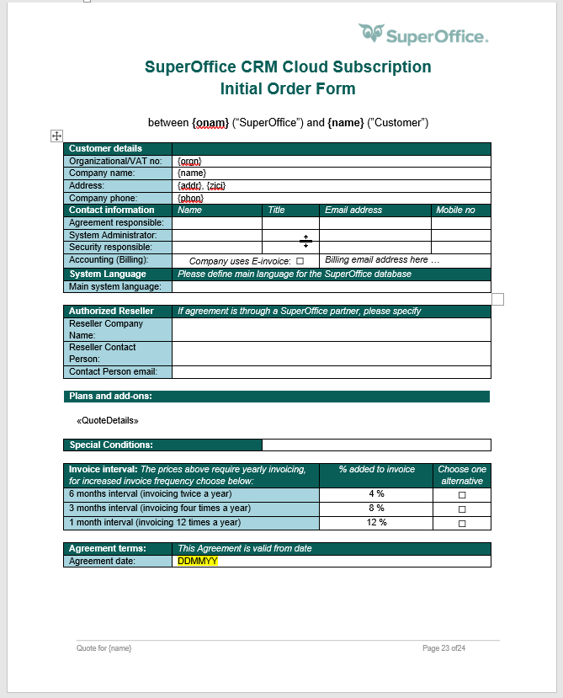

Notes:
For SuperOffice internal people, the Quote template is also placed within the initial order form, and there’s a new product configurator being released to help you pick the right products.
For all, including partners, there will be a version of this in Excel. Partners then can use this to create their product configuration and copy and paste this into the proposal template.

Slide 29
SuperOffice 10 use cases
A look at 7 different real customer cases
INSPIRATIONAL MATERIAL FOR TRAINING PURPOSES
September 2021

Slide 30
7 real net new customer cases
- where all chose SuperOffice 9 in the cloud
Case details
Solution – SO 9
Scenarios – SO 10
Company, challenges, goals, scope, competition, etc
The chosen configuration and list prices
Two scenarios per case – Essential and Premium configurations and prices

Slide 31
Keep in mind!
There is no “right or wrong” answer here.
SuperOffice 10 pricing & packaging does offer more flexibility and scalability.
There will be more roads to the “right” solution than today.

Slide 32
Benchmarking of SuperOffice 10 pricing model
Together with Bain & Company we have benchmarked the new pricing and packaging model.
Competitive evaluation vs Salesforce, Dynamics, HubSpot, Zendesk, Lime and WebCRM.
Tested on user panels – with participants consisting of typical buyers personas in the ICP.
Tested in internal groups consisting of sales and management.

Slide 33
PPVVC is still valid!
Pain
Power
Value
Vision
Control
Solution selling skills are a key ingredient – PPVVC = Pain, Power, Value, Vision, Control.
..but this is not a Solution Selling Training – it is about configuring the right solution with SuperOffice 10.
Pain - What high priority pain/ opportunity has the prospect admitted to you and what is it costing them today?
Power - Who do you believe is the Power Sponsor and why? Can we gain access and influence?
Value - What vision did you create for the prospect? Is vision differentiated towards us?
Vision - Has the prospect identified enough value to compel them to move ahead now?
Control - Who is controlling the buying process? Has the prospect agreed to your draft joint evaluation plan?

Slide 34
Montana Bausysteme AG
Building & Construction
Switzerland

Slide 35
Montana Bausysteme AG
Company facts / Project goals
Project / IT / Deal potential / Time
Montana is a multi-metal company and is manufacturing panels for roofs, ceilings and façades. Montana is mostly acting in the sector of building and constructions.
Montana has over 100 employees and is evaluating a new CRM Solution for their Sales and Marketing processes and teams. Today, they have over eight different platforms with customer relevant data.
Challenges: Lack of common processes for Sales and Marketing, meaning they struggle with pipeline management and sales reporting. Poor customer insight across the team and management is missing data/insights for running the business.
Pains: Main pain is that churn is high – and competition is aggressive – and they are losing market share.
Goals: Structure, unify and optimize their sales and marketing process. Common contact management and replace several of the current “silo” databases. Utilize a common marketing and sales processes to drive more business across new and existing customers, including improving customer retention rate. Ultimately, retention of market share is key.
Project Scope: Contact Management / Sales with no quote (ERP) but with stakeholder / Marketing with forms / individual Dashboards / Project- and Object Management / Mirroring services / Interface to SAP / individual scripts for automated mailings (trigger events when prospects become customer.
Limitation: Lack of internal personnel resources at Montana, they are looking for a CRM partner to fill this gap.
Initial potential: 19x User (2x Sales & Marketing User / 16x Sales / 1x Marketing) incl. Synchronizer, 1x Expander Services / 1x Integration Services
Growth potential: More Users – new employees / CS / Quote in a later stage
Competitors: Salesforce
Timeline: From request to go live (1 year)

Slide 36
What we ended up selling – SO 9
Comments
Configuration / Price*
This configuration was a result of the sales process with the customer.
Zero discount.
The implementation services scope ended up at 19,5 days, equal to CHF 36,060.
SO Software | QTY | Currency | Price/User/Month | Total/Month
Marketing | 1 | CHF | 61,60 | 61,60
Sales | 16 | CHF | 61,60 | 985,60
Complete | 2 | CHF | 71,90 | 143,80
Synchronizer | 19 | CHF | 4,20 | 79,80
Expander Services | 1 | CHF | 71,90 | 71,90
Integration Services | 1 | CHF | 71,90 | 71,90
Total Software |  | CHF |  | 1,414,60
*At list price

Slide 37
How would we solve it with 10..?

Slide 38
Sales features
Evaluate vs the need of the customer..
Essentials Edition
Sales and opportunity management
Sales forecasting
Dashboards with default tiles
Currency support
Sales secretary
Premium Edition
Sales guide
Sales forecasting on product level
Dashboards with custom tiles
Stakeholders
Sale targets and KPI's
Activity Monitors (SAINT)
Combined selections
Project management
Quote Management
  Create and manage quotes
  Products and pricelists
  Alternatives and versions
  Approval
  Templates
In addition to all from the Essential edition

Slide 39
Service features
Evaluate vs the need of the customer..
Essentials Edition
Request / Ticket management
Categorization and auto-assign to agent
Auto reply and reply templates
Mobile CRM Request management
Standard Service reports
Dashboards with default tiles
Premium Edition
Automated rule-based escalation
Warnings and notifications – Time limits
Knowledge base (FAQs)*
Activity Monitors (SAINT)
Dashboards with custom tiles
Combined selections
Project management
In addition to all from the Essential edition
* CEP will give access to Knowledge base (FAQ) even in the Essentials plan
Notes:
CATHRINE: So – we suspect a lot of sales team notice that If you need Project, you need Premium. That’s a tough one to get their head around.
ERIK: That’s right. It is meant to be a «Premium driver» ...

Slide 40
Marketing features
Evaluate vs the need of the customer..
Mailings (personalized mass email)
Mailing service included (MailGun)
Drag and drop email designer
Company specific mailing templates
Free mailing template library
Free image library built in
Google analytics tracking
Tracking of open-rate and link-clicks
Custom actions on link-clicks
Dashboards with custom tiles
Bounce management
Spam complaints management
Forms (Web forms)*
Form submissions management with custom actions
Consent management in forms
Company specific form templates
Free form template library
Double opt-in and landing pages on forms
Automatic Reply email on submissions
Combined selections (Create/Edit)
Project management
* Marketing users only. Sales and Service users need CEP/Forms as add-on

Slide 41
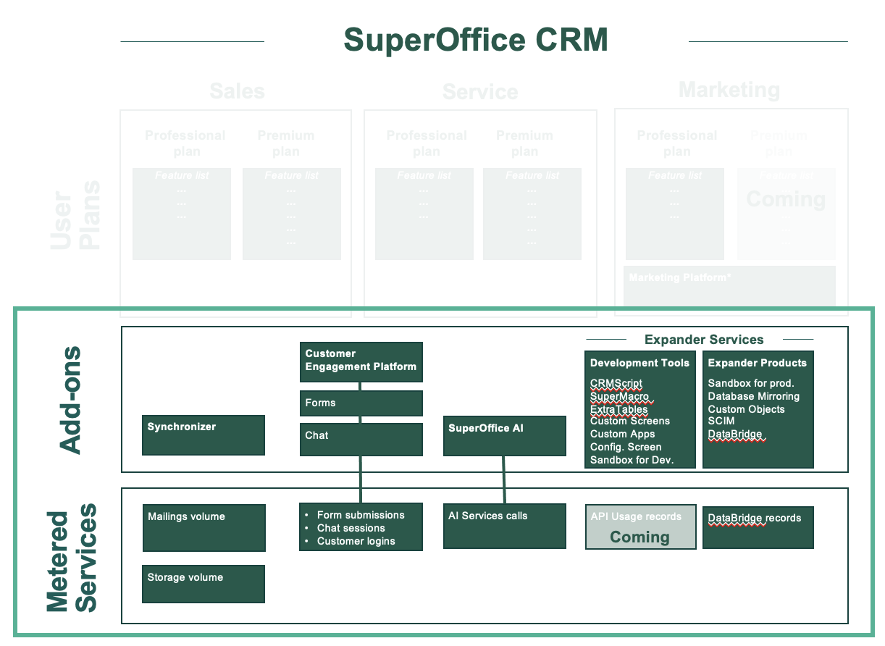
Add on Modules
All modules – and Apps in the App Store – are available both for Essentials and Premium.
This means zero differentiation here – unlike most competitors!

Slide 42
SuperOffice 10 configuration scenarios
This case could – in theory at least – be solved both with Essentials and Premium
Essentials
Premium
SO Software | QTY | Currency | Price/User/Month | Total/Month
Marketing E | 1 | CHF | 59,81 | 59,81
Marketing Platform | 1 | CHF | 239,23 | 239,23
Sales E | 16 | CHF | 59,81 | 956,96
Multiplan Sales E + Service E + Marketing E | 2 | CHF | 104,07 | 208,14
Synchronizer | 19 | CHF | 5,14 | 97,66
Development Tools | 1 | CHF | 76,31 | 76,31
Integration Services – custom App | 1 | CHF | 71,90 | 71,90
Total Software |  | CHF |  | 1.710,01
SO Software | QTY | Currency | Price/User/Month | Total/Month
Marketing E | 1 | CHF | 59,81 | 59,81
Marketing Platform | 1 | CHF | 239,23 | 239,23
Sales P | 16 | CHF | 83,73 | 1.339,68
Multiplan Sales P + Service P + Marketing E | 2 | CHF | 140,55 | 281,10
Synchronizer | 19 | CHF | 5,14 | 97,66
Development Tools | 1 | CHF | 76,31 | 76,31
Integration Services – custom App | 1 | CHF | 71,90 | 71,90
Total Software |  | CHF |  | 2.165,69
121% of SO 9
153% of SO 9

Slide 43
Ernst Schweizer AG
Building & Construction
Switzerland

Slide 44
Ernst Schweizer AG
Company facts / Project goals
Project / IT / Deal potential / Time
Ernst Schweizer AG, a leading metal construction company offering a wide range of products for the building industry. The operational business of Ernst Schweizer AG is divided into 6 business units and 5 of them have a sales department. All these sales departments are organized in a decentralized manner.
Challenges: There is no common sales support system in place, meaning a total lack of common processes and best practises, with system support across sales departments. Shared pipeline management processes and sales reporting is not present. Challenging to address cross-selling potential in a structured way, leading to lost opportunities. No common request handling process. In short, low or non existing customer insight overview across the company.
Pains: Not able to meet the required rate for revenue growth.
Goals: Accelerate revenue growth through digitalization and standardization of sales and marketing processes, implement system support to secure best practise sharing across first request to after sales process, contact management, request handling.
Project Scope: Contact Management / Sales with no quote (ERP) but with stakeholder / Marketing / Ticketing / individual Dashboards-Reports / Project-Object Management / Office365 integration / Interface to ProAlpha (ERP) / Integration to Olmero, Infomanager & SIMAP (CH local data submission platform)
Limitation: Indirect Communication through an external Project Manager
Initial potential: 136x User (89x Sales, Marketing & Service User / 47x light User – “Assistant”) incl. Synchronizer, 1x Expander Services / 1x Integration Services / 1x Olmero Integration (CH) / 1x Forms
Growth potential: CEP & Power BI
Competitors: Microsoft & Adito
Timeline: RFI May 2021 / Planned Go-Live January 22

Slide 45
What we ended up selling – SO 9
Comments
Configuration / Price*
This configuration was a result of the sales process with the customer.
47 of the users considered to be light users, resulting in higher discount (70%) for Standard and Synchronizer for these users.
The remaining software discount (89 users) received 12% discount. Avg discount of 27%.
The implementation services scope ended up at 36 days, equal to CHF 66.000.
SO Software | QTY | Currency | Price/User/Month | Total/Month
Standard (light users) | 47 | CHF | 51,00 | 2.397,00
Complete | 89 | CHF | 71,90 | 6.399,10
Synchronizer | 136 | CHF | 4,20 | 571,20
Expander Services | 1 | CHF | 71,90 | 71,90
Integration Services | 1 | CHF | 71,90 | 71,90
Forms (51-150 users) | 1 | CHF | 426,00 | 426,00
Olmero Integration – DataBridge Construction | 1 | CHF | 51,00 | 51,00
Total Software |  | CHF |  | 9.988,10
*At list price – actual CV/month for this deal ended at CHF 7.284,78

Slide 46
SuperOffice 10 scenario
Essentials configuration/price
Premium configuration/price
Run the same exercise as with case 1..
Notes:
CMD:
Service premium because the ability to create more workflows and specific rules for assignment, escalation and priorisation and knowledgebase. .
Maybe they can use Service Essentials + Development Tools – allow for workflows and customization but suspect they need the additional ability to escalate and define knowledge base etc.

Slide 47
SuperOffice 10 configuration scenarios
This case has a good mix of plans on 9, resulting in a reasonable uplift in the subscription fees.
Essentials
Premium
SO Software | QTY | Currency | Price/User/Month | Total/Month
Sales E | 47 | CHF | 59,81 | 2.811,07
Multiplan Sales E + Service E + Marketing E | 89 | CHF | 104,07 | 9.262,23
Marketing Platform | 1 | CHF | 239,23 | 239,23
Synchronizer | 136 | CHF | 5,14 | 699,04
Development Tools | 1 | CHF | 76,31 | 76,31
Forms Designer (51-150) | 1 | CHF | 167,46 | 167,46
Olmero Integration – DataBridge Construction | 1 | CHF | 51,00 | 51,00
Total Software |  | CHF |  | 13.306,79
SO Software | QTY | Currency | Price/User/Month | Total/Month
Sales P | 47 | CHF | 83,73 | 3.935,31
Multiplan Sales P + Service P + Marketing E | 89 | CHF | 140,55 | 12.508,95
Marketing Platform | 1 | CHF | 239,23 | 239,23
Synchronizer | 136 | CHF | 5,14 | 699,04
Development Tools | 1 | CHF | 76,31 | 76,31
Forms Designer (51-150) | 1 | CHF | 167,46 | 167,46
Olmero Integration – DataBridge Construction | 1 | CHF | 51,00 | 51,00
Total Software |  | CHF |  | 17.677,30
137% of SO 9
178% of SO 9

Slide 48
Svenska Retursystem AB
Logistics
Sweden

Slide 49
Svenska Retursystem AB
Company facts / Project goals
Project / IT / Deal potential / Time
About the company. They develop and operate an efficient reusable system that simplifies and improves customers’ logistics and distribution of goods. The system is based on crates and pallets that provides an effective supply chain, from producer to wholesaler and finally to consumer in the stores.
The main challenge: They had outsourced their costumer service and decided to bring it back inhouse. Therefor they needed a system to manage their request handling.
The goal for the customer: They needed a solution for both call center functionality and service management.
Project scope: They had outsourced their costumer service and decided to bring it back inhouse. Therefor they needed a system to manage their request handling.
Limitation: None listed.
Initial potential: 46 Service Users, expand. Sales and Marketing
Growth potential: ?
Competitors: Freshdesk
Timeline and implementation: Sales process: April-August - Implementation: August-October Go live November

Slide 50
What we ended up selling – SO 9
Comments
Configuration / Price*
This configuration was a result of the sales process with the customer.
Price was an issue in tough competition
  We took a safe path and offered 35% discount – the 4 Standard users were given 100% discount – considered “light” users.
Why would we win?
  Easy of use – beat complete functionality
  Trust in SuperOffice – We showed professionality and interest (external purchasing consultancy firm)
The implementation services scope ended up at 22,5 days, equal to SEK 252.000 .
SO Software | QTY | Currency | Price/User/Month | Total/Month
Standard | 4 | SEK | 419,00 | 2.397,00
Service | 46 | SEK | 524,00 | 24.140,00
CEP | 1 | SEK | 4.600,00 | 4.600,00
Expander Services | 1 | SEK | 630,00 | 630,00
Total Software |  | SEK |  | 31.767,00
*At list price – actual CV/month for this deal ended at SEK 20.599,00

Slide 51
SuperOffice 10 scenario
Essentials configuration/price
Premium configuration/price
Run the same exercise as with case 1..
Notes:
CMD:
Service premium because the ability to create more workflows and specific rules for assignment, escalation and priorisation and knowledgebase. .
Maybe they can use Service Essentials + Development Tools – allow for workflows and customization but suspect they need the additional ability to escalate and define knowledge base etc.

Slide 52
SuperOffice 10 configuration scenarios
This case is dominated by Service users, where the lower Essentials price level results in a very favourable entry solution. The premium scenario is insignificantly higher than on SO 9.
Essentials
Premium
SO Software | QTY | Currency | Price/User/Month | Total/Month
Sales E | 4 | SEK | 510,00 | 2.040,00
Service E | 46 | SEK | 408,00 | 18.768,00
CEP | 1 | SEK | 1.276,00 | 1.276,00
Development Tools | 1 | SEK | 651,00 | 651,00
Total Software |  | SEK |  | 20.695,00
SO Software | QTY | Currency | Price/User/Month | Total/Month
Sales P | 4 | SEK | 714,00 | 2.856,00
Service P | 46 | SEK | 663,00 | 30.498,00
CEP | 1 | SEK | 1.276,00 | 1.276,00
Development Tools | 1 | SEK | 651,00 | 651,00
Total Software |  | SEK |  | 35.281,00
65% of SO 9
110% of SO 9

Slide 53
Beko Groothandel
Wholesale
Netherlands

Slide 54
Beko Groothandel
Company facts / Project goals
Project / IT / Deal potential / Time
About the company: Supplier of products for bakeries, pastry chefs and chocolatiers.
Challenges: The main challenge is that they don’t have a central commercial solution. This results in the fact that there is no structured way of working and they miss information to get the maximum out of their customers. Of course, they also haven’t the right insights to develop their business.
Besides that, there isn’t a smooth collaboration between different departments like Marketing and Customer Service. This will be phase 2 in this project.
Pain: not utilizing revenue potential (upsell) with existing customers
The goal for the customer: Reduce pressure on internal sales – costs. Sales efficiency - costs & revenue. Introduction of new concepts – more upsell within customer base
Project scope: Pipeline management, Customer data (company/person), Contact management, Visiting report, Automated (sales) processes
Initial potential: Users, processes, growth potential and phases: 33 x sales, 1 x complete, 34 x synchronizer, 1 x ES
Limitation: none
Growth potential: Service and Marketing (GDPR)
Competitors: Salesforce and Zoho
Timeline and implementation: Orientation (Oct 2020 – Dec 2020) - Decision (Jan 2021) – Implementation (Febr – June)

Slide 55
What we ended up selling – SO 9
Comments
Configuration / Price*
This configuration was a result of the sales process with the customer.
Discount 8%.
The implementation services scope ended up at 82 hours, equal to
EUR € 11.070.
Customer signed for 116 hours. The remaining hours will be used in phase 2.
SO Software | QTY | Currency | Price/User/Month | Total/Month
Sales | 33 | EUR | 57,50 | 1.897,50
Complete | 1 | EUR | 67,80 | 67,80
Expander Services | 1 | EUR | 67,80 | 67,80
Total Software |  | EUR |  | 2,033,10
*At list price – actual CV/month for this deal ended at EUR 1.870,45

Slide 56
SuperOffice 10 scenario
Essentials configuration/price
Premium configuration/price
Run the same exercise as with case 1..
Notes:
CMD:
Service premium because the ability to create more workflows and specific rules for assignment, escalation and priorisation and knowledgebase. .
Maybe they can use Service Essentials + Development Tools – allow for workflows and customization but suspect they need the additional ability to escalate and define knowledge base etc.

Slide 57
SuperOffice 10 configuration scenarios
This case is dominated by a pure Sales process focused user group, resulting in a reasonable uplift in the subscription fees.
Essentials
Premium
SO Software | QTY | Currency | Price/User/Month | Total/Month
Sales E | 33 | EUR | 55,80 | 1.841,40
Multiplan Sales E + Service E + Marketing E | 1 | EUR | 97,10 | 97,10
Marketing Platform | 1 | EUR | 223,21 | 223,21
Development Tools | 1 | EUR | 71,21 | 71,21
Total Software |  | EUR |  | 2.232,92
SO Software | QTY | Currency | Price/User/Month | Total/Month
Sales P | 33 | EUR | 78,13 | 2.578,29
Multiplan Sales P + Service P + Marketing E | 1 | EUR | 131,14 | 131,14
Marketing Platform | 1 | EUR | 223,21 | 223,21
Development Tools | 1 | EUR | 71,21 | 71,21
Total Software |  | EUR |  | 3.003,85
110% of SO 9
148% of SO 9

Slide 58
Unilamp AS
Manufacturing / Wholesale
Norway

Slide 59
Unilamp AS
Company facts / Project goals
Project / IT / Deal potential / Time
About the company: Unilamp Norden AS is a company within the professional electrical and lighting market. They deliver lightning to building projects and industrial buildings. They have 34 employees.
Unilamp Norden AS is a Nordic sales representative for Unilamp, and has several distributors in the Nordics.
Unilamp's reputable products are currently sold in more than 50 countries worldwide.
Pain: They don't reach their growth target.
The main challenge: Poor insight into customers /prospects, due to lack of centralized solution and data spread in many systems. This leads to missed sales opportunities.
The goal for the customer: They need to accelerate growth (revenue), especially within net new Customers and landing bigger projects. They need 360-degree overview and streamlined processes.
There was also a goal to reduce the cost of other software, because this should rather be solved in SuperOffice.
Project scope: Service, Sales; Pipeline management with InOrder from Keyforce, Sales Automation, Integration to Visma ERP, Project and Project Guide, Marketing
Initial potential: 30 users (1 during the project period)
Limitation: Quote, they had to use InOrder from Keyforce
Growth potential: Other Unilamp subsidiaries/markets (as 90% of Unilamp Norden will use SuperOffice)
Competitors: HubSpot, because they already used Hubspot some wanted to continue with this.
Timeline and implementation: Sales process started in March 21, landed in September 21, the bulk of the users to be ordered in December 21.

Slide 60
What we ended up selling – SO 9
Comments
Configuration / Price*
This configuration was a result of the sales process with the customer.
During the project period they purchased only 1 user (September), the next 29 come when they go live in December
Discount given was 15 %.
The implementation services scope ended up at 19 days, equal to
NOK 230 000,-
SO Software | QTY | Currency | Price/User/Month | Total/Month
Complete | 30 | NOK | 620 | 18 600
Expander Services | 1 | NOK | 620 | 620
Total Software | 30 | NOK |  | 19 220
*At list price – actual CV/month for this deal ended at NOK 16 337 (yearly NOK 196 000,-)

Slide 61
SuperOffice 10 scenario
Essentials configuration/price
Premium configuration/price
Run the same exercise as with case 1..
Notes:
CMD:
Service premium because the ability to create more workflows and specific rules for assignment, escalation and priorisation and knowledgebase. .
Maybe they can use Service Essentials + Development Tools – allow for workflows and customization but suspect they need the additional ability to escalate and define knowledge base etc.

Slide 62
SuperOffice 10 configuration scenarios
This case is dominated by Complete users and hence results in a good uplift in the subscription fees. The question is wether the mix of users / plans would have been different if addressed with 10 from the start. If the customer really needs the multiplan configuration, the subscription fee is still reasonable.
Essentials
Premium
SO Software | QTY | Currency | Price/User/Month | Total/Month
Multiplan Sales E + Service E + Marketing E | 30 | NOK | 700,00 | 21.000,00
Marketing Platform | 1 | NOK | 2.000,00 | 2.000,00
Development Tools | 1 | NOK | 638,00 | 638,00
Total Software |  | NOK |  | 23.638,00
SO Software | QTY | Currency | Price/User/Month | Total/Month
Multiplan Sales P + Service P + Marketing E | 30 | NOK | 900,00 | 27.000,00
Marketing Platform | 1 | NOK | 2.000,00 | 2.000,00
Development Tools | 1 | NOK | 638,00 | 638,00
Total Software |  | NOK |  | 29.638,00
123% of SO 9
149% of SO 9

Slide 63
Enercity Contracting GmbH
Utilities
Germany

Slide 64
Enercity Contracting GmbH
Company facts / Project goals
Project / IT / Deal potential / Time
About the company: Enercity Contracting GmbH with its subsidiary Enercity Contracting Nord GmbH is an energy service provider operating throughout Germany in the contracting sector.
The main challenge: Low customer satisfaction, leading to lower customer retention – affecting their top-line and profits
PAIN: High churn numbers in a competitive industry
The goal for the customer: Main goal is to build / deliver a better customer experience, as this is vital to their retention rate and overall revenues and profits. They defined a goal for increasing customer satisfaction through better processing of inquiries, a customer portal and customer care process – which was combined with simplifying the work process on their employee side as well. The result should also include higher employee productivity.
Project scope:
  Sales: Pipeline Management, Quotation
  Marketing: Newsletter and Events
  Service: Requests, After Sales and CEP
Initial potential: 60 x Complete user + nebula synchronizer, 1 x expander services, 1 x CEP, 1 x activity folders
  Phase 1: Start 01.06.2021 with 10 complete, 10 nebula synchronizer, expander services, activity folders
  Phase 2: Start 01.07.2021 with 50 complete, 50 nebula synchronizer and cep
Growth potential: more licences in other subsidiaries
Limitation: None
Competitors: Salesforce and Microsoft Dynamics
Timeline and implementation:
  Orientation (Nov 2020 – Apr 2021)
  Decision (May 2021)
  Implementation (May 2021 – October 2021)

Slide 65
What we ended up selling – SO 9
Comments
Configuration / Price*
This configuration was a result of the sales process with the customer.
Our right to win: SuperOffice is by far the most user-friendly and "easy" to use – suite! The focus is precisely on the processes that they need to achieve their benefits. Came in through a recommendation - powerful
The implementation services scope ended up at 38 days, equal to 41.040,00 €
Price getting and discounts:
  User license discount 15%
  CEP discount: 39% higher discount because the customer was unsure with metered services.
SO Software | QTY | Currency | Price/User/Month | Total/Month
Complete | 60 | EUR | 67,80 | 4.068,00
CEP | 1 | EUR | 1.026,00 | 1.026,00
Activity Folders | 1 | EUR | 161,75 | 161,75
Synchronizer | 60 | EUR | 4,20 | 252,00
Total Software |  | EUR |  | 5.507,75
*At list price – actual CV/month for this deal ended at EUR 4.358,00 (annual value 52.297,00 €)

Slide 66
SuperOffice 10 scenario
Essentials configuration/price
Premium configuration/price
Run the same exercise as with case 1..
Notes:
CMD:
Service premium because the ability to create more workflows and specific rules for assignment, escalation and priorisation and knowledgebase. .
Maybe they can use Service Essentials + Development Tools – allow for workflows and customization but suspect they need the additional ability to escalate and define knowledge base etc.

Slide 67
SuperOffice 10 configuration scenarios
This case is dominated by Complete users but the uplift is only significant on the premium scenario. The question is also here wether the mix of users / plans would have been different if addressed with 10 from the start. If the customer really needs the multiplan configuration, the subscription fee is still reasonable.
Essentials
Premium
SO Software | QTY | Currency | Price/User/Month | Total/Month
Multiplan Sales E + Service E + Marketing E | 60 | EUR | 78,13 | 4,687,80
Marketing Platform | 1 | EUR | 223,21 | 223,21
Activity Folders | 1 | EUR | 161,75 | 161,75
Synchronizer | 60 | EUR | 4,80 | 288,00
CEP | 1 | EUR | 390,63 | 390,63
Development Tools | 1 | EUR | 71,21 | 71,21
Total Software |  | EUR |  | 9.003,20
SO Software | QTY | Currency | Price/User/Month | Total/Month
Multiplan Sales P + Service P + Marketing E | 60 | EUR | 131,14 | 7.868,40
Marketing Platform | 1 | EUR | 223,21 | 223,21
Activity Folders | 1 | EUR | 161,75 | 161,75
Synchronizer | 60 | EUR | 4,80 | 288,00
CEP | 1 | EUR | 390,63 | 390,63
Development Tools | 1 | EUR | 71,21 | 71,21
Total Software |  | EUR |  | 9.003,20
106% of SO 9
163% of SO 9

Slide 68
TSI Turbo Service International
Manufacturing
United Kingdom

Slide 69
TSI Turbo Service International
Company facts / Project goals
Project / IT / Deal potential / Time
TSI are a company that supply marine turbine engines (manufacturer combustion engines for boats etc.)
TSI currently have around 32 employees across Europe according to Hoovers, they also have a corporate family of 4 companies.
The main challenge was they initially had no way to locate customer information (1000s of records with no living space), this meant that employees were taking too long to locate information and caused frustration and lack of efficiency in the business. They also were losing potential revenue due to this lack of efficiency.
The main goals for the customer were to increase internal efficiency and for them to secure a solution that can offer a 360-degree view of their customer information.
Project Scope: Was wanting mainly Sales and Marketing, with the longer-term potential of implementing Service for the business. Had 1000s of records that they were wishing to import so this can be easily managed on a CRM solution. Using, company/contact management, diary management, sales and quote, projects for logging jobs, marketing for their on-going communication with customers and prospects.
Limitation: Budget was mentioned as a potential limitation, however, after negotiation Sarah agreed our prices were reasonable and within their overall budget for implementation and subscription. There was also a concern around implementing another system for employees to use and not wanting to put too much onto the team.
Initial Potential: 16 x Complete Users – Wanted both sales and marketing for all users initially also the eventual role out of request management.
Growth Potential: At least an additional 4 x Complete Users, this has been reached already also included the purchase of Expander Services.
Competitors: None established.
Timeline and implementation: From request to go-live 3 months (03/04/2020 to 01/07/2020)

Slide 70
What we ended up selling – SO 9
Comments
Configuration / Price*
This configuration was the result of the sales process with the customer
Customer required complete licenses to provide full flexibility within the team which enabled the use of all areas
Implementation: Services provided – 1.5 day’s CRM configuration, 1 day data import, 0.5-day admin training and 2 half days user training (CRM/Sales) - equates to 32 hours
No discount given – the customer understood the value of the functionality in relation to the price
The implementation services scope ended up at 4 days equal to £3,648
SO Software | QTY | Currency | Price/User/Month | Total/Month
Complete | 16 | GBP | £53,40 | £854,40
Total Software |  | GBP |  | £854,40
*At list price

Slide 71
SuperOffice 10 scenario
Essentials configuration/price
Premium configuration/price
Run the same exercise as with case 1..
Notes:
CMD:
Service premium because the ability to create more workflows and specific rules for assignment, escalation and priorisation and knowledgebase. .
Maybe they can use Service Essentials + Development Tools – allow for workflows and customization but suspect they need the additional ability to escalate and define knowledge base etc.

Slide 72
SuperOffice 10 configuration scenarios
This case is also dominated by Complete users, with little else included, and hence results in a significant uplift in the subscription fees in both scenarios. The question is again wether the mix of users / plans would have been different if addressed with 10 from the start.
Essentials
Premium
SO Software | QTY | Currency | Price/User/Month | Total/Month
Marketing Paltform | 1 | GBP | 171,67 | 171,67
Multiplan Sales E + Service E + Marketing | 16 | GBP | 74,68 | 1.194,88
Total Software |  | GBP |  | 1.366,55
SO Software | QTY | Currency | Price/User/Month | Total/Month
Marketing Platform | 1 | GBP | 171,67 | 171,67
Multiplan Sales P + Service P + Marketing | 16 | GBP | 100,86 | 1.613,76
Total Software |  | GBP |  | 1.785,43
159% of SO 9
209% of SO 9

Slide 73
Let´s summarize

Slide 74
In summary..
Customer need?
Phased?
Price getting
Uncovering more detailed need – per team and user – becomes more important.
Finding the right starting point is more important – to match needs, ambitions and budget
We will still end up discounting – keep in mind that the new pricing is benchmarked!

Slide 75
Good luck with our own readiness training sessions.

