Slide 1
SuperOffice 10 Readiness Program
Session 1
Understanding the new price model

Slide 2

New Pricing
& Packaging

Slide 3
6 Key strategic initiatives (AVC-plan)
1
2
3
4
5
6
Governance processes
Commercial Operating Model
GTM & Sales Excellence
Develop & implement a new price model for SuperOffice CRM for a better fit to the market
Migration Acceleration
Services Offering

Slide 4

Why have we changed our price and packaging model?
overall_0_132439578454489237 columns_1_132439557979278443 20_1_132439581861943688 24_1_132439581864097917 28_1_132439581866092602
Different customers have different needs. The current “flat” price model contain little granularity or flexibility to allow for such differences.
The new structure offer our more options to pick the feature sets and modules that fit different requirements – no more, no less.
The price model is more aligned with the market in general and also a better fit to design future feature sets and add-ons.

Slide 5
Project Organisation - Price & Packaging 2021
Project Coordination
GN
Packaging & Licensing
GN
EE, CM, CMD
Product Implementation
Erik E
CM
Internal Systems
Marianne S
Chr M, ØS, IS
Steering Committee
GJ
GN, OEV, JLL
SUO Board
Communication
(commercial)
CMD
GJ, JLL, HC,
Financial Impact
Final Pricing
GJ
GJS/OEV/GN
Feedback, Surveys
& Market testing
Internal, Partners, Customers

Slide 6
Implementation Plan
Price & Packaging 2021
SuperOffice 10
Product Release
Available Oct 6
Milestone:
Development
Complete
Valid from
October 1
May
June 20
August
2021
01
02
03
04
05
06
07
08
09
10
11
Info to Online and Onsite Customers
about price increase.
Vacation
Info to BUY Customers about price increase.
            Price Model details specs
            Price & Financial Impact
            Product Implementation
            Internal Systems
            Communication and Training programs
Internal Information &
Education
Product training
Price sheet and SSM
Migration training
Consulting services
GA - Release
New Customers
Convert old quotes
Online migrated auto
Onsite/Buy migration
projects
New Price Model
Development Project
Testing & Verification activities
Reference Groups, Tests, audits
Communication to customers
Subscription → 4 months ahead
1. Oct → communication end of May
Buy is effective from 1. jan → 4 months ahead
1. January → communication end of August

Slide 7

End Result:
The G10 Price Model

Slide 8
Plans
2 editions/deployment models/pricelists:
SuperOffice CRM Cloud
SuperOffice CRM Onsite
SuperOffice CRM
Sales
Service
Marketing
3 Solutions
Essentials
plan
Premium
plan
Essentials
plan
Premium
plan
Essentials
plan
Premium
plan
Coming
2 Editions:
Essentails
Premium
Tiers = internal description
(not to be used for customers)
Feature list
…
…
…
Feature list
…
…
…
…
…
Feature list
…
…
…
Feature list
…
…
…
…
…
Feature list
…
…
…
Feature list
…
…
…
…
…
Marketing Platform*
Customer Engagement Platform
Expander Services
Add-ons
Development Tools
CRMScript
SuperMacro
ExtraTables
Custom Screens
Custom Apps
Config. Screen
Sandbox for Dev.
Expander Products
Sandbox for prod.
Database Mirroring
Custom Objects
SCIM
DataBridge
Forms
Synchronizer
Chat
SuperOffice AI
Mailings volume
Form submissions
Chat sessions
Customer logins
AI Services calls
API Usage records
DataBridge records
Metered
Services
Coming
Storage volume

Slide 9
It all starts with the 3 Solutions &
5 plans …

Slide 10
Plans
SuperOffice CRM
Sales
Service
Marketing
Essentials
plan
Premium
plan
Essentials
plan
Premium
plan
Essentials
plan
Premium
plan
Coming
Feature list
…
…
…
Feature list
…
…
…
…
…
Feature list
…
…
…
Feature list
…
…
…
…
…
Feature list
…
…
…
Feature list
…
…
…
…
…
Marketing Platform*
Customer Engagement Platform
Expander Services
Add-ons
Development Tools
CRMScript
SuperMacro
ExtraTables
Custom Screens
Custom Apps
Config. Screen
Sandbox for Dev.
Expander Products
Sandbox for prod.
Database Mirroring
Custom Objects
SCIM
DataBridge
Forms
Synchronizer
Chat
SuperOffice AI
Mailings volume
Form submissions
Chat sessions
Customer logins
AI Services calls
API Usage records
DataBridge records
Metered
Services
Storage volume
Notes:
CATHRINE: Hey Erik – before you dive into more details – With what we see here, the first thing I think people will wonder about is what’s happened to the Standard user plan.
ERIK: The standard user plan is gone as a plan, but the features are of course still very much present throughout the plans – i.e. our core features. This is because we wanted to align more towards the main processes of sales, service and marketing – where the standard user plan simply is too small for either and too big to act as an entry plan.
CATHRINE: That’s good to know. I suspect a few is also wondering about: The Assistant User plan – is it dead or still alive?
ERIK: Not dead. But also not for now. When discussing this new model it is easy to see the potential for NEW customers, however it is rather complex for existing/migration/downgrade scenarios – so the decision was to await this for now.
CATHRINE: A final question ; what about the complete user plan? I am sure a lot is wondering what did we do with that?
ERIK: That is of course a relevant question and one, I promise to get back to in a bit….. So let me give you more details:

Slide 11
Why 3 solutions – It’s one suite, isn’t it?
Yes, SuperOffice is a complete CRM suite. This is one of our strengths
The 3 solutions is a tool to discuss one business area at the time with customers
It is not that often that we talk to the same person about all 3 business areas (Sales, Service and Marketing)
Customers are often not looking for solutions in all 3 business areas at the same time
Each solution can stand at it´s own feet…
The 3 solutions matches our 3 business areas:
Sales
Service
Marketing

Slide 12
The 360⁰ principle is continued
We will stick to our strategy that any user, regardless of plan, will have access to all data, activities, sales, requests, mailings etc. on a company or contact.
This is what we call a 360⁰ view on a customer
What will differ, is the set of features the user has access to. This depends on what specific plan the user is subscribing to.
Two examples:
A user with a Service plan can see all sales registered in the system, but not create, edit or delete sales
A user with a Sales plan will see all mailings that a customer has received, but s/he will not be able to navigate to the mailing itself to see reports on the mailing, link clicks etc.

Slide 13
Common features across all plans and tiers
Users across all plans will have a common set of features:
Contact management
Companies and contacts
Relations
Custom fields
Consent management
Calendar
Diary and tasks
Invitations
Video meeting integration*
Mobile CRM
iOS App
Android App
Document management
Documents and templates
Language support
MS SharePoint documents*
Google Workplace documents*
Email
SuperOffice inbox
SuperOffice for Outlook 365
SuperOffice for Google
Search / Selections
Static Selections
Dynamic selections
Selection tasks
Send email to (max 500)
Reporting and dashboards
Dashboards with default charts
Standard reports
Print
* cloud only feature

Slide 14
The two tiers:
Essentials and Premium
Notes:
Erik: - We have 2 tiers names Essentials and Premium.. Cathrine – can you comment on why we landed on these

Slide 15
The idea behind the 2 tiers:
In SuperOffice we try to make things as simple as possible.
That’s why we have defined only 2 levels of functionality to choose from: the Essentials plan or the Premium plan
The Essentials plan – Exactly what you need. No more, no less.
After more than 30 years in this business we know exactly what you need to get started and to run a lean, efficient, standardized CRM system.
We have carefully selected the absolute necessary functions and designed the price plans SuperOffice CRM Essentials. An Essentials solution is easy to use, price-worthy and easily upgraded to a SuperOffice CRM Premium plan.
The Premium Plan – Everything you need. Everything we have.
By choosing the Premium plan you will get access to all features, a continuous flow of updates and the solution that provides most value for money.
Our complete set of CRM functionality are available in the price plans SuperOffice CRM Premium. It’s all the CRM functions you can possibly need. Ever.
Notes:
User plans: CRM functionality, user-role oriented and configurable
Add-ons: company/system oriented functionality. Site-license providing ALL users access.
Metered service. We always include a reasonable amount of usage as part of the license price. But since usage sometimes varies heavily between companies, it is fair that significant overage is paid by the company that benefits from it. We think it is both fairness and good psychology in this model.

Slide 16
Plans
SuperOffice CRM
Sales
Service
Marketing
Essentials
plan
Premium
plan
Essentials
plan
Premium
plan
Essentials
plan
Premium
plan
Coming
Feature list
…
…
…
Feature list
…
…
…
…
…
Feature list
…
…
…
Feature list
…
…
…
…
…
Feature list
…
…
…
Feature list
…
…
…
…
…
Marketing Platform*
Customer Engagement Platform
Expander Services
Add-ons
Development Tools
CRMScript
SuperMacro
ExtraTables
Custom Screens
Custom Apps
Config. Screen
Sandbox for Dev.
Expander Products
Sandbox for prod.
Database Mirroring
Custom Objects
SCIM
DataBridge
Forms
Synchronizer
Chat
SuperOffice AI
Mailings volume
Form submissions
Chat sessions
Customer logins
AI Services calls
API Usage records
DataBridge records
Metered
Services
Storage volume

Slide 17
Within one plan: All users must be on the same tier.
Decide between Essentials OR Premium for the entire solution within one plan

Slide 18
Sales – Essentials vs Premium
Essentials Edition – Target customers (NOK 500)
Ideal for sale teams without and formalized selling method implemented. This is a good fit when the sales process and details of each sale isn’t to complex. This helps you keeping track of your opportunities, and helps you follow up at the right time and keep track of where in the process you are. This gives you a good overall indication of your forecast and pipeline at any time.
Premium edition – Target customers (NOK 700)
Ideal for sale organisations with a formalized selling method implemented. This is a good fit when the sales process and details of each sale varies within the organisation. Also recommended when structured quotes with prices, discounts and approvals is a part of your formalized selling processes. This gives you capabilities to explore a more detailed look at your forecast, pipeline and KPIs. Working with project sales or partner sales? This is the solution you need.

Slide 19
Sales features
Essentials Edition
Sales and opportunity management
Sales forecasting
Dashboards with default tiles
Currency support
Sales secretary
Premium Edition
Sales guide
Sales forecasting on product level
Dashboards with custom tiles
Stakeholders
Sale targets and KPI's
Activity Monitors (SAINT)
Combined selections
Project management
Quote Management
  Create and manage quotes
  Products and pricelists
  Alternatives and versions
  Approval
  Templates
In addition to all from the Essential edition

Slide 20
Service – Essentials vs Premium
Essentials Edition – Target customers (NOK 400)
Ideal for dedicated and/or smaller service teams that has a more limited diversity on incoming requests. They typically work after “the first in – first out” principle and have a lower set of requirement to automations
Premium edition – Target customers (NOK 650)
Ideal for larger organizations that have several teams handling incoming requests. Typically, they have more diversity on types on incoming requests. They are depending on automations and advanced escalation across the organisation due to a larger number of incoming requests.

Slide 21
Service features
Essentials Edition
Request / Ticket management
Categorization
Auto reply and reply templates
Mobile CRM Request management
Standard Service reports
Dashboards with default tiles
Premium Edition
Automated rule-based escalation
Warnings and notifications – Time limits
Auto-assign to agent
Knowledge base (FAQs)*
Activity Monitors (SAINT)
Dashboards with custom tiles
Combined selections
Project management
In addition to all from the Essential edition
* CEP will give access to Knowledge base (FAQ) even in the Essentials plan
Notes:
CATHRINE: So – we suspect a lot of sales team notice that If you need Project, you need Premium. That’s a tough one to get their head around.
ERIK: That’s right. It is meant to be a «Premium driver» ...

Slide 22
Marketing – a new model
The number of marketing users do not reflect that value of this plan
The value is represented by the set of features and automations, and the number of email sent
The potential for many marketing users on a site, is limited
We are looking for some commitment (money up front) for this set of features
The pricing model:
o Access to the marketing platform: Fixed price per month including 10.000 emails (NOK 2.000)
+ Marketing User license: Price pr user/month (NOK 500)
+ Usage: Number of emails sent that exceeds the number included, is sold in packets of 10.000 emails. Invoiced as a metered service (NOK 500 / packet)
Note:
Only users with a marketing plan have access to mailings (change from today)
Forms are included for users with the marketing plan. CEP is not needed for Marketing users to use forms.
The price for access to the marketing plan and emails included are the same for large and small customers

Slide 23
Marketing features
Mailings (personalized mass email)
Mailing service included (MailGun)
Drag and drop email designer
Company specific mailing templates
Free mailing template library
Free image library built in
Google analytics tracking
Tracking of open-rate and link-clicks
Custom actions on link-clicks
Dashboards with custom tiles
Bounce management
Spam complaints management
Forms (Web forms)*
Form submissions management with custom actions
Consent management in forms
Company specific form templates
Free form template library
Double opt-in and landing pages on forms
Automatic Reply email on submissions
Combined selections (Create/Edit)
Project management
* Marketing users only. Sales and Service users need CEP/Forms as add-on

Slide 24
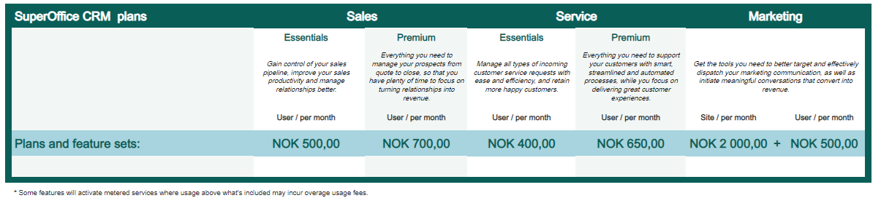
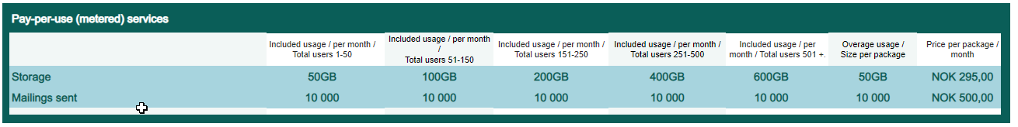
In the price list:

Slide 25
Multi plan users:
When the same person needs access to more than one plan…

Slide 26
No problem – you just buy the plans that this user needs
You will get a big discount when the same user buys more than one plan

Slide 27
Multi plan users (replacing Complete)
A named user can be a user in 1, 2 or 3 plans
Remember: All users are on the same tier within one plan
Pricing:
Most expensive cloud: 0 % discount on list price
Second most expensive cloud: 50 % discount on list price
Third most expensive cloud: 70 % discount on list price
The most expensive plan varies depending on what tier this customer is on (Essentials or Premium)
A standard user in Sales can be less expensive than professional user in Service
Access to marketing platform is not discounted, only users plans
This requires a new calculator as a quote/order tool – to come!
Price depends upon the combination

Slide 28
Mix tiers between plans?
Users will get the tier the company has chosen when combining plans
Example:
The customer has chosen Sales Essential and Service Premium as the plans for their installation
A multi plan user will then get all features included in these two plans (Sales Essentials + Service Premium)

Slide 29
Summary:
Main changes from the plans in SuperOffice 8 / 9

Slide 30
Main changes
The user plan Standard is removed
This plan is dropped to turn the fucus on our 3 main solution areas
The user plan Complete is removed
This plan is replaced with multi plan users
Mailings is only available to users in the Marketing Plan
Personalized mass email to a (large) number of recipients is a Marketing tool.
This feature requires separate email services and monitoring to work. Normal Email is not made for this
This is how the marked and competition addresses this capability
If sales and CX people needs to perform Marketing stuff, they need access to the marketing plan (multi plan user)
Notes:
Combined: Before: if you would search for cities in London or Manchester, you would need a combined selection
With OR: You can user OR as part of search in dynamic and static

Slide 31
Main changes continued...
Project / Project management is only available in Premium (and Marketing)
We see this as a specific dimension of our solution requested specifically by companies.
This will be a main driver to Premium
Combined selections is only available in Premium (and Marketing)
We see this as an advanced feature to segmentation/reporting
With new OR capabilities in dynamic and static selections the need for combined is reduced.
This is advanced functionality that requires effort from the users.
This is also driver to Premium
Notes:
Combined: Before: if you would search for cities in London or Manchester, you would need a combined selection
With OR: You can user OR as part of search in dynamic and static

Slide 32
User Plans
SuperOffice CRM
Sales
Service
Marketing
Professional
plan
Premium
plan
Professional
plan
Premium
plan
Professional
plan
Premium
plan
Coming
Feature list
…
…
…
Feature list
…
…
…
…
…
Feature list
…
…
…
Feature list
…
…
…
…
…
Feature list
…
…
…
Feature list
…
…
…
…
…
Marketing Platform*
Customer Engagement Platform
Expander Services
Add-ons
Development Tools
CRMScript
SuperMacro
ExtraTables
Custom Screens
Custom Apps
Config. Screen
Sandbox for Dev.
Expander Products
Sandbox for prod.
Database Mirroring
Custom Objects
SCIM
DataBridge
Forms
Synchronizer
Chat
SuperOffice AI
Mailings volume
Form submissions
Chat sessions
Customer logins
AI Services calls
API Usage records
DataBridge records
Metered
Services
Coming
Storage volume

Slide 33
An add-on is a software extension that adds extra features to a program. It may extend certain functions within the program, add new items to the program's interface, or give the program additional capabilities

Slide 34
Customer Engagement Platform
Add-On
Metered
Customer Engagment Platform
Specific Modules
CEP Usage
Provides the ability to interact and engage with your customers via many different digital channels and touchpoints.
Includes Customer Centre, Chat and forms
Customer facing apps that can be bought and used as separate modules
Forms
Chat
Additional pay-per-use services apply according to consumption of these
# Form submissions
# Chat sessions
# Customer logins

Slide 35
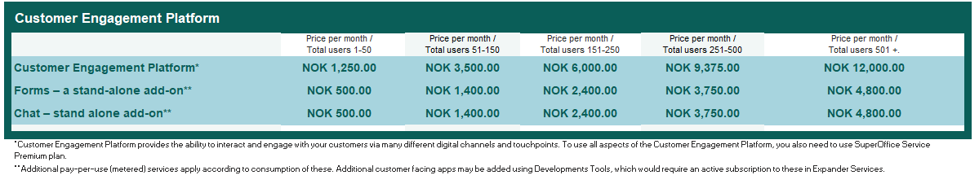
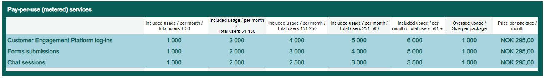
In the price list:
Notes:
The price has been reduced substantially for all intervals. This reduction is based on feedback and further evaluations on how these products fitted in the new price lists.

Slide 36
SuperOffice AI
Add-On
Metered
SuperOffice AI
Platform
AI Specific Service
AI Service Usage
The Platform service provides admin, provisioning and account management.
A set of AI Specific Services included.
Price per org/month.
Access to specific AI services available at all time.
Price per month/org.
Including free Usage
Overage Usage is priced in packages.

Slide 37
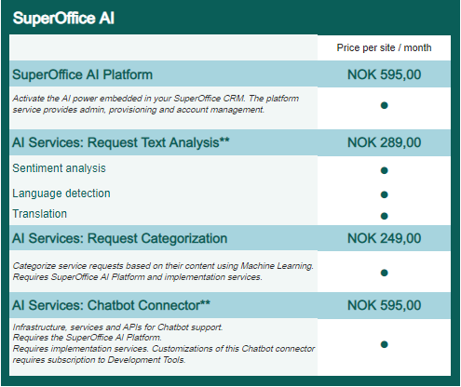
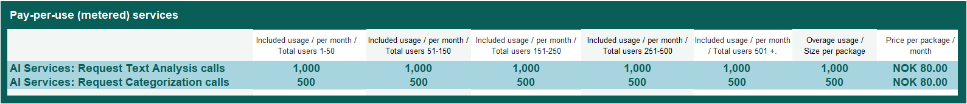
In the price list:

Slide 38
Synchronizer & Databridge
Add-On
Metered
Synchronizer
Databridge
Usage
This add-on is priced per user, and the number of users follows the total number of SuperOffice CRM users, independent upon individual plans selected.
Integration tool for SuperOffice for extracting, reading and flip-flopping between various applications.
Priced per site and includes a set of rows for import
Additional pay-per-use services apply according to consumption of these
Databridge # rows
Notes:
Synchronizer & DataBridge represent functionality most of our customers consider natural extensions to SuperOffice CRM.
Both products will have an official status and much easier to sell
It generates more revenue
Smooth buying experience
Smooth (internal) selling process
Simplifies complex integration between the two licensing/price/billing systems and will eliminate the integration we currently have in the near futurenc
In respect to the Synchronizer, it is worth noting that The fast sync option (sync twice as fast) will no longer be offered by InfoBridge
Synchronizer will come with unlimited resource synchronization *)
Databridge has also been around for a while, but now in our main price list, it follows a easier to understand pricing model instead of user tier model
This new and fair pricing model makes DataBridge accessible to all customers small & large
Unlimited integration profiles (import/export jobs)
And a Metered component available, you pay more when you use more

Slide 39
DataBridge for SuperOffice
Isn’t 50.000 records to low? Let’s take a look at some numbers
With 50.000 records a month a customer could do the following;
  Import or export 2.500 companies and persons daily
  When a customer would import or export daily 200 new companies, 50 new sales, 30 quotes, which each 30 articles, they will still 21.400 records left by the end of the month
  Import every hour (24/7), 75 new service tickets
*) Number of records or rows of data that is imported or exported.

Slide 40
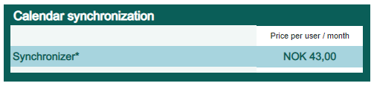
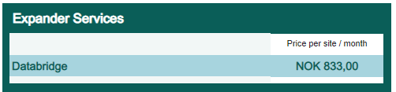
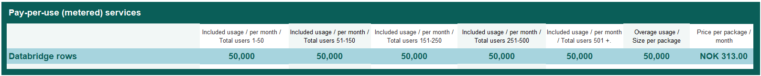
In the price list:

Slide 41
Expander Services
Add-On
Metered
Development Tools*
Development products
API Usage
Enables customers and partners to extend, configure and automate SuperOffice CRM
CRMScript Custom Screens
Custom Apps Config. Screen
Sandbox for Dev SuperMacro
ExtraTables
Stand alone products that helps customer utilize and integrate SuperOffice CRM.
Sandbox for prod.
Database Mirroring
SCIM
DataBridge
Overage API Usage may at some point be priced.
See additional slides.

Slide 42
Production Sandbox Environments
(FKA – Test Environment)
Add-On
Metered
Production Sandbox Environment
Extended Migration Service
API Usage
Innovate, customize and train in a safe environment.
- A copy of a customer tenant
- Test, explore and train safely
- Available for all cloud customers
- Subscribe to # of users and plans that fit
- Data and configuration copies and updated on a regular basis
Set of services to assist the migration from onsite to cloud (larger/complex projects).
-EMS priced as a fixed service (€2000 + vat)
- A Production Sandbox Environment included in the EMS package during the migration project
– Sandbox sold later as a stand alone product
Not activated

Slide 43
Cross-domain Identity Management (SCIM)
Add-On
Metered
SCIM
Available for
API Usage
SCIM is a common language to describe what an identity is and how to handle it.
Cloud only
Requires Azure Active Directory (Azure AD) or Google.
Available upon request
Not activated

Slide 44
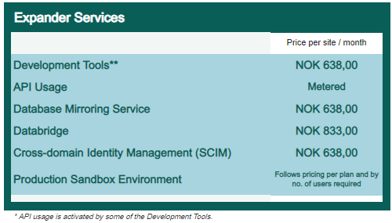
In the price list:

Slide 45
Pay-per-use (metered) is payment for use of service above level included in the monthly subscription price (overage usage).

Slide 46
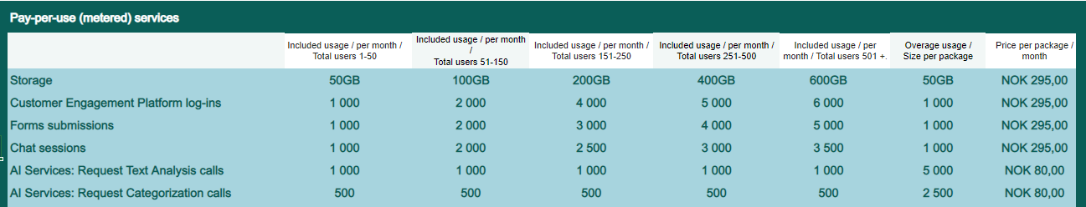
Pay-per-use

Slide 47
API usage service
Announcing a future change…

Slide 48
Motivation
The motivation for introducing an API usage service are related to:
Performance
Stability
Quality (sustainability)
Operational cost.
The proactive tools to control API traffic are: education, insights (monitoring, analytics)
The tools to make sure API traffic is not exceeding acceptable levels are: billing and throttling.
All other players in the market charge a price for the use of APIs
It is no our ambition to turn this into a major source of income.

Slide 49
The plan for introducing the API usage service
Q2/Q3 2021: Requirements, analysis and design of total system.
Implementation of monitoring, metering and analytics in SuperOffice 10
Q4/Q1 2022: Build insights in traffic, educate developers, improve current Apps and customizations.
Report and communicate insights to customers, partners and developers.
Design and build the API Usage metering and billing system.
Q2/2022: Introduce the payable service API Usage model in the market

Slide 50
Message to the market
SuperOffice plan to introduce API usage as a payable service during 2022.
The API Usage system/charge will not deviate substantially from similar CRM vendors in the market.
Metering and Reporting of API load will be included in SuperOffice 10 release in October 2021. Reports will be available to Customers, Partners, Developers and SuperOffice.

Slide 51
Existing customers*
* Existing customers means all CRM Cloud customers at the time where the API Usage Service is formally released.
Existing customers shall in principle not be charged
for the API Usage Service
API traffic will as a general rule be covered by the free included volume (limit).
Limits will have to be respected and overage cost might occur in special cases
Existing customer is nevertheless granted a grace period of 12 months after the introduction of the API Usage Service.
We will not send any invoice to any customer without discussing with them first.

Slide 52
What will be metered
Custom apps
3rd party standard apps from the AppStore
Custom CRM scripts / macros
Not metered:
All SuperOffice products and add-ons on our own pricelist
Services already metered on our pricelist

Slide 53
How will we count usage
Number of “logical records” you read or write through NetServer (database)
Customers will get a generous amount of records included
Usage above this will be invoiced in packages of x records per month
A simple example
You have a custom app that every night updates 10.000 companies in your system with data from an external system.
This is 300.000 records per month

Slide 54
Helping customers, partners and consultants
We will meter API traffic and report usage to the customer and to the developers of scripts and apps.
We will provide a analytics dashboard for specific apps and customers.
We will provide education and advice to developers and tech consultants that are making addons and customizations.
We will give them time to prepare and adapt.
Writing best practise, efficient code is good for everything: sustainability, cost of ownership (customer), operational cost (customer), operational cost (SuperOffice), solution stability, solution performance, efficiency and more.

Slide 55
Cloud vs Onsite in SuperOffice 10
Is the offering exactly the same?

Slide 56
No not exactly – This is Cloud Only:
Features and free add-ons:
Video meetings integration
SuperOffice for Outlook
SharePoint Documents
Google Workplace Documents
Mailing service (Mailgun)
Add-ons
SuperOffice AI
Expander Services
  Database Mirroring Service
  Cross-domain Identity Mngmnt (SCIM)
  Sandbox environment
Metered Services:
Metered services are only applicable for Cloud customers. Onsite customers are using their own services here.
Exception: Databridge
Apps from the SuperOffice App Store:
Apps listed here are only available for Cloud subscriptions.
Notes:
Business Analyze products are also on the Onsite price lists with the same names as before, but with a small increase in price to follow the general price list for 9 (and therefore 10).

Slide 57

The Complete
10 Price List
Notes:
Excel ark

Slide 58
WARNING!
Less is not always more
The new pricelists is NOT simpler but in every practical way much more complex than the old pricelist
It can be presented easily, however, it is more complex when setting up a typical proposal
The new pricelist is a sales tool that demands a relationship between a capable salesperson and the prospect (customer).

Slide 59
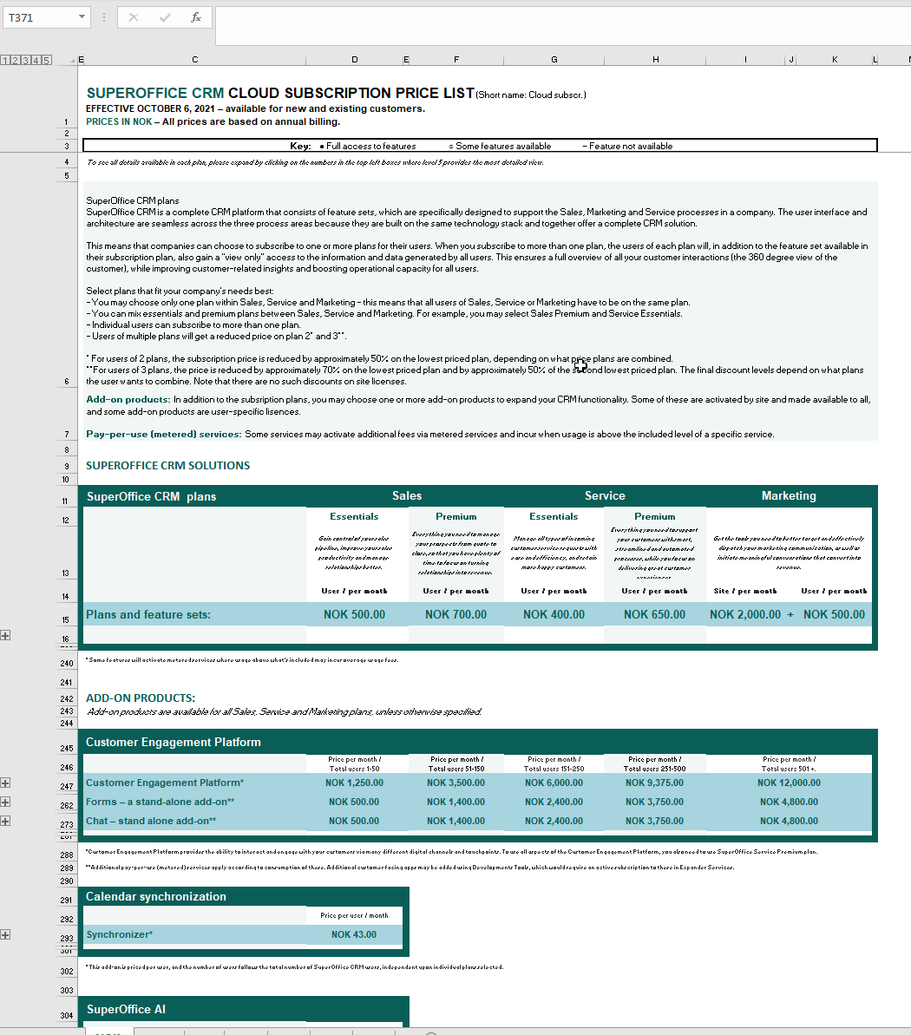
The New Pricelist:
An Excel tool
Notes:
Simplified
A more detailed view
And even more detailed when required (for you/ presentation)

Slide 60
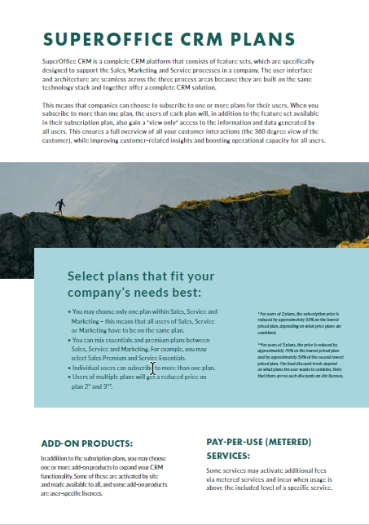
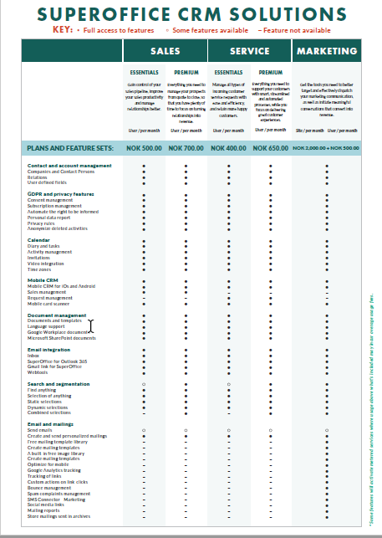
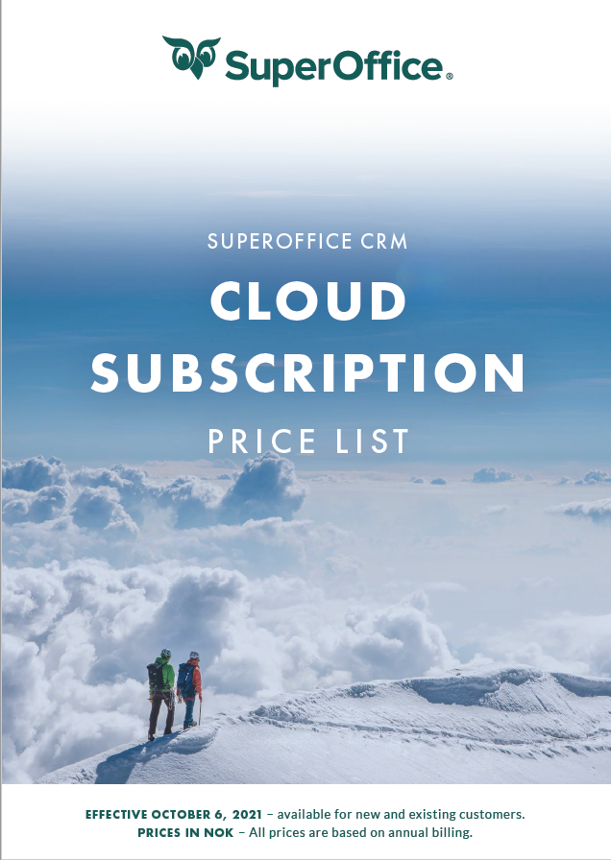
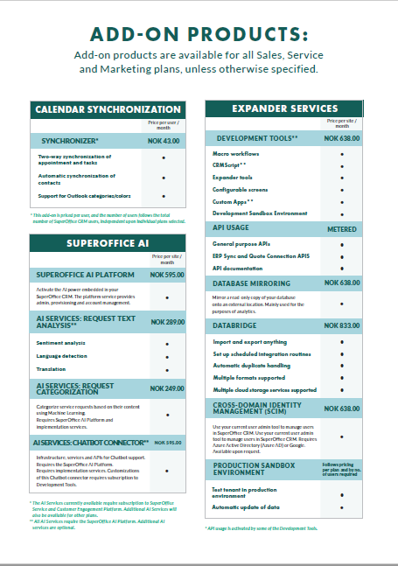
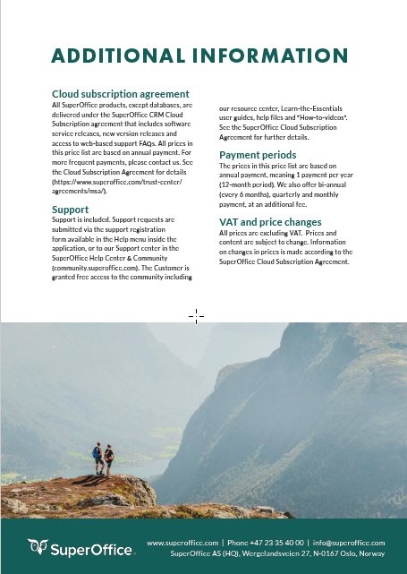
What about the current price lists in Trust Center?
These will be removed. The SuperOffice 10 price lists will only be available in the new Help Center & Community – when logged in.

Slide 61
THANK YOU FOR PARTICIPATING!

