Slide 1
Sales pitch slides
Work in progress
Context:
Follow-up meetings with prospects / existing customers who are seeking to explore how SuperOffice CRM can help their business goals.
Hidden slides = more relevant for existing customers.

Slide 2
Drive growth at every customer touchpoint

Slide 3


HOW DO YOU PLAN TO GROW?
Customer
value
Upsell to
existing customer
Customer portfolio
Win new
customers
Reduce
churn
Disengage with
non-profitable customers
Customer
lifetime
Source: Markup Consulting
Notes:
Times are tough these days.
Most companies feel the economic pressures. There are many things that worry business leaders.
When the storm is rough, businesses need a razor-sharp focus on:
Not just winning new customers but also the need to
Keep customers longer
Sell more to existing customers
It means going back to the basics and making sure your foundation is solid and work with your customer portfolio in a structured manner.
From marketing this typically boils down to : Click

Slide 4
Your current marketing approach
What are you trying to achieve with marketing?
Where do you prioritize your efforts and investments?

Slide 5

inbound marketing strategies
ATTRACT
CONVERT
CLOSE
LOYALTY
Strangers
Visitor
Lead
Customer
Promoter
Website, SEO
Blog, webinars, podcasts
Social media
Paid/organic distribution
Forms
Calls-to-action
Landing pages
Contact
CRM
Emails
Workflows
Customer relationships
Surveys
Events
Customer programs
After-sales service
Notes:
We appreciate that going all the way with an inbound marketing strategy is not for everyone! Quite a number of industries and companies find that placing all eggs in the inbound basked can be a waste time, money and effort and it’s more important to look at outbound strategies – which we also will want to discuss.
That said, most companies benefit from using some of the tactics involved – like those listed here.
Which ones are you using today?
What do you find most effective?
Some tactics you want to do more of?
Are there challenges with implementing these tactics that you’d like to address?
Areas you’d like to optimize?
An effective inbound strategy requires of course knowing who your ideal customer profile is and where to reach whether digitally or offline.
To do this at scale, SuperOffice Marketing include tools to help you capture those leads, and nurture these through the funnel
and turn these into happy loyal customers with the least amount of effort.
CLICK

Slide 6
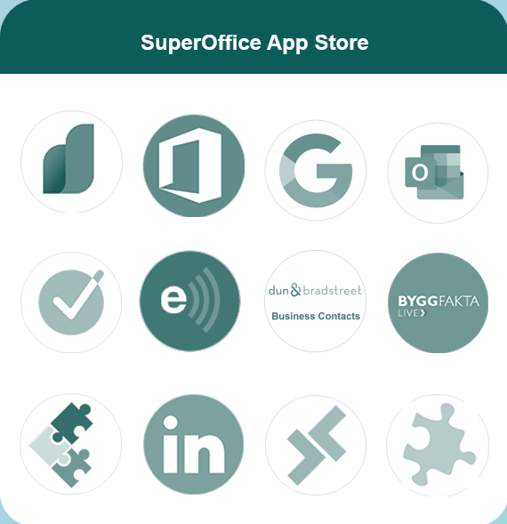
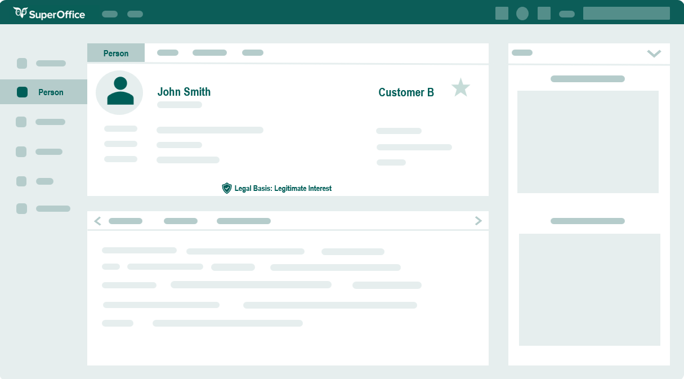
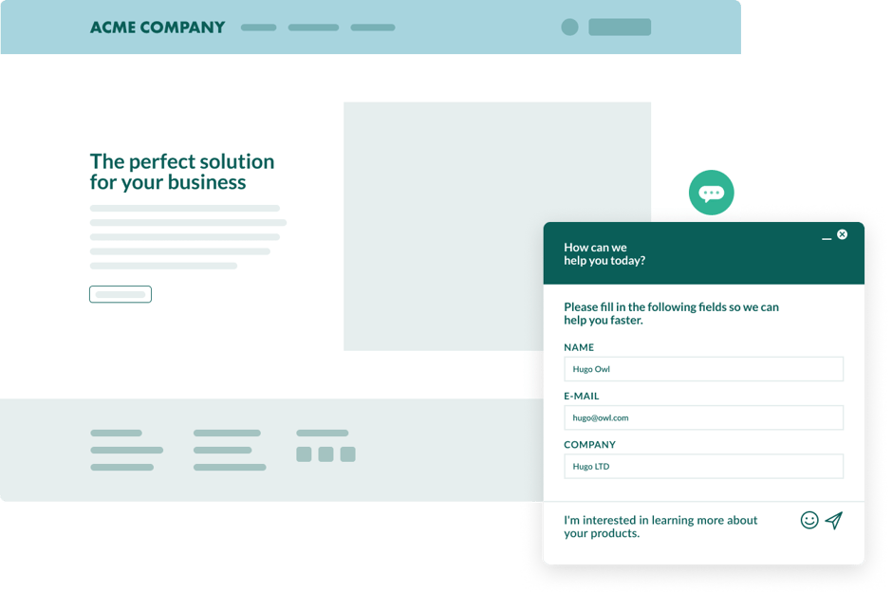


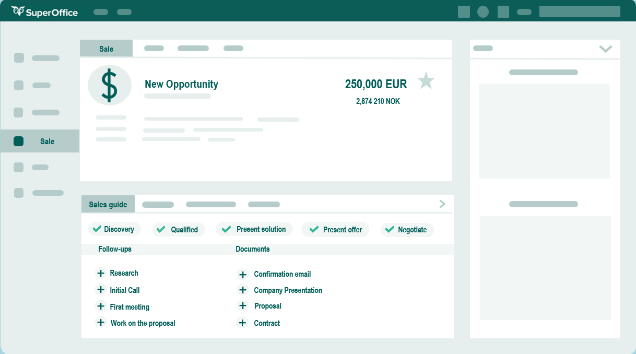
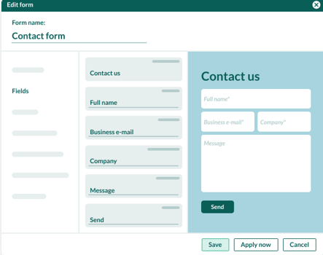

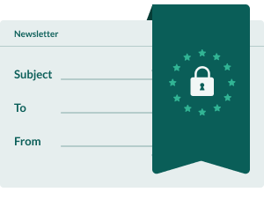
Engage your leads
Attract prospects to your website and engage new leads
SuperOffice CRM
Enrich with lead Apps*
Capture leads
Seamless connection between CRM and selected App*
Notification to person Privacy e-mail (GDPR)
*Separate agreements, prices and terms apply to App purchases
Notes:
Attracting visitors to your site requires a whole set of other activities and content that help your prospects to find you and learn more about you. But once you have them there –making it easy for them to get in touch – and for you to capture their interest is essential.
,
Automate how you collect leads:
Web forms in themselves are not something new - most companies use them. What’s new is meeting your customers’ expectations in terms of quality of response, availability and response time.
Therefore, imagine that you offer to post digital forms on your website and give potential and existing customers an interactive experience where they can easily fill out and submit forms directly from their device, no matter where they are.
These are linked directly to your CRM system so that the information is created immediately, and notifications regarding privacy, legal basis and consent are sent to the customers automatically.
This makes it easier to collect and data and be GDPR compliant. The system will create a task in the CRM database and send a notification to the person in your company who is responsible for the follow-up.
Then you may want to enrich this data with automatic input from other company database sources -There are plenty of apps that can enrich your data as well as help your prospecting and ensure seamless data flow into SuperOffice where you manage your activities and store history.

Slide 7
Outbound marketing strategies
Advertising
Tradeshows/Events
Networking
Cold outreach
BDRs and ABM
Paid banner/Google ads
Social media ads
TV/Radio/Print ads
Video ads
Native ads in channels
Ad-retargeting
Industry events
Stand
Speaker
Giveaways
LinkedIn and social selling
Partners networks
Employee networks
Customers
Networking groups/communities
Cold emails/DMs
Cold-calling
Direct mailing
BDRs = Business Development Reps as door openers
ABM = Targeted outbound (and inbound) communication
Notes:
Most likely you are also employing one or several outbound strategies (often referred to as interruption marketing) to generate awareness and interest:
Such as
various forms of advertising – in digital channels or more traditional channels.
Tradeshows, fairs and industry events – for many is vital to participate and/or attend to gain exposure, network and capture new leads, in addition to gather information and insights into your marketplace.
Networking is also important for a lot of B2B companies – there has in fact be coined a new term – NEARBOUND – referring to utilizing the connections available in particularly through partners – but also the wider network – such as your employees, digital communities and even your customers' network. Tapping into these for names, or referrals is not just a sales strategy but also very much a marketing strategy. – Building lists and having an outreach plan. For example:
Mailings – cold mailings or in combination with cold-calling but even old-fashioned mails is still relevant for many – particularly if your target audience is less digital – but even those who are primarily online respond to some old-fashioned snail mail.
When talking about outbound is it also often a case of using BDRs i.e. Business Development Reps who opens up new leads through using a combination of cold-outreach towards identified lists. – and often also in combination with an ABM – account based marketing which is a focused approach for who you call, email or target your advertising and content towards.
Are you currently pursuing any of these strategies?
Again – what works? What doesn’t? Why?
Are there areas on these you can imagine doing differently so that they would work better for you?
Most B2B companies we talk to have or want to use a combination of both inbound and outbound strategies. And to do these initiatives well, teams benefit from the capabilities available in SuperOffice Marketing.

Slide 8
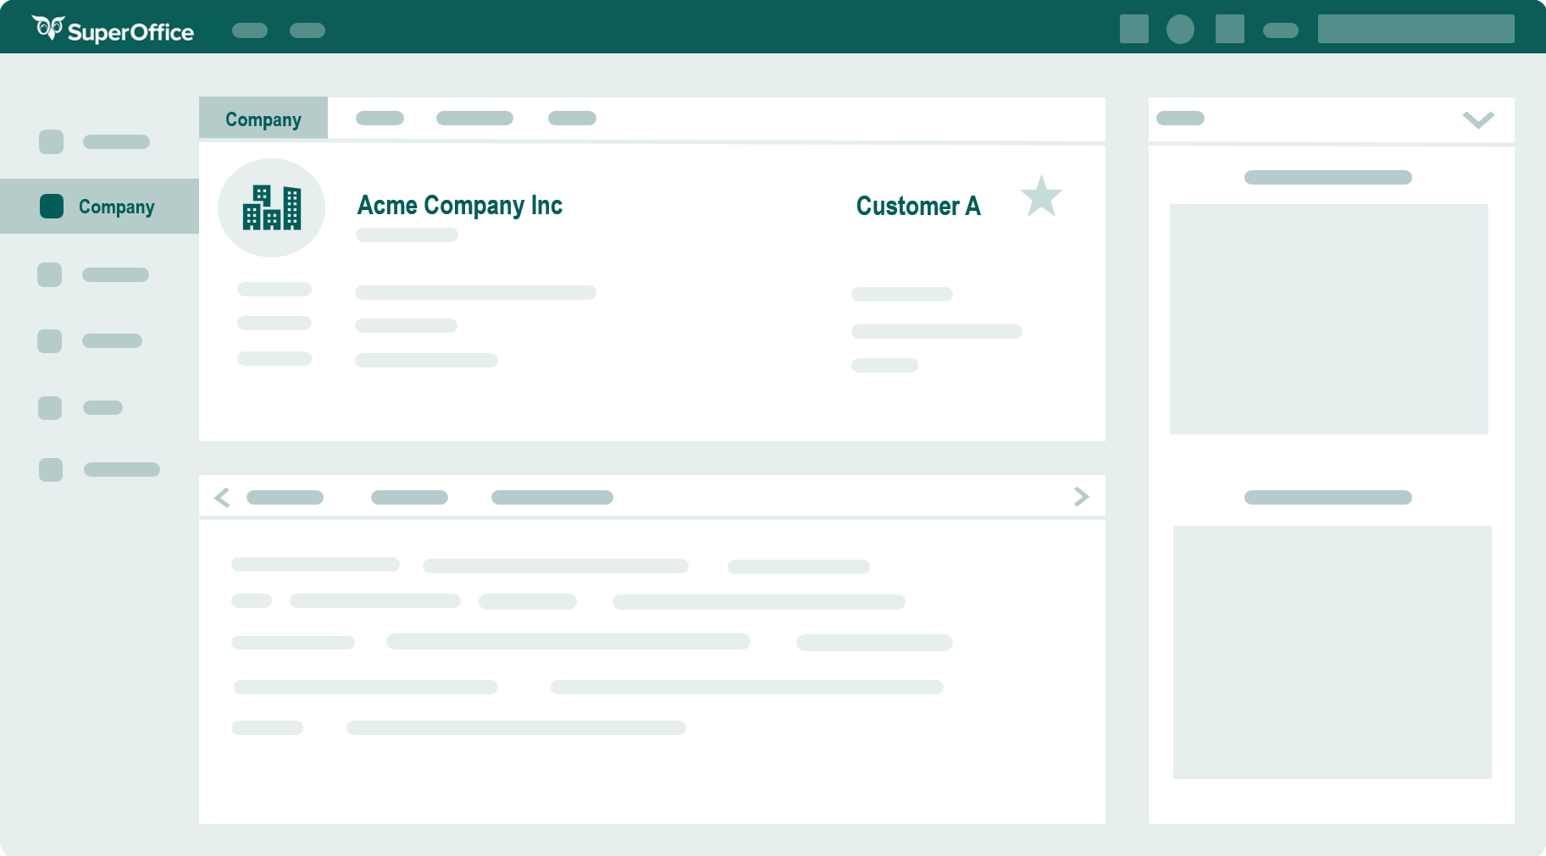
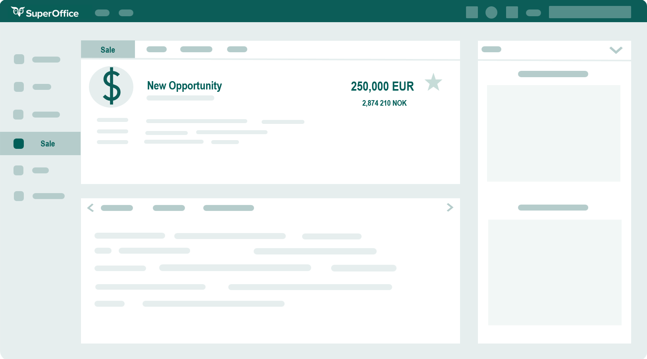
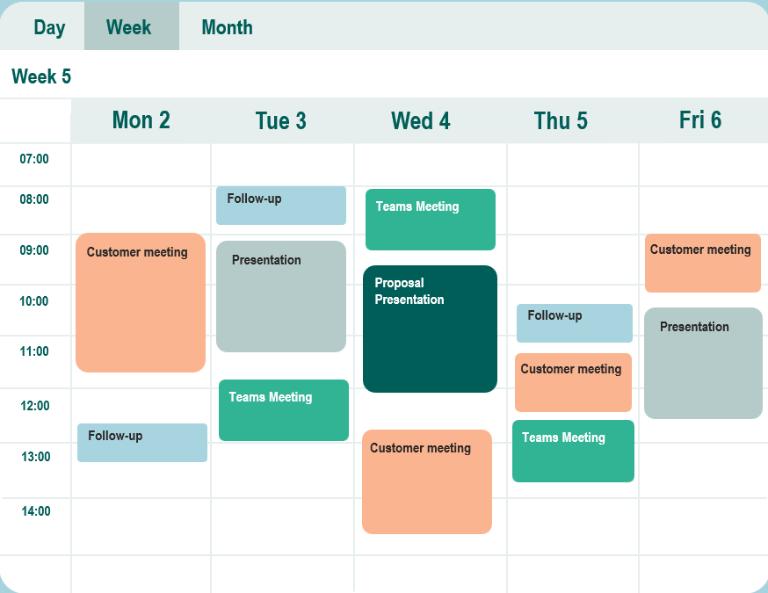
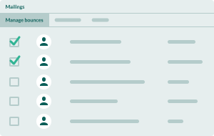



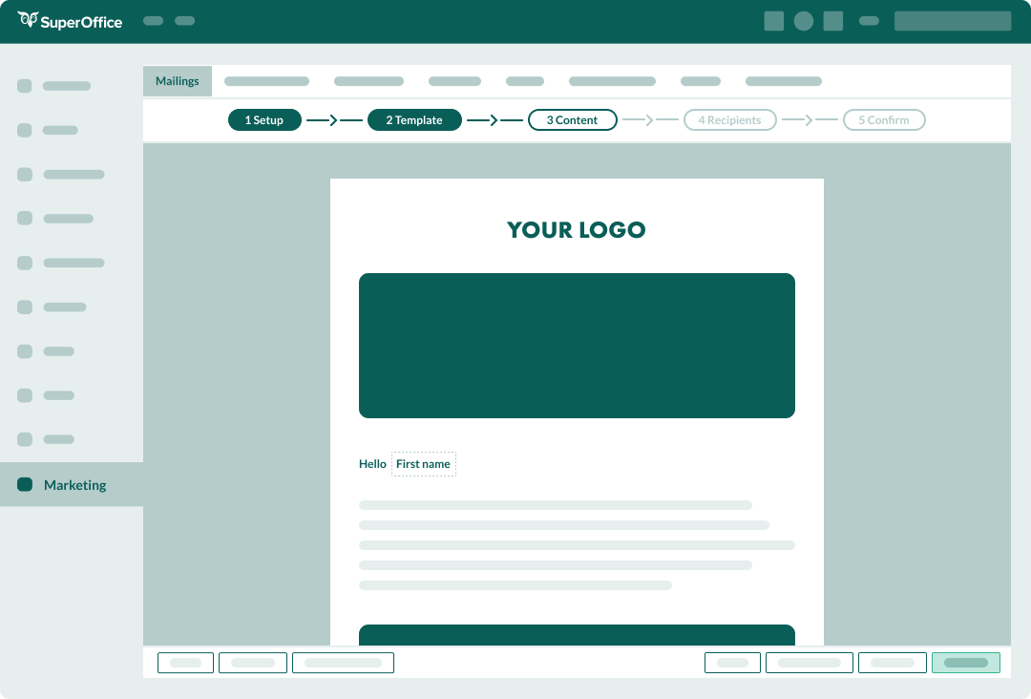
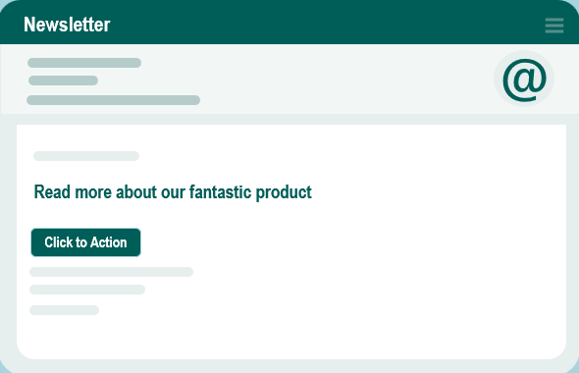

Communicate effectively
Personalize customer journeys and nurture leads into warm sales opportunities
Create new sales opportunities and follow-ups directly from the campaign flow
SuperOffice CRM – your customer data platform
Create dynamic selections based on given criteria
Track what contacts engage with directly in your CRM solution.
Automate flows based on contacts behaviour and engagement (triggers)
Notes:
Once captured, imagine that you can effectively communicate with them, based on their segmentation criteria as well as their engagement with your brand so that you are able to nurture and move leads through the funnel and turn these into sales opportunities that are follow-up on by sales.
Before we show you how SuperOffice can help you with exactly these important processes, we’d like challenge the conventional wisdom regarding marketing a little: CLICK

Slide 9
BUT Marketing doesn't just stop at the sale.
Are you tired of generating endless leads with little return?
Notes:
While many of the marketing activities we've looked at generally lead to the one outcome of lead generation, that is not the sole function of marketing.
Many marketers we've spoken to are often frustrated by the lack of follow-through and results from the leads they have brought into the pipeline. Sales teams are frustrated by slow addition of leads from Marketing into their pipeline. Service teams who are critical touchpoints to customer feedback often operate in silos, with little or no contact to what Marketing or Sales use in promising features to leads and new customers.

Slide 10
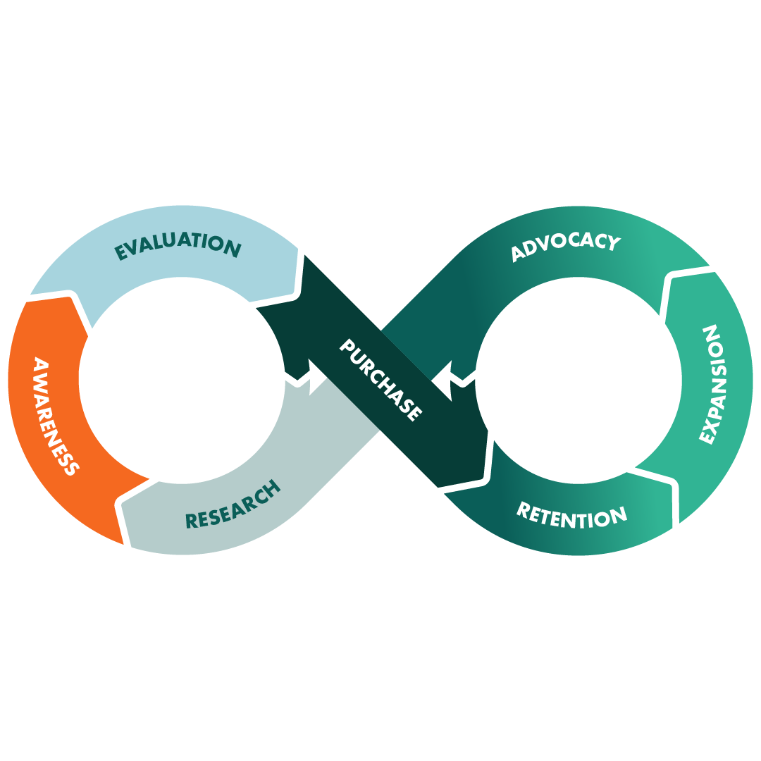
The relationship loop
Make the most of your hard-earned leads by maximizing every customer interaction
Notes:
Introducing the Relationship Loop: refocusing on making the most out of every customer touchpoint along the customer journey – in the shape of an infinite loop.
This Loop is a simple framework: every time your marketing, sales, or service team connects with a customer, it strengthens the relationship and feeds back into the journey, making it even more valuable and impactful.
-----
But that marketing has a role to play across the customer journey –
From content creation to communicating to customers, marketing is present on many of the stages we see here - awareness, consideration, selling, retention – it can all fall under the marketing’s team responsibility
So for many companies it is important to start focusing on how to affect the entire life-cycle of a customer.
So that marketing can : CLICK

Slide 11
Strengthen and support every step of the customer journey
Connecting sales, marketing, and customer service teams on one view*
Engage your leads: Ensure every lead is ready for sales with tailored meaningful interactions
Welcome new clients: Personalize your outreach to build meaningful connections and grow your customer base
Grow customer relationships: Nurture existing customers to drive more sales with relationship-focused outreach
*Connected on one view, tool, and database

Slide 12
MARKETING ACROSS THE RELATIONSHIP LOOP
 | Research | 2. Awareness | 3. Evaluation | 4. Purchase | 5. Retention | 6. Expansion | 7. Advocacy
Customer action | To become aware about the problem and start looking for a solution | To become aware of the solution | To choose the ideal vendor | To buy their chosen solution | To continue using the product | To strengthen their engagement | To vocalize their satisfaction
Company purpose | To inform and help prospects understand their problem and see you as a solution | To convince prospects you’re a good solution | To persuade prospects you’re better than others | To make the process as smooth as possible | To help the customer continue to get value | To increase the lifetime value of your customers | To develop supporters of your product
Touchpoint/Channel | Website, email, social media, media | Website, email, third party media | Website, email, ads | Website, product, proposal | Email, website, portal | Email, product | Email, website,
Marketing tactics | Content, SEO, thought leadership, social media, PR | Content, SEO, PPC, social, PR | Pricing calculator, video, personalization email, comparison, retargeting | Product demos, customer success stories, custom proposals | Product information updates, thought leadership content, on-demand support, use cases | Personalized recommendations, customer success stories, free trials, educational content | Customer content, in-depth case studies, social media, webinars and podcasts, events
Tools | CRM, web form, website | CRM, web form, email | CRM, email, data analytics | CRM, email | CRM, Knowledge base, customer portal | CRM, email | CRM, email

Slide 13
Kickstart your marketing with automation for your essential processes:
1
Lead generation and nurturing campaigns
4
Tradeshows/Event campaigns
Automated email sequence. List management. Segmentation and personalization. Email and action triggers. Optimized send times.
Lead capturing. Segmentation, Lead nurturing through the funnel.
2
ABM campaigns
5
Upsell/cross sell campaigns
ABM tailors marketing efforts to individual accounts, aiming to deepen relationships, drive loyalty, and maximize revenue.
Recommend related items based on purchase history or behaviors to drive revenues.
3
6
Customer retention and loyalty programs
BDR campaigns
Combine sales and marketing efforts in your campaign. Use follow-ups as triggers or actions within flows.
Automated loyalty programs. Tailor made offers. Delivery of relevant content. Win-back campaigns.
Notes:
Let us help simplify your entry into marketing automation and streamline your core activities so you can save time, generate more leads and more impact from your marketing efforts.
You can use SuperOffice Marketing (Premium) to automate your inbound and outbound lead gen activities – as well as initiatives to maximize the potential in your existing customer base.
https://www.engagebay.com/blog/marketing-automation-use-cases/

Slide 14
Greater impact with predictable pricing
Powerful marketing automation embedded directly within your CRM
One solution,
one tech stack,
one shared database
Prove – and improve – marketing ROI
Accessible to everyone, regardless of expertise
Avoid paying for features you can’t use or contacts you don’t send to
No integration required
High data integrity
No information silos
Draw on all CRM data for targeting
True alignment across teams
Report from lead to close in shared dashboards
Gain better insights into processes for improvements
Ensure more accountability across teams
No need to be or rely on a marketing specialist
Perfect for when other teams, not just marketing, are part of communication activities
Get started quickly.
Most B2B companies use no more than 30% of the features available in a MA platform.
Unlike most solutions, SuperOffice charges only for the emails and texts you actually send, not just for having the option to send them.
Notes:
Achieve greater impact at a lower costs – because there are significant additional benefits from using a marketing automation solution that is built inside your CRM solution:
With one solution, one tech-stack and one common database, you don’t have to worry about integration of customer data and can rely on your customer data’s integrity and value.
You remove silos and have all available CRM data for your targeting and more precise communication.
With one solution you also can more easily demonstrate the impact of your marketing efforts – reporting not only on leads but revenue.
Embrace a marketing automation tool that is so intuitive that you don’t need an army or experts to use it. Instead, your teams are able to run life-cycle marketing strategies that impacts the bottom line.
And with SuO you get the features you need without paying excess for the possibility of communicating to many contacts – which is the norm of marketing automation tool pricing.
We don’t think that pricing is fair to you.

Slide 15
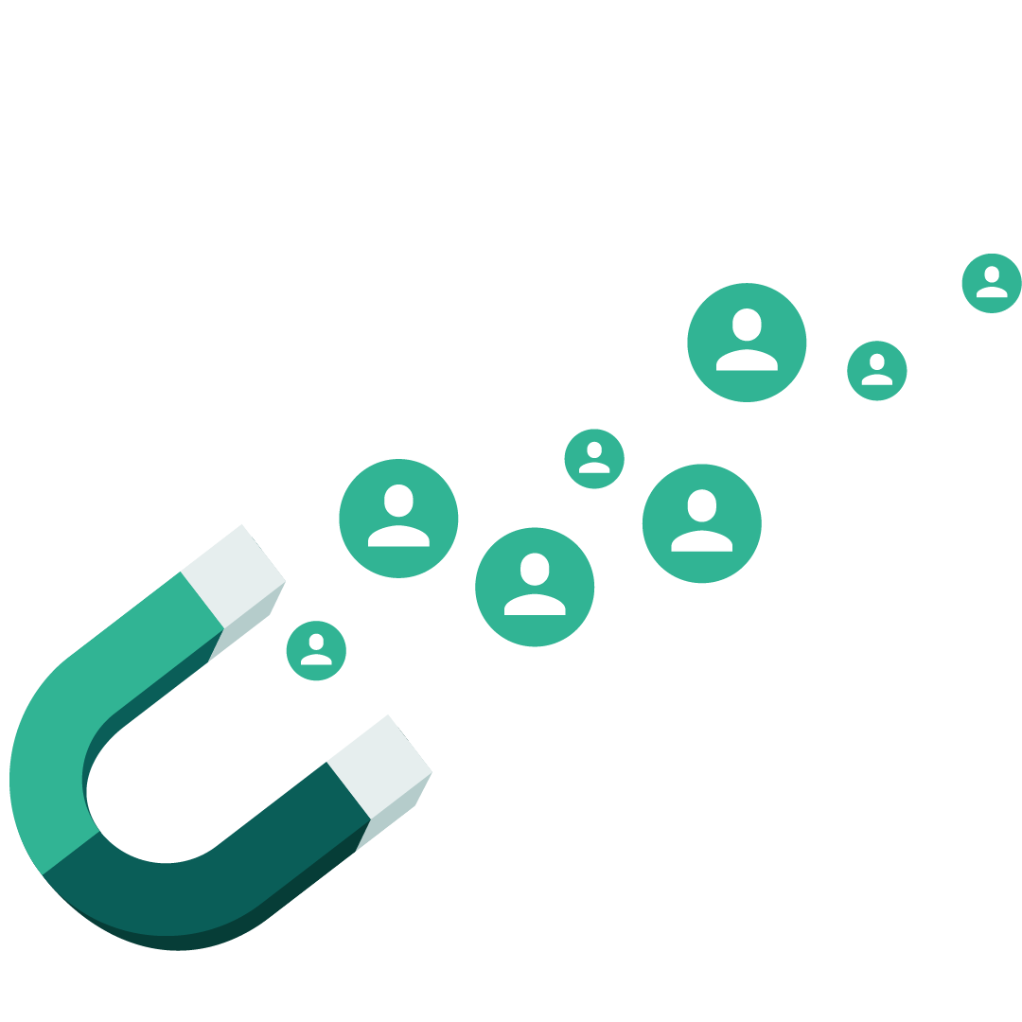
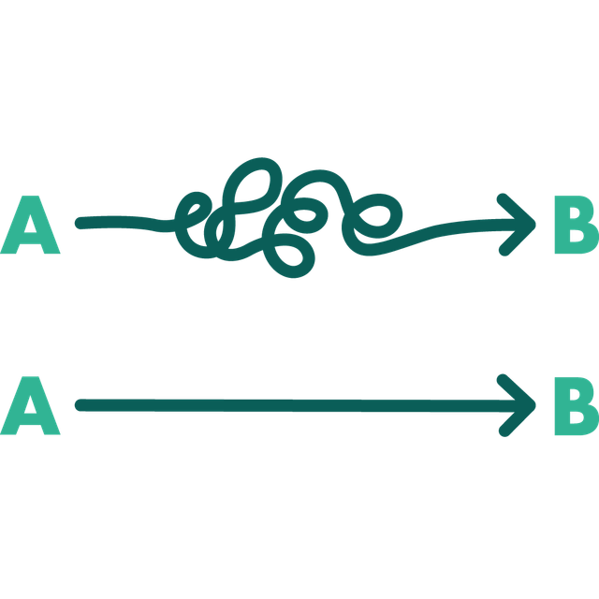
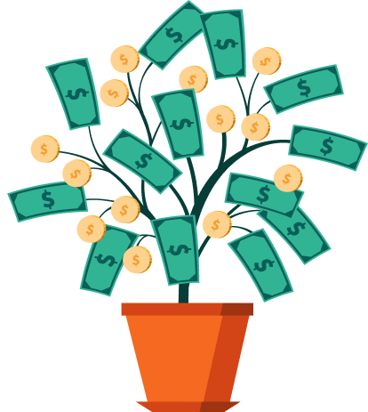

SuperOFfice CRM help customers to:
Acquire new customers
Sell more
to existing customers
Reduce customer turnover
Improve customer experiences
Improve productivity
Notes:
SuperOffice helps place your relationships at the core of your business.
Our solution empowers you to:

Slide 16
Next steps?
Notes:
Agree on the next steps with your prospect

